Slide 1
Employee Segmentation using Routers – Informatica PowerCenter
ETL Project using Routers, Union, and Oracle Targets
ENG: Rewan Ali

Slide 2
Project Overview
Goal: Segment employees based on salary and department ID
Tool Used: Informatica PowerCenter
Target Database: Oracle
Strategy: Routers for branching + Union for unmatched records

Slide 3
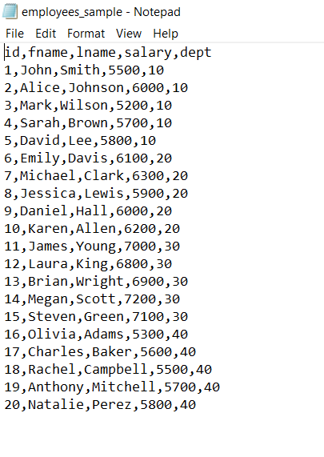
Source Structure
Source: Flat File
Columns: ID, FirstName,
LastName, Salary, and
DepartmentID

Slide 4
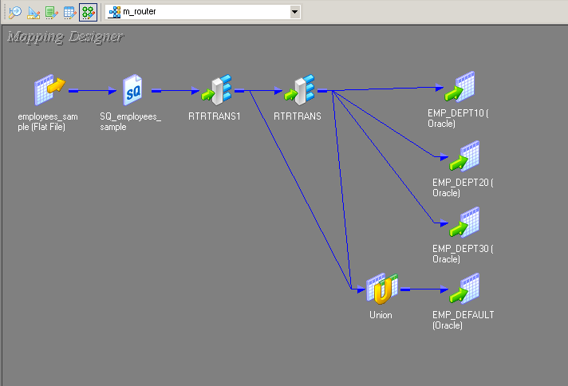
Mapping Design (ETL Flow)
Overview of the full mapping structure

Slide 5
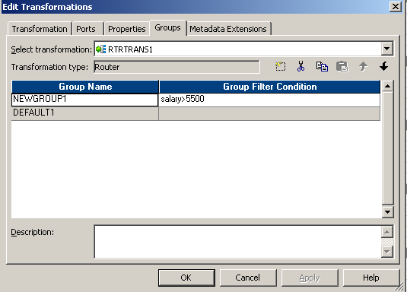
Router 1 – Salary Split
Logic:
- Group: Salary > 5500
- Default: Salary <= 5500

Slide 6
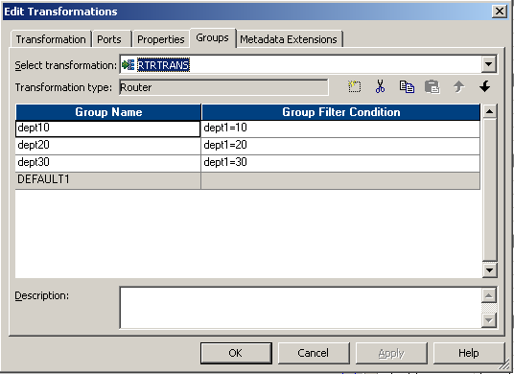
Router 2 – Department Split
Logic:
- G1: DeptID = 10
- G2: DeptID = 20
- G3: DeptID = 30
- Default: All others

Slide 7
Union Transformation
Combines:
- Default group from Salary Router
- Default group from Dept Router

Slide 8
Target Design
Oracle targets:
- dept_10_target
- dept_20_target
- dept_30_target
- Other_employees: whose salary less than
5500 and there department’s not on 10, 20
or 30

Slide 9
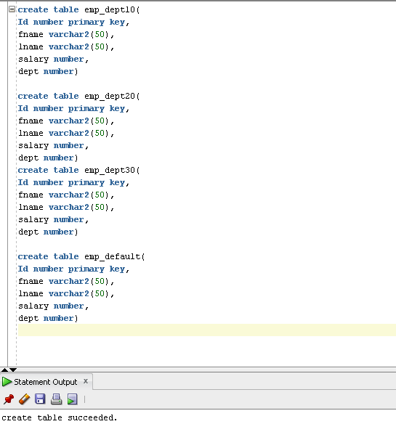
Oracle target creation

Slide 10
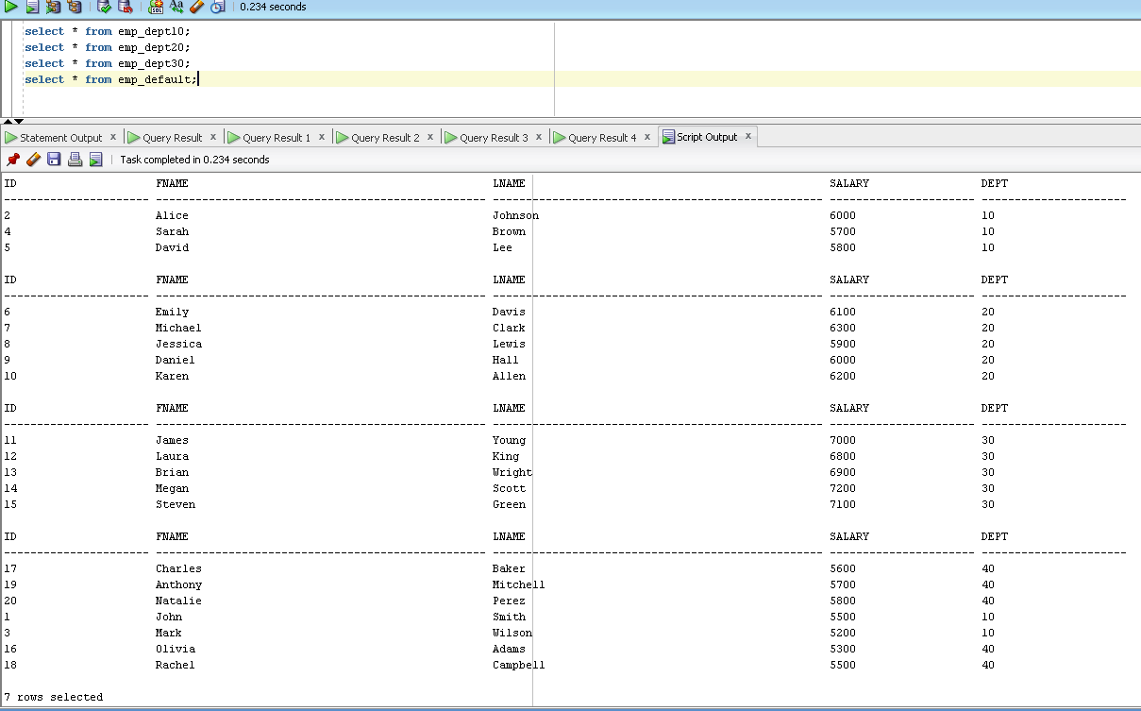
Target final output

Slide 11
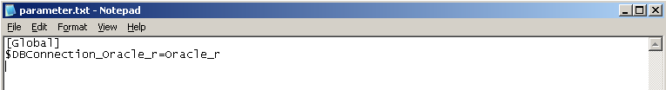
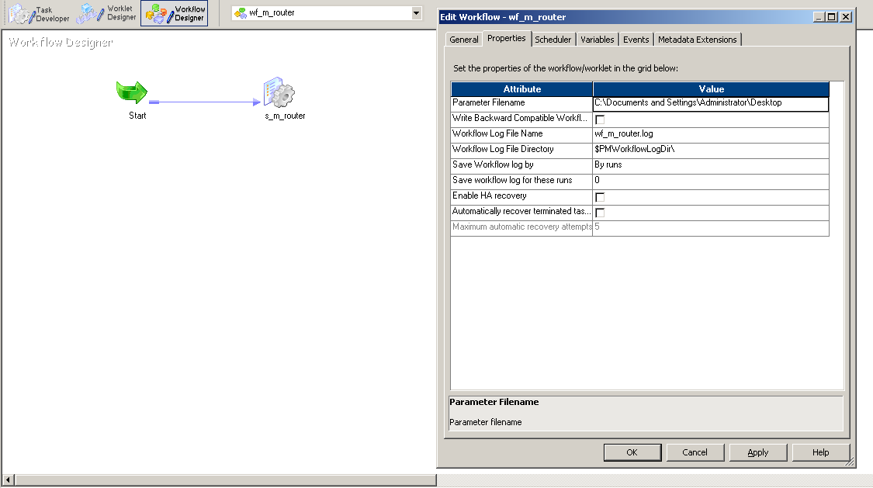
Work flow connection (using parameter file)
Parameter file
Parameter path connection

Slide 12
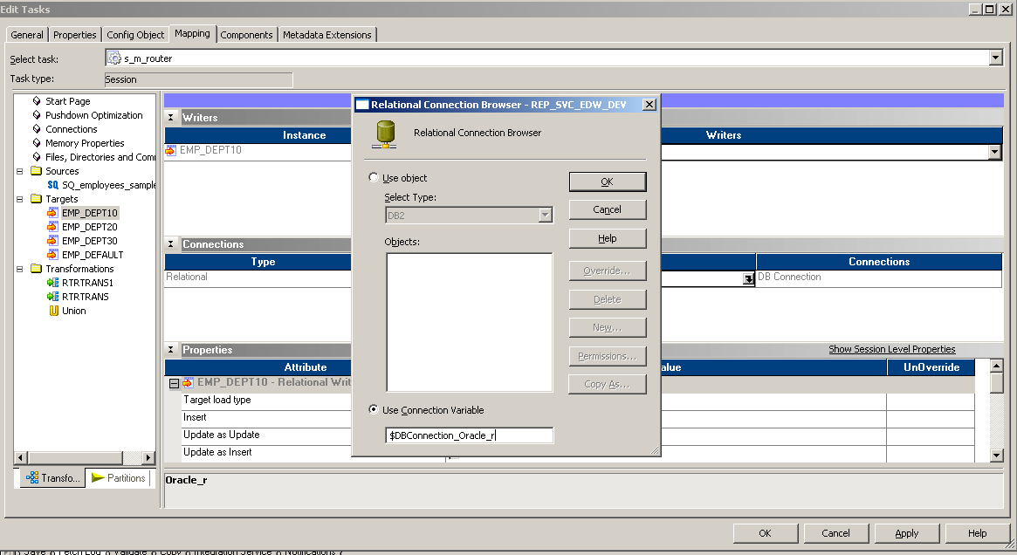
Parameter target connection

Slide 13
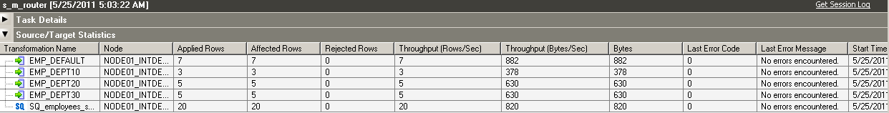
Monitor
Running workflow: Succeeded
All 20 records are routed to this targets

Slide 14
Learnings objectives
Router transformation (multi-branch logic)
Union transformation use
Segmenting by business rules
Oracle target experience
Parameter connection

