Slide 1


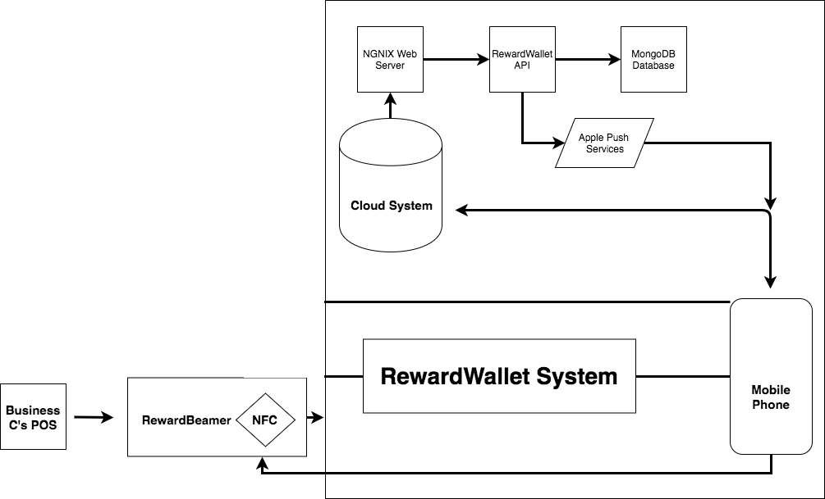
Future Work
RewardWallet
1. A maps section which will indicate to users
participating businesses in the area.
2. Allow customers to use their points to redeem rewards
or discounts from stores.
3. QR codes will be added as an alternative means to
redeem points.
4. Mobile ordering will be available.
5. We will also create an iPad application for businesses.
6. Advanced reward distribution models
By Nathan Tannar, Mandy Xiao, Molly Bin
What
Flow Chart
A system that keeps track of transactions users make at a business to allocate rewards to a customer’s profile based on how the business customizes their distribution model.
Flow Chart
1.POS/ External Device | Sends POST request to RewardBeamer to initiate a transaction
2. RewardBeamer | Sends POST request to the Cloud API
3. Cloud API | Creates a transaction for the business
4. RewardBeamer | Configures the NFC controller to act as a serial tag
5. Mobile App | Sends a POST request with the transaction token ID to the Cloud API
6. Cloud API | Determine the amount of points to allocate. Sends an update point balance to the user and closes the transaction.
7. Mobile App | Receives updated point balance
Why
By creating the hardware needed by a business, a mobile app for the user and a cloud system to bring it all together, RewardWallet gives business owners an end-to-end solution for adding a customizable digital loyalty system to their store.
Conclusion
Business’s POS
RewardWallet provides an intricate yet affordable solution for small and medium businesses that lack the infrastructure for developing their own reward system. This easily integratable solution will revolutionize the relationship between businesses and their customers.

