Slide 1



ECO Plantation
Team Member
Delta and Aces TechFest 6.0 Hackathon
Presented by CODECRAFT
Achyut Parajuli
Rewat Acharya
Anjil Neupane
Subin Rai

Slide 2

Team Member
Aims and objective
Introduction
Plantation Tracker: Log and monitor community-wide tree planting efforts.
Donation Hub: Streamlined donation requests for planting projects.
Community Blog: Share experiences and insights, fostering collaboration.
News Updates: Stay informed about global eco-events and initiatives.
User Profile Management: Easily track and manage personal contributions.

Slide 3

Software as a Solution
Addressing major environmental issues like deforestation and low community engagement in sustainable practices.
By giving users the ability to actively engage in
Plantation Countation
Tree-planting campaigns (Events Oraganization)
Connect with like-minded people (Community)
Donation

Slide 4
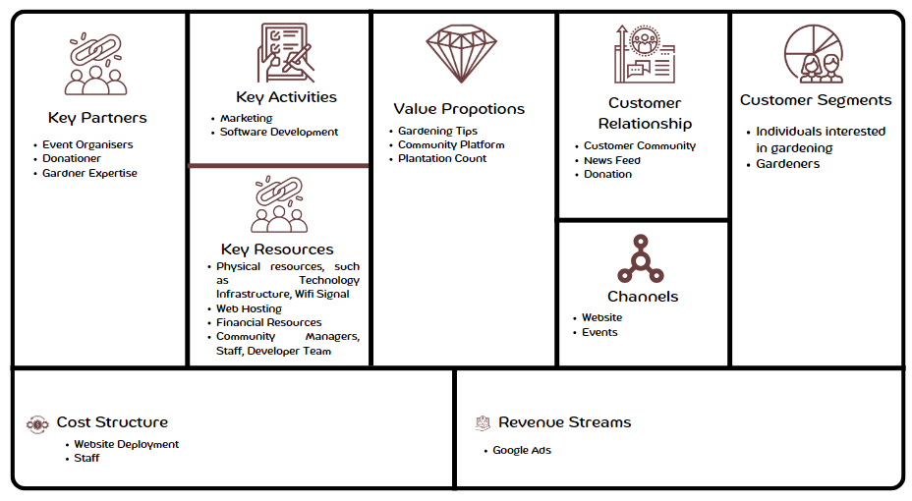
Business Model Canvas

Slide 5

Technology Used
MVC .Net
Microsoft SQL Server
Bootstrap 5

Slide 6

Conclusion
Represents a movement towards a greener, more sustainable future.
Addressing environmental challenges
Encourages individual participation towards afforestation.

Slide 7


