Slide 1

BIG BANG
MODEL
Presented By:
Pasquin | Rambonanza | Cleofe | Desalit | Marasigan

Slide 2
WHAT IS BIG BANG MODEL?
The Big Bang Model comprises of focusing all the possible resources in the software development and coding, with very little or no planning. The requirements are understood and implemented as they come. Any changes required may or may not need to revamp the complete software.
This model is ideal for small projects with one or two developers working together and is also useful for academic or practice projects. It is an ideal model for the product where requirements are not well understood and the final release date is not given.

Slide 3
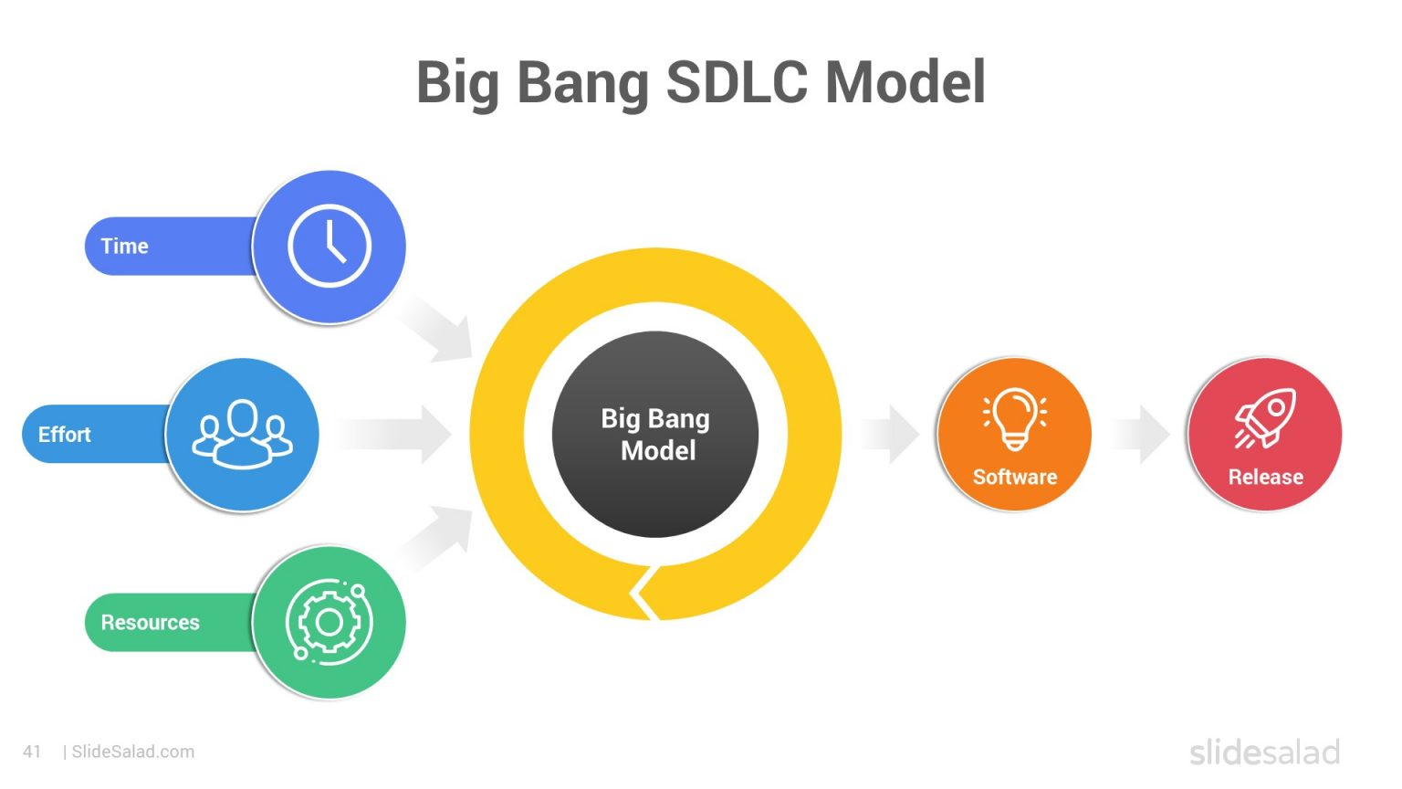

Slide 4
SAMPLE SCENARIO
A group of friends plans a surprise birthday party for Anna without any detailed planning or coordination. Each friend does tasks their own way buying decorations, ordering food, and booking the venue without checking if everything matches. In the end, Anna is surprised and happy, but some things go wrong, showing how the Big Bang model’s lack of planning can lead to mixed results.

Slide 5


BIG BANG MODEL PHASES
DEVELOPMENT PHASE
OUTPUT PHASE
RELEASE PHASE
All available time, human effort, and resources are gathered and invested right away.
There’s no formal planning or requirement analysis — the focus is on using everything at once to start development.
The working software product is produced from the development effort.
Any issues or missing features are adjusted informally.
The completed software is released or delivered to the client or users.
If feedback or problems arise, quick fixes are made without following a formal process.

Slide 6

ADVANTAGE AND DISADVANTAGE OF BIG BANG MODEL
ADVANTAGE
DISADVANTAGE
This is a very simple model
Little or no planning required
Easy to manage
Very few resources required
Gives flexibility to developers
It is a good learning aid for new comers or students.
Very High risk and uncertainty.
Not a good model for complex and object-oriented projects.
Poor model for long and ongoing projects.
Can turn out to be very expensive if requirements are misunderstood.

Slide 7
APPLICATION OF BIG BANG MODEL
Small-scale projects.
Academic and experimental projects.
Unclear or changing requirements.
Flexible development.

Slide 8
THANK
YOU

