Slide 1




Slide 2
Project description
The project consist from a GPS module (Quectel L80), a GSM module (SIM800L) and a MSP430G2 launchpad with MSP430G2553 microcontroller.
Is a prototype which performs the following operations:
Receive and send SMS messages;
Gather information from GPS satellites and processes it;
The project can be implemented in the following applications:
Anti-Theft system for cars;
Tracking system for animals;
Drone control system;
Other Smart House applications;

Slide 3
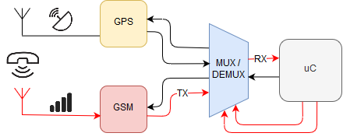
Functioning
The system waits to receive the SMS. The SMS message can contain words like “lat”, “long” or “time”. The communication between the modules and the microcontroller is made via UART. Because there is a single UART module and the uC requires to communicate with 2 modules, there is a need for a multiplexer. The MUX switches from GSM to GPS and vice-versa when uC demands it.

Slide 4
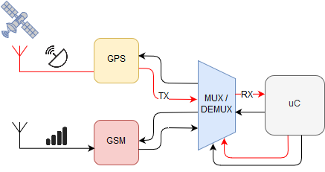
The uC verifies if the arrived SMS is valid. If it is, the uC stores the phone number, changes the state of the multiplexer and waits for the GPS data to arrive. Once the data arrives, the uC extract the needed data, and processes it in order to be transmitted.

Slide 5
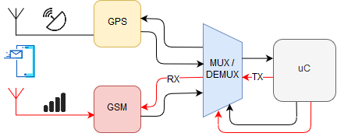
The extracted and processed GPS data is now, ready to be transmitted. The uC will respond back through the GSM module with the asked data.

Slide 6
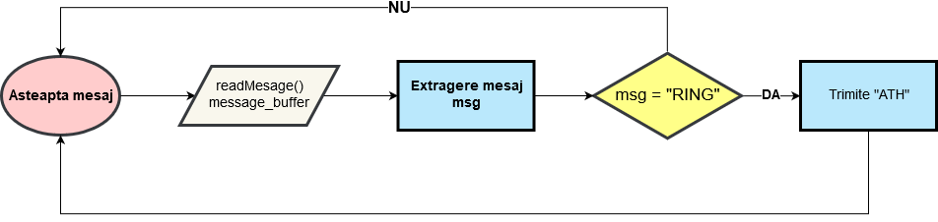
Detecting call algorithm
What happens if someone tries to call the phone number? The system will hang up the call. Above is the algorithm.

Slide 7
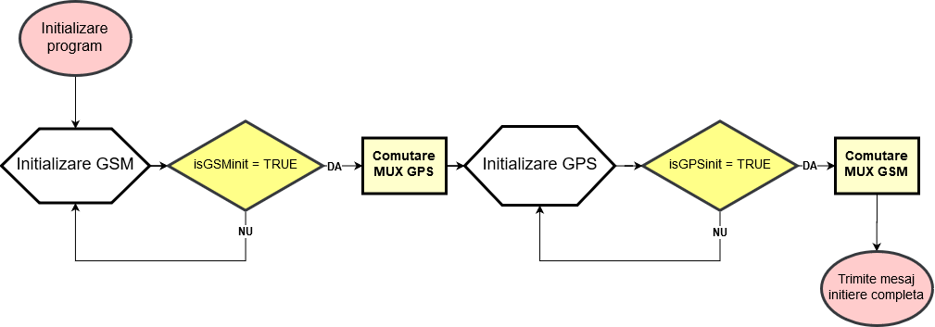
1. Initialization

Slide 8
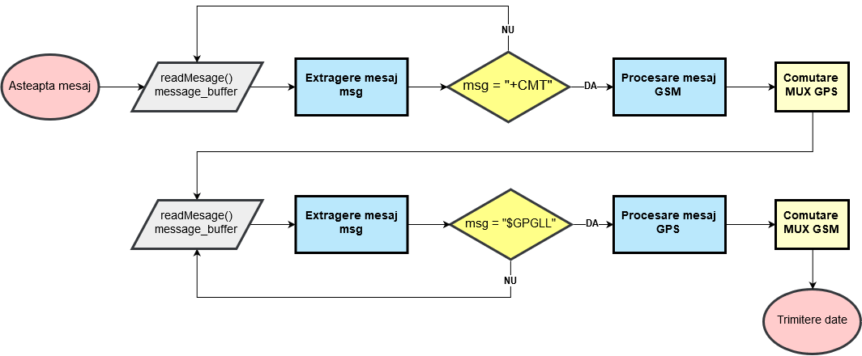
2. Extract data

Slide 9
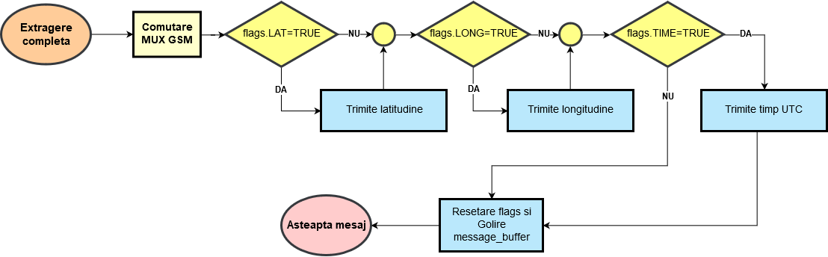
3. Send data
* The algorithms are in Romanian. For later edit, it will be a version of the algorithm on English.

Slide 10



The System is not function if:
- The GSM module has not made a connection to the network or it has not a stable power supply. Also the configuration message will not be send.
- The GSM module is not up on the satellites network. It can be offline and will not send good data. This can be verified by PPS led.
- SIM does not have credit, or it wasn't charged yet. In order to communicate within the network it must be recharged, and be active.

Slide 11
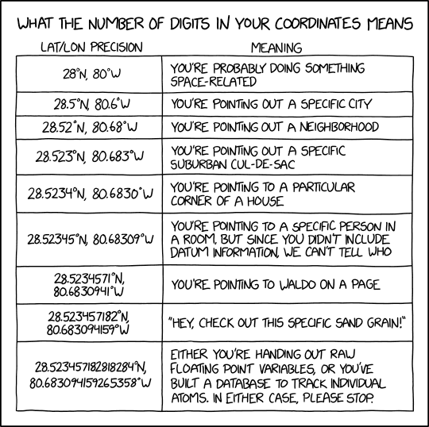
FOR PROJECTS: SEKABONE@GMAIL.COM

