Slide 1


Varuna
National Weather Big Data Analytics Platform — Real-time meteorological intelligence for India, powered by Exasol in-memory analytics.
Done by :
Thoyeshwar.L
Vishal.K
Notes:
1

Slide 2
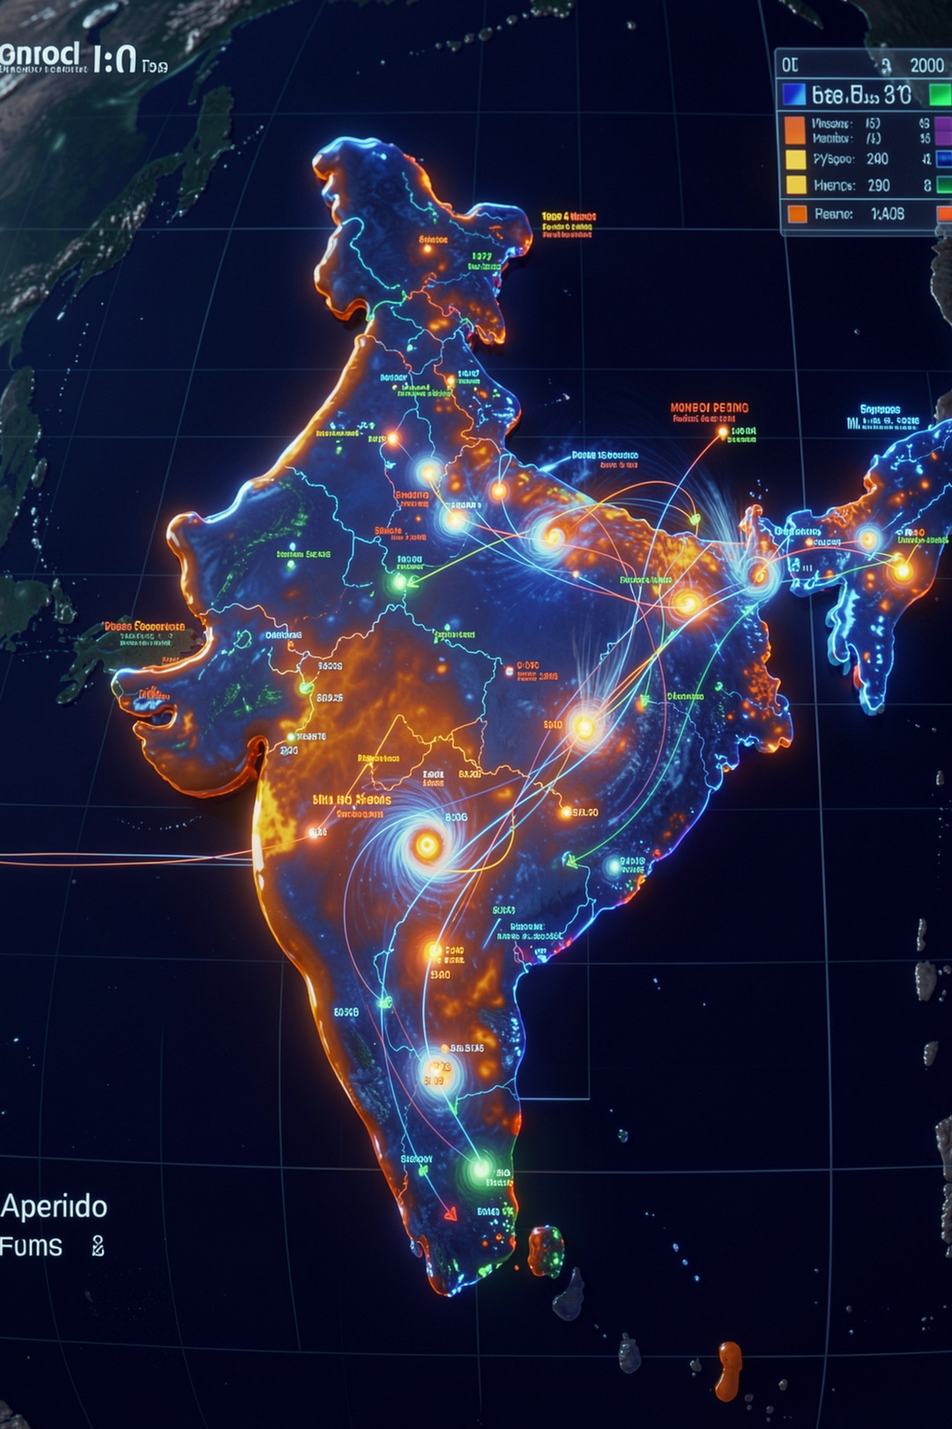
Executive Summary
The Problem
The Vision
India's weather data is fragmented across government agencies, radar networks, social media, and citizen reports — creating dangerous blind spots during fast-moving disasters like cyclones and floods.
A unified National Meteorological Command Center that fuses Open-Meteo radar telemetry, NDMA alerts, crowdsourced citizen reports, and #IMD social intelligence into sub-second analytics, powered by Exasol's in-memory columnar database.
Notes:
2

Slide 3

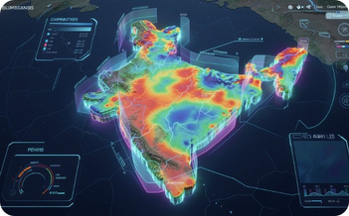

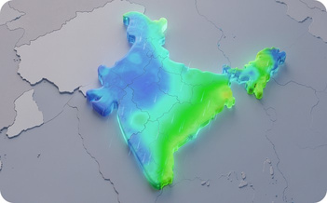
Key Platform Features
National Command Center
Interactive GIS Doppler Radar
Multi-Station Climate Trajectory
Pan-India Rainfall Heatmap
Real-time atmospheric overview with live regional temperature rankings and instant station search.
Multi-layer geospatial map with thermal radar sweeps and precipitation density visualization.
24-hour diurnal curves, 7-day trends, and 12-month seasonal climatology across major Indian cities.
Visual precipitation telemetry tracking the Southwest Monsoon across the entire subcontinent.
Extreme Weather Leaderboard
Live #IMD Social Intelligence
Citizen Science Portal
Real-time severity scoring with synoptic mechanism detail for top weather events.
Server-Sent Events feed of verified tweets, citizen reports, and NDMA alerts.
Geocoded observation form with one-click GPS auto-detection and hazard severity meters.
Notes:
3

Slide 4

Five Data Sources Powering Varuna
Open-Meteo REST API
1
Hourly observations and multi-day forecasts for 50+ Indian cities via a reliable open REST interface.
Twitter/X #IMD Posts
2
NLP-classified social posts tagged #IMD, #MumbaiRains, #CycloneDana with extracted GPS coordinates and severity scores.
Citizen GPS Reports
3
Crowdsourced field-truth observations geocoded to validate and cross-check radar data in real time.
NDMA Disaster Scraping
4
Live official alerts and emergency warnings scraped directly from India's National Disaster Management Authority.
NOAA / IMD Historical Datasets
5
Multi-year station records enabling robust climatology baselines and long-term trend analysis.
Notes:
4

Slide 5

End-to-End Data Workflow
Data Sources
Ingestion
Storage
API & SSE
Data flows continuously from five external sources through ingestion, storage, and API layers into a live React dashboard — delivering sub-second analytics at every stage.
Notes:
5

Slide 6



Exasol In-Memory Database Layer
Sub-15 ms query latency on multi-million-row aggregations — enabling real-time disaster analytics at national scale.
DIM_CITIES
FACT_WEATHER_HOURLY
FACT_SOCIAL_MEDIA_POSTS
Dimension table storing coordinates, elevations, and climate zone classifications for all monitored stations.
Core fact table distributed by city ID and partitioned by timestamp range for optimized time-series queries.
Geotagged NLP sentiment scores, engagement metrics, and hazard category classifications.
FACT_CITIZEN_REPORTS
FACT_DISASTER_ALERTS
Euclidean-distance indexed for real-time cross-validation against radar sensor observations.
Active emergency warning index with live ingestion from NDMA official alert feeds.
Notes:
6

Slide 7

Technology Stack & Repository Structure
Frontend — /client
React 18 + Vite powering interactive GIS maps, live dashboards, and the social intelligence stream.
Backend — /server
Node.js + Express serving a REST API and real-time Server-Sent Events streaming layer.
Data Processing — /ingest
Python 3.9+ pipelines for batch ingestion, NLP classification, and geocoding of raw data sources.
Database — /tools/exasol
Exasol in-memory columnar cluster providing sub-15 ms query response on aggregated weather data.
Notes:
7

Slide 8
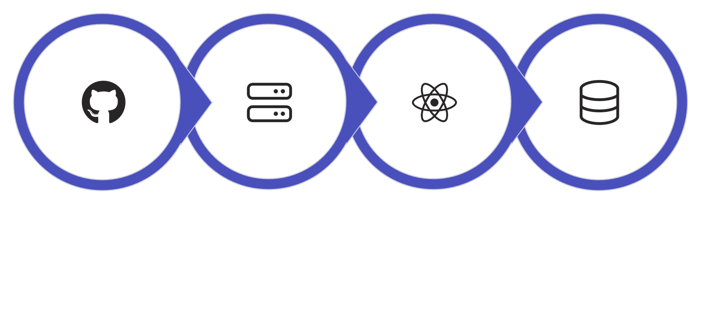
Deployment: Quick Start Workflow
Step 2: Start Backend
Step 3: Start Frontend
Step 4: Load Data
Step 1: Clone
The full stack — backend API, React frontend, and Exasol database — can be running and populated with historical data in minutes.
Notes:
8

Slide 9

Why Varuna Matters
Unified National Intelligence
Varuna is the first platform to fuse five fragmented weather data ecosystems — government, radar, social, citizen, and historical — into a single coherent national view.
Sub-Second Disaster Response
Real-time analytics under 15 ms enable faster public communication, earlier evacuations, and more coordinated emergency management across agencies.
Open, Extensible, Future-Ready
Built on proven open-source technologies — React, Python, Node.js, and Exasol — the architecture is designed to scale to new data sources and new regions.
Notes:
9

Slide 10

Thank You
Varuna
Oceans, Water & Rain — powered by real-time data
OPEN SOURCE
MIT LICENSE
Notes:
10

