Slide 1

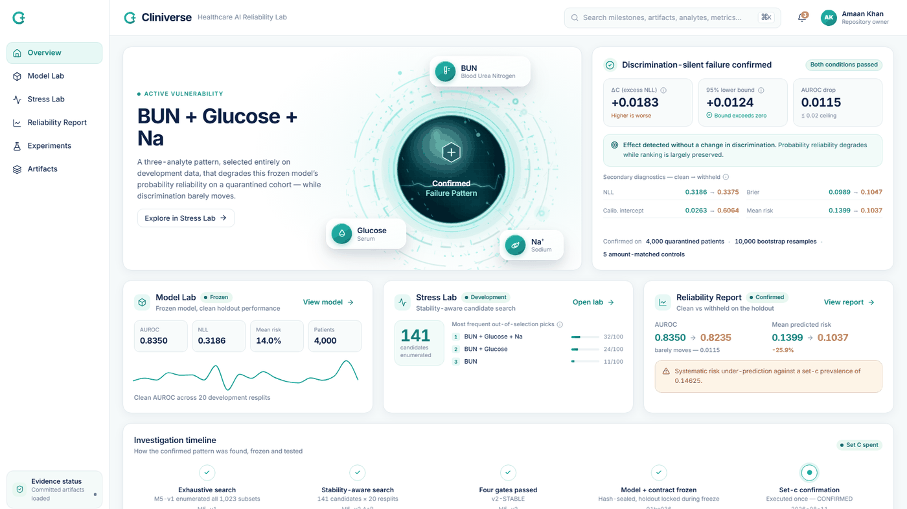
CLINIVERSE
The ranking still looked reasonable.
The probabilities did not.
Healthcare AI Reliability Lab
CONFIRMED PATTERN
AUROC
Mean predicted risk
Observed mortality
BUN + Glucose + Na
0.835 → 0.824
14.0% → 10.4%
14.625%
BOTH CONDITIONS PASSED
141 candidates · 20 development resplits · 4,000-patient holdout
ML Empowerment Build Challenge 2.0
01
Notes:
Healthcare models are often judged by whether they rank patients correctly. In our final holdout, that ranking still looked reasonable: AUROC moved only from 0.835 to 0.824. But the model's mean predicted risk fell from about fourteen percent to ten-point-four percent, while observed mortality was fourteen-point-six-two-five percent. That gap is the failure Cliniverse is built to reveal.
[Sources]
- README.md — confirmed Set-C result
- docs/readme-assets/screens/overview.png

Slide 2
CLINIVERSE
Healthcare AI Reliability Lab
02
THE PROBLEM
A good ranking score can hide a bad probability shift.
ILLUSTRATIVE — NOT PROJECT RESULTS
RANKING QUESTION
PROBABILITY QUESTION
A
Patient A
Did A score higher than B?
Do the numbers still mean the same thing?
died
Model A
Model B
0.80 > 0.40
0.45 > 0.20
B
Patient B
same order
survived
same order · shifted meaning
Ranking can stay intact while probability reliability moves.
Notes:
AUROC asks a ranking question. If Patient A died and Patient B survived, did the model score Patient A higher? In this illustrative example, zero-point-eight remains above zero-point-four, and zero-point-four-five remains above zero-point-two. The order is unchanged, so the ranking can still look fine. But the meaning of the probabilities has shifted. Cliniverse separates that probability question from the ranking question. These example numbers are illustrative, not project results.
[Sources]
- README.md — problem framing
- Illustrative values supplied in the presentation brief; not project results

Slide 3
CLINIVERSE
Healthcare AI Reliability Lab
03
THE USE CASE
Crash-test the model before deployment.
The mortality predictor is the model under test — Cliniverse is the instrument around it.
CLINIVERSE
MODEL
OUTPUT
Frozen healthcare
risk model
Controlled
information stress
Reliability
evidence
the car
what breaks first
the crash-test facility
FOR
Model developers
ML researchers
Model-governance teams
Not a doctor or patient application
Notes:
The mortality predictor is the model under test, not the product. Think of that model as a car. Cliniverse is the crash-test facility around it. We deliberately stress the model's information environment, compare the damage with a matched control, and turn the result into reliability evidence. This is for model developers, ML researchers, and governance teams—not doctors or patients.
[Sources]
- README.md — product definition and crash-test analogy

Slide 4
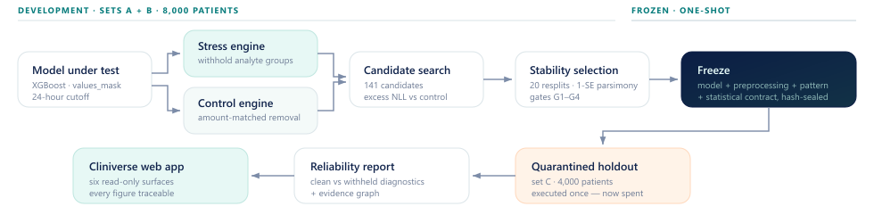
CLINIVERSE
Healthcare AI Reliability Lab
04
HOW CLINIVERSE WORKS
Seven stages turn a suspicion into evidence.
Stress → Control → Search → Stabilise → Freeze → Confirm → Evidence
Matched control
Delete the same amount of information at random from the same patients.
Notes:
The method is a disciplined sequence: stress, control, search, stabilise, freeze, confirm, and evidence. The critical stage is the matched control. Removing information always hurts somewhat, so the candidate is compared against deleting the same number of cells at random from the same patients. The search and stability work happen only on development data. Then the model, preprocessing, pattern, and statistical contract are frozen before one quarantined holdout confirmation.
[Sources]
- docs/readme-assets/workflow.svg
- README.md — amount-matched control and validation sequence

Slide 5
CLINIVERSE
Healthcare AI Reliability Lab
05
SYSTEM ARCHITECTURE
The product wraps a frozen model with a reliability engine.
DEVELOPMENT · 8,000 PATIENTS
FROZEN · ONE-SHOT HOLDOUT
01
02
03
04
05
06
PhysioNet /
CinC 2012
Frozen
XGBoost
Reliability
engine
Stability
search
Set-C
confirmation
Evidence
UI
12,000 retrospective
ICU patients
values_mask
24-hour cutoff
stress + amount-
matched control
141 candidates
20 resplits · gates
4,000 patients
executed once
committed artifacts
React + Firebase
Python science pipeline
Frozen contract and committed evidence
Read-only product surfaces
8,000 development patients
4,000-patient holdout
Evidence, not live inference
Notes:
Cliniverse starts with the PhysioNet Computing in Cardiology 2012 cohort and a frozen XGBoost mortality model using values plus missingness indicators through a twenty-four-hour cutoff. The reliability engine runs candidate stress and amount-matched control conditions, then performs stability selection across development resplits. A hash-sealed contract governs the single Set-C confirmation. Committed evidence then feeds the read-only React interface hosted on Firebase.
[Sources]
- README.md — dataset, model contract, architecture, and deployment
- Repository frontend and experiment structure

Slide 6
CLINIVERSE
Healthcare AI Reliability Lab
06
How do we know it is not just ‘less data = worse model’?
The control removes quantity as the explanation.
CANDIDATE DELETION
AMOUNT-MATCHED CONTROL
BUN + Glucose + Na
Random cell deletion
=
same patients
same patients
same number of removed cells
same number of removed cells
Measure the excess probability loss
Candidates
Dev resplits
Exact stability
candidate loss − matched-control loss
141
20
11 / 20
minimum majority threshold
Notes:
For every candidate deletion, Cliniverse constructs an amount-matched random deletion. Both operate on the same patients and remove the same number of cells. The measurement is not raw degradation; it is the excess probability loss of the candidate over that control. We evaluated one hundred forty-one candidate patterns over twenty development resplits. The final exact pattern appeared in eleven of twenty resplits—the minimum majority threshold, passed by a single resplit. That is evidence, but deliberately not overstated stability.
[Sources]
- README.md — amount-matched experiment, 141 candidates, 20 resplits, G2 stability gate

Slide 7
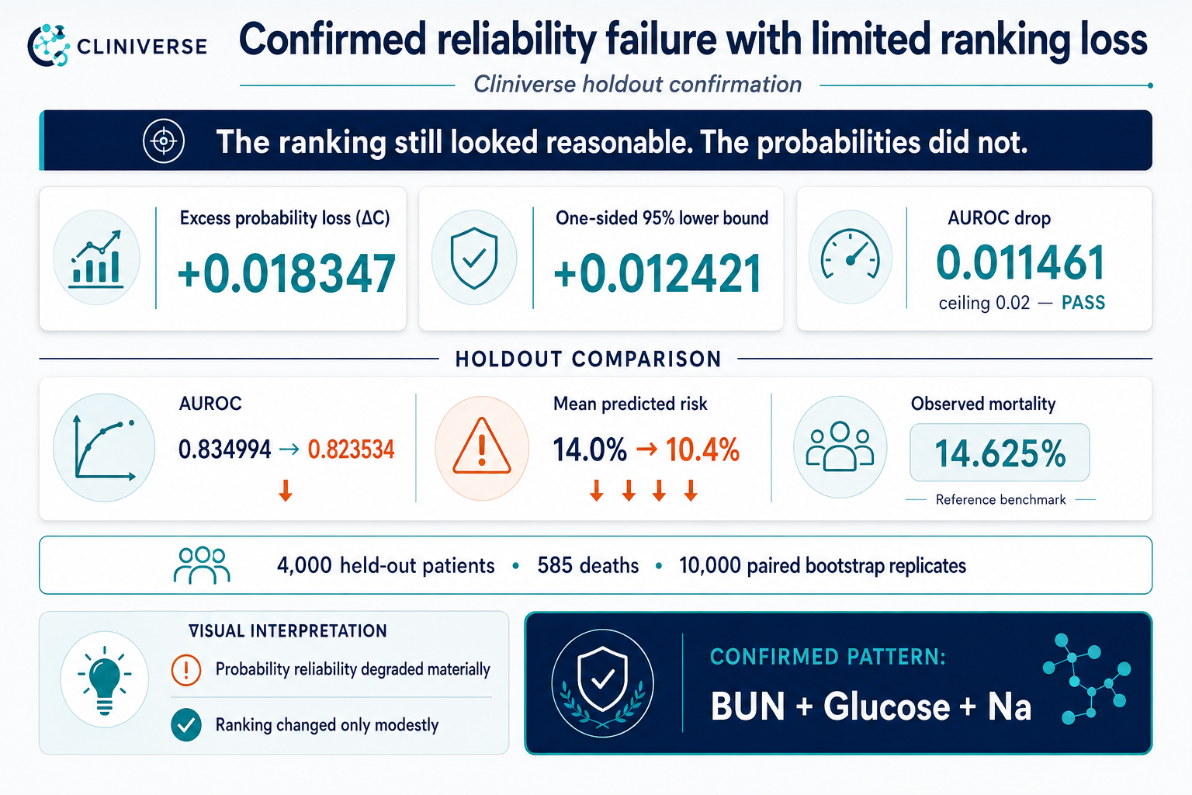
07
Notes:
On the four-thousand-patient holdout, the frozen BUN plus Glucose plus sodium pattern produced excess probability loss of plus zero-point-zero-one-eight-three-four-seven. The one-sided ninety-five percent lower bound was plus zero-point-zero-one-two-four-two-one, safely above zero. AUROC moved from zero-point-eight-three-four-nine-nine-four to zero-point-eight-two-three-five-three-four—a drop of zero-point-zero-one-one-four-six-one. Mean predicted risk fell from about fourteen percent to ten-point-four percent, against observed mortality of fourteen-point-six-two-five percent. Probability behavior degraded while ranking changed only modestly.
[Sources]
- C:/Users/OMEN/Downloads/Holdout confirmation.png
- README.md — Set-C result and boundaries

Slide 8
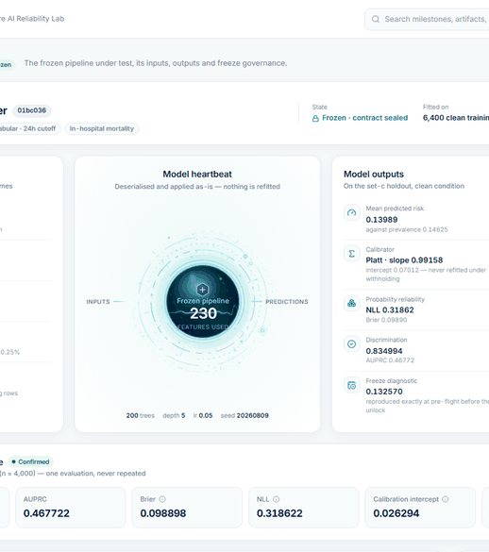
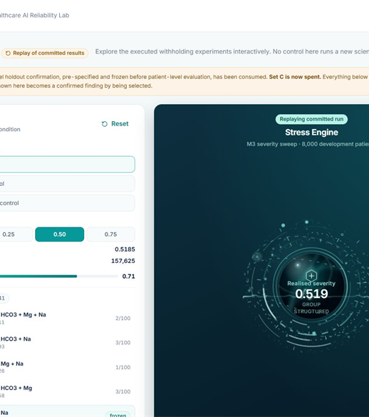
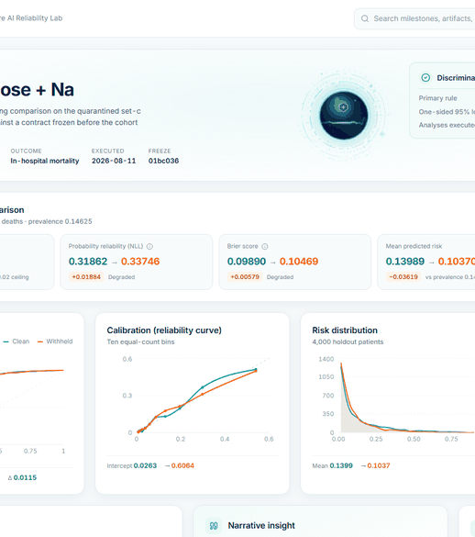
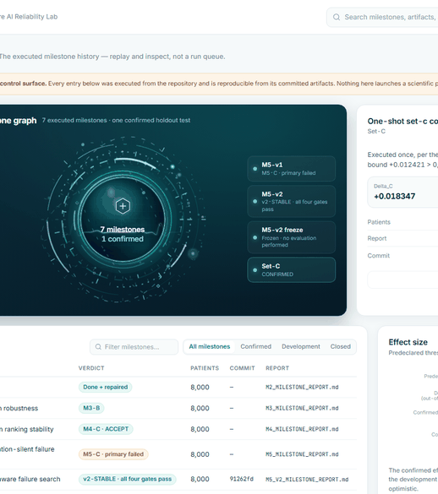
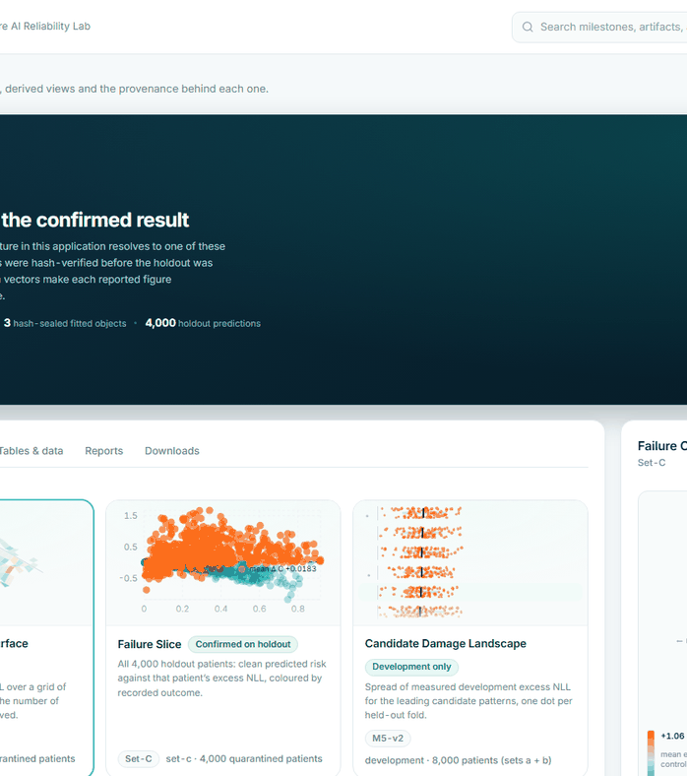
CLINIVERSE
Healthcare AI Reliability Lab
08
LIVE PRODUCT DEMO
The evidence is interactive.
Overview → Stress Lab → Reliability Report → Artifacts → Experiments
cliniverse-lab.web.app
Switch to browser after this slide
Overview
Model Lab
Stress Lab
Reliability Report
Experiments
Artifacts
LIVE DEMO
Committed evidence · replay-only controls · Set C spent
Notes:
The result is not trapped in a static chart. Cliniverse exposes six read-only product areas, each backed by committed evidence. I will switch to the live browser now and follow this path: Overview, Stress Lab, Reliability Report, Artifacts, and Experiments.
[BROWSER SWITCH — OPEN https://cliniverse-lab.web.app]
OVERVIEW: Point to the confirmed BUN plus Glucose plus sodium pattern and say: ‘This is the one frozen pattern that reached the holdout. The three headline metrics are excess probability loss, its one-sided lower bound, and the modest AUROC drop.’
STRESS LAB: Click Stress Lab. Say: ‘This is a replay of committed experiments, not a new holdout run. Set C is spent.’ Click requested severity 0.25, then 0.75. Say: ‘These controls re-read saved artifacts to show the severity response; they do not rerun scientific inference.’
RELIABILITY REPORT: Click Reliability Report. Point to the AUROC movement, NLL or probability reliability degradation, mean risk shift, and the calibration and risk charts. Say: ‘The ranking curves stay close, but the probability and calibration views show the material shift.’
ARTIFACTS: Click Artifacts. Say: ‘Every visual resolves to committed evidence. The fitted objects were hash-verified before the holdout opened, and the displayed figures are independently recomputable.’
EXPERIMENTS: Click Experiments. Point to M5-v1 and say: ‘The first primary search failed. We kept that negative result.’ Point to Set C and say: ‘Final confirmation executed once. Set C is now spent.’
[BROWSER SWITCH — RETURN TO SLIDE 9]
If the site loads slowly, say: ‘The live site is loading; the same committed product surfaces are captured in the deck, so I will continue with the verified evidence and return if time permits.’
[Sources]
- All six screenshots in docs/readme-assets/screens/
- https://cliniverse-lab.web.app
- README.md — interface and execution semantics

Slide 9
CLINIVERSE
Healthcare AI Reliability Lab
09
WHY THIS MATTERS
Reliability should be tested before high-stakes use.
A disciplined reliability lab does three jobs.
1
2
3
Discover
Verify
Inspect
fragile information
dependencies
under a frozen
evaluation contract
evidence and
provenance
RESPONSIBLE BOUNDARIES
Research / model-governance prototype
Not clinically validated
No patient-level decision making
Retrospective synthetic withholding · no causal or clinical claim
Notes:
Cliniverse contributes three things. It discovers fragile information dependencies under controlled synthetic stress. It verifies one frozen claim under a fixed evaluation contract. And it makes the evidence and provenance inspectable. The boundary matters: this is a research and model-governance prototype. It is not clinically validated, and it performs no patient-level decision making.
[Sources]
- README.md — scope, limitations, and research-use boundaries

Slide 10
CLINIVERSE
Before we trust the prediction,
we should crash-test the probability.
Healthcare AI Reliability Lab
Stress. Control. Freeze. Confirm.
cliniverse-lab.web.app
github.com/Rex123-hash/ClinicVerse
10
Notes:
Before we trust a prediction in a high-stakes environment, we should crash-test the probability—not only admire the ranking score. Cliniverse turns hidden reliability failure into controlled, frozen, traceable evidence. Stress. Control. Freeze. Confirm. That is Cliniverse: the Healthcare AI Reliability Lab.
[Sources]
- Project synthesis based on README.md and the confirmed holdout result

