Slide 1
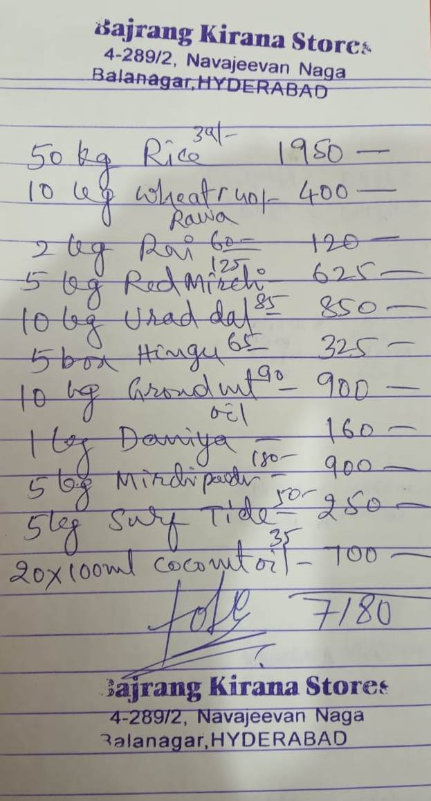
DUKANBOOK · PRODUCT REVIEW
Phase 2
AI Bill Generator
Handwritten bill → verified digital invoice → confirmed accounts
Notes:
Open with the promise: the existing assistant turns a rough shop bill into verified accounting, without skipping human confirmation.
[Sources]
- C:\Users\OMEN\AppData\Local\Temp\codex-clipboard-47efb078-ac69-4c23-a720-37582e853b09.png
- E:\DukaanBook\README.md

Slide 2
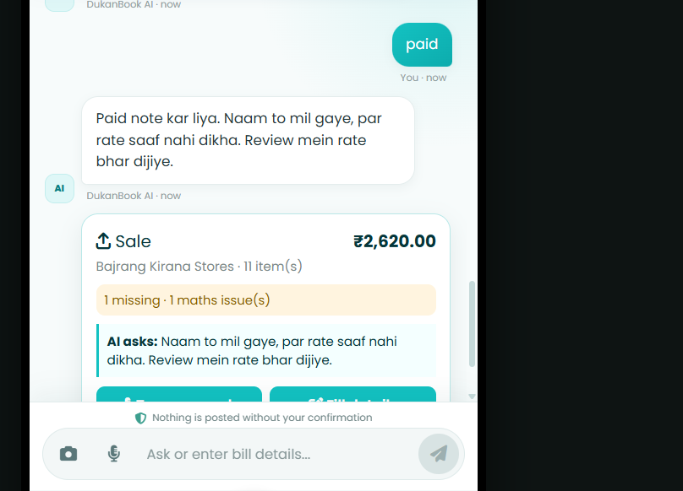
DUKANBOOK · PHASE 2
The hard part is not OCR — it is trustworthy interpretation
A real kirana bill mixes product names, quantities, tiny rates, far-right amounts, overwritten text and a handwritten total.
A single vision pass can see the products yet miss the money column. That creates a believable but wrong draft — exactly the failure Phase 2 must prevent.
Observed failure: ₹2,620 shown while the bill total is ₹7,180
02
Notes:
Use the supplied screenshot as evidence of the original extraction gap: products were found, but faint rates and right-side amounts were not.
[Sources]
- C:\Users\OMEN\AppData\Local\Temp\codex-clipboard-47efb078-ac69-4c23-a720-37582e853b09.png
- C:\Users\OMEN\AppData\Local\Temp\codex-clipboard-c6282576-99c1-43ed-a3ad-e0d1fa69c2f4.png
- E:\DukaanBook\app\billing\extractors.py

Slide 3
DUKANBOOK · PHASE 2
One assistant carries the bill from camera to accounts
01
02
03
04
05
06
Scan
Read
Check
Ask
Review
Post
Photo enters the existing chatbot.
AI extracts header, rows and totals.
Code recalculates every rupee.
Only unresolved fields are requested.
User edits or confirms the draft.
Bill, stock and accounts update atomically.
Nothing reaches the ledger before confirmation.
03
Notes:
Walk left to right. The Bills tab remains history/management; creation stays inside the existing AI Assistant.
[Sources]
- E:\DukaanBook\web\app.js
- E:\DukaanBook\app\billing\service.py
- E:\DukaanBook\app\billing\repository.py

Slide 4
DUKANBOOK · PHASE 2
Vision reads the document in layers, not as one guess
Original scan
Parallel first read
Focused reads
Normalize
Stored unchanged and remains authoritative.
Vertex Gemini vision + optional Document AI OCR.
Header · items · terms · money columns
Dates, phones, GST evidence and row order.
Confirmation
Guided review
Deterministic math
Explicit user approval is required.
One missing question at a time.
Integer paise, Decimal rounding and mismatch checks.
Provider-neutral canonical draft
Local Ollama and GCP return the same schema; only the reader changes.
04
Notes:
This is the core technical idea: probabilistic reading is isolated from deterministic validation and posting.
[Sources]
- E:\DukaanBook\app\billing\models.py
- E:\DukaanBook\app\billing\extractors.py
- E:\DukaanBook\app\billing\calculator.py

Slide 5
DUKANBOOK · PHASE 2
The difficult bill now reconciles to exactly ₹7,180
PRODUCT
QTY × RATE
AMOUNT
Rice
50 × ₹39
₹1,950
Wheat rawa
10 × ₹40
₹400
Rai
2 × ₹60
₹120
Red mirchi
5 × ₹125
₹625
Urad dal
10 × ₹85
₹850
Hing
5 × ₹65
₹325
Groundnut oil
10 × ₹90
₹900
Dhaniya
1 × ₹160
₹160
Mirchi powder
5 × ₹180
₹900
Surf/Tide
5 × ₹50
₹250
Coconut oil
20 × ₹35
₹700
11/11 rates recovered · Total ₹7,180
05
Notes:
This is live evidence from the exact supplied image after the spatial money pass and deterministic validation.
[Sources]
- C:\Users\OMEN\AppData\Local\Temp\codex-clipboard-47efb078-ac69-4c23-a720-37582e853b09.png
- E:\DukaanBook\app\billing\extractors.py
- E:\DukaanBook\tests\test_billing.py

Slide 6
DUKANBOOK · PHASE 2
AI reads; deterministic code verifies
Probabilistic
Deterministic
• Names and handwriting
• Quantity / rate / amount cells
• Date, GST and payment wording
• Confidence and ambiguity
• Integer paise — no float drift
• Quantity × unit rate per line
• GST / CGST / SGST / IGST split
• Discount, charges and round-off
• Written-total mismatch blocks confirm
A plausible AI answer is never enough.
The calculator must independently agree.
06
Notes:
Emphasize the trust boundary: models copy evidence; Decimal/integer-paise code owns all totals and confirmation blockers.
[Sources]
- E:\DukaanBook\app\billing\calculator.py
- E:\DukaanBook\tests\test_billing.py

Slide 7
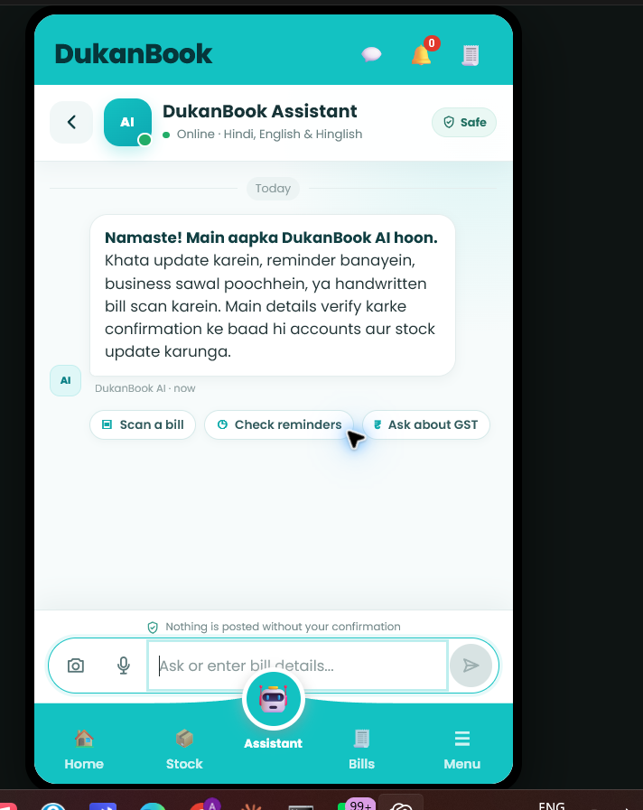
DUKANBOOK · PHASE 2
The chatbot asks only for what the scan could not prove
Three ways to complete a draft
1 Type the answer in natural Hinglish
2 Speak — the same bill draft is updated
3 Open Review and edit fields manually
The draft remembers previous answers, asks one focused question at a time, and never resets unrelated fields.
07
Notes:
The assistant drives the user; the user should not have to know which fields are missing before starting.
[Sources]
- C:\Users\OMEN\AppData\Local\Temp\codex-clipboard-0e4a2d31-76d6-41f0-964b-a827a3f6c8bc.png
- E:\DukaanBook\web\app.js
- E:\DukaanBook\app\billing\service.py

Slide 8
DUKANBOOK · PHASE 2
Confirmation is the accounting safety boundary
Scan
Review
Confirm
Atomic posting
Creates a persistent draft only.
Shows missing fields and maths issues.
Explicit user action; blocked on errors.
Bill + stock + ledger + cashbook succeed together.
If posting fails, the transaction rolls back — there is no half-updated shop.
Idempotency also prevents a double-click from creating duplicate accounting entries.
08
Notes:
Connect confirmation to business safety: a scan can never silently alter stock or money.
[Sources]
- E:\DukaanBook\app\billing\repository.py
- E:\DukaanBook\app\billing\service.py
- E:\DukaanBook\tests\test_billing_api.py

Slide 9
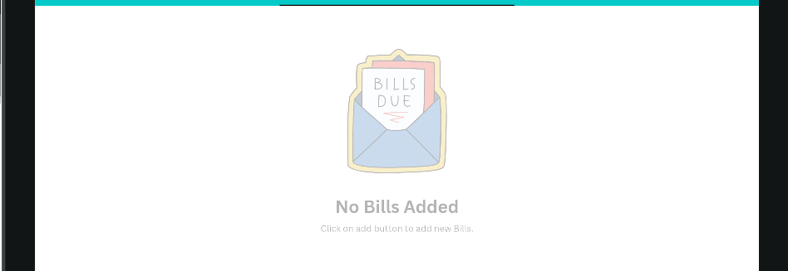
DUKANBOOK · PHASE 2
One canonical draft produces GST and non-GST bills
NON-GST
GST
• Subtotal from verified line totals
• Discounts, charges and round-off
• Paid / partial / credit handling
• Clean DukanBook PDF
• Bill-level or per-line rates
• CGST + SGST or IGST scheme
• HSN and GSTIN fields when present
• Tax ladder reconciles to grand total
Professional invoice · QR · totals · Powered by DukanBook
09
Notes:
Phase 2 keeps the original Bills tab as the management view and generates downloadable branded invoices from confirmed data.
[Sources]
- C:\Users\OMEN\AppData\Local\Temp\codex-clipboard-0d3e83dd-7bd6-4996-850e-5e04e6511ffd.png
- E:\DukaanBook\app\billing\pdf.py
- E:\DukaanBook\app\billing\calculator.py

Slide 10
DUKANBOOK · PHASE 2
Voice is natural, interruptible — and never overlaps
Serialized speech queue
Each reply follows one path:
Synthesize → play completely → release → play next
The Stop button cancels the current audio, aborts speech generation and clears queued replies.
Typed replies obey the speaker switch; voice questions always receive a spoken answer.
10
Notes:
This addresses a practical demo failure: multiple asynchronous replies can no longer create overlapping voices.
[Sources]
- C:\Users\OMEN\AppData\Local\Temp\codex-clipboard-0e4a2d31-76d6-41f0-964b-a827a3f6c8bc.png
- E:\DukaanBook\web\app.js
- E:\DukaanBook\app\voice.py

Slide 11
DUKANBOOK · PHASE 2
Cloud quality is optional; the product still works locally
PRODUCT
BACKEND
AI + VOICE
DELIVERY
HTML · CSS · JavaScript
Existing Assistant + Bills tab
FastAPI · Python
SQLite · atomic transactions
Vertex Gemini · Document AI
STT V2 Chirp 3 · Chirp 3 HD
Docker · Cloud Run
min instances = 0
Private code-only switch
Safe fallback
GCP_ENABLED is not exposed in the UI or API. The repository owner controls provider policy in source code.
If GCP is disabled or unavailable, Ollama, local Whisper and edge-tts continue through the same interfaces.
11
Notes:
Cloud Run scales to zero when idle. The code-only switch ensures access remains with the repository owner, while adapters keep the local workflow intact.
[Sources]
- E:\DukaanBook\app\config.py
- E:\DukaanBook\app\gcp.py
- E:\DukaanBook\Dockerfile
- E:\DukaanBook\requirements-prod.txt

Slide 12
DUKANBOOK · PHASE 2
Phase 2 is ready for a controlled demo
213
11 / 11
₹7,180
0
automated tests passed
rates recovered from the supplied bill
verified total — zero warnings
minimum Cloud Run instances
Demo next: scan → resolve → review → confirm → verify stock, ledger and cashbook.
Human confirmation remains the final authority.
Notes:
Close with measurable proof and the exact live demo sequence. Do not position extraction alone as success; the confirmed accounting updates are the outcome.
[Sources]
- E:\DukaanBook\tests
- C:\Users\OMEN\AppData\Local\Temp\codex-clipboard-47efb078-ac69-4c23-a720-37582e853b09.png
- Live local validation on 2026-08-03

