Slide 1

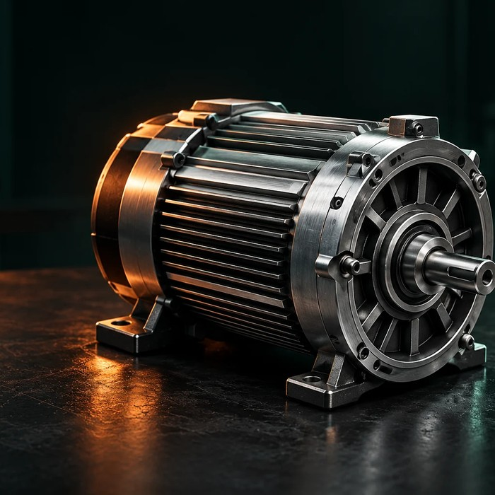
MechaSight — Different ≠ Faulty
Robust multi-sensor machine anomaly detection under real-world operating shifts
THE PROBLEM
DETECTION PIPELINE
A detector trained under one operating condition raises false alarms when only the load, speed or background noise changes. A changed signal is not automatically a fault.
Sensors
mic · acc · gyro
L0
one detector per sensor
L2 score fusion
calibrated mean of L0
Decision
normal / anomaly at frozen threshold
RoboticArm
articulated arm
BrushlessMotor
rotating drive
L1 early fusion
one model, all sensors
Microphone
sound · 1 ch
Accelerometer
vibration · 3-axis
Gyroscope
rotation · 3-axis
L3 sensor-integrity fallback a dead or invalid sensor is excluded; decide on the surviving sensors, or abstain
Same machine, new operating conditions: the signals shift, yet the machine is healthy. MechaSight measures how often that is wrongly called a fault.
Student researcher: Amaan Khan · Supervisor: Vikas Sharma · Co-supervisor: Surbhi Upadhyay
Notes:
MechaSight asks one question: when a machine's signals change, is it faulty, or just running differently? We use the public IMAD-DS dataset: a robotic arm and a brushless motor, each recorded with a microphone, a 3-axis accelerometer and a 3-axis gyroscope. L0 is one detector per sensor. L2 fuses their calibrated scores. L1 trains one model on all sensors together. L3 is a safety rule: if a sensor is dead or invalid, it is excluded and we decide on the remaining sensors or abstain.

Slide 2
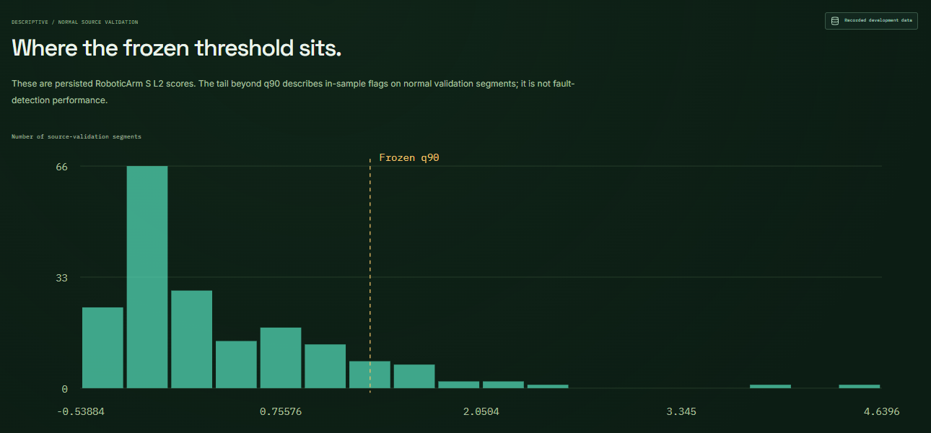
Work completed — verified on development data
156
24
single-sensor detectors benchmarked and frozen (5 model families, 2 machines, 2 regimes)
new early-fusion (L1) models trained — Mahalanobis and dense autoencoders
208
0.0
score-fusion (L2) calibrations across 52 fusion units
max score difference: all 24 L1 and 208 L2 outputs reproduced exactly
Genuine development plot from the MechaSight website: persisted RoboticArm L2 scores for 186 normal validation segments and the frozen q90 threshold. It describes the threshold, not fault-detection accuracy.
1,992
6
Real multi-sensor pipeline
IMAD-DS recordings → 7 channels aligned on timestamps → features and spectra → detectors. Splits are grouped by recording parent so no recording leaks between training and testing.
synthetic sensor-failure runs; all pass criteria met, 0 false triggers on 21,154 clean channels
chapter interactive website: real recordings, 120 genuine model scores, 55 tests passing
Protected test evaluation of the fusion models has not been run yet. No fusion accuracy is claimed.
Notes:
What is finished: the data pipeline, the frozen single-sensor benchmark, 24 new early-fusion models and 208 score-fusion calibrations. Re-running the frozen models on development data reproduces every score exactly. The sensor-failure rule passed 1,992 synthetic failure tests, with zero integrity-gate false triggers on the clean development inputs tested. That is about the integrity gates only, not the anomaly detectors' false-positive rate. The plot is real development data from our website: it shows where the frozen threshold sits on normal segments. It is not a fault-detection result; the final protected test is still pending.

Slide 3
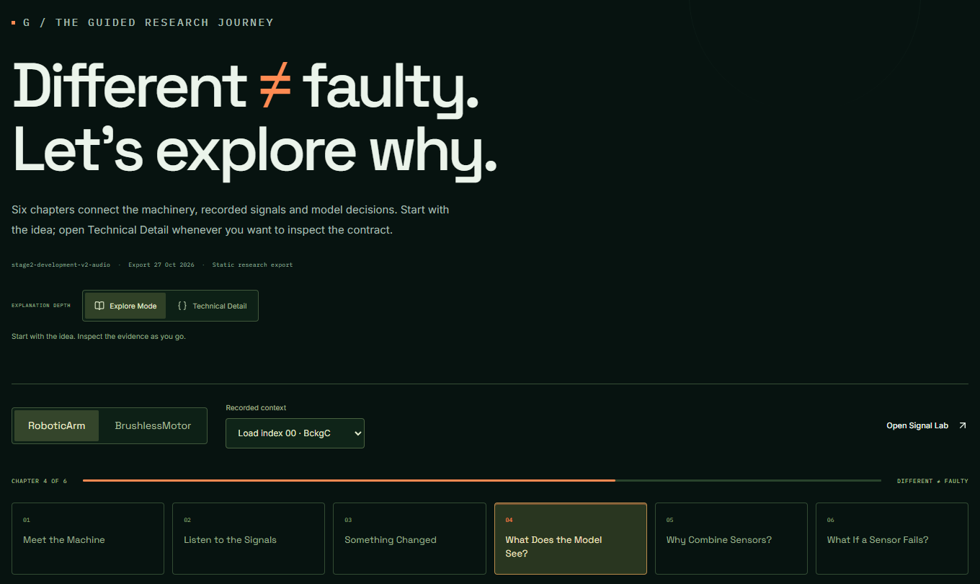
Current status and plan before the next evaluation
COMPLETED
CURRENT
NEXT
Research foundations and leakage-controlled splits
Single-sensor benchmarks
L1 training and L2 calibration
L3 sensor-integrity testing
Development evaluation and demo website
Protected-evaluation readiness: label-free index, input adapter, ledger batch interface
Waiting for independent review and authorization
Independent review of the final executable
Authorized protected evaluation: 232 planned looks
Statistical comparisons: AUROC, false-alarm rate, recall, 10,000-draw bootstrap
Conclusions, report and submission
Guided journey, Signal Lab, Findings and Sensor Studio: the demo runs locally on this laptop (npm run preview → 127.0.0.1:4173). It is not publicly deployed.
Evaluation discipline every look at the protected test set is logged. 196 looks so far; the frozen plan adds 232 (→ 428), only after human authorization. Labels are opened once, after all scores are locked.
Notes:
Everything up to development evaluation is complete. Right now we are finishing readiness for the final protected test: the label-free window index, the input adapter and the look ledger. Next: an independent review, then the authorized protected evaluation of 232 planned looks, then the frozen statistical comparisons, and finally the report. We log every look at the test set so the result cannot be tuned after seeing it.

