Slide 1
Assigment Submission
technology stack used:
- Python3
- PySide2
- MongoDB

Slide 2
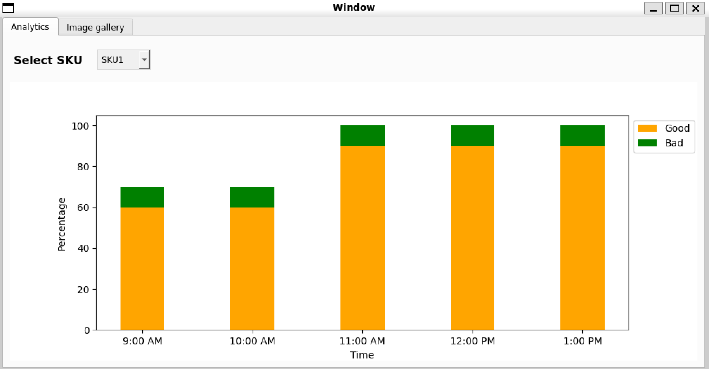
Analytics tab
It has chart and an menu that can be used to select SKUs.

Slide 3
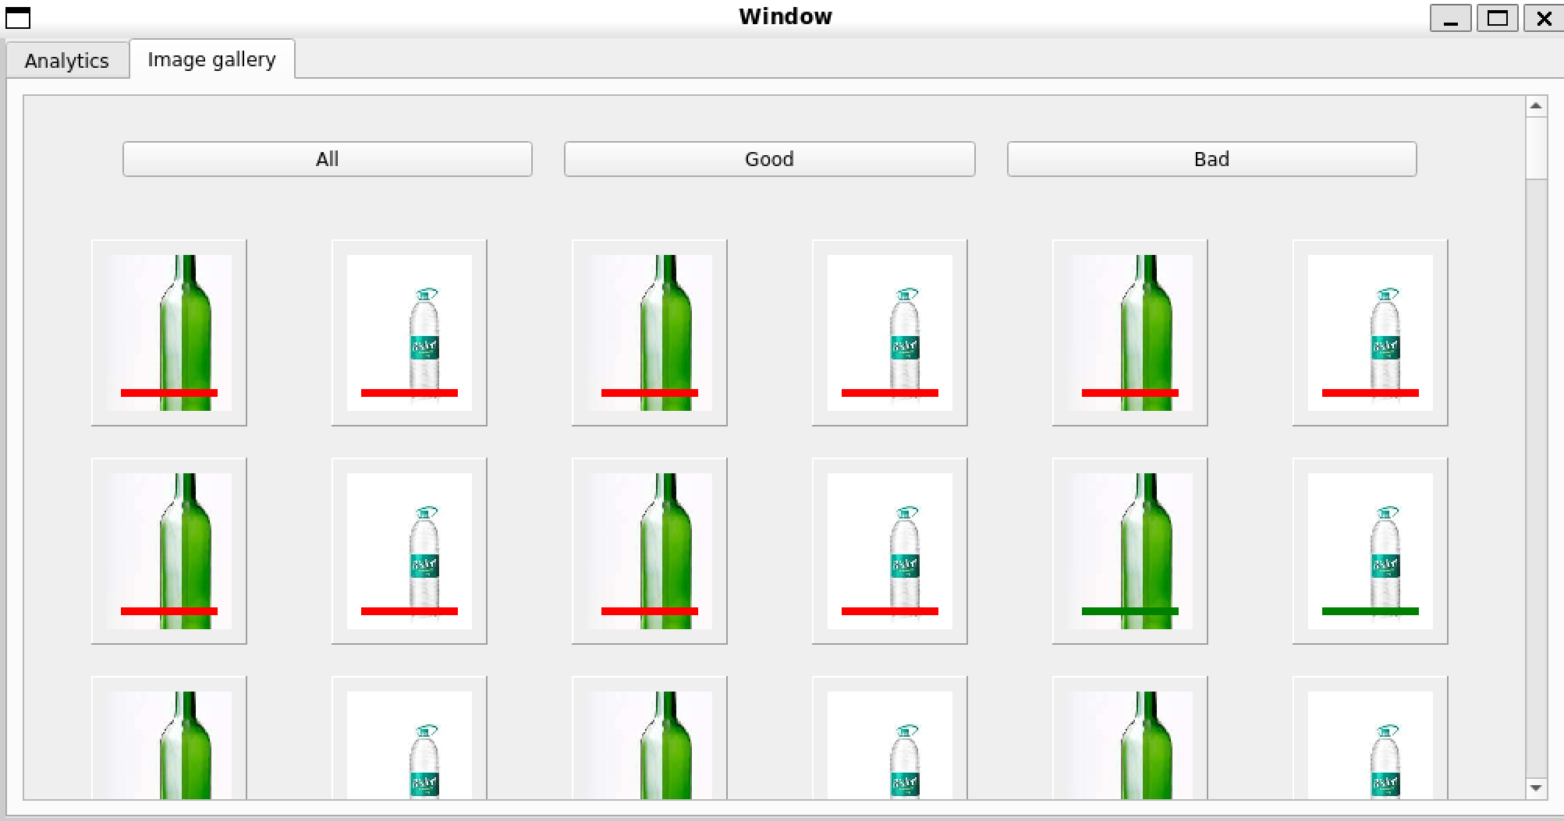
Image gallery tab
There are three filter tabs that will filter the images based on the status of the bottle in db.

