Slide 1
Digital Circuit and System Lab01
20240307
TA: 王英育 Ying-Yu (Inyi) Wang
Institute of Electronics,
National Yang Ming Chiao Tung University

Slide 2
MobaXterm
Remote host: [ee21~ee30].iee.nycu.edu.tw
You can find your account from the table.
Specify username: [DCS001 - DCS149]
Port: 415
Click OK.
You need to use the NYCU’s IP!
140.113.xxx.xxx
If your IP isn’t belong to NYCU, use the NYCU VPN.
NYCU VPN Tutorial

Slide 3

MAC
Design a multiply accumulate unit:
$Y = A × B + C$
How to implement the function of multiplier and adder?
Read the file Arithmetic.cpp and Arithmetic.h.
4 bits
Multiplier
A
B
4 bits
Adder
9 bits
Y
C
8 bits
Fig. 1. The block diagram of MAC

Slide 4
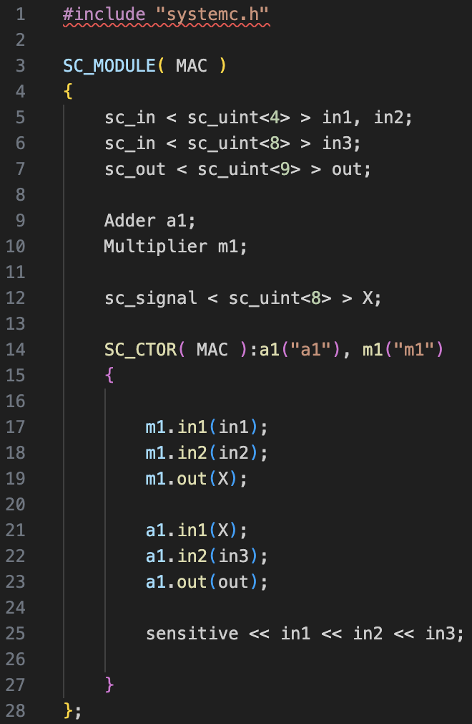
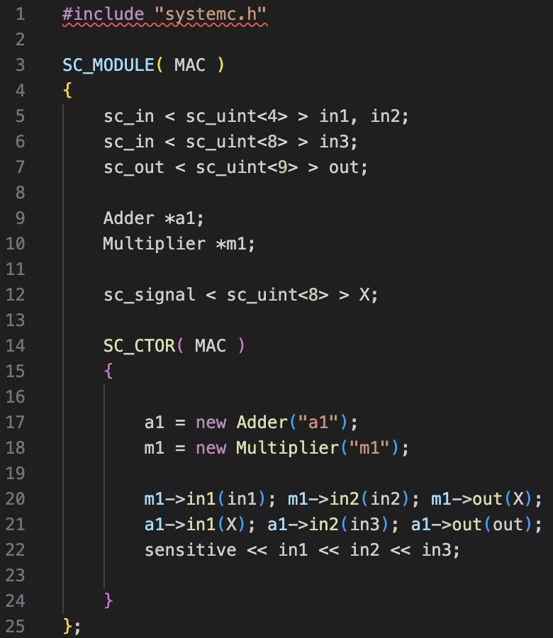
MAC
There are two coding styles in SystemC:
Constructor
Pointer
Fig. 2. Constructor coding style
Fig. 3. Pointer coding style

Slide 5








Neuron
The operation of a neuron is composed of multiplication and addition.
After multiplication and addition, the output of a neuron will carry out the activation function.
$$X1$$
$$W1$$
$$Σ$$
Activation function f
$$Y$$
$$X2$$
$$W2$$
$$b$$
$$Y = f(ΣX_{i}W_{i}+b)$$
Fig. 4. The block diagram of a neuron

Slide 6
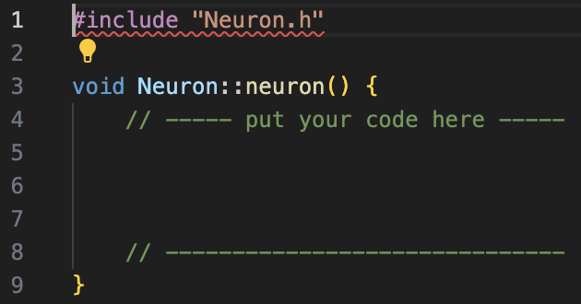

Neuron
Based on Figure 4, complete the function of a neuron.
In this design, ReLU is chosen as the activation function.
$$ReLU(x) = max⁡(0,x)$$
Fig. 5. The behavior of ReLU activation function
Fig. 6. The Lab part of Neuron.cpp

Slide 7
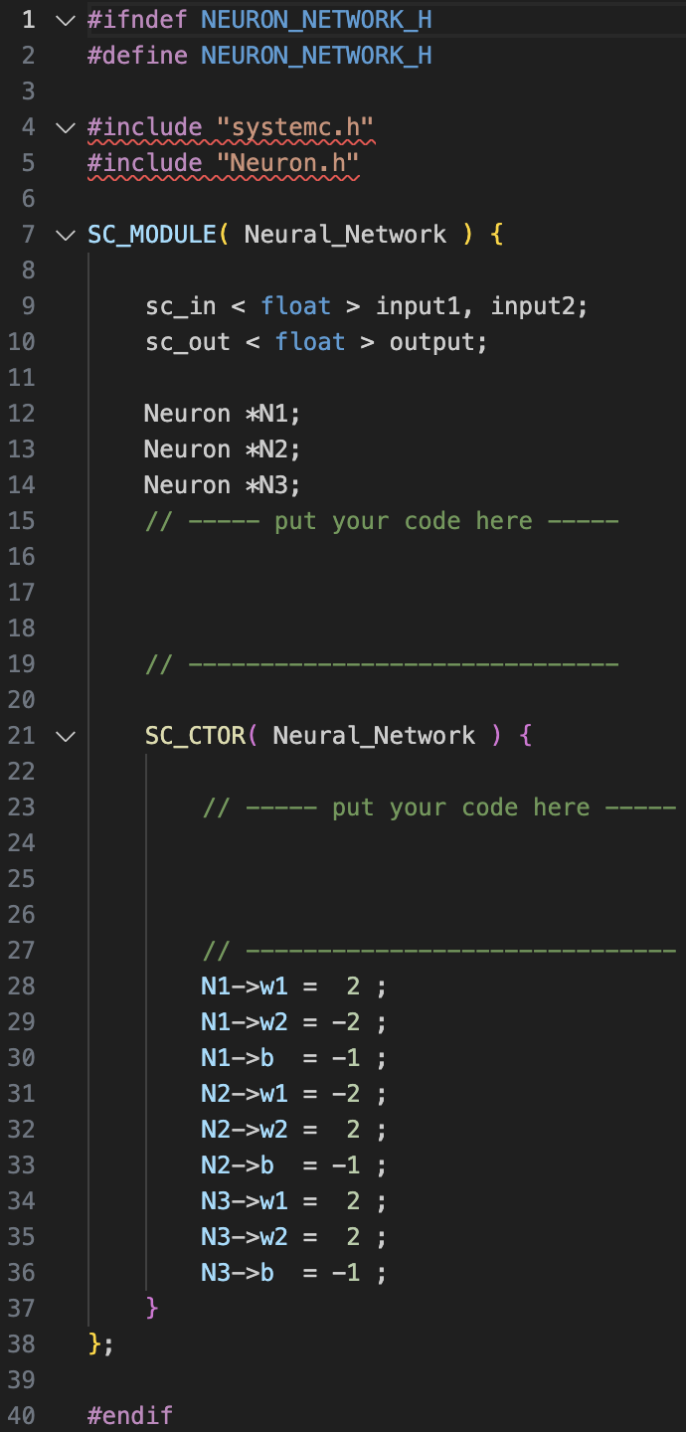





Neural Network
Based on neuron, complete the design of the neural network with the pointer style.
$$X1$$
Neuron 1
Neuron 3
$$X2$$
$$Y$$
$$X1$$
Neuron 2
$$X2$$
Fig. 7. The block diagram of a Neural Network
Fig. 8. The Lab part of Neuron_Network.h

Slide 8
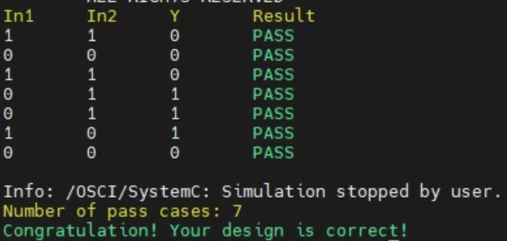
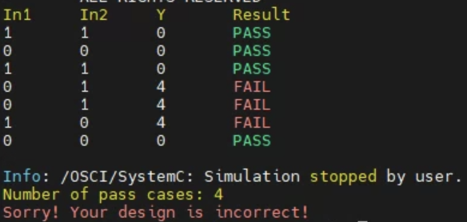
Score
The final report shows “Congratulation! Your design is correct!”.
TAs will take a look at your neuron.cpp and Neuron_Network.cpp.
Fig. 9. The two final reports

Slide 9
Command List
Extract files from TA’s directory:
$ tar -xvf ~DCSTA01/Lab01.tar
Compile & Run SystemC source code:
$ ./01_systemc
Clean SystemC executable file:
$ ./09_clean
Hand in your Lab: there are two steps
$ ./10_tar && ./11_tar
Hand in your Lab01.tar file to E3.

