Slide 1


Silentvault – a password based zero knowledge file server
JMJ
Author:
Std. Sgt. Codreanu Andrei-Daniel

Slide 2
Table of contents
Introduction
SilentVault’s architecture
Comparison to classical authentication methods
The math behind
Wireshark-captured traffic

Slide 3
1. Introduction
A file server is a client-server storage system where clients store their data ‘in the cloud’;
Clients’ data are considered sensitive information; thus, it needs to be protected from malicious entities;
From a Cryptographic POV, “Zero Knowledge” refers to information regarding each client that is available to the server, zero being the preferred value;
The server acts only as an ‘untrusted’ worker.

Slide 4
2. Silentvault’s architecture
Overview
SilentVault has been created only as a proof of concept for zero-knowledge password base authentication. Thus, the application’s architecture is minimal and main components include:
Client module – responsible for authentication and file requests (i.e. upload, download, checking and deletion). Is considered a semi-reliable environment
Server module – manages sessions and storage
CryptoService – implements a Schnorr-like protocol
Payload and resolver layers for protocol abstraction
Communication is made over a secure TLS channel

Slide 5
2. Silentvault’s architecture
Functionalities &
responsibilities
Functionalities:
Clients can upload files to the server, download previously uploaded files, check a list of all their files on the server and demand the server to delete a file;
The Server manages users’ files and public data and implement a minimal CLI with logging capabilities.
Responsibilities
Clients execute the mathematical equations for authentication;
Clients manage the encryption of the files about to be uploaded.
The Server acts as a ‘worker’ for the client. It cannot validate passwords or initiate authentications on behalf of any client.

Slide 6
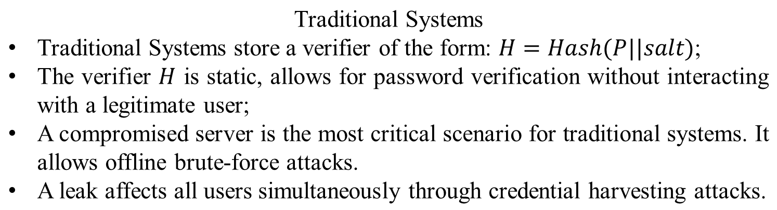
3. Comparison to classical authentication methods

Slide 7
3. Comparison to classical authentication methods
Zero Knowledge Approach
Only public values are stored – a compromised server reveals data with no practical value for authentication.
Authentication is achieved using a protocol in which a client proves their knowledge of the secret without revealing it.
Each authentication is unique and user validation cannot be verified offline.
Secret data cannot be harvested – reduces the risk of a chain reaction.

Slide 8
3. Comparison to classical authentication methods
Property | Classical Auth | Zero Knowledge
Password Exposure | Indirect | None
Reusable Verifier | Yes | No
Offline Attack | Yes | No
Replay Attack | Possible | Impossible
Server Compromise | Critical | Limited
TLS Dependency | Yes | No
Complexity | Low | High
Message Count | Low | High (interactive)
Computational Cost | Low | High

Slide 9
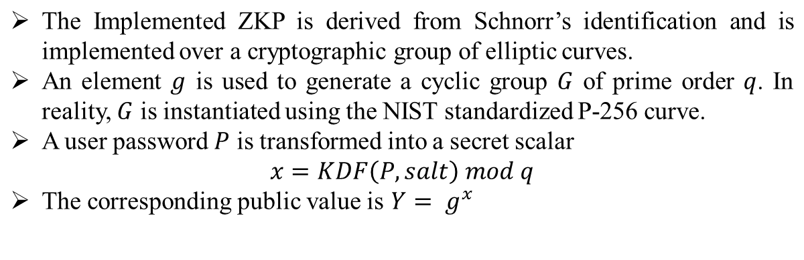
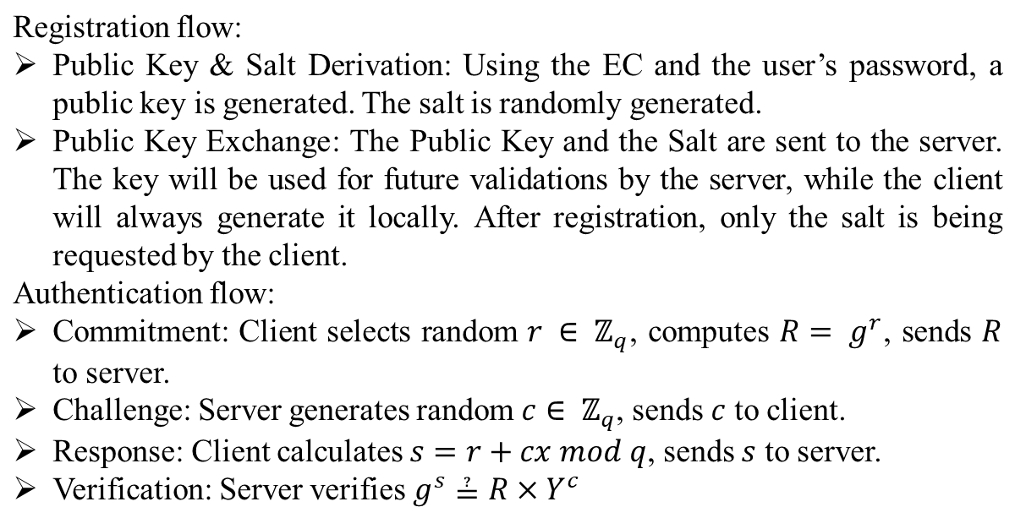
4. The math behind

Slide 10
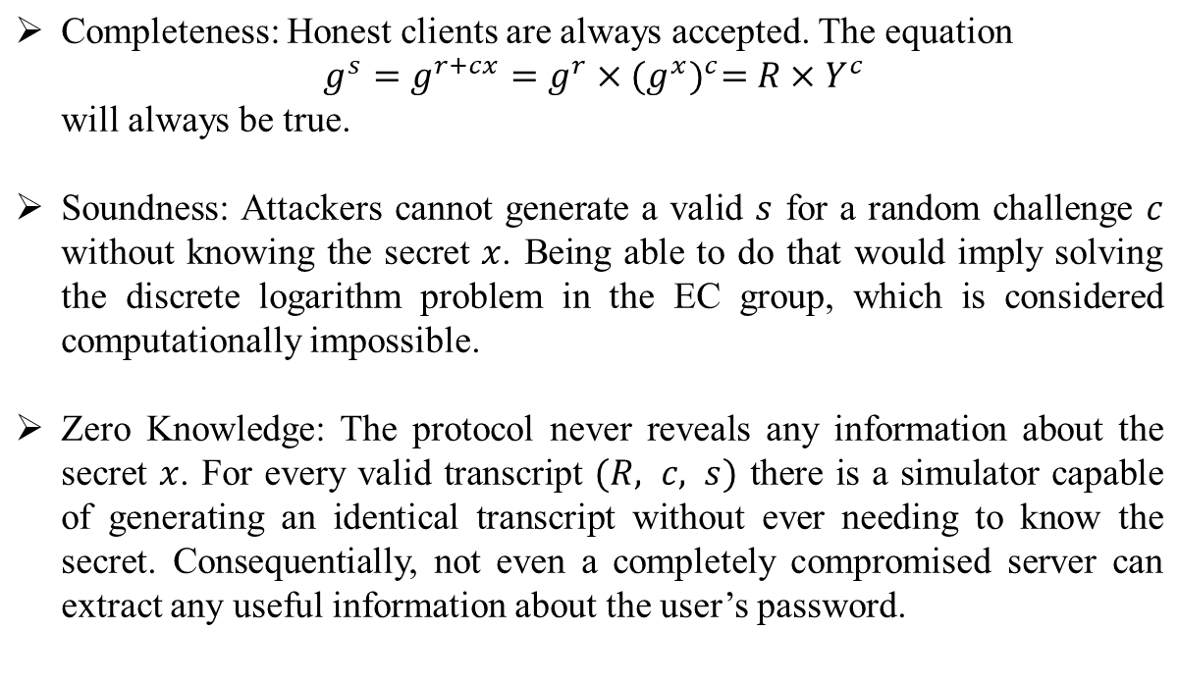
4. The math behind
Security properties

Slide 11
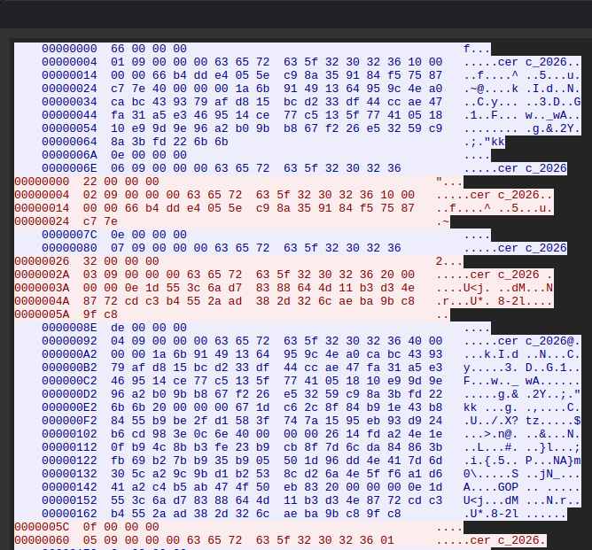
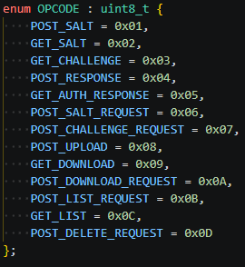
5. Wireshark captured traffic

Slide 12
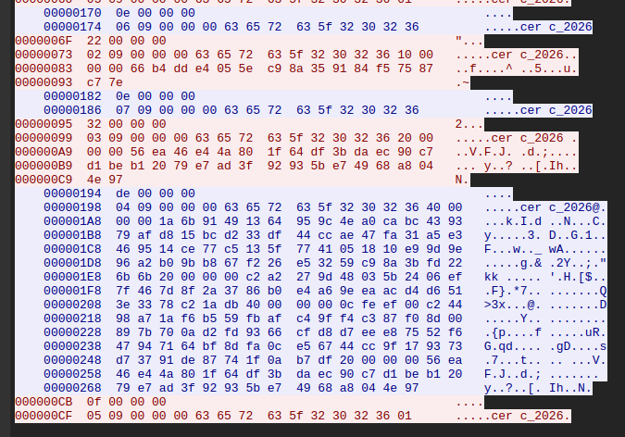
5. Wireshark captured traffic

Slide 13
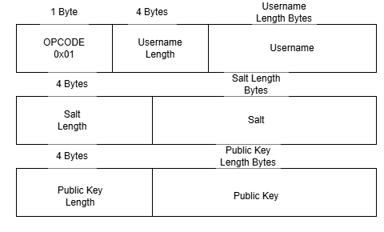
5. Wireshark captured traffic
Payload Header for sending salt and public to server

Slide 14
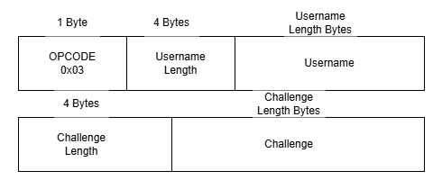
5. Wireshark captured traffic
Payload Header for getting a challenge from the server

Slide 15
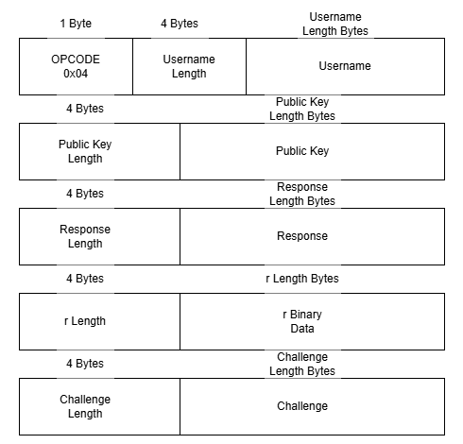
5. Wireshark captured traffic
Payload Header for sending the challenge response to the server

Slide 16

Silentvault – a password based zero knowledge file server
https://www.github.com/RexGloriae/SilentVault

