Slide 1

CactAI
Accountability-based security for small teams
A cactus doesn't chase you. It just makes touching it a bad idea.
Cybersecurity + AI · AI For Impact Hackathon 2026 · Erick Sientaro · Ishmail · Hozen
Notes:
Ishmail: do not read the slide. Go straight into the hook on slide 2.

Slide 2
A REAL PDPC CASE
The breach that was warned about
Dec 2020
Unfixed
Feb 2021
S$10,000
Pentest finds an SQL injection hole
The developer never patched it
4,625 students' data for sale on the dark web
PDPC fine. The company learned of it from the regulator
“The vulnerability was left unfixed until the Incident happened.”
Missing response, not missing alert.
ChampionTutor Inc. (Private Limited), PDPC decision DP-2103-B7984, published 14 Oct 2021, para 2.
2
Notes:
Ishmail, about 15 seconds: "In December 2020, a Singapore tuition platform's own security test found a hole in its website. Nobody fixed it. Two months later, 4,625 students' details were for sale on the dark web, and the company only found out when the regulator told them." The point: the alert existed.

Slide 3
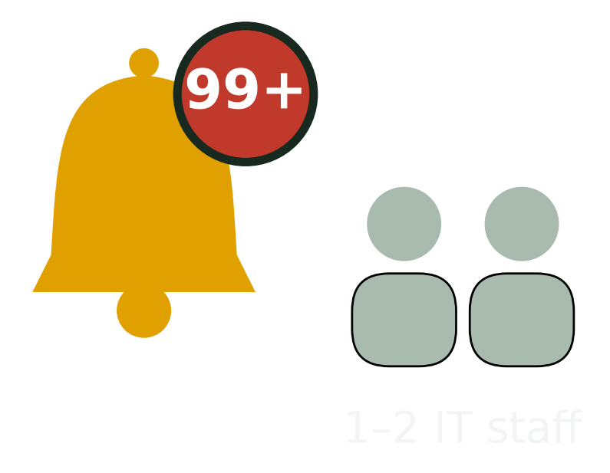
WHY SMALL TEAMS GET BREACHED
The problem
▪ Singapore SMEs and private schools hold lots of personal data, with one or two IT staff
▪ No 24/7 security team, so alerts pile up and get ignored (alert fatigue)
▪ PDPA fines: up to S$1M or 10% of Singapore turnover, whichever is higher
▪ After a breach, no one can prove who knew what, and when
PDPA s48J (PDPC Guide on Active Enforcement, Oct 2022). 10% limb applies where Singapore turnover exceeds S$10M.
3
Notes:
Ishmail: "They already get alerts. The breach happens because nobody acts on them in time." PDPA figure: up to S$1M, or 10% of Singapore turnover if it exceeds S$10M, whichever is higher (s48J, since 1 Oct 2022).

Slide 4
THE IDEA
CactAI in one sentence
Scores your risk from 0 to 100 across web, database and OS, warns the people you choose, and past your own tolerance line applies a temporary, reversible fix, with a tamper-evident record.
Warn
Remind
Contain
Report
→
→
→
Alert the on-duty operator
SLA missed: remind, copy the lead
Temporary block, 2h expiry
Evidence report + audit chain
4
Notes:
Ishmail: stress "your own tolerance line" and "temporary". Humans stay in charge.

Slide 5
TWO PRINCIPLES
CIA + NA
CIA
NA
Protect the data
Prove who did what
▪ Confidentiality
▪ Integrity
▪ Availability
▪ Non-repudiation: every alert and acknowledgement is hash-chained
▪ Authentication: every decision is tied to a named operator
Result: “I was never notified” is no longer an excuse.
5
Notes:
Hozen: be honest. We prove delivery and acknowledgement, not that someone read it. The report says "Ack: none", not "they saw it".

Slide 6
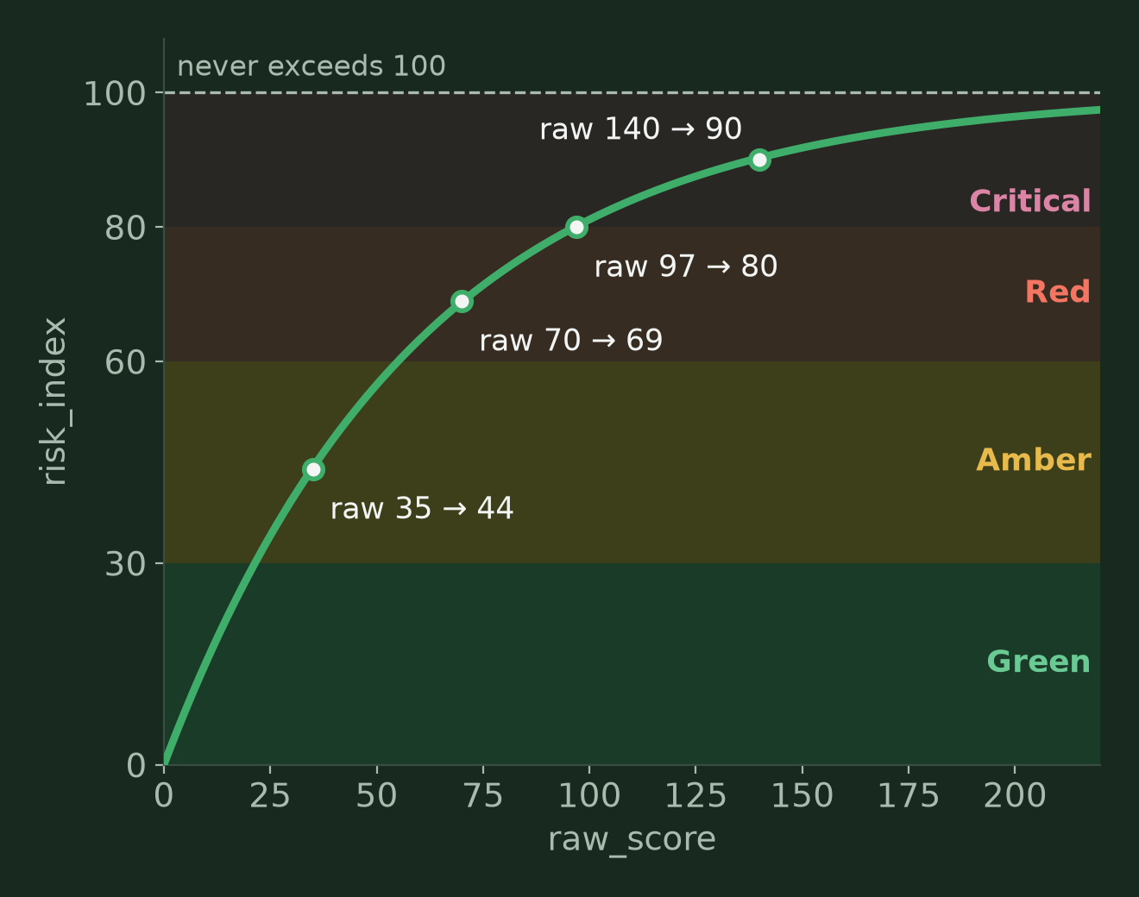
HOW RISK IS SCORED
The 0 to 100 risk index
points = base × confidence × criticality
raw = Σ points + inaction penalty
index = 100 × (1 − e^(−raw / 60))
▪ Inaction penalty: +5 per hour unacknowledged, capped at +30
▪ Bands: Green 0–29 · Amber 30–59 · Red 60–79 · Critical 80–100
▪ Threshold is set by each organization
6
Notes:
Erick: executives read 0 to 100 instantly. The curve means stacking incidents can never push it past 100. Severity examples: brute force 30, SQL injection 40, shell spawned 60, bulk data dump 70.

Slide 7
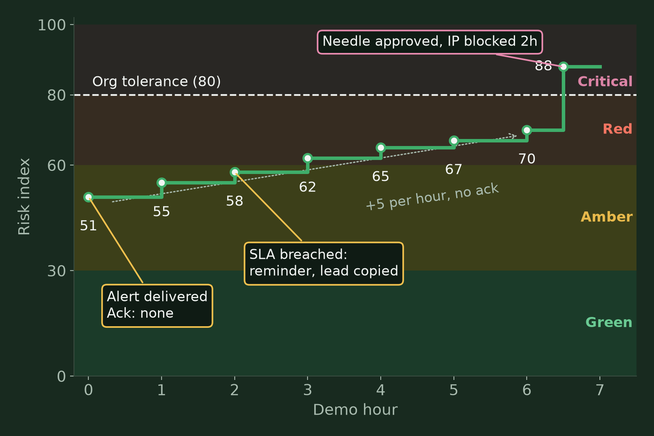
ESCALATION OVER TIME
Risk grows when nobody acts
▪ Brute force detected: index jumps into Amber
▪ Alert delivered, no acknowledgement: +5 every hour
▪ SLA (2h) breached: reminder, team lead copied
▪ SQL injection lands on a neglected system: crosses 80, Needle approves a 2h block
7
Notes:
Erick: the slope between hour 0 and 6 is entirely caused by inaction. That is the accountability story in one picture. Brute force 30 × 0.94 × 1.5 = 42.3 points; SQL injection ≈ 54. Replace with the values from the recorded take if they differ.

Slide 8
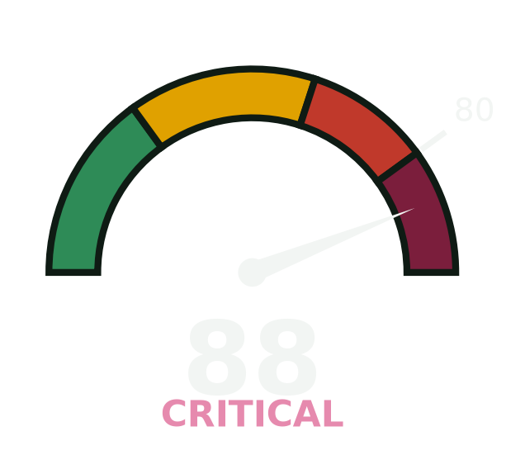
WHAT YOU WILL SEE
Live demo
▪ Lab student portal with synthetic member data, all on localhost
▪ Brute force → classified → operator alert ignored
▪ Inaction penalty climbs → SQL injection → crosses 80
▪ Needle approves → IP blocked for 2h → evidence report → a human decides
8
Notes:
Erick: say if the attack is a replay and if Jev is in fallback mode. Judges respect honesty more than polish. Replace the gauge with a screenshot of the dashboard at the moment the gauge crosses 80.

Slide 9
FOR LEADERSHIP
The Security Evidence Report
Responsible entity
On-duty operator and shift
SLA violation
Overdue by 4h 30m (policy 2h)
Timeline
Detected → alert delivered → reminder → threshold crossed
Acknowledgement
Ack: none
Forced action
IP blocked, 2h expiry, approved by Needle
#41 alert delivered
→
#42 Needle approved
→
#43 operator rollback
✔ chain valid
9
Notes:
Ishmail: this is for leadership, not to punish. It shows where the process failed so it can be fixed. It is fact-based: delivered, acknowledged or not, and what the system did. Use the real report from the Reports page for the screenshot if time allows.

Slide 10

THE SPINES STAY ON THE CACTUS
Ethics: no hack back
▪ CactAI never attacks back.
▪ Hacking back is a crime in Singapore: Computer Misuse Act s3 (access), s5 (modification), s7 (obstruction)
▪ Attacker IPs are often spoofed or hijacked innocent machines
▪ Our “prick”: block, tarpit, honeypots and honeytokens, evidence to SingCERT or the police
Computer Misuse Act 1993 (2020 Rev. Ed.), ss 3, 5, 7: sso.agc.gov.sg/Act/CMA1993
10
Notes:
Hozen: the attacker is pricked by attribution and prosecution, not retaliation. There is no self-defence exception in the Computer Misuse Act.

Slide 11
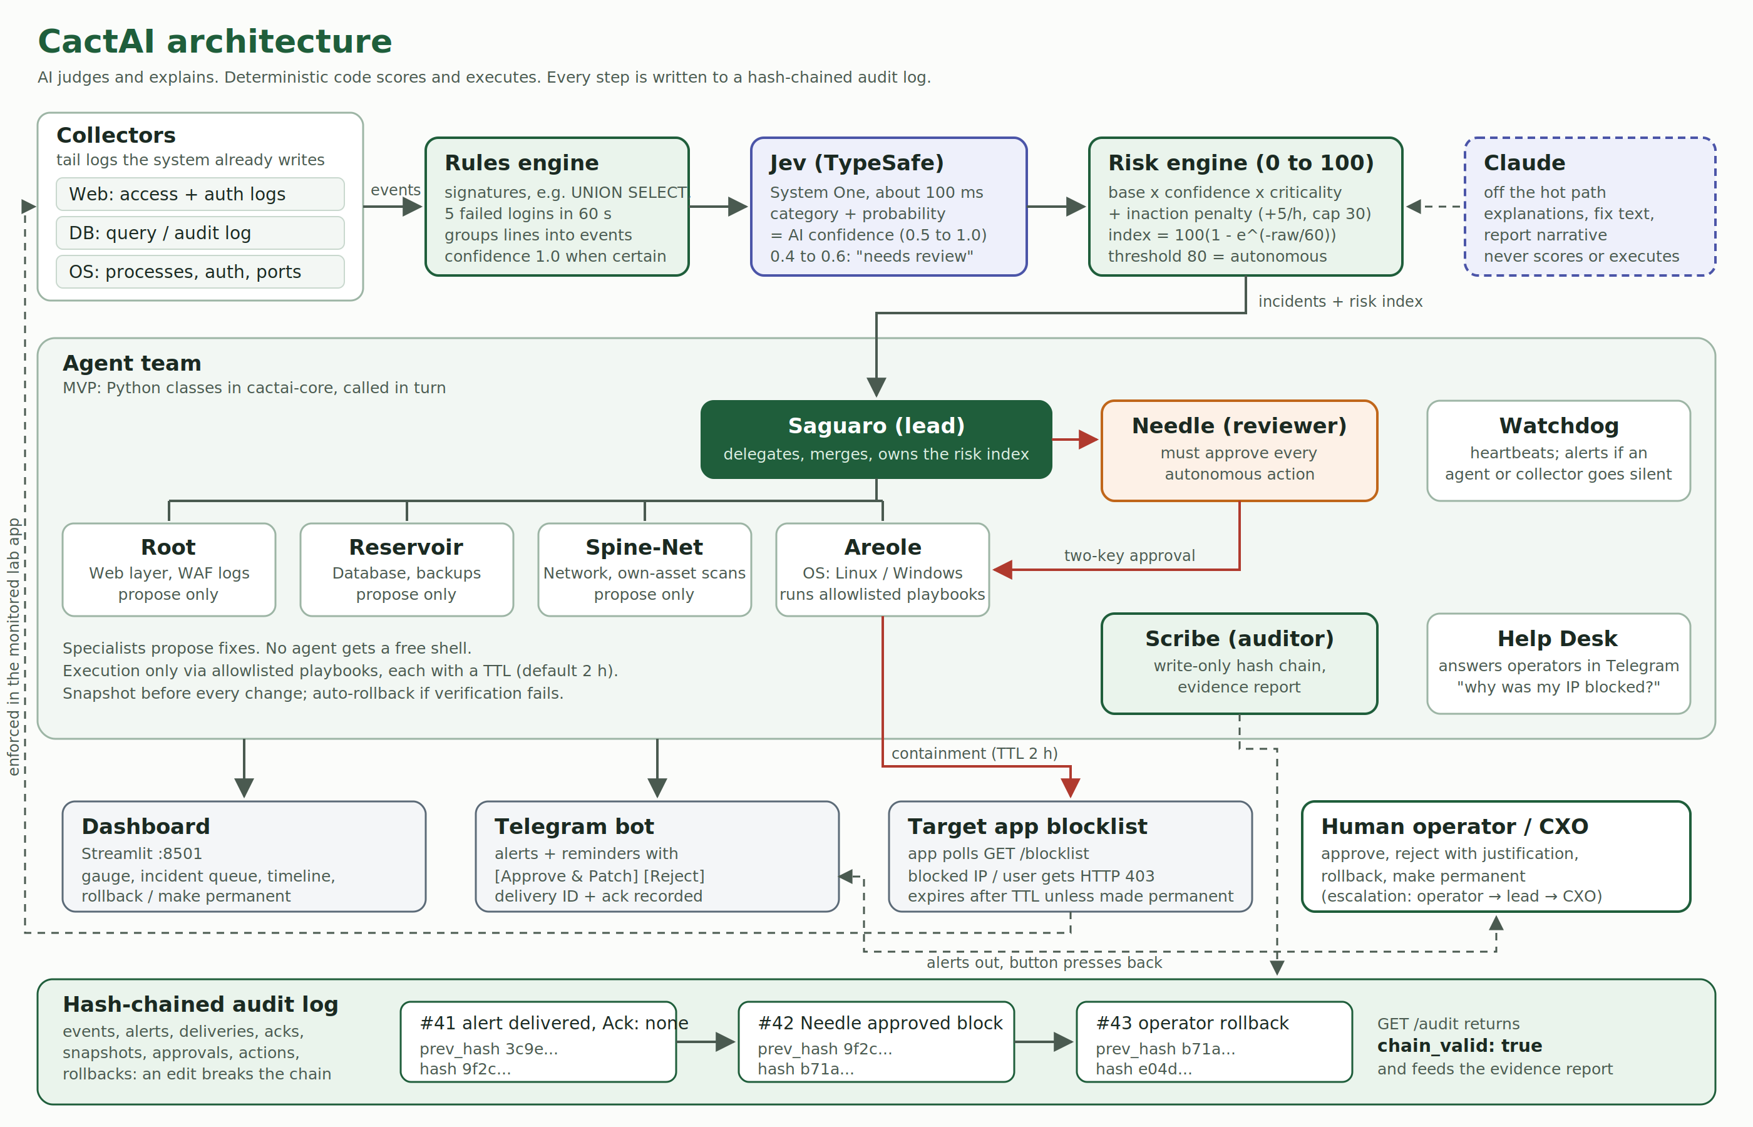
HOW IT FITS TOGETHER
Agent architecture
11
Notes:
Erick: in the MVP the agents are Python classes in one core service, called in turn; separate services are on the roadmap. No agent has a free shell: only allowlisted playbooks with a TTL. AI judges and explains. Deterministic code scores and executes.

Slide 12
WHAT'S NEXT
Roadmap and team
Now (MVP)
Next
Later
▪ Web, DB and OS collectors
▪ Rules → Jev → fallback classifier
▪ Cyanide AI planner + Needle two-key rule
▪ Blocklist containment with 2h TTL
▪ Evidence report + hash chain
▪ Real firewall blocking (iptables, netsh)
▪ Tarpit, honeypots, honeytokens
▪ Windows Event Log agent
▪ Cloud config scan (S3, security groups)
▪ Single-binary collectors
▪ Agents as separate services
▪ Pilot with a Singapore private school
Erick Sientaro
Ishmail
Hozen
Developer
CEO, pitch
Slides and sources
12
Notes:
Ishmail closes: "Alerts tell you something is wrong. CactAI makes sure someone answers, and proves it when they don't."

Slide 13
SOURCES
References
▪ PDPC, Breach of the Protection Obligation by ChampionTutor Inc. (Private Limited), DP-2103-B7984, 14 Oct 2021
▪ PDPC, Guide on Active Enforcement (revised 1 Oct 2022): financial penalties under PDPA s48J
▪ Computer Misuse Act 1993 (2020 Rev. Ed.), sections 3, 5 and 7, Singapore Statutes Online
▪ TypeSafe System One (Jev) documentation, docs.typesafe.ai
▪ Code and plan: github.com/RexGuard/cactai · rexguard.github.io/cactai
13
Notes:
Optional. Leave on screen at the end or skip in the video.

