Slide 1
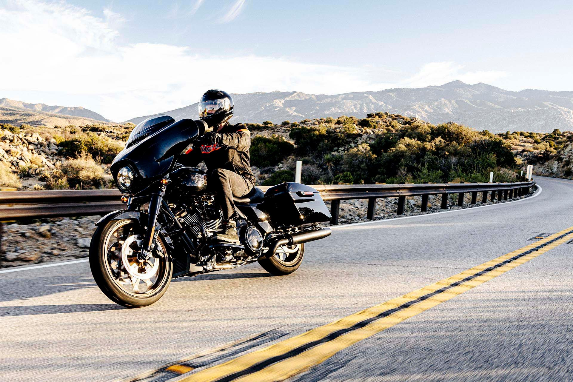

Harley-Davidson, Inc. (HOG:NYSE)
Wisdom Seeds Success
Recommendation : BUY | Target Price : $68 | Closing Price : $20.11 | Upside : 238%
Notes:
Range of target price like 60-65

Slide 2
Thesis
BUY: Strategic and newfound financial flexibility
Addressing long-term demographic issue
Launch of the Sprint bike
Funded by HDFS deal
The current price represents concerns regarding any future profitability, which is not reflective of the financial reality of the firm
Notes:
We believe that Harley is a BUY given its strategic outlook and newfound financial flexibility. Through its financial flexibility Harley has shifted it’s focus to targeting the younger riders addressing their long -erm demographic issue in which riders are aging out of their riding years. Through the HDFS deal, HDMC is sitting on 300 million which allows for the strategic shift and aggressive investment in the small displacement Sprint.
Trading at a __ p/e.
Valuation does not reflect this.
Valuation has not priced it in
Summarize thesis by: addressing long term
How do you get from 3.44 to 5.74 –> share buy backs
2033 – 4.74 earnings and 5.7 b sales
Went down to .36 earning and sales of 4
So how did we get to 5.74 in 2027? Margins are going from 12% to 9% and shares 30%
P/E of 10 assuming same p/e as in 2023 which is conservative
Debt to asset

Slide 3
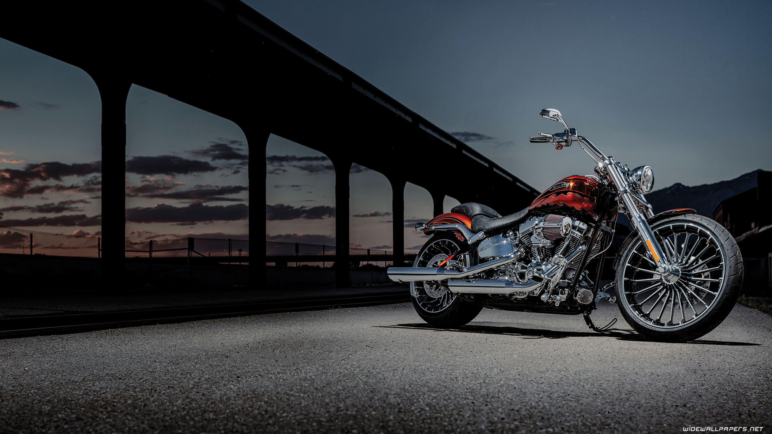
Business Description

Slide 4



Segment Description
HDFS
HMC
LVWR
Provides financing for motorcycle purchases
Generates revenue from selling contracts to outside firms
Sold 2/3 of the segment in 2025
Core brand focused on premium cruisers
High-margin bikes and brand apparel support profitability
A small moonshot bet on the future of electrification
Overview
Driver
Financials
Valuation
ESG
Risks
Appendix
Source: FactSet, Harley Investor Relations, HOG 2025 Q1-Q4

Slide 5
Revenue Breakdown
2025 Revenues by Region
North America
Canada
EMEA
Asia Pacific
Latin America
62%
5%
16%
14%
2%
Sales Growth
% of Revenues by Segment
Livewire, <1%
Harley-Davidson Financial Services, 20%
Harley Davidson Motor Company, 79%
Overview
Driver
Financials
Valuation
ESG
Risks
Appendix
Source: FactSet, Harley Investor Relations, HOG 2025 Q1-Q4

Slide 6
Industry Overview
Harley vs Comps Price (Indexed)
 | Harley Prices | Peer Average Prices
Heavyweight Cruisers | 15k - 24k | 9.5k - 17k
Middleweight Cruisers | 8k - 14k | 6k - 11.5k
Dominant in the heavyweight market but is slowest growing market segment
2026 is a transition year
Competition in foreign markets
Harley Bike Sales by Model
Comps Sheet
Ticker | Name | Market Value | P/E TTM | P/B | EV/ EBITDA | Net Margin | ROIC | ROE | ($B) LTM Sales
HOG | Harley | $2,398 | 4.9 | 1.18 | 14.9 | 8.8% | 5.7% | 14.2% | 4.7
HMC | Honda | $39,783 | 10.2 | 0.47 | 4.8 | 3.9% | 4.3% | 6.6% | 144.3
YAMHF | Yamaha | $3,328 | 28.9 | 1.18 | 7.6 | 4.2% | 7.4% | 9.7% | 16.8
SZKMF | Suzuki | $27,606 | 10.5 | 1.12 | 4.8 | 7.1% | 12.8% | 14.6% | 39.1
BAMXF | BMW | $62,823 | 8.2 | 0.62 | 7.0 | 5.1% | 5.0% | 8.0% | 150.6
Average | - | $27,188 | 12.5 | 0.91 | 7.8 | 5.8% | 7.0% | 10.6% | 71.1
Median | - | $27,606 | 10.2 | 1.12 | 7.0 | 5.1% | 5.7% | 9.7% | 39.1
Overview
Driver
Financials
Valuation
ESG
Risks
Appendix
Source: FactSet, Harley Investor Relations, HOG 2025 Q1-Q4
Notes:
25% market share ← prove this change visuals
Say: why have they been underperforming bc we are dominant in the heavyweight cruisers which targets older demographic and not in the younger demographic

Slide 7
Business Drivers

Slide 8
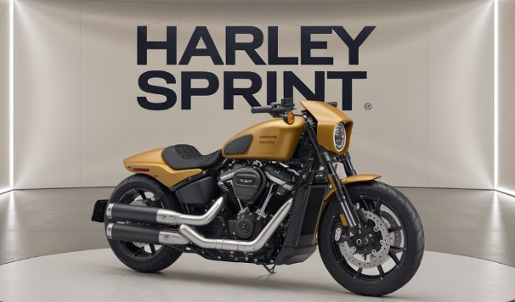
Driver 1: Lower Displacement Penetration
Motorcycle Riders in the U.S. by Age
Sprint Bike
Demographic shift as Harley’s riders age out of their riding years
Affordable models like the Sprint serve as entry-level bikes that target the younger riders
Global Total Annual Units of Small Displacement
Small Displacement Motorcycles by Region
56M
Never been able to be done before due to lack of resources
38M
HDFS deal provides the financial flexibility needed
Overview
Driver
Financials
Valuation
ESG
Risks
Appendix
Source: FactSet, Harley Investor Relations, HOG 2025 Q1-Q4, Datainsightsmarket, Motor & Wheels
Notes:
Smaller displacement bikes are almost none existent in US so this sprint bike will penetrate the market
Blast
Why didn’t they do this before because they didn’t have the financial flexibility they have due to the financial service deal we brought in new management
People running the operations part lasted only less than a year
We had 4 new people come in

Slide 9
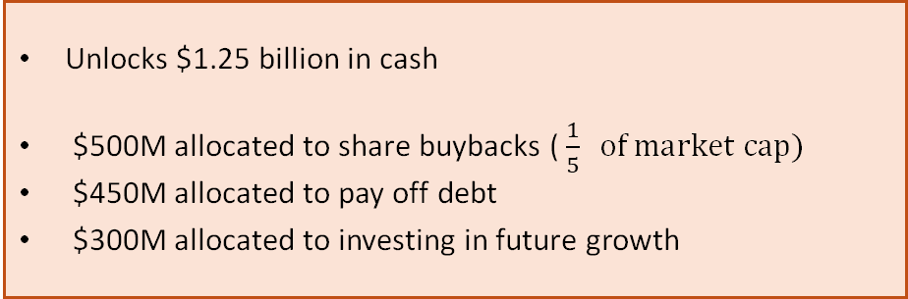
Driver 2: HDFS Transaction
Agreement to sell two-thirds of the segment to two outside firms (PIMCO, KKR)
Buybacks Lead to EPS Growth
Future Investments (36%)
Share Buybacks (40%)
Unlocks $1.25 billion in cash
$500M allocated to share buybacks ( $\frac{1}{5} of market cap)$
$450M allocated to pay off debt
$300M allocated to investing in future growth
Payoff Debt (24%)
Overview
Driver
Financials
Valuation
ESG
Risks
Appendix
Source: FactSet, Harley Investor Relations, HOG 2025 Q1-Q4
Notes:
Scale things 500 M is what percent of the stock → 1/5th
Transition to fund sprint launch
What percent of the debt are they paying off?
How does this change or debt to cap ratio? --- goes from x to x --- quantify the impact of this

Slide 10
Financial Analysis
Finances Guiding Innovation

Slide 11
The HDFS Transaction Timeline
Q3 2025 | Q4 2025 | 2026 and on
Credit Loss Reversal: $301M gain on paper Asset Reclassification: $4.1B in loans moved to "Held-for-Sale," effectively removing them from long-term risk | The $1B Dividend: HDFS officially transferred $1 billion in cash to the parent company, which was used to fund share buybacks Debt Reduction: HDFS debt dropped from $6.1B to $2.7B. The company paid $73M in one-time costs | Forward Flow Agreement: KKR and PIMCO entered a five-year agreement to purchase two-thirds of HDFS's future annual retail loan originations Servicing Fees: HDFS generates new revenue by charging KKR and PIMCO a fixed servicing fee for the loans they purchase: 1.0% for prime loans and 2.5% for subprime loans
This transaction reduces income by 30%, reduces share count by 20%, substantially reduces debt and adds $300M cash to the balance sheet to invest in growth
Overview
Driver
Financials
Valuation
ESG
Risks
Appendix
Source: FactSet, Harley Investor Relations, HOG 2025 Q1-Q4
Notes:
What is the loss of earnings from this sell?
Sold 2/3 of the business loss of 1/3 of profits and buying back around 20% of shares and picking up servicing fee so its slightly dilutive. We are using the money to reduce financial risk and invest in the future
Quantify this

Slide 12
The Income Problem
At first glance, Harley-Davidson's 2025 Q3 financial statements show a dramatic year-over-year increase in profitability, though it was largely driven by a one-time strategic maneuver
$301 Million of the $339 Million 2025 net income was attributable to a credit loss reversal
Livewire reported a net loss of $75 Million
2025 Reported EPS(Diluted) = $2.78
- Credit Loss Reversal Portion ($301M/122.12M Shares) = $2.46
Adjusted EPS = $0.32
Current Share Price $20.26/Adjusted EPS of $0.32
Adjusted TTM PE of 63.31x
Metric | 2025 | Adjusted 2025 | 2024 | YOY Change | Adjusted YOY Change
Consolidated Revenue | $4.47 Billion | $4.47 Billion | $5.19 Billion | -14% | -14%
Net Income | $339 Million | $38 Million | $455 Million | -25% | -92%
Diluted EPS | $2.78 | $0.32 | $3.44 | -19% | -91%
PE (TTM) | 7.81x | 63.31x | 7.49 | +4% | 745%
Cash Position | $3.09 Billion | $3.09 Billion | $1.73 Billion | +79% | +79%
Overview
Driver
Financials
Valuation
ESG
Risks
Appendix
Source: FactSet, Harley Investor Relations, HOG 2025 Q1-Q4
Notes:
Need Du Pont ROE
How do you go from

Slide 13
The Tariff Drain
EBIT Margin Slowly Rebounds
Cumulative Cost in 2025 of $67 Million
Senior management have projected $75 to $105 Million in Tariff expenses for 2026
To combat this, the “Transition Year” strategy was announced to align wholesale shipments with retail demand and save $150 Million annually
We believe that EBIT margins will continue on a downward trend until 2027, which will mark a multi-year march up to historical eps as tariffs move to the rear-view mirror
Tariffs Reduced 2025 Adj. EPS by 64%
Overview
Driver
Financials
Valuation
ESG
Risks
Appendix
Source: FactSet, Harley Investor Relations, HOG 2025 Q1-Q4
Notes:
Quantify all of this to eps --- slides

Slide 14
Buying Back
Harley bought back almost a fourth of it’s existing shares over the past five years
Price = Price/Earnings*Earnings
As shares decrease, we expect
EPS to increase especially if earnings increase, and even if earnings moderately decline
A higher PE to reflect that EPS Growth
In summary, buybacks offer more upside potential and more downside insulation
Overview
Driver
Financials
Valuation
ESG
Risks
Appendix
Source: FactSet, Harley Investor Relations, HOG 2025 Q1-Q4
Notes:
Fewer words

Slide 15
Valuation
It’s Time To Buy

Slide 16
We calculated a 12-month target price of $67.99
Valuation
Sales Revenue Estimates
Price Target
PV Cash Flows | $12.21
Terminal Value | $55.78
Price Target | $67.99
Cost of Equity
Market Return |  | 10.0%
Risk Free Rate |  | 4.07%
Market Risk Prem. |  | 5.9%
Beta |  | 1.19
Stock Risk Prem. |  | 7.1%
r = rf + stock RP |  | 11.1%
WACC Calculation
AT - Cost of Debt |  | 4.78%
Cost of Equity |  | 11.1%
Weight of Debt |  | 89.7%
Weight of Equity |  | 10.3%
WACC |  | 4.57%
DCF Base
 | 2020 | 2021 | 2022 | 2023 | 2024 | 2025 | 2026E | 2027E | 2028E | 2029E | 2030E | 2031E
Net income | $1 | $650 | $739 | $695 | $445 | $38 | $10 | $181 | $333 | $465 | $621 | $685
% of sales | 0.0% | 12.2% | 12.8% | 11.9% | 8.6% | 0.9% | 0.2% | 3.6% | 6.0% | 7.6% | 9.2% | 9.2%
EPS | $0.01 | $4.23 | $5.07 | $5.10 | $3.58 | $0.34 | $0.11 | $2.09 | $4.06 | $6.04 | $8.26 | $9.31
Growth |  | 49770.2% | 19.7% | 0.6% | -29.8% | -90.4% | -67.2% | 1751.6% | 94.4% | 48.8% | 36.7% | 12.7%
Terminal P/E |  |  |  |  |  |  |  |  |  |  |  | 10.00
* Terminal EPS |  |  |  |  |  |  |  |  |  |  |  | $9.31
Terminal value |  |  |  |  |  |  |  |  |  |  |  | $93.09
* Discount factor |  |  |  |  |  |  |  |  |  |  |  | 0.60
Discounted terminal value |  |  |  |  |  |  |  |  |  |  |  | $55.78
First Stage |  |  |  |  |  |  |  |  |  |  |  | $12.21
Value P/E |  |  |  |  |  |  |  |  |  |  |  | $67.99
${(FCFE1/(1+r)}^{1}$ + …${{(FCFE}_{6}/(1+r)}^{6}$ ) +(${(EPS}_{6}$*${PE}_{6}$) ${/(1+r)}^{6}$ ) = V
${PV\left({FCFE}_{1→6}\right)+PV(EPS}_{6}$*${PE}_{6}$) = V
$\$12.21+PV\left(\$9.31∗10\right)$ = V
$\$12.21+\$55.78$= $67.99
Overview
Driver
Financials
Valuation
ESG
Risks
Appendix
Source: FactSet, Harley Investor Relations, HOG 2025 Q1-Q4
Notes:
How did we come up with 10. Conservative P/E compared to our comps.
Few years ago trading at a 10 P/E
Conservative p/e bc comps are way higher and market is slow to price this in, still accounting for full credit for earnings recovery

Slide 17
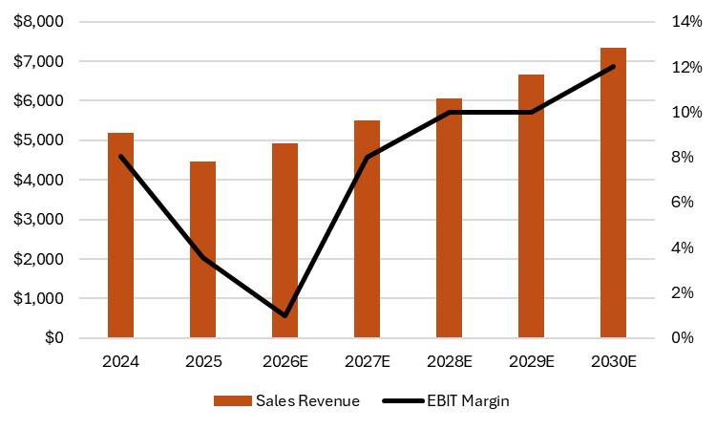
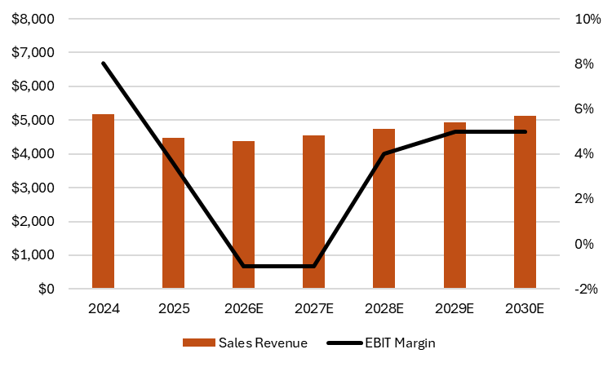
Valuation
​
​ | Price Target​
Bull Case Valuation​ | $82
Base Case Valuation​ | $68
Bear Case Valuation​ | $29
Bull Case
Bear Case
First stage | Terminal value​ | Value ​
$​9.53 | $72.95 | $82.48​
First stage​ | Terminal value​ | Value ​
$17.05 | $12.06 | $29.11
Terminal P/E​ | 12.00
* Terminal EPS​ | $10.15
Terminal value​ | $121.76
* Discount factor​ | 0.60
Discounted terminal value​ | $72.95
First Stage​ | $9.53​
Value P/E​ | $82.48​
Terminal P/E​ | 8.00 ​
* Terminal EPS​ | $2.52 ​
Terminal value​ | $20.13 ​
* Discount factor​ | 0.60 ​
Discounted terminal value​ | $12.06 ​
First Stage​ | $17.05
Value P/E​ | $29.11​
Overview
Driver
Financials
Valuation
ESG
Risks
Appendix
Source: FactSet, Harley Investor Relations, HOG 2025 Q1-Q4
Notes:
Bull case 10-12 growth rate 10 in 2026 and 12 and 2027 Bear has a growth of -2 in 2026 and 4 in 2027

Slide 18
Environmental, Social & Governance
Long Term Transition Remains Manageable

Slide 19
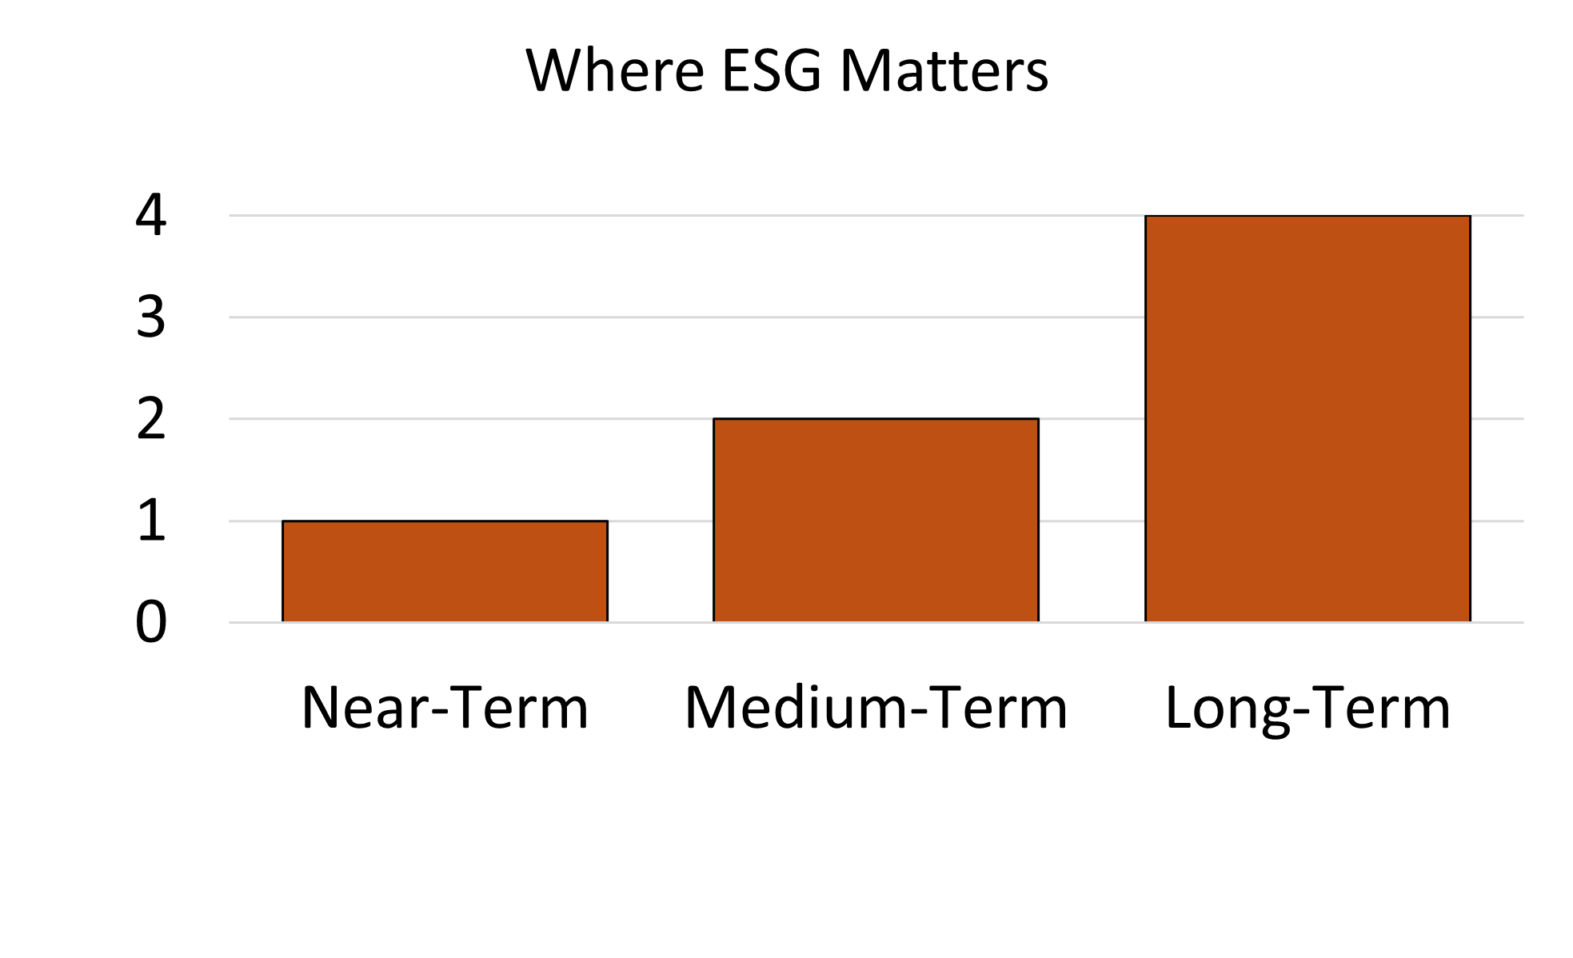
Environmental, Social & Governance
Environmental
Social
Regulation affects the future
Tightening emissions standards
Livewire enables electrification
Manufacturing lower cc bikes
No near-term demand impact
Result: Impacts future growth, not today’s profits
Stable Drivers
Strong brand loyalty
No material labor or regulatory controversies
Headwinds
Aging demographic
Younger rider adoption slower
0-5Y 5-10Y 10Y+
Investment Interpretation
Environmental and Social considerations positively influence long-term growth assumptions but do not impair near-term cash flows or margins.
Overview
Driver
Financials
Valuation
ESG
Risks
Appendix
Source: FactSet, Harley Investor Relations, HOG 2025 Q1-Q4
Notes:
75% of the board is independent and CEO is not the share person
Most operation managers don’t last longer than a year
Change low,medium, high
Small cc for environmental
Social: diversity? How many women?

Slide 20
Environmental, Social & Governance
Board Independence
Shareholder Alignment
• Independent board oversight • Strong shareholder voting rights • No structural control provisions • 50% board diversity (female or other)
Remaining ESG Considerations
• No dual board and chair • Risk in executing electrification strategy
• 39% of board and management renewed within the past year
Category | Weight | Score
Environmental | 0.333 | 60.0%
Social | 0.333 | 53.3%
Governance | 0.333 | 50.0%
Total ESG score | 1 | 54.4%
Overview
Driver
Financials
Valuation
ESG
Risks
Appendix
Source: FactSet, Harley Investor Relations, HOG 2025 Q1-Q4
Notes:
CEO is not chairman
Managers/leadership don’t last less than a year

Slide 21
Investment Risks
Demographic Solutions For a Tough Market

Slide 22
Investment Risks
Investment Risk Heat Map
Motorcycle Riders in the U.S. by Age Group
c
Risk
MF1
MS1
Revenue if Sprint Bike Succeeds
Revenue if Sprint Bike Fails
Impact
Category | Challenge | Mitigation
[M1] | Aging rider base and high-cost barrier for younger riders | 2026 debut of the $6k Sprint line to attract younger, budget-conscious riders
Overview
Driver
Financials
Valuation
ESG
Risks
Appendix
Source: FactSet, Harley Investor Relations, HOG 2025 Q1-Q4, Motor & Wheels

Slide 23
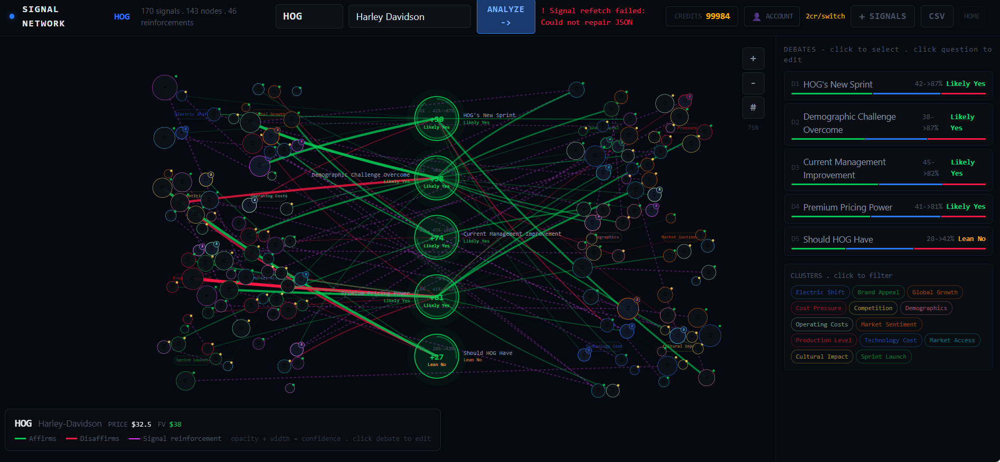
Investment Risks
Overview
Driver
Financials
Valuation
ESG
Risks
Appendix
Overview
Driver
Financials
Valuation
ESG
Risks
Appendix
Notes:
We worked with an n house AI model that scrapes data from the internet that is reliable, recent, and applicable like the SEC Edgar and investor relations and weights it by relevancy to answer the questions posed ,which in this case further supports the success of the Sprint Bike mitigating Harleys demographic issue. If investor sentiment across the web agreed with our thesis.
If it agrees or disagree with our thesis which as we see it does.

Slide 24
Summary
BUY
Industry: Automobile Manufacturing
Sector: Consumer Discretionary
Target Price $68
Closing Price $20.11
Upside 238%

Slide 25
Financial Performance | Valuation
1. Income Statement | 6. DCF Base
2. Balance Sheet | 7. DCF Bull
3. Statement of Cashflows | 8. DCF Bear
4. Facility/Status | Miscellaneous
5. Geographic Segment of Revenue | 9. SWOT Analysis
 | 10. Porter Five Forces
 | 11. Rating Table Breakdown and ESG Ranking
Overview
Driver
Financials
Valuation
ESG
Risks
Appendix
Source: FactSet, Harley Investor Relations, HOG 2025 Q1-Q3
Notes:
Hyperlinks
Appendix on every other slide needs to be linked to the Appendix table of content
60 limit of hyperlink

Slide 26
1. Income Statement
All Figures are in Thousands | 2020 | 2021 | 2022 | 2023 | 2024 | 2025 | 2026E | 2027E
Sales | 4054.4 | 5336.3 | 5755.1 | 5836.5 | 5186.8 | 4472.8 | 4696.5 | 5072.2
%Growth |  | 31.6% | 7.8% | 1.4% | -11.1% | -13.8% | 5.0% | 8.0%
Direct costs | 2874.2 | 3589.6 | 3808.6 | 3759.7 | 3394.6 | 2907.3 | 3287.5 | 3499.8
%Growth |  | 24.9% | 6.1% | -1.3% | -9.7% | -14.4% | 13.1% | 6.5 %
Gross Margin | 1180.2 | 1746.7 | 1946.5 | 2076.8 | 1792.2 | 1565.5 | 1408.9 | 1572.4
SG&A, R&D, D&A, and other | 1170.5 | 923.3 | 1037.2 | 1297.7 | 1375.6 | 1406.3 | 1362.0 | 1318.8
%Growth |  | -21.1% | 12.3% | 25.1% | 6.0% | 2.2% | -3.1% | -3.2%
EBIT | 9.7 | 823.4 | 909.3 | 779.1 | 416.6 | 159.2 | 47.0 | 253.6
%Growth |  | 8407.5% | 10.4% | -14.3% | -46.5% | -61.8% | -70.5% | 440.0%
Net Interest | -23.6 | -24.3 | -26.7 | 16.0 | 27.9 | 25.8 | 25.6 | 27.8
Other | -1.8 | 2.0 | 4.9 | 7.2 | 7.2 | 4.5 | 4.7 | 5.1
EBT | 35.1 | 845.7 | 931.1 | 755.9 | 381.5 | 129.0 | 16.6 | 220.7
Taxes | -17.0 | 169.2 | 192.0 | 171.8 | 72.0 | 25.8 | 3.3 | 44.1
Income | 52.1 | 676.5 | 739.1 | 584.1 | 309.5 | 103.2 | 13.3 | 176.6
Other | 50.8 | 26.5 | -0.1 | -111.0 | -135.7 | 65.0 | 3.0 | 3.0
Net income | 1.3 | 650.0 | 739.2 | 695.0 | 445.2 | 38.2 | 10.3 | 173.6
%Growth |  | 49978.9% | 13.7% | -6.0% | -36.0% | -91.4% | -73.0% | 1582.0%
Basic Shares | 152.93 | 153.57 | 145.86 | 136.31 | 124.28 | 111.18 | 91.48 | 86.48
%Growth |  | 0.4% | -5.0% | -6.5% | -8.8% | -10.5% | -17.7% | -5.5%
Fully Diluted Shares | 153.91 | 154.98 | 149.39 | 145.10 | 132.29 | 119.19 | 99.49 | 94.94
EPS Basic | 0.01 | 4.23 | 5.07 | 5.10 | 3.58 | .34 | .11 | 2.01
%Growth |  | 49770.2% | 19.7% | 0.6% | -29.8% | -90.4% | -67.2% | 1679.3%
EPS Fully Diluted | 0.01 | 4.19 | 4.95 | 4.79 | 3.37 | .32 | .10 | 1.84
%Growth |  | 49633.1% | 18.0% | -3.2% | -29.7% | -90.5% | -67.6% | 1671.0%
Overview
Driver
Financials
Valuation
ESG
Risks
Appendix
Source: FactSet, Harley Investor Relations, HOG 2025 Q1-Q3

Slide 27
2. Balance Sheet
All Figures are in Thousands | 2020 | 2021 | 2022 | 2023 | 2024 | 2025 | 2026E | 2027E
Cash | 3,257 | 1,875 | 1,433 | 1,534 | 1,590 | 3,091 | 2,533 | 2,425
Operating assets ex cash | 2,588 | 2,675 | 3,317 | 3,630 | 3,407 | 1,700 | 1,785 | 1,927
Operating assets | 5,845 | 4,550 | 4,751 | 5,164 | 4,997 | 4,790 | 4,318 | 4,352
Operating liabilities | 3,982 | 3,343 | 3,534 | 3,384 | 3,557 | 2,907 | 3,053 | 3,297
NOWC | 1,863 | 1,207 | 1,217 | 1,779 | 1,439 | 1,883 | 1,265 | 1,056
NOWC ex cash (NWC) | (1,394) | (668) | (216) | 246 | (150) | (1,208) | (1,268) | (1,369)
NFA | 6,165 | 6,501 | 6,742 | 6,977 | 6,885 | 5,937 | 6,234 | 6,733
Invested capital | 8,029 | 7,708 | 7,959 | 8,756 | 8,324 | 7,820 | 7,499 | 7,788
Marketable securities
Total assets | 12,011 | 11,051 | 11,492 | 12,141 | 11,882 | $10,728 | $10,552 | $11,085
S-T and L-T debt and financing leases | 5,963 | 4,844 | 4,721 | 5,237 | 4,894 | 4,444 | 4,844 | 5,244
Other liabilities and noncontrolling interests | 343 | 311 | 330 | 267 | 272 | 272 | 272 | 272
Debt/equity-like securities
Equity | 1,723 | 2,553 | 2,907 | 3,253 | 3,159 | 3,105 | 2,383 | 2,273
Total supplied capital | 8,029 | 7,708 | 7,959 | 8,757 | 8,324 | 7,414 | 7,537 | 8,373
Total liabilities and equity | 12,011 | 11,051 | 11,492 | 12,141 | 11,882 | 10,728 | 10,552 | 11,085
Overview
Driver
Financials
Valuation
ESG
Risks
Appendix
Source: FactSet, Harley Investor Relations, HOG 2025 Q1-Q4

Slide 28
3. Statement of Cash Flows​ | ​ | ​ | ​ | ​ | ​ | ​
All Figures are in Thousands ​ | 2021​ | 2022​ | 2023​ | 2024​ | 2025 | 2026E​
Net cash provided by operating activities | $975,701 | $548,461 | $754,887 | $1,063,833 | $568,922 | $722,724
Net cash used by investing activities | -459,447 | -773,011 | -512,304 | -383,330 | 3,778,775 | 2,163,392
Net increase in deposits | 210,112 | 26,605 | 129,855 | 102,119 | -14,711 | 15,970
Dividends paid | -92,426 | -93,180 | -96,310 | -91,224 | -86,388 | -89,099
Repurchase of common stock | -11,623 | -338,627 | -363,987 | -459,829 | 202,234 | -133,064
Other financing activities | 2,488 | -1,985 | 1,946 | 11 | -787 | -576
Net cash used by financing activities | -1,884,931 | -201,967 | -174,646 | -572,315 | -3,010,300 | -1,693,049
Net increase (decrease) in cash, cash equivalents and restricted cash | -$1,383,949 | -$446,042 | $69,634 | $92,043 | $1,350,890 | $ 1,193,067
Cash, cash equivalents and restricted cash, beginning of period | $3,409,168 | $2,025,219 | $1,579,177 | $1,648,811 | $1,740,854 | $1,338,039
Cash, cash equivalents and restricted cash, end of period | $2,025,219 | $1,579,177 | $1,648,811 | $1,740,854 | $3,091,744 | $2,533,106
Cash and cash equivalents | $1,874,745 | $1,579,177 | $1,648,811 | $1,589,608 | $3,091,744 | $2,533,106
Restricted cash | 128,935 | 135,424 | 104,642 | 135,661 | - | -
Restricted cash included in Other long-term assets | 21,539 | 10,578 | 10,363 | 15,585 | - | -
Cash, cash equivalents and restricted cash per the Consolidated statements of cash flows | $2,025,219 | $1,579,177 | $1,648,811 | $1,740,854 | $3,091,744 | $2,533,106
Overview
Driver
Financials
Valuation
ESG
Risks
Appendix
Source: FactSet, Harley Investor Relations, HOG 2025 Q1-Q3

Slide 29
4. Facilities/Status
Type of Facility | Location | Status
HDMC
Corporate office | Milwaukee, WI | Owned
Product development center | Wauwatosa, WI | Owned
Manufacturing - Motorcycle powertrain production | Menomonee Falls, WI | Owned
Manufacturing - Motorcycle components parts production and painting | Tomahawk, WI | Owned
Manufacturing - Motorcycle parts fabrication, painting and assembly | York, PA | Owned
Manufacturing - Motorcycle production for Asian and European markets | Rayong, Thailand | Owned
Manufacturing - Motorcycle assembly for Brazilian market | Manaus, Brazil | Leased
HDFS
Corporate and retail operations office | Reno, NV | Leased
Wholesale and retail operations office | Plano, TX | Leased
Livewire
Corporate office | Milwaukee, WI | Leased (From Harley-Davidson)
Livewire Labs - Customer experience center | Malibu, CA | Leased (inactive)
Livewire Labs - Retail operations | Carson, CA | Leased (inactive)
Livewire Labs - Marketing displays and test rides | Los Angeles, CA | Leased (inactive)
Corporate office and research and development activities | Fort Worth, TX | Leased
Overview
Driver
Financials
Valuation
ESG
Risks
Appendix
Source: FactSet, Harley Investor Relations, HOG 2025 Q1-Q4

Slide 30
5. Geographic Segment of Revenue
 | 2021 | 2022 | 2023 | 2024
HDMC revenue:
United States | 2,996,471 | 3,253,875 | 3,289,227 | 2,814,482
EMEA | 703,048 | 693,073 | 637,492 | 584,490
Canada | 182,230 | 216,389 | 220,158 | 210,526
Japan | 150,138 | 175,292 | 200,539 | 128,432
Australia and New Zealand | 134,301 | 147,551 | 127,352 | 119,949
Other countries | 338,246 | 401,492 | 369,826 | 264,027
 | 4,504,434 | 4,887,672 | 4,844,594 | 4,121,906
Livewire revenue:
United States | 24,633 | 36,256 | 31,483 | 21,461
International | 11,173 | 10,577 | 6,815 | 4,897
 | 35,806 | 46,833 | 38,298 | 26,358
HDFS revenue:
United States | 765,917 | 794,912 | 922,758 | 1,006,574
Canada | 18,613 | 16,276 | 18,220 | 21,167
Europe | 7,464 | 6,071 | 7,343 | 6,503
Other countries | 4,074 | 3,366 | 5,265 | 4,294
 | 796,068 | 820,625 | 953,586 | 1,038,538
Long-lived assets:
United States | 595,375 | 611,421 | 644,620 | 640,837
Thailand | 81,927 | 72,474 | 82,197 | 113,094
Other countries | 6,682 | 5,991 | 4,907 | 3,141
 | 683,984 | 689,886 | 731,724 | 757,072
Overview
Driver
Financials
Valuation
ESG
Risks
Appendix
Source: FactSet, Harley Investor Relations, HOG 2025 Q1-Q4

Slide 31
6. DCF Base
 | 2020 | 2021 | 2022 | 2023 | 2024 | 2025 | 2026E | 2027E | 2028E | 2029E | 2030E | 2031E
Net income | $1 | $650 | $739 | $695 | $445 | $38 | $10 | $181 | $333 | $465 | $621 | $685
% of sales | 0.0% | 12.2% | 12.8% | 11.9% | 8.6% | 0.9% | 0.2% | 3.6% | 6.0% | 7.6% | 9.2% | 9.2%
EPS | $0.01 | $4.23 | $5.07 | $5.10 | $3.58 | $0.34 | $0.11 | $2.09 | $4.06 | $6.04 | $8.26 | $9.31
Growth |  | 49770.2% | 19.7% | 0.6% | -29.8% | -90.4% | -67.2% | 1751.6% | 94.4% | 48.8% | 36.7% | 12.7%
Terminal P/E |  |  |  |  |  |  |  |  |  |  |  | 10.00
* Terminal EPS |  |  |  |  |  |  |  |  |  |  |  | $9.31
Terminal value |  |  |  |  |  |  |  |  |  |  |  | $93.09
* Discount factor |  |  |  |  |  |  |  |  |  |  |  | 0.60
Discounted terminal value |  |  |  |  |  |  |  |  |  |  |  | $55.78
First Stage |  |  |  |  |  |  |  |  |  |  |  | $12.21
Value P/E |  |  |  |  |  |  |  |  |  |  |  | $67.99
Overview
Driver
Financials
Valuation
ESG
Risks
Appendix
Source: FactSet, Harley Investor Relations, HOG 2025 Q1-Q3

Slide 32
7. DCF Bull
 | 2020 | 2021 | 2022 | 2023 | 2024 | 2025 | 2026E | 2027E | 2028E | 2029E | 2030E | 2031E
Net Income | $1 | $650 | $739 | $695 | $445 | $38 | $12 | $330 | $461 | $508 | $677 | $746
% of sales | 0.0% | 12.2% | 12.8% | 11.9% | 8.6% | 0.9% | 0.2% | 6.0% | 7.6% | 7.6% | 9.2% | 9.3%
EPS | $0.01 | $4.23 | $5.07 | $5.10 | $3.58 | $0.34 | $0.13 | $3.82 | $5.62 | $6.59 | $9.00 | $10.15
Growth |  | 49770.2% | 19.7% | 0.6% | -29.8% | -90.4% | -62.1% | 2829.9% | 47.0% | 17.3% | 36.6% | 12.7%
Terminal P/E |  |  |  |  |  |  |  |  |  |  |  | 12.00
* Terminal EPS |  |  |  |  |  |  |  |  |  |  |  | $10.15
Terminal value |  |  |  |  |  |  |  |  |  |  |  | $121.76
* Discount factor |  |  |  |  |  |  |  |  |  |  |  | 0.60
Discounted terminal value |  |  |  |  |  |  |  |  |  |  |  | $72.95
First Stage |  |  |  |  |  |  |  |  |  |  |  | $9.53
Value P/E |  |  |  |  |  |  |  |  |  |  |  | $82.48
Overview
Driver
Financials
Valuation
ESG
Risks
Appendix
Source: FactSet, Harley Investor Relations, HOG 2025 Q1-Q4

Slide 33
8. DCF Bear
 | 2020 | 2021 | 2022 | 2023 | 2024 | 2025 | 2026E | 2027E | 2028E | 2029E | 2030E | 2031E
Net income | $1 | $650 | $739 | $695 | $445 | $38 | -$62 | -$59 | $128 | $172 | $178 | $185
% of sales | 0.0% | 12.2% | 12.8% | 11.9% | 8.6% | 0.9% | -1.4% | -1.3% | 2.7% | 3.5% | 3.5% | 3.5%
EPS | $0.01 | $4.23 | $5.07 | $5.10 | $3.58 | $0.34 | ($0.68) | ($0.68) | $1.56 | $2.23 | $2.37 | $2.52
Growth |  | 49770.2% | 19.7% | 0.6% | -29.8% | -90.4% | -297.5% | 0% | 129.4% | 43.2% | 6.3% | 6.2%
Terminal P/E |  |  |  |  |  |  |  |  |  |  |  | 8.00
* Terminal EPS |  |  |  |  |  |  |  |  |  |  |  | $2.52
Terminal value |  |  |  |  |  |  |  |  |  |  |  | $20.13
* Discount factor |  |  |  |  |  |  |  |  |  |  |  | 0.60
Discounted terminal value |  |  |  |  |  |  |  |  |  |  |  | $12.06
First Stage |  |  |  |  |  |  |  |  |  |  |  | $17.05
Value P/E |  |  |  |  |  |  |  |  |  |  |  | $29.11
Overview
Driver
Financials
Valuation
ESG
Risks
Appendix
Source: FactSet, Harley Investor Relations, HOG 2025 Q1-Q4

Slide 34
9. SWOT Analysis
Strengths​ | Weakness​
Strong brand loyalty & lifestyle image Leader in heavyweight touring motorcycles Financing arm (HDFS) supports sales & profits Strong cash flow, dividends, buybacks | Aging customer base Expensive bikes limit younger buyers Reliance on heavyweight segment Electric segment unprofitable
Opportunities​ | Threats​
New entry-level “Sprint” motorcycle Electric bikes & scooters expansion International growth markets Lower interest rates boost financing | Cyclical demand & recession risk Cheaper competitors & substitutes Tariffs and supply chain issues High interest rates reduce demand
Overview
Driver
Financials
Valuation
ESG
Risks
Appendix
Source: FactSet, Harley Investor Relations, HOG 2025 Q1-Q4, Company Reports

Slide 35
Porter Five Forces Analysis
Force | Risk Score | Key Points
Threat of New Entrants | 2/5 | Strong brand loyalty; 1-million-member HOG community; high capital needs; global dealer network is hard to replicate
Threat of Substitutes | 4/5 | Competes with RVs, boats, travel; cars/public transit substitute daily use; younger riders prefer scooters and smaller bikes
Bargaining Power of Buyers | 4/5 | Economic conditions impact buyer's demand, online software’s gives buyers a range of options and allows comparison of products
Bargaining Power of Suppliers | 3/5 | Diversified global suppliers; still exposed to geopolitical risk, tariffs, and raw material volatility
Rivalry Among Competitors | 5/5 | With the launch of the Sprint bike competition from Honda, Kawasaki, Yamaha will increase
Overview
Driver
Financials
Valuation
ESG
Risks
Appendix
Source: FactSet, Harley Investor Relations, HOG 2025 Q1-Q4
Notes:
Consumer free cash flow – bargaining power of buyers

Slide 36
10. Rating Table Breakdown
80%-100% | Excellent
60%-79% | Good
40%-59% | Moderate
Below 40% | Poor
11. ESG Justification and Scoring Methodology |  | Weight (%) | Score (0-10) | Weighted Score (%)
Environmental | Sustainability Practices | 11.1% | 7 | 77.7%
 | Environmental Impact | 11.1% | 5 | 55.5%
 | Eco-Friendly Initiatives | 11.1% | 6 | 66.6%
Total Environmental |  | 33.3% | 18 | 60.0%
Social | Diversity and Inclusion | 11.1% | 6 | 66.6%
 | Community Engagement | 11.1% | 6 | 66.6%
 | Customer Engagement | 11.1% | 4 | 44.4%
Total Social |  | 33.3% | 16 | 53.3%
Governance | Board & Leadership Diversity | 5.6% | 6 | 66.6%
 | Shareholder Rights Provisions | 5.6% | 5 | 55.5%
 | Corporate Bylaws | 5.6% | 4 | 44.4%
 | Executive Compensation Structure | 5.6% | 4 | 44.4%
 | Transparency & Accountability | 5.6% | 6 | 66.6%
 | Risk Management | 5.6% | 5 | 55.5%
Total Governance |  | 33.3% | 30 | 50.0%
Total |  | 100.0% | 64 | 54.4%
Overview
Driver
Financials
Valuation
ESG
Risks
Appendix
Source: FactSet, Harley Investor Relations, HOG 2025 Q1-Q4, Company Reports

