Slide 1
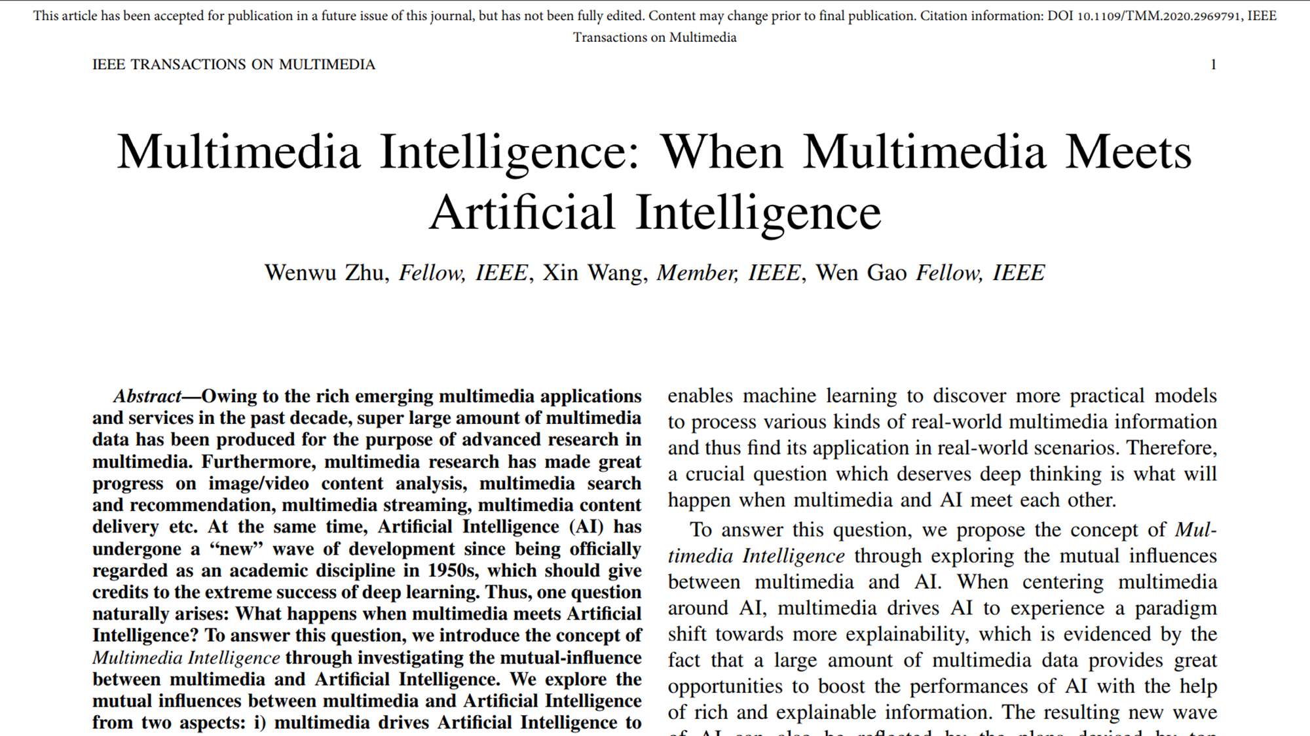
CS380 Lab7
Paper
Review
Presentation
Paper Review Presentation
Paper:
Multimedia Intelligence: When Multimedia Meets Artificial Intelligence
Presenter: RexRusk
Group 2
RexRusk
Incognito Wang
Incognito Zheng
Incognito Weng
This work was made by RexRusk, assisted by Wang. We also thank Jinglong Zheng and Bing Weng.
Notes:
This is Group 2 presenting the paper review of Multimedia Intelligence: When Multimedia Meets Artificial Intelligence.

Slide 2
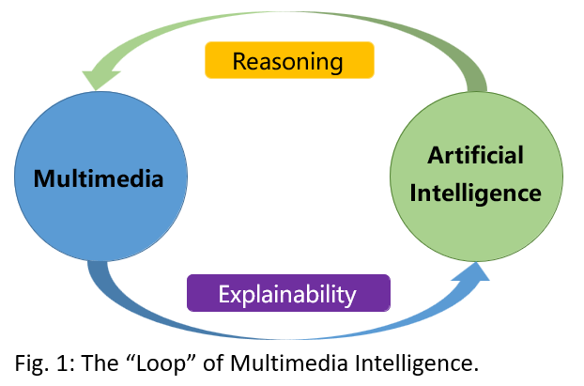
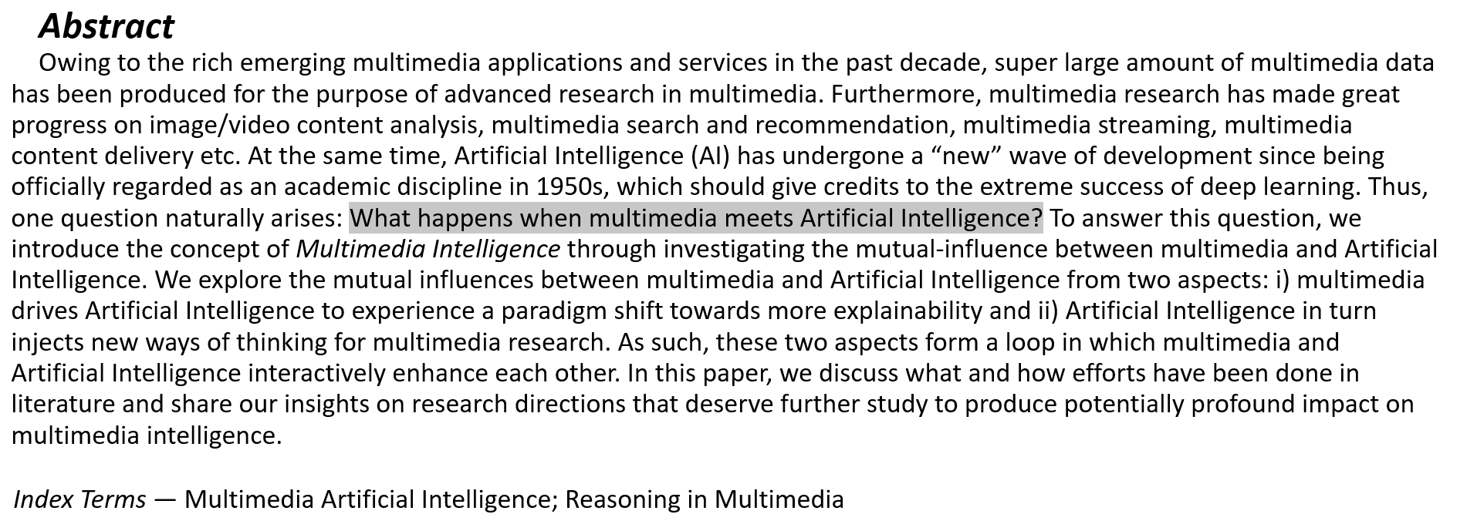
1
State The Problem the Paper Addresses
What happens when multimedia meets Artificial Intelligence?
What will happen when multimedia and AI meet each other?
Multimedia → AI:
Multimedia drives AI to experience a paradigm shift towards more explain ability.
AI → multimedia:
AI leads to more inferable multimedia.
AI injects new ways of thinking for multimedia research.
Notes:
Firstly, Let's look at the abstract, and here we can find the problem the paper addressee is: What happens when multimedia meets Artificial Intelligence?
The main topic the paper discusses is the mutual influence between multimedia and artificial intelligence (AI). And then, the authors introduce the concept named Multimedia Intelligence, as a way to investigate the mutual influence between the two fields.

Slide 3
2
What Others Doing to Solve This Problem
01
Applying AI Techniques
Image & Video Classification, Language translation, Speech recognition.
AI-based multimedia search & recommendation systems.
Drive AI towards more explainability by providing rich and explainable information that can be used to boost the performance of AI.
Inject new ways of thinking for multimedia research by providing new approaches to analyzing and processing multimedia data.
02
Improve Efficiency
03
Exploring Explainability in AI
04
Investigating New Approaches
Notes:
Some of the contributions made by other researchers in the field of multimedia AI according to the paper include the follows:
Applying AI techniques, such as deep learning, to various multimedia tasks, such as image and video classification, language translation, and speech recognition.
Using AI to improve the efficiency and effectiveness of multimedia search and recommendation systems, as well as to optimize multimedia content delivery.
Exploring the potential for multimedia data to drive AI towards more explain-ability by providing rich and explainable information that can be used to boost the performance of AI.
Investigating the potential for AI to inject new ways of thinking for multimedia research by providing new approaches to analyzing and processing multimedia data.
Overall, the authors suggest that there has been significant progress in the field of multimedia intelligence, with research efforts focused on the mutual influence between multimedia and AI and the potential for both fields to enhance each other. They suggest that further research in this area could lead to significant advances in both fields and have a profound impact on multimedia intelligence.

Slide 4
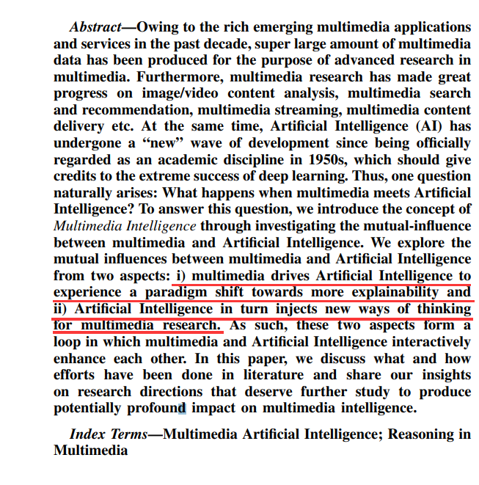
3
Solution Proposed by Authors - Overview
The paper mainly discusses the mutual influences between multimedia and AI from two aspects:
(A) Multimedia promotes AI.
(B) AI boosts Multimedia.
I. WHEN MULTIMEDIA MEETS AI
Multimedia → AI:
Multimedia drives AI to experience a paradigm shift towards more explain ability.
AI → multimedia:
AI leads to more inferable multimedia.
AI injects new ways of thinking for multimedia research.
Notes:
The paper discusses the mutual influences between multimedia and AI from two perspectives, one is Multimedia promotes AI, and the other is AI boosts Multimedia.
Here, the paper gives us a figure to better understand this relationship, and how multimedia and AI mutual influences each other [Image].
From Multimedia to AI, the paper defined that:
Multimedia drives AI to experience a paradigm shift towards more explain ability.
That means the increasing availability of multimedia data has enabled machine learning to process various types of real-world multimedia information, leading to the application of AI in practical scenarios.
And from AI to Multimedia, the paper defined that:
AI leads to more inferable multimedia. And AI injects new ways of thinking for multimedia research.
That means the rich and explainable information provided by multimedia data has the potential to improve the performance of AI.
The paper also explores how AI can in turn inject new ways of thinking for multimedia research, leading to a loop of mutual enhancement between the two fields.

Slide 5
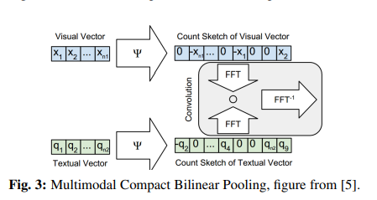
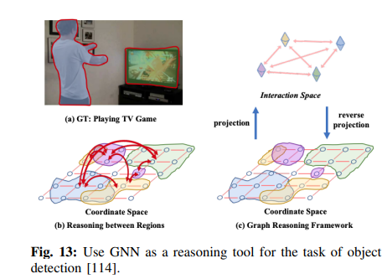
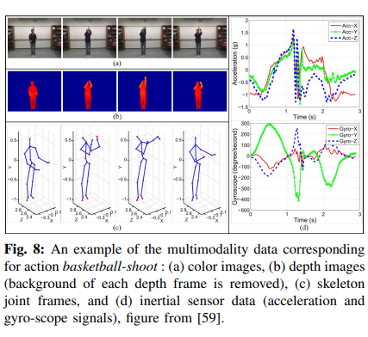
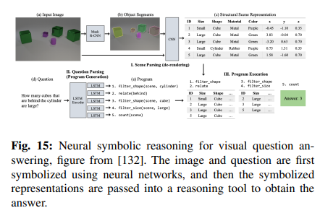
4
Solution Proposed by Authors - Detail
To further study these aspects and produce potentially profound impacts on multimedia intelligence, the authors suggest several research directions below for real-world scenarios.
(I) Multimedia Promotes Machine Learning
(II) Machine Learning Boosts Multimedia
A. Multimedia Promotes Machine Learning Techniques
A. Reasoning-Inspired Perception Learning
Multimedia Representation
Multi-Step Reasoning (RNN)
Multimedia Alignment
Relational Reasoning (GNN)
Multimedia Fusion
Attention Map and Visualization
Multimedia Transfer
B. Multimedia Promotes Machine Learning Applications
B. Perception-Reasoning Cascade Learning
Multimedia Search and Recommendation
Neural Modular Network (NMN)
Multimedia Recognition
Neural-Symbolic Reasoning
Multimedia Detection
Multimedia Generation
Multimedia Language and Vision
Notes:
To further study these aspects and produce potentially profound impacts on multimedia intelligence, the authors suggest several research directions below for real-world scenarios.
They are divided in to to aspects, Multimedia Promotes Machine Learning and Machine Learning Boosts Multimedia. In each aspect, the authors also divided the multiple applications into two categories.
They detailed discuss about multimedia promotes machine learning on techniques and applications.
And discussed machine learning boosts multimedia on Reasoning-Inspired Perception Learning and Perception-Reasoning Cascade Learning.

Slide 6
4
Solution Proposed by Authors - Detail
(I) Multimedia Promotes Machine Learning
A. Multimedia Promotes Machine Learning Techniques
01
Multimedia Representation
Element-wise operation, Feature concatenation, Fully connected layers, Multimodal deep belief network, Multimodal compact bilinear pooling, Multimodal convolutional neural networks recognition.
e.g. Align the sentences or phrases with the corresponding
video segments or image regions.
Integrate signals from multiple modalities together with the goal of predicting a specific outcome
e.g. Multimodal autoencoder. Transfer information from one modality to another through the shared hidden layers.
02
Multimedia Alignment
03
Multimedia Fusion
04
Multimedia Transfer
Notes:
The four examples given by the paper show how multimedia promotes machine learning techniques.
Multimedia Representation has mainly two different categories: joint and coordinated. And the authors mentions these features of multimedia representation listed here.
Multimedia Alignment aims to find relationships and alignment between instances from two or more modalities. it is fundamental for machines to understand multimedia data. For example, aligning the sentences or phrases with the corresponding video segments or image regions.
Multimedia Fusion aims to integrate signals from multiple modalities together with the goal of predicting a specific outcome.
Multimedia Transfer aims at transferring useful information across different modalities with the goal of modeling a resource-poor modality. For example, the Multi-Modal Auto-Encoder transfers information from one modality to another through the shared hidden layers.

Slide 7
4
Solution Proposed by Authors - Detail
(I) Multimedia Promotes Machine Learning
B. Multimedia Promotes Machine Learning Applications
01
Multimedia Search and Recommendation
Video recommendation, Music recommendation, Group recommendation, Social recommendation
Audio-Visual Speech Recognition (AVSR)
Detect the body action in basketball shooting
Image/video captioning and image/video generation from natural language
Temporal sentence localization in videos, Image/video captioning, Image/video generation from natural language
02
Multimedia Recognition
03
Multimedia Detection
04
Multimedia Generation
05
Multimedia Language and Vision
Notes:
The five examples given by the paper show how multimedia promotes machine learning applications.
Multimedia Recognition is one of the earliest examples of multimedia research. Audio-visual speech recognition is a representative application.
In Multimedia Detection area, an important research area that heavily utilizes multimedia data is human activity detection. This figure demonstrates an example of multi-modal detection, which detects the body action in basketball shooting.
Multimedia Generation is another important aspect for multimedia artificial intelligence. For instance, image/video captioning and image/video generation from natural language serve as two sets of typical applications.
Multimedia Language and Vision is another category of multi-modal applications emphasize the interaction between language and vision. The most representative applications are Temporal sentence localization in videos, Image/video captioning, Image/video generation from natural language.

Slide 8
4
Solution Proposed by Authors - Detail
(II) Machine Learning Boosts Multimedia
A. Reasoning-Inspired Perception Learning
01
Multi-Step Reasoning (RNN)
Video recommendation, Music recommendation, Group recommendation, Social recommendation
Audio-Visual Speech Recognition (AVSR)
Detect the body action in basketball shooting
Image/video captioning and image/video generation from natural language
Temporal sentence localization in videos, Image/video captioning, Image/video generation from natural language
02
Relational Reasoning (GNN)
03
Attention Map and Visualization
Notes:
Machine learning boosts multimedia in many aspects. Reasoning-Inspired Perception Learning is one theory the peper mentioned.
Some researchers try to equip the neural networks with reasoning ability through augmenting neural networks with reasoning-inspired layers or modules. Here are some theories aiming to imitate humans multi-step thinking process, including: Multi-Step Reasoning, Relational Reasoning, Attention Map and Visualization.

Slide 9
4
Solution Proposed by Authors - Detail
(II) Machine Learning Boosts Multimedia
B. Perception-Reasoning Cascade Learning
Neural Modular Network (NMN)
01
Video recommendation, Music recommendation, Group recommendation, Social recommendation
Audio-Visual Speech Recognition (AVSR)
Detect the body action in basketball shooting
Image/video captioning and image/video generation from natural language
Temporal sentence localization in videos, Image/video captioning, Image/video generation from natural language
02
Neural-Symbolic Reasoning
Notes:
Perception-Reasoning Cascade Learning is another theoriy the peper mentioned to express how machine learning boosts multimedia.
On the one hand, quite a few efforts have been devoted to integrating the ability to reason into deep neural networks On the other hand, others try to decouple DNN’s powerful low-level representation ability and cascade the process of perception to simulate high-level human-readable cognition, aiming at true AI. Here are some theories mentioned in the paper: Neural Modular Network (NMN), Neural-Symbolic Reasoning.

Slide 10
5
Evaluation Undertaken
In this paper, the authors reveal the convergence of multimedia and AI in the “big data” era. They present the novel concept of Multimedia Intelligence which explores the co-influence between multimedia and AI.
The author review the current state of research in the field of multimedia intelligence and provide insights on potential future research directions that could have a profound impact on the field.
IV. FUTURE RESEARCH AND DIRECTIONS
A. Multimedia Turing Test
B. Explainable Reasoning in Multimedia
C. AutoML and Meta-learning
(1) Multimedia drives AI towards more explain-ability.
(2) AI in turn boosts multimedia to be more inferrable.
D. Digital Retinas
Notes:
In this paper, the authors reveal the convergence of multimedia and AI in the “big data” era. They present the novel concept of Multimedia Intelligence which explores the co-influence between multimedia and AI. The exploration includes the following two directions:
(1) Multimedia drives AI towards more explain-ability.
(2) AI in turn boosts multimedia to be more inferrable.
These two directions form a loop of multimedia intelligence where multimedia and AI enhance each other in an interactive and iterative way.
The authors carefully study the circles in the loop, in particular, investigating how multimedia promotes machine learning and how machine learning in turn boosts multimedia.
Last but not least, they summary what have been done in the loop already and point out what needs to be done to complete the loop, followed by their thought on several future research directions deserving further study for multimedia intelligence.

Slide 11
6
Reflection On What Authors Say Is Novel
The paper provides an interesting and potentially novel concept of Multimedia Intelligence, which explores the co-influence between multimedia and AI.
The paper uses many novel research achievements as examples which are of great help for us to have a clearer view of the development of artificial intelligence science.
Notes:
The paper provides an interesting and potentially novel concept of Multimedia Intelligence, which explores the co-influence between multimedia and AI.
Another point that makes the paper novel is that the author uses many up-to-date research achievements as examples to express the authors views. These examples is novel and of great help for us to better understand the development of artificial intelligence science.

Slide 12
7
What We Believe Is Novel
In part 4 of the paper, the author gives four examples to express the future research and directions about Multimedia Intelligence. We think these examples are really novel and they broad our horizon.
Multimedia Turing Test
Explainable Reasoning in Multimedia
Auto-ML and Meta-learning
Digital Retinas
Notes:
In part 4 of the paper, the author gives four examples to express the future research and directions about Multimedia Intelligence. We think these examples are really novel and they broad our horizon.
Multimedia Turing Test aims to evaluate the computer algorithm’s ability of human-level concept learning, and may serve as a further step to enhance the human-like reasoning for multimedia.
Explainable Reasoning in multimedia is one important research direction to explore more for future work, and deserve further investigations.
Auto-ML means enabling a computer algorithm to automatically adapt to different data, tasks and environments, which is exactly what we human are good at.
Meta-learning, that is learning to learn, aims at extracting and learn a form of general knowledge from different tasks that can be used by various other tasks in the future, which is also a unique characteristic possessed by human.
They focus on developing the ability of human-like task/environment-adaptation and general knowledge sublimation.
Digital Retina defines a framework that a camera is typically equipped with a globally unified timer and an accurate positioner, and can output two streams simultaneously, including a compressed video stream for online/offline viewing and data storage, and a compact feature stream extracted from the original image/video signals for pattern recognition, visual analysis and search.

Slide 13
The End
Paper
Review
Presentation
Thanks For Your Watching!
Notes:
Thanks for your watching!

