Slide 1
Monkey
Maxim in Appetizer
AppCrawler
Monkey 3.0

Slide 2
Maxim in Appetizer
Select App
Setup parameter
Start Monkey Test
Log analysis

Slide 3
Select App
Stub for App
Will add detection code for monitoring the app behavior during the Monkey running
Record the log for crashing or App Hang information
Without Stub
Only save logs during monkey running

Slide 4
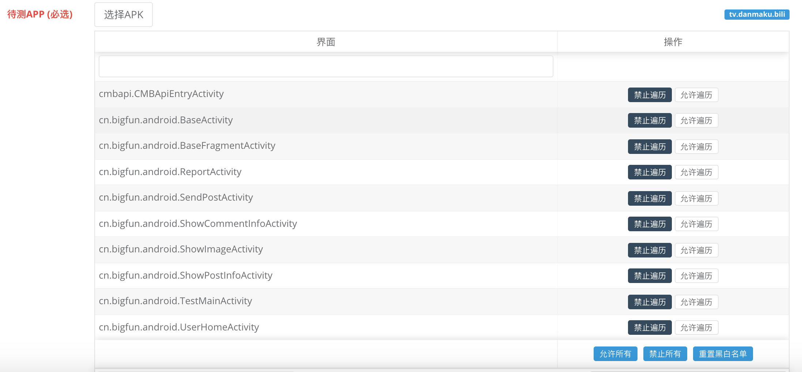
Parameter
Select Activities
Running monkey on what activities

Slide 5
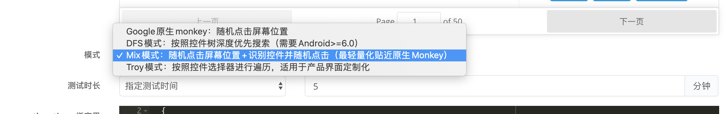
Parameter
Select mode
Monkey from Android
DFS
Mix
Troy
Test duration
Time
Event Count

Slide 6
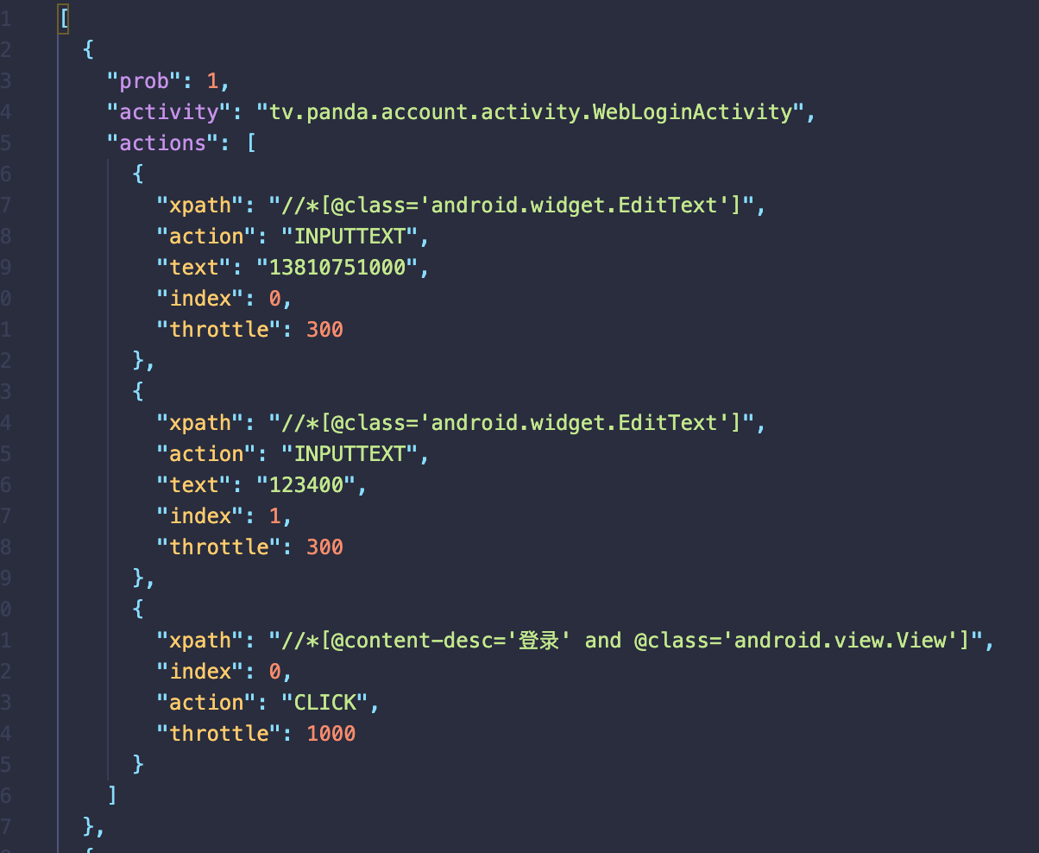
Parameter
max.xpath.actions
Use to define the specific step for activities

Slide 7
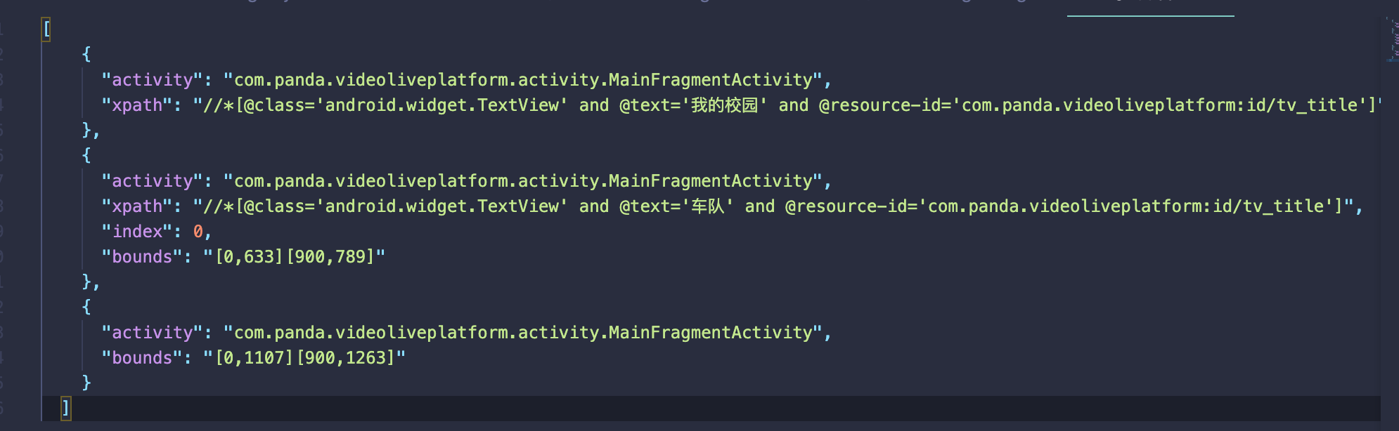
Parameter
max.widget.black
Blacklist of elements in activities
Blacklist of regions in activities

Slide 8
Parameter
max.config
max.startAfterNSecondsofsleep=6000
max.wakeupAfterNSecondsofsleep=4000
max.takeScreenShot = false
max.savePageSource = false
Timed Screenshot
Waiting Time at Start
Flag for save page xml

Slide 9
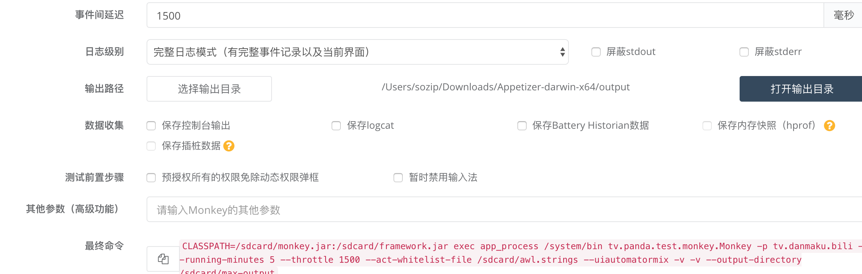
Parameter
Delay for events. eg. 1500ms
Log level
Output directory
Data collection
Save console output
Save logcat
Battery History
Memory profile
Stub data

Slide 10
Running Test

Slide 11
Log Analysis
See log attachment

Slide 12
Limitation
Specific steps only support hard code Json format
Stubs can find suspicious crashes, need inject code in debug apk.

Slide 13
AppCrawler in Appetizer
Introduction
Setup parameter
Start AppCrawler
Report

Slide 14
AppCrawler Introduction
Base on Appium
Support aOS and iOS
Target is to traverse all screens in App
Configurable for traverse rules

Slide 15
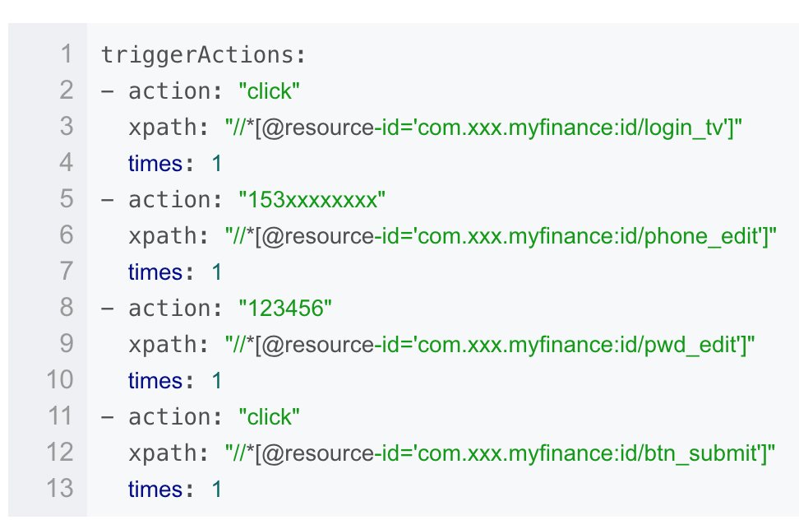
AppCrawler Parameter
Capability
androidCapability to save android specific capabilities in Appium
iosCapability to save ios specific capabilities in Appium
triggerActions
Setup rules
selectedList
Default elements click

Slide 16
AppCrawler Parameter
firstList
High-priority elements xpath to traverse
lastList
low priority elements xpath to traverse
blackList
Exclude elements for any actions
backButton
Xpath for back button location

Slide 17
AppCrawler Run

Slide 18
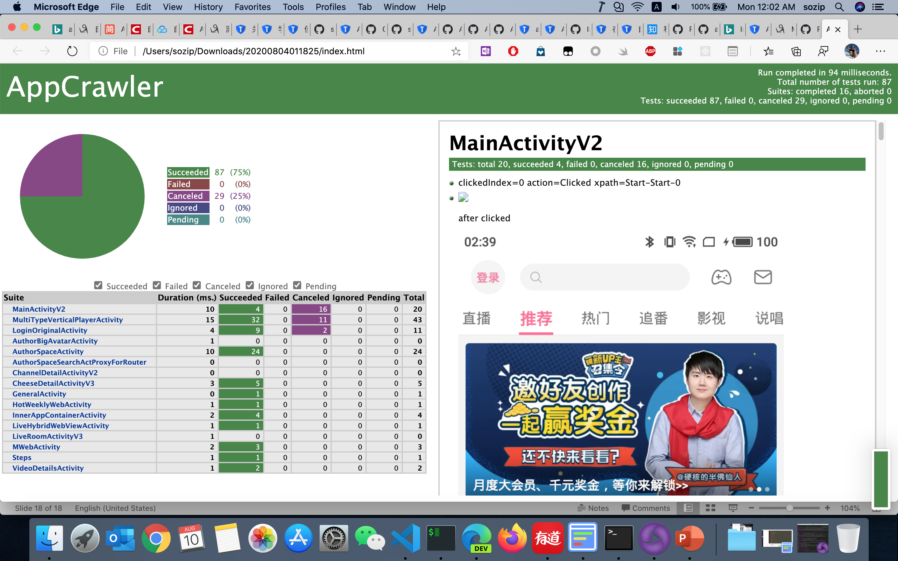
AppCrawler Report
List all elements which traversed
Including screenshot
Can diff with previous version

Slide 19
Monkey 3.0
Test data accumulation
History testing data collection and management
Data analysis
Big data technology to analyze test result data, find the relationship about defect and product module
Test prediction

