Slide 1

A little history about our bootcamp through Slack
Ironhack F.Project DA-FT-BER-05-21
By Héctor Santos

Slide 2

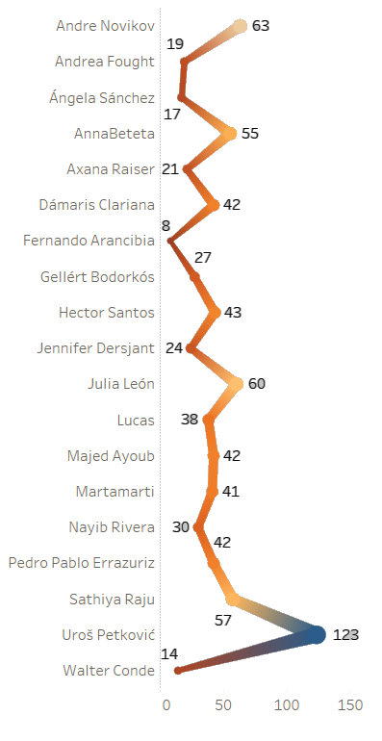

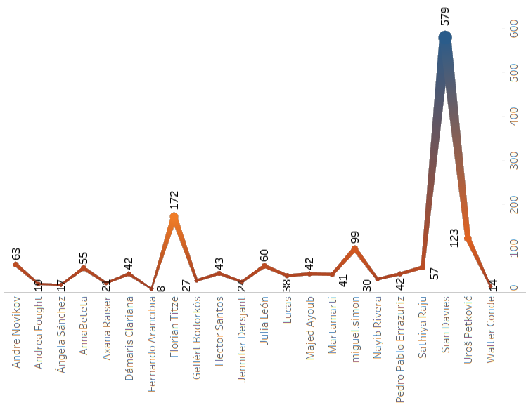
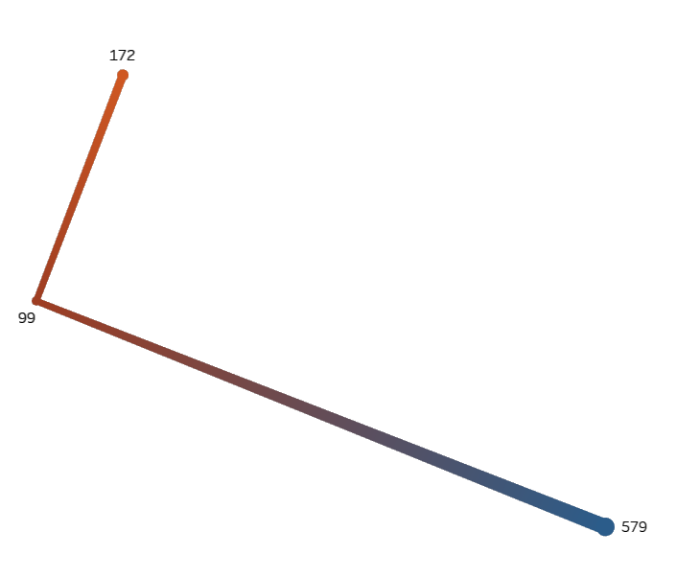
Average messages in Bootcamp: 40
1616
Flo
Miguel
766
Total messages send by user with TA’s
Sian
Total messages send by user without TA’s

Slide 3

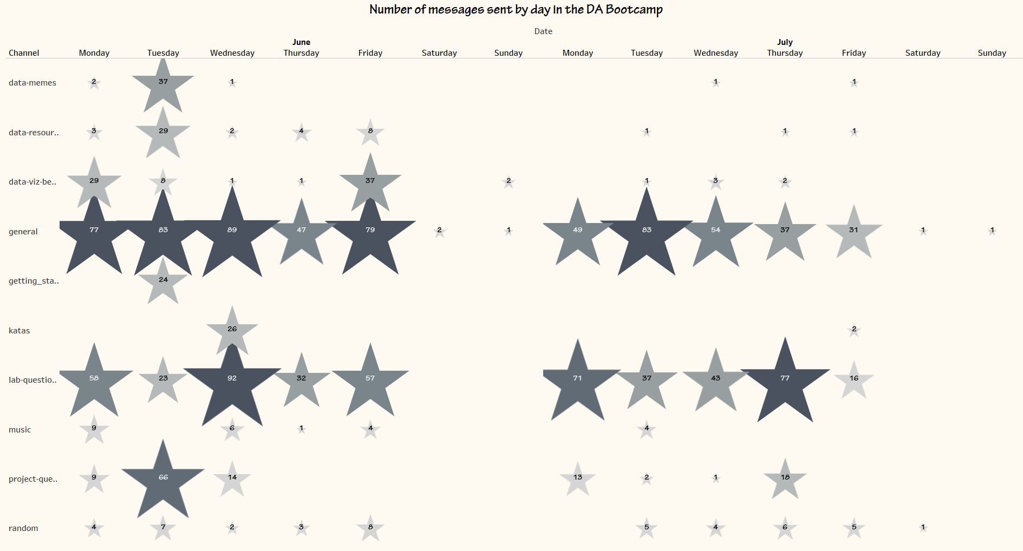

Slide 4
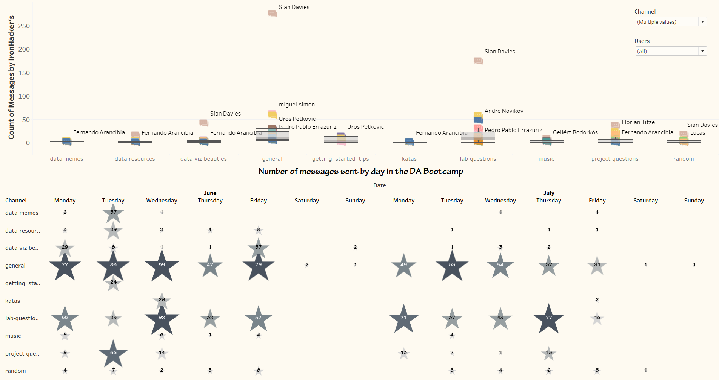
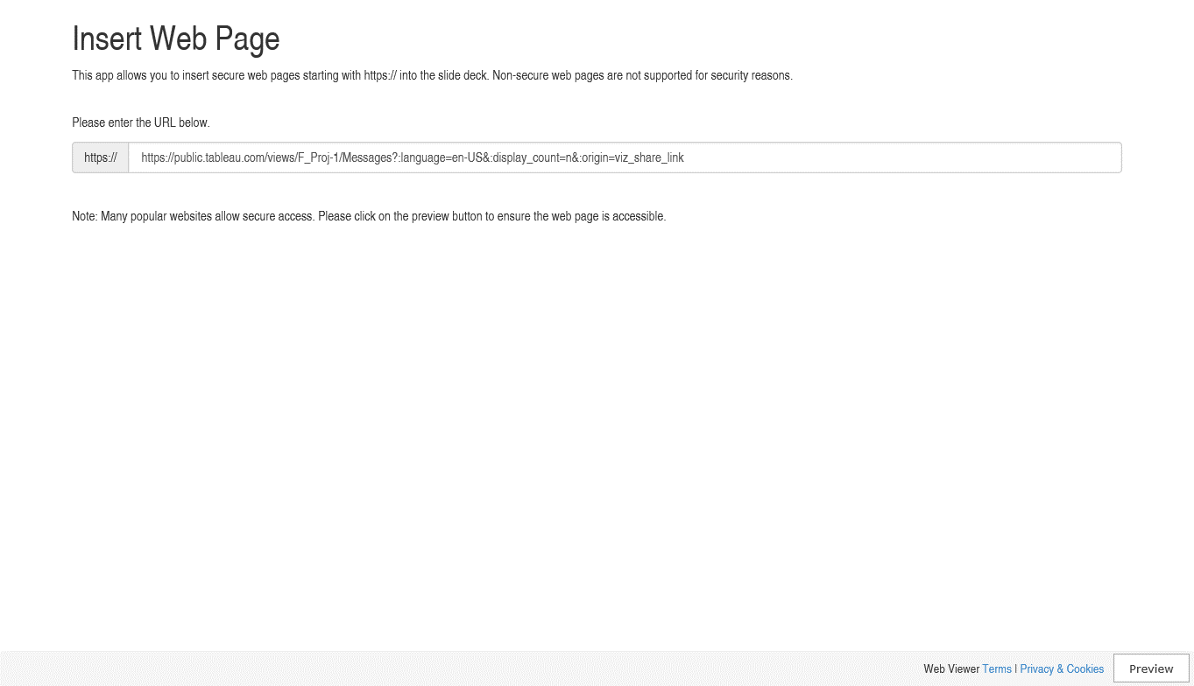
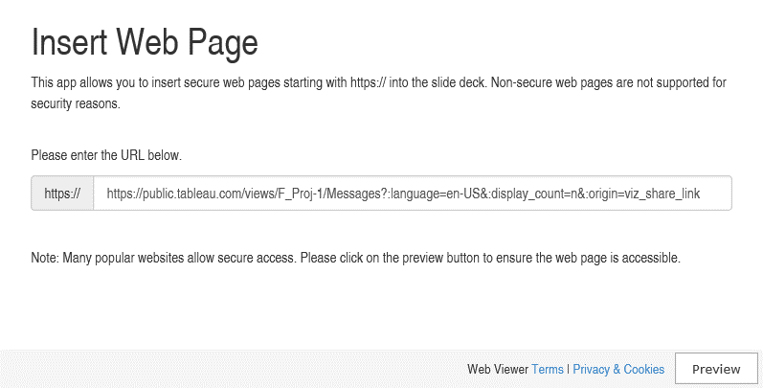

Slide 5
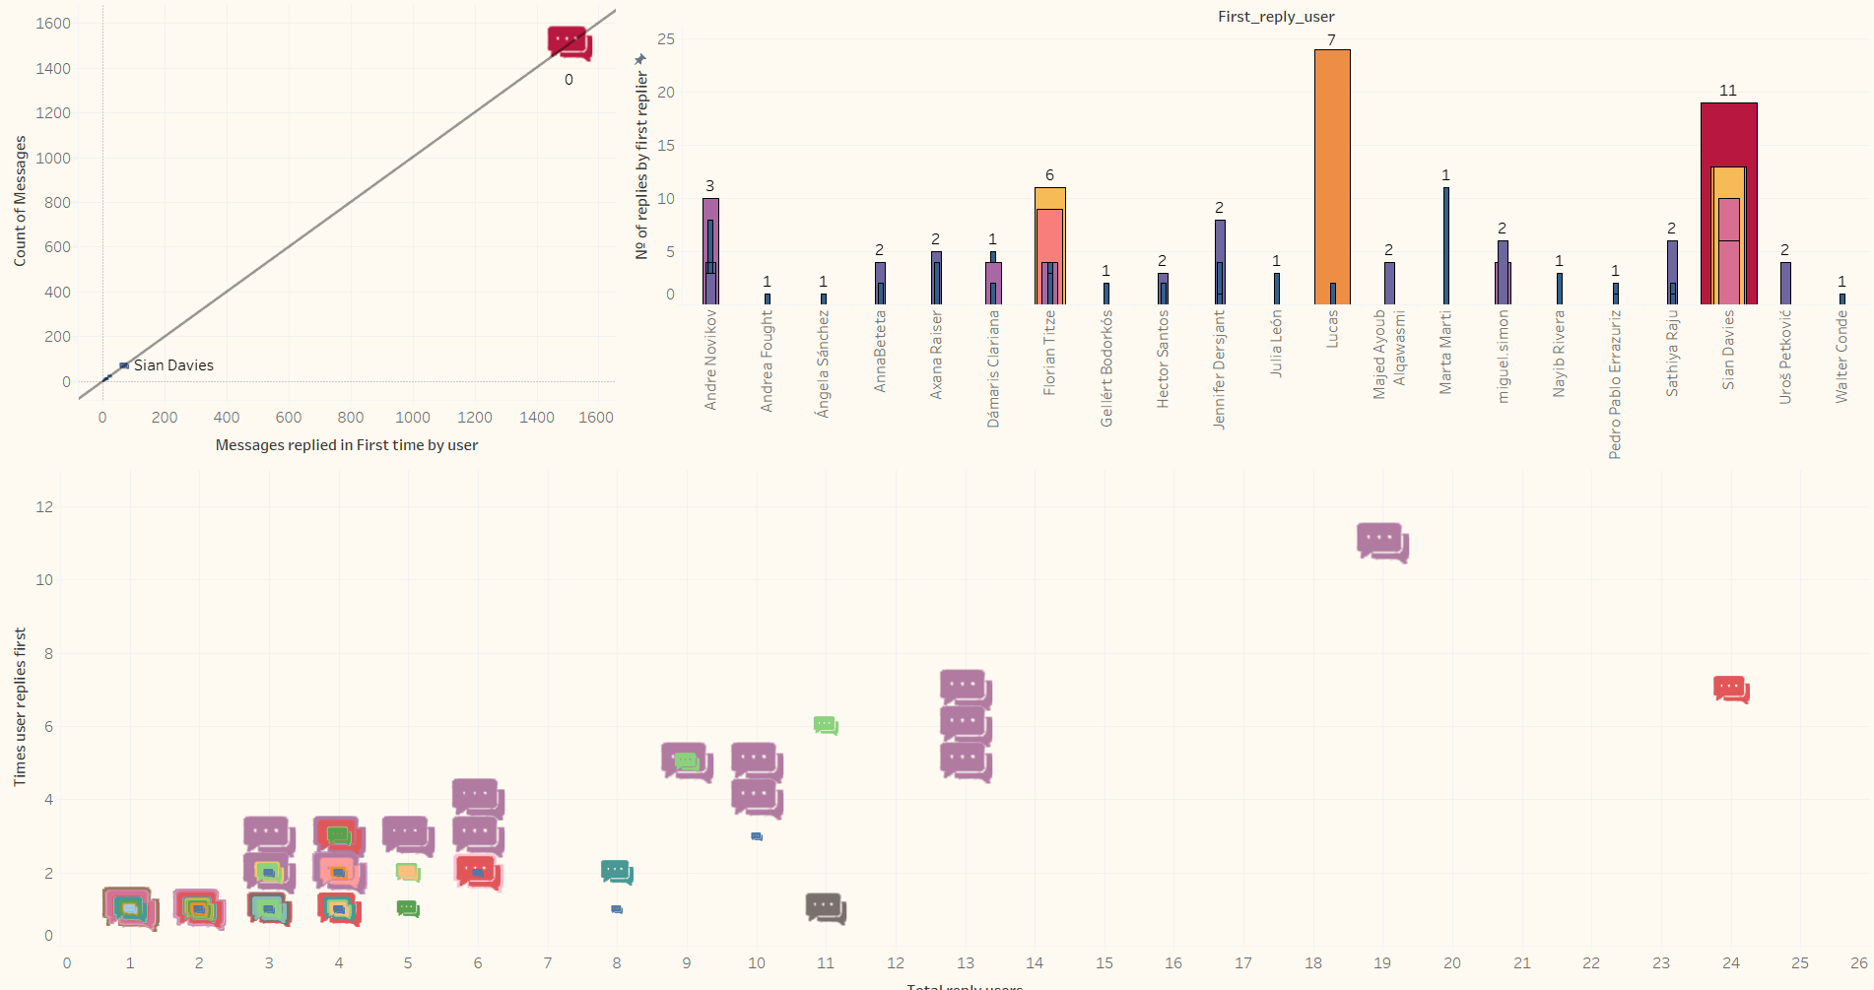
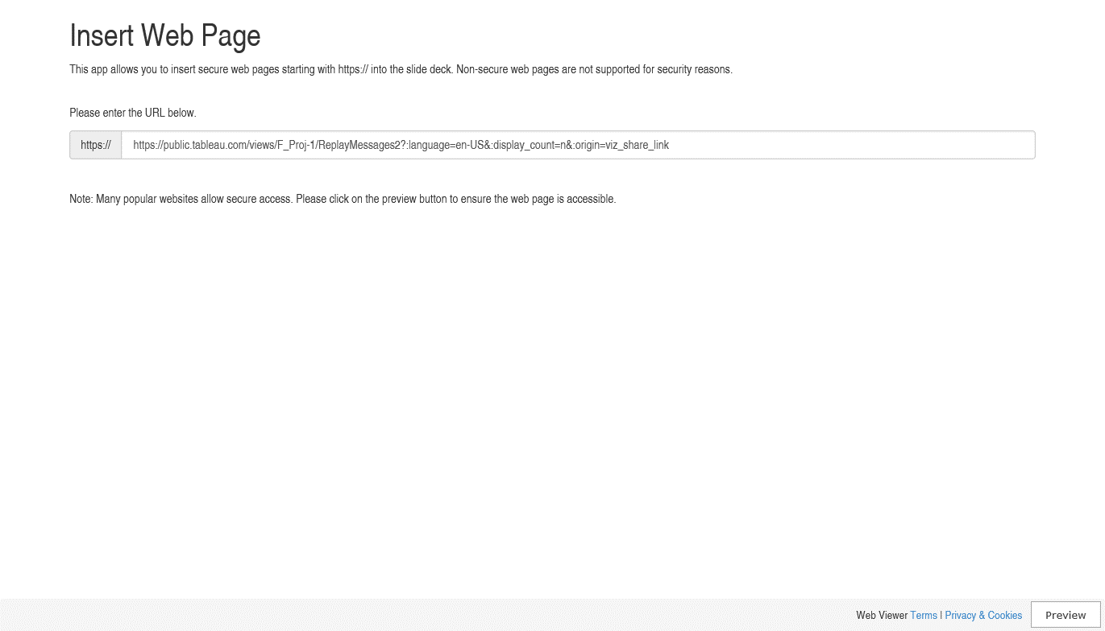

Slide 6
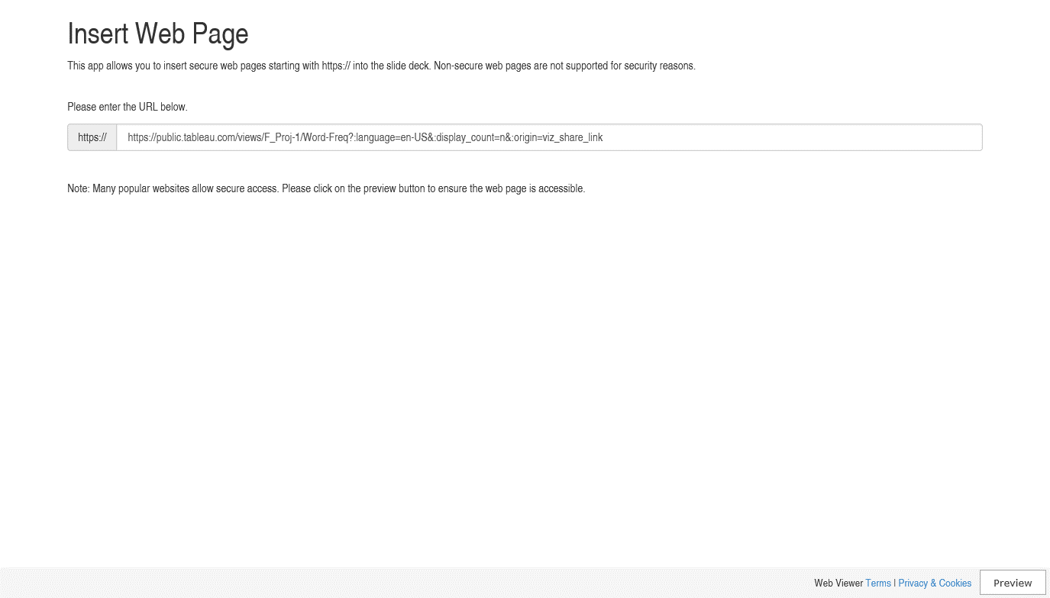

Slide 7
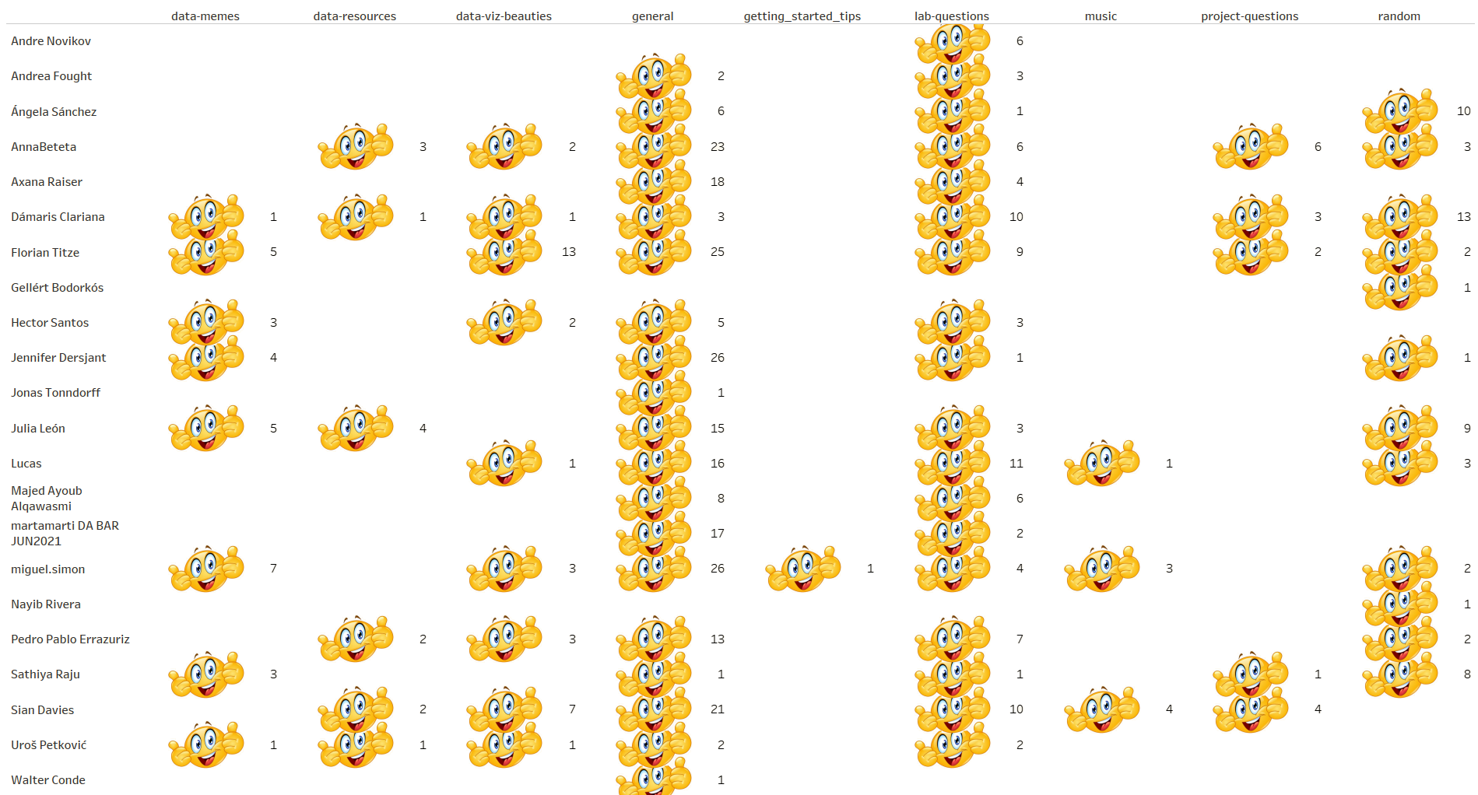

Slide 8
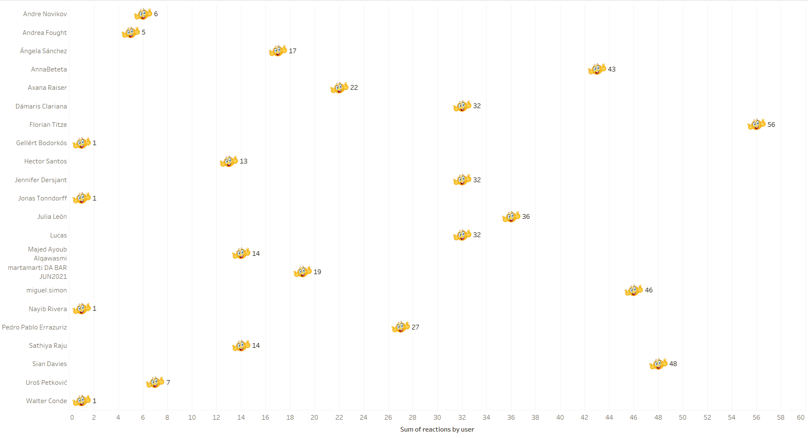
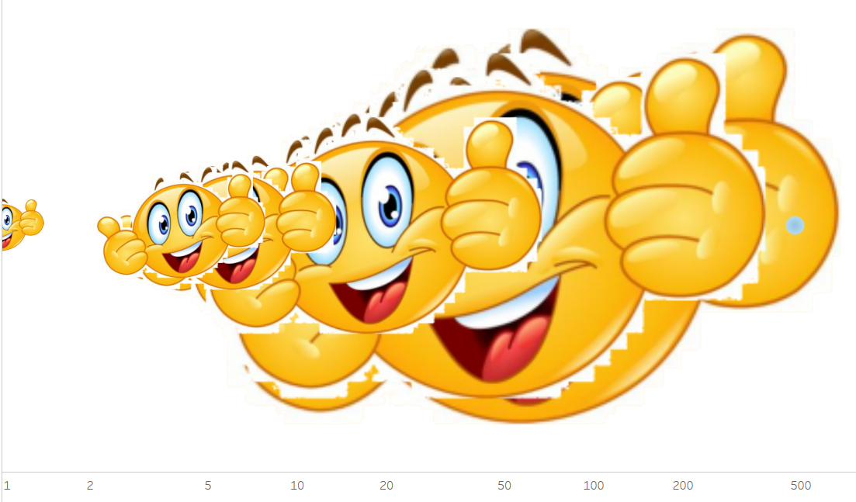
477

Slide 9

Ironhack F.Project DA-FT-BER-05-21
By Héctor Santos

Slide 10

Thank you for
your attention.

