Slide 1
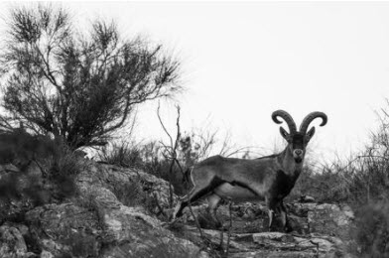
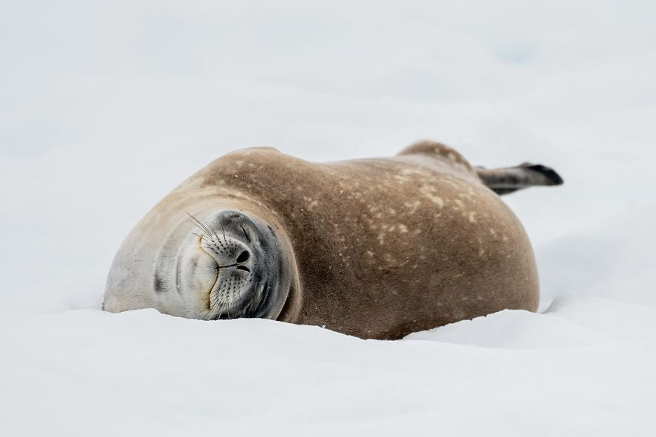
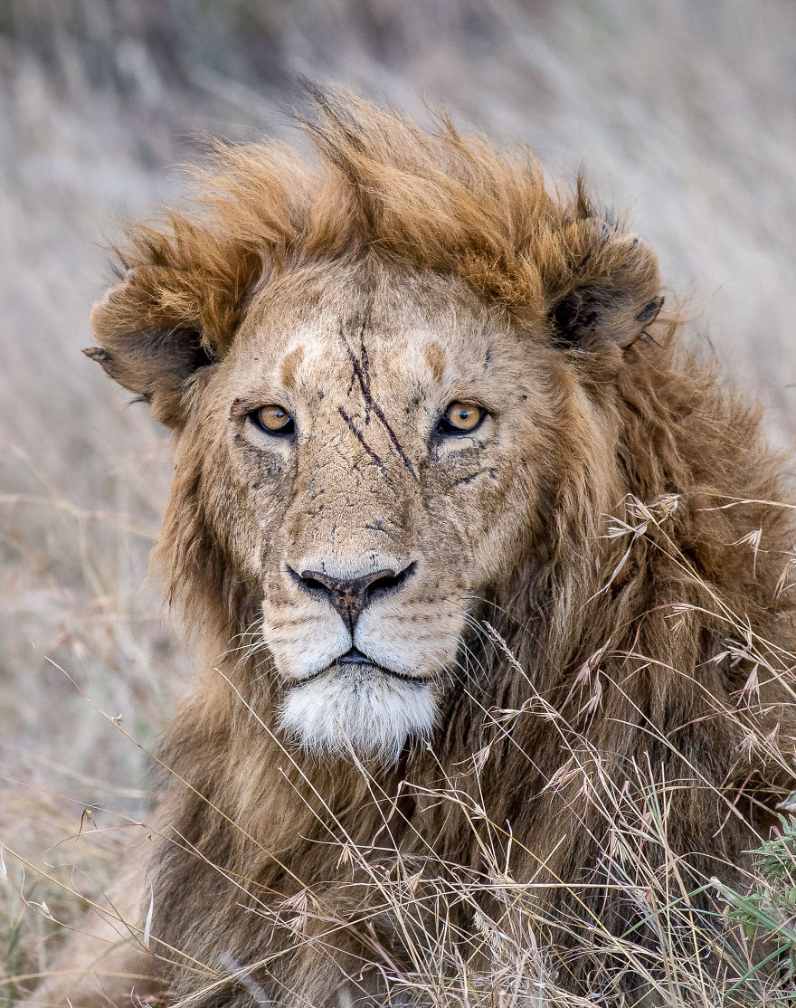
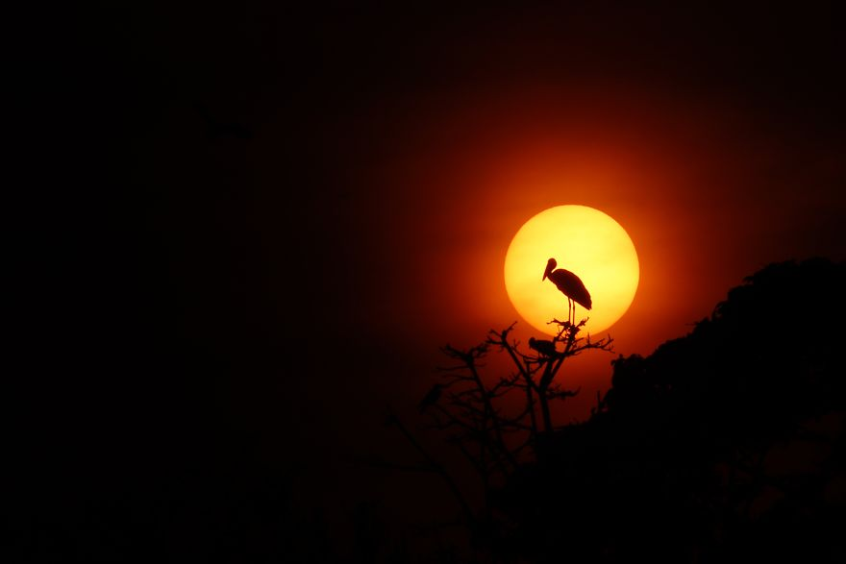
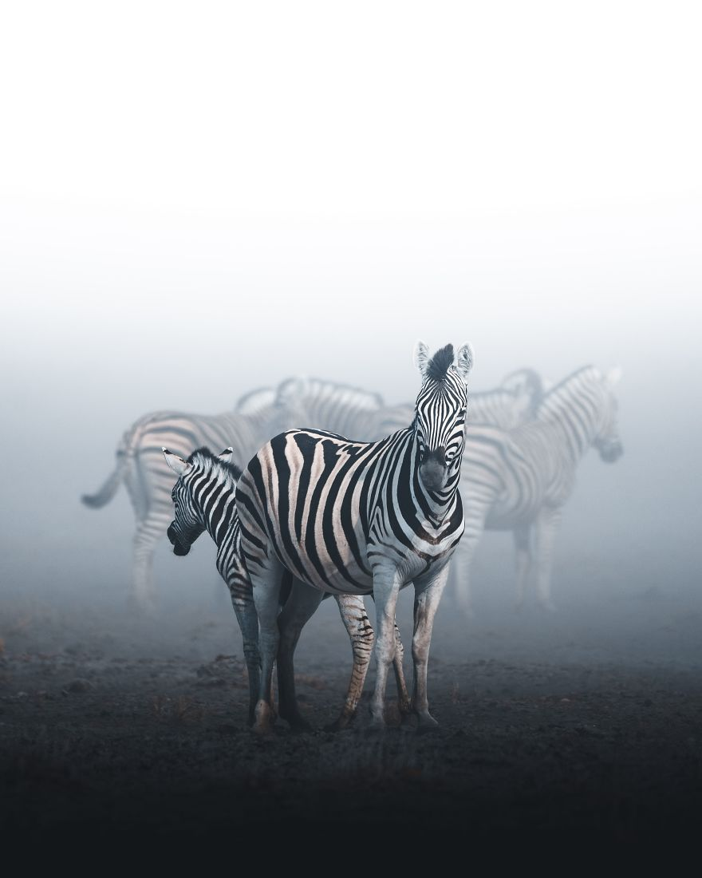
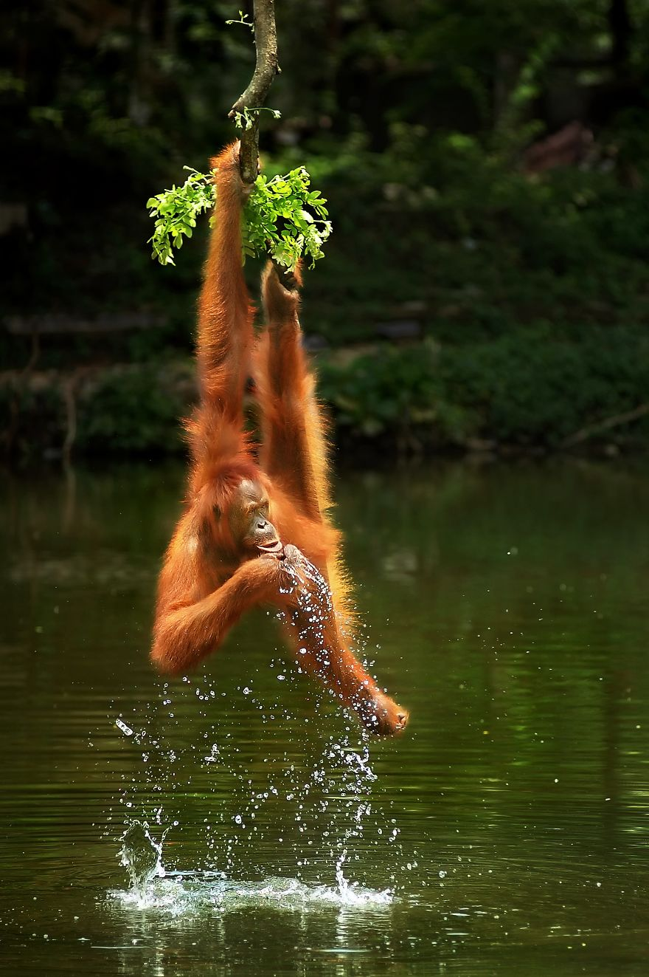
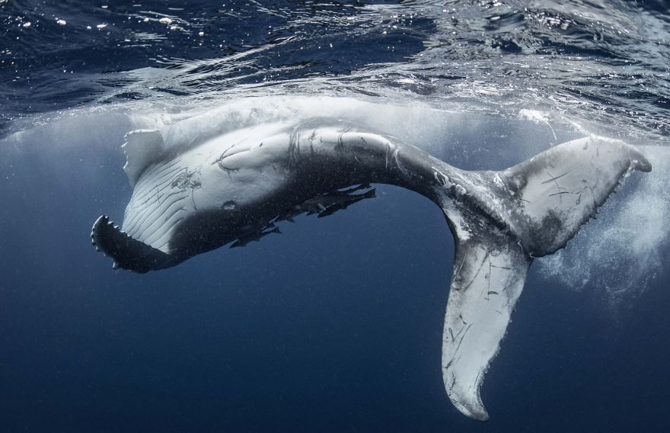
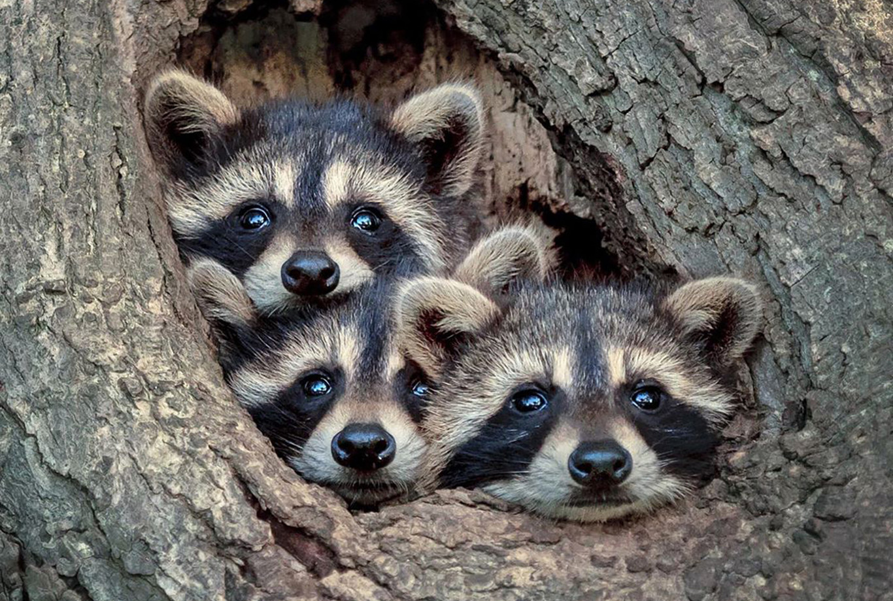
Is Earth changing for humans actions?
By Héctor Santos
01/07/21

Slide 2
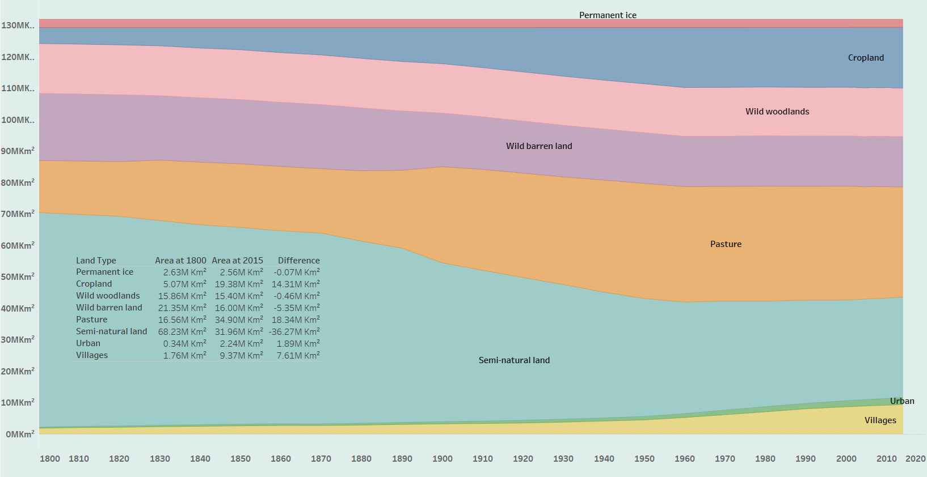

Slide 3
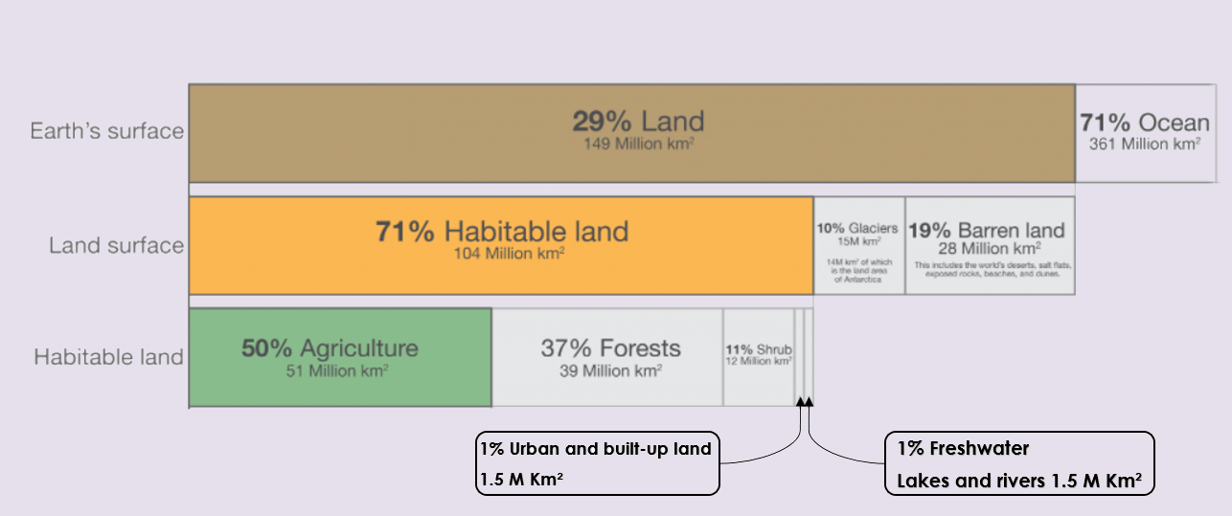
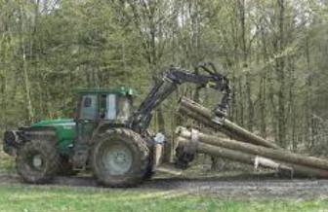
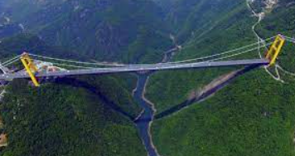
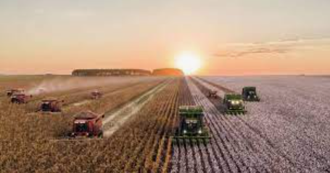
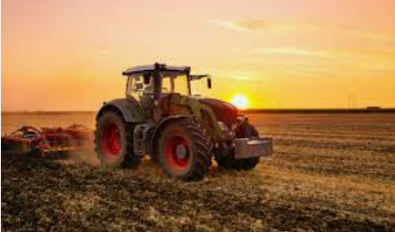
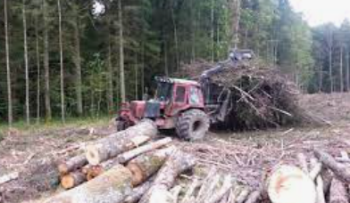

Slide 4
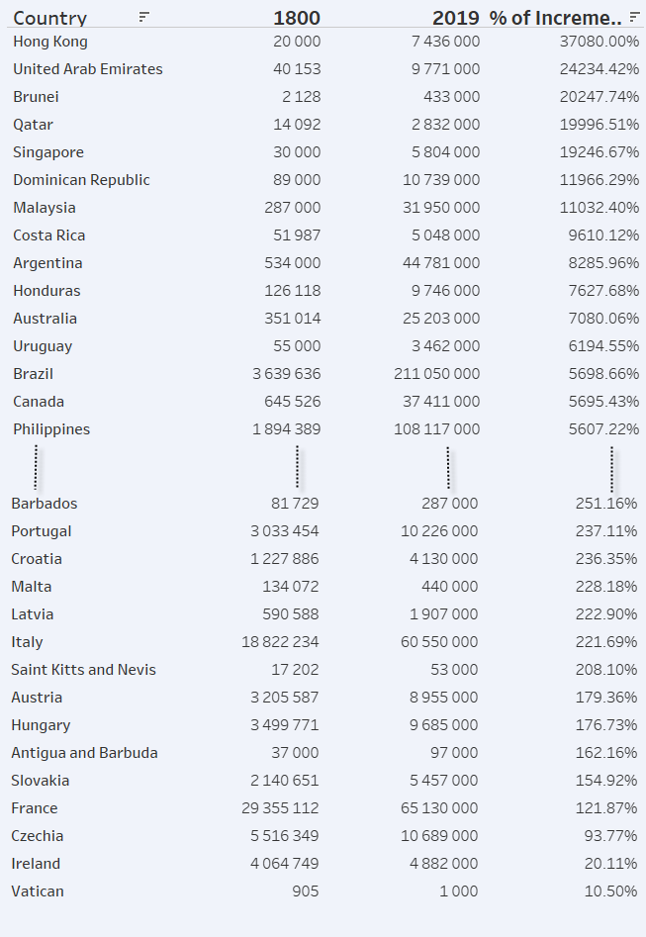
In this table only see the 15 Countries have grown the most and the 15 that least. If you like view all list, click on the link below.
For view all table ctrl+click in table

Slide 5
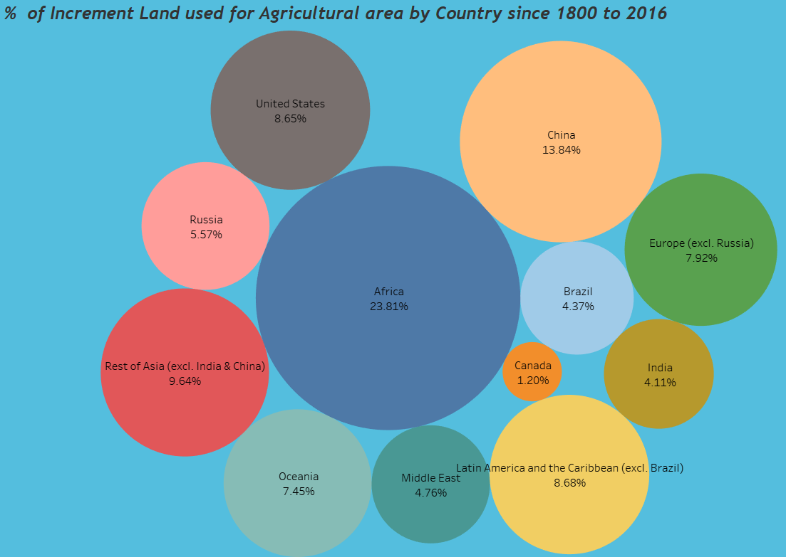
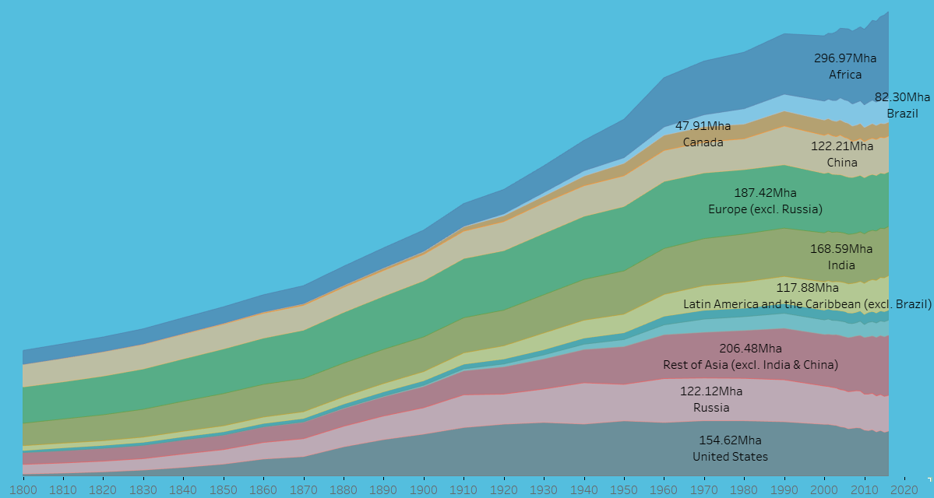
This visualization shows total land used for agriculture (which is a combination of cropland and grazing land) over the long-term, measured in hectares.

Slide 6
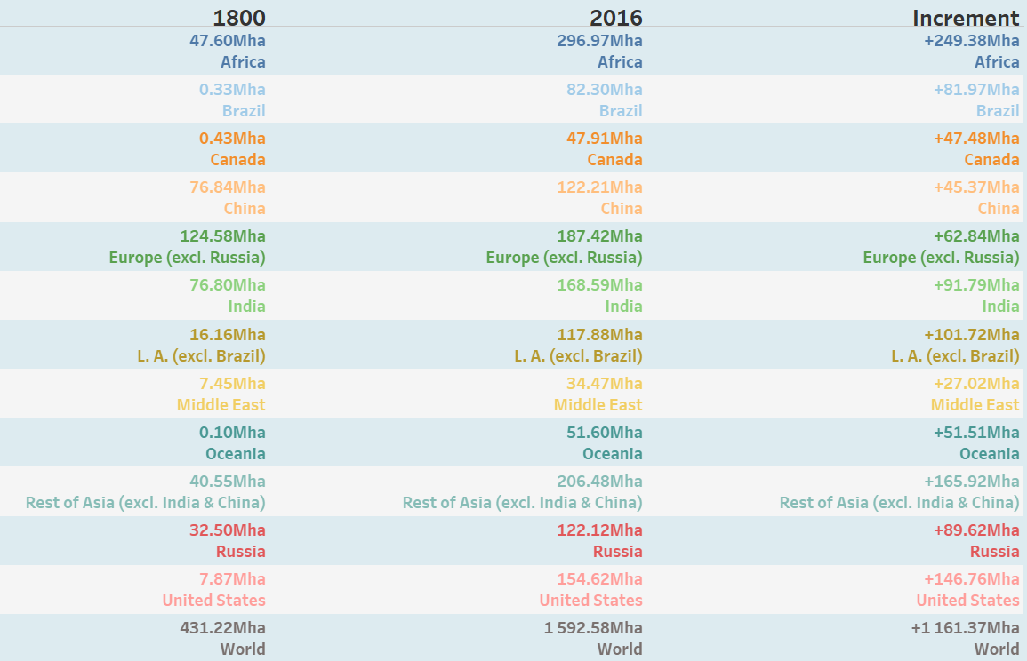

Slide 7
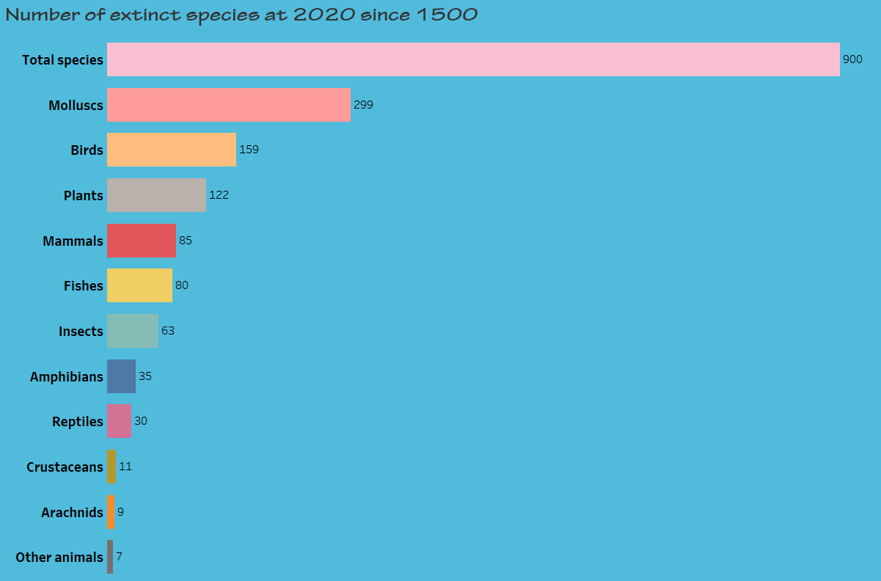
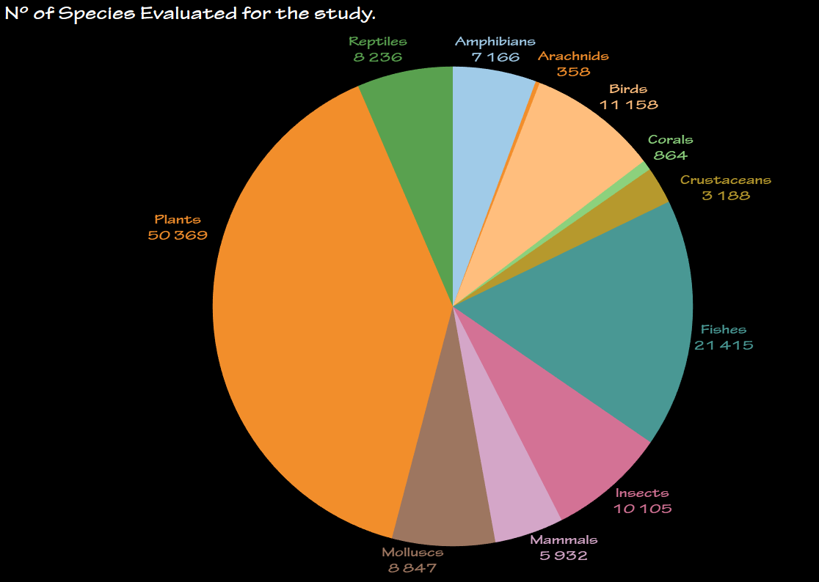

Slide 8
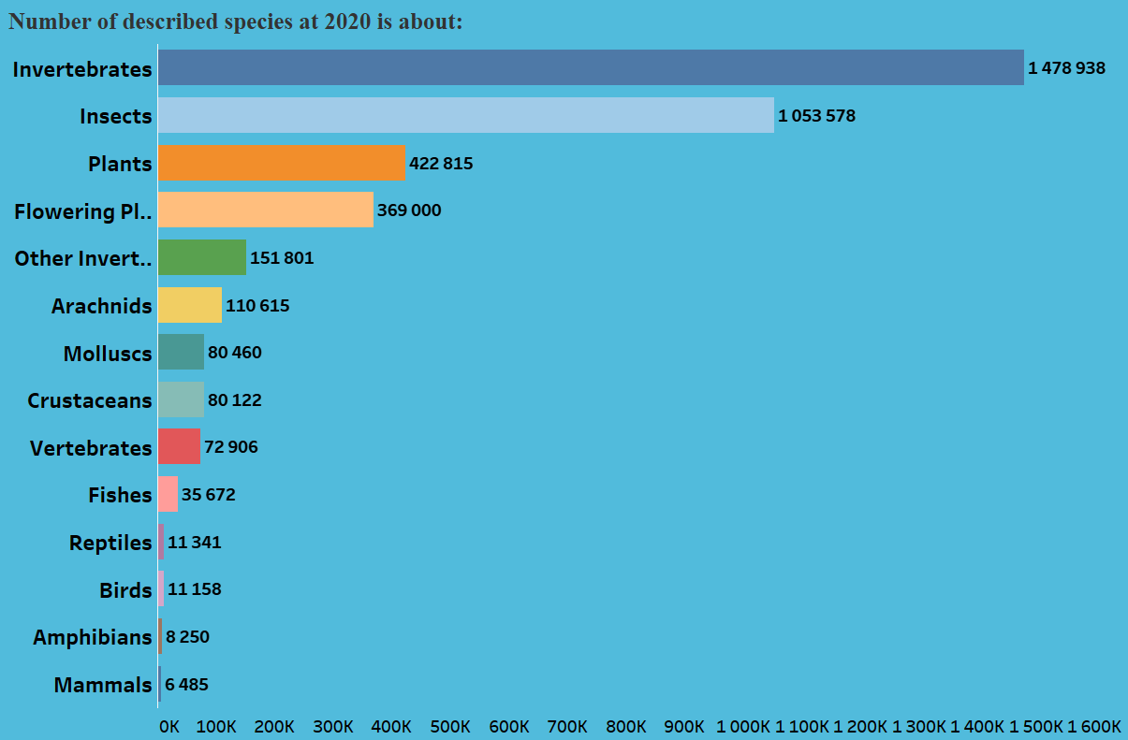

Slide 9
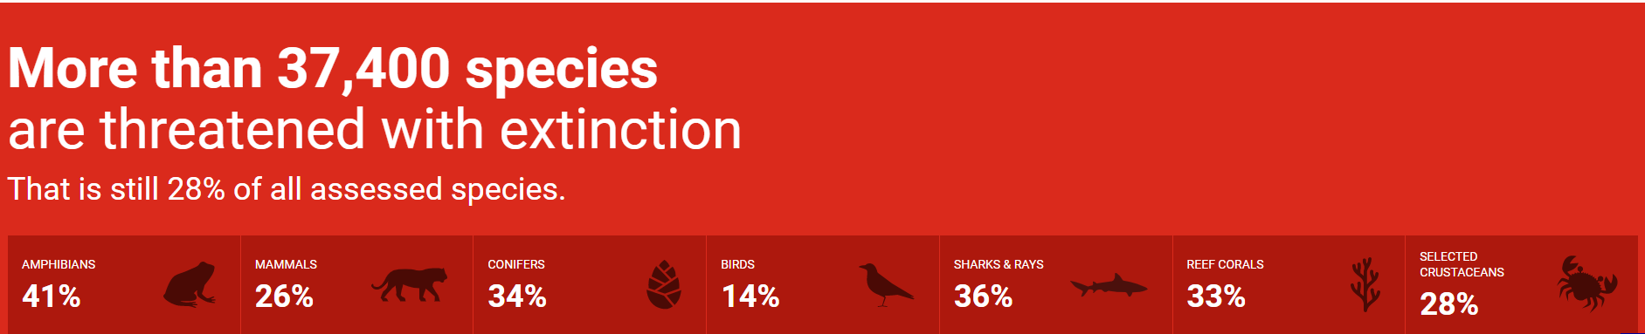
Some Links if you like view a littel more or more much:
https://www.iucnredlist.org/
https://dataverse.harvard.edu/dataverse/ArchaeoGLOBE
https://ourworldindata.org/
https://medium.com/@progrextor/a-little-history-of-our-planet-by-human-actions-7aa083bb5a00
https://github.com/RexTor78/Habitats-Extinctions.git
https://trello.com/b/zE4X1GgT/habitats-extinctions

