Slide 1
ARTIFICIAL INTELLIGENCE (CS F407)
One-Class Classification for Credit Card Fraud Detection: A Comparative Analysis of Isolation Forest, LOF, and SVM

Slide 2
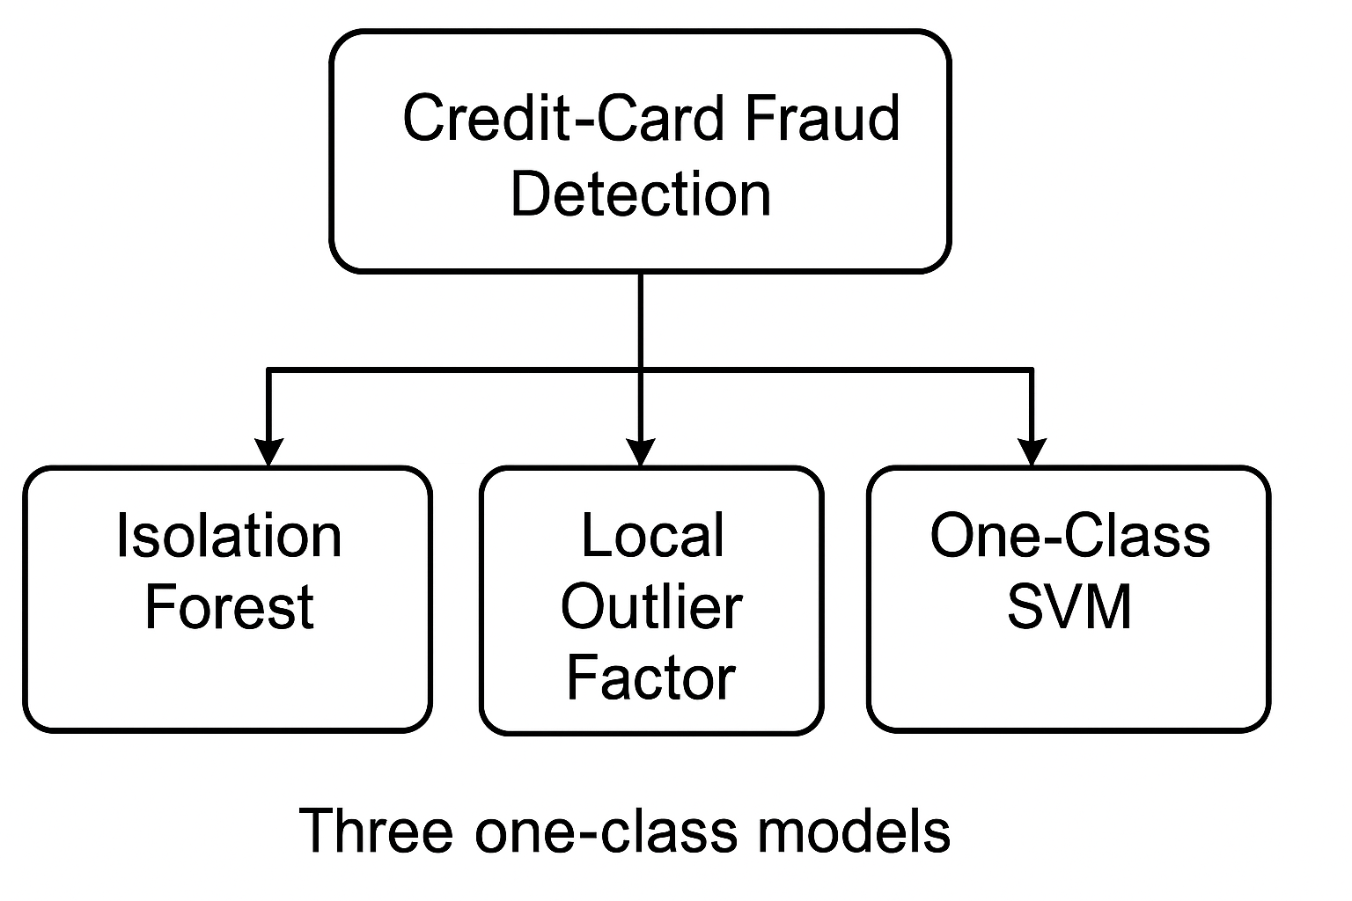
Abstract
We detect rare credit card fraud using three models: custom Isolation Forest, custom LOF, and scikit-learn One-Class SVM.
Fraud is rare and costly; traditional methods fail due to extreme imbalance.
We built and compared models on the Kaggle ULB dataset, focusing on precision, recall, and F1-score.

Slide 3
Dataset
The ULB Credit Card Fraud dataset (Kaggle) comprises 284 807 anonymized transactions, of which 492 are fraudulent (≈ .172% fraud rate).
Feature Type | Description
PCA Components | V1–V28: Confidential principal components derived from original transaction attributes
Temporal Features | Time: Seconds elapsed since the first recorded transaction TxnFreq_1h: Number of transactions by the same card in the past hour
Monetary Feature | Amount: Transaction amount (standardized)
Class Distribution | 0.172% fraud / 99.828% legitimate

Slide 4
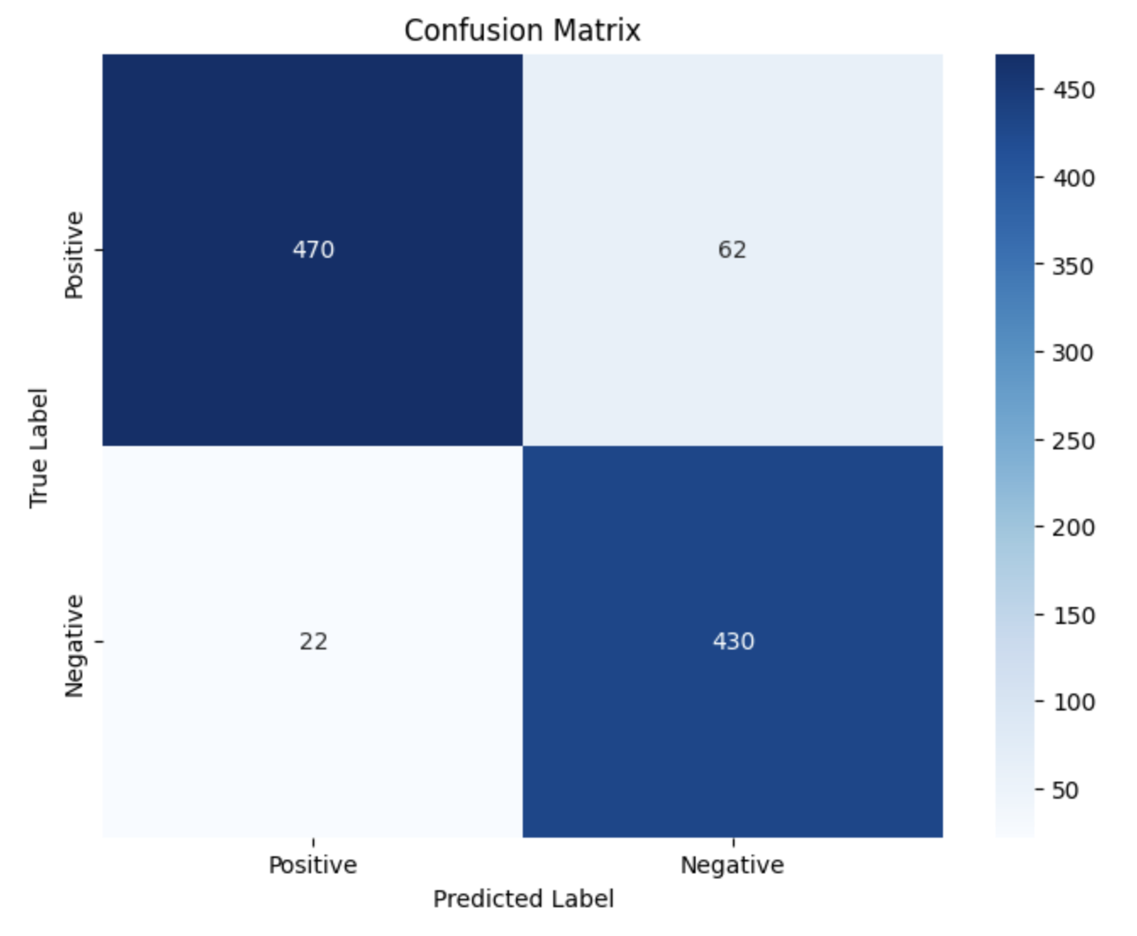
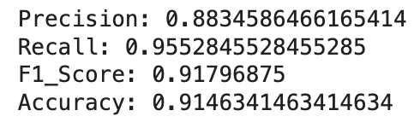
Model 1: Isolation Forest
Isolation forest is a collection of randomly generated trees. Not only does it have a very simple architecture, but it also proves to have an edge over the other algorithms when it comes to computational efficiency. It does not utilize distance or density based methods, eliminating major computational costs. It has a linear time complexity along with a low memory requirement.
This algorithm is implemented for the task anomaly detection. In a dataset dominated by one major class, anomalies can be easily detected via this algorithm.
Parameters:
Number of Trees=100
Total Height=30
Threshold=28.78
Metrics:

Slide 5
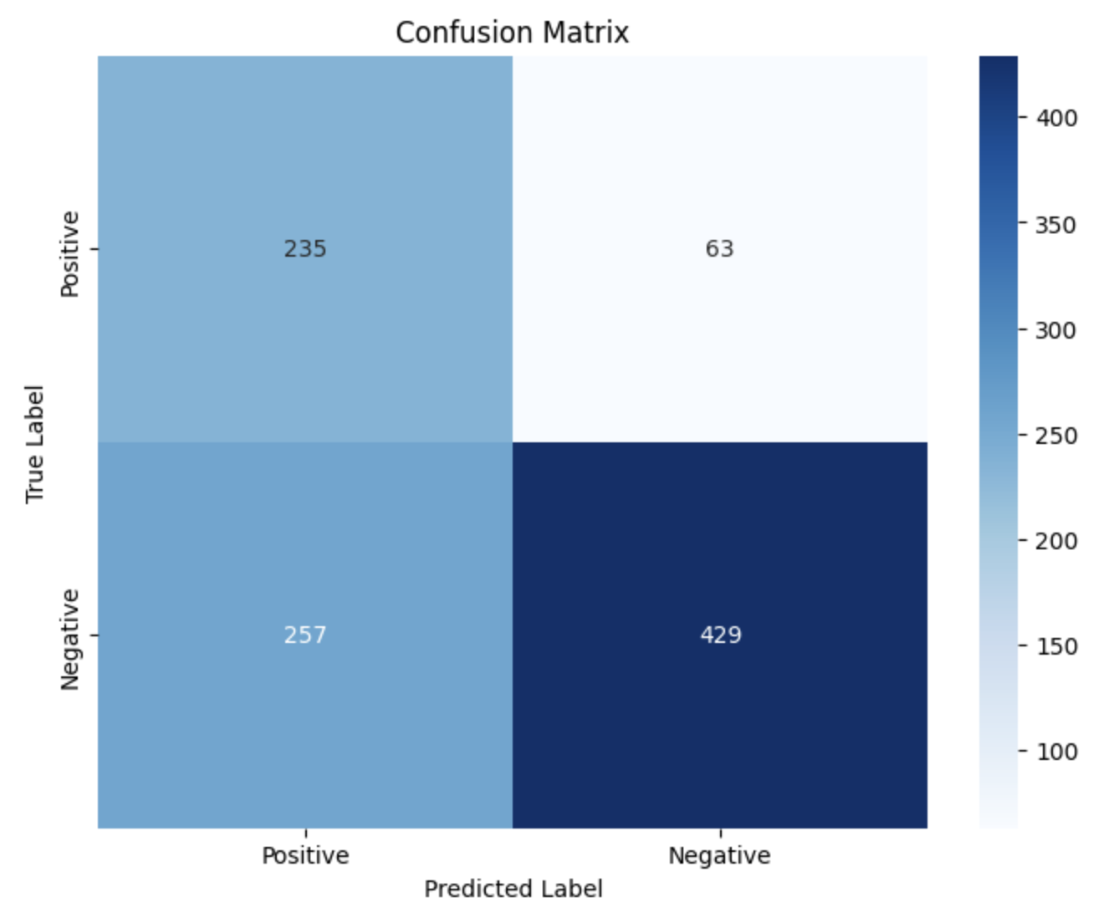
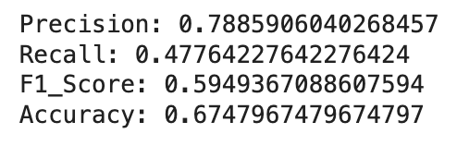
Model 2: Custom Local Outlier Factor (LOF)
Local Outlier Factor is a KNN based algorithm useful for classifying outliers in data. It is useful for Anomaly Detection. It is a density based outlier function, which classifies anomalies based on a score obtained known as LOF, to classify whether a function is an anomaly or a normal point.
The model was tested on the same data as Isolation Forest. Although this algorithm is not susceptible to local density, it performs poorly on models with many features. It also takes on simple approaches to find anomalies, hence it is not a powerful model on data with high features.
Parameters:
K=100 (number of neighbors)
Threshold=1.022706367005985
Metrics:

Slide 6
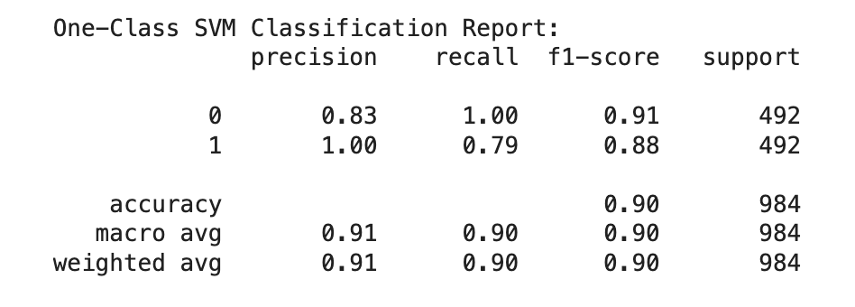
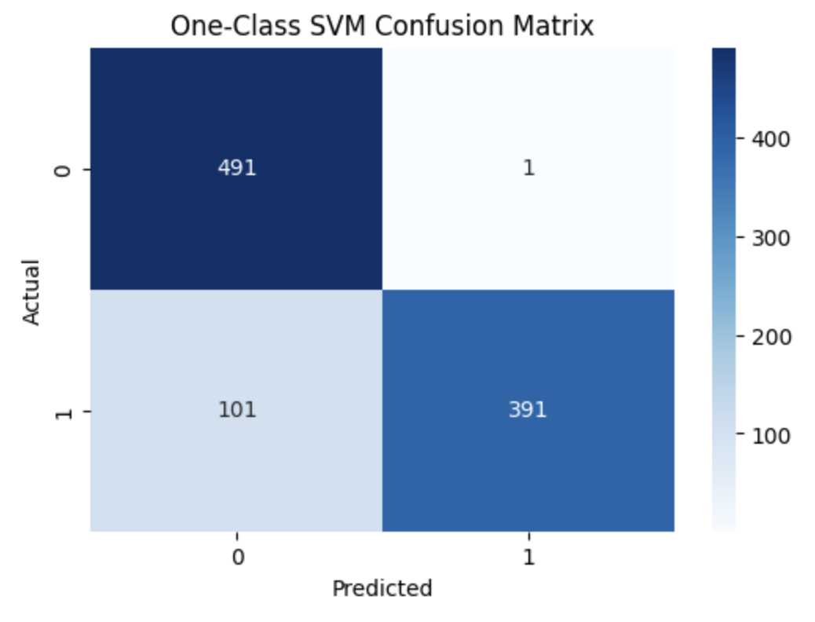
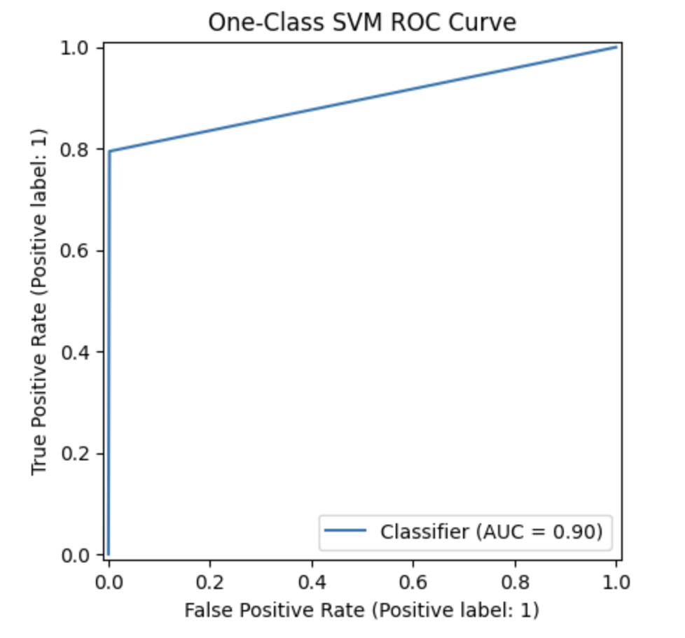
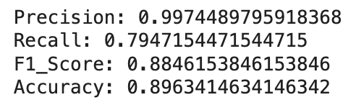
Model 3: One-Class SVM (Scikit-learn)
The idea of a Support Vector Machine (One class) is that, lower the value of dot product of w and xi, the higher the chance of xi being anomalous, where w represents weights of the model whereas xi is the input. One Class SVM assumes the origin to be the negative classification and aims to maximize the distance between the Class data and origin.
To help the model perform even better, we can introduce non linearity via kernels. These facilitate in handling non linearity without being in a higher space, as the kernel computes the dot product directly.
Parameters:
kernel='rbf'
nu=0.002
gamma='scale'
Metrics:

Slide 7
Model Performance Comparison:
Among the three models, the Custom Isolation Forest offers the best overall performance with a strong balance of precision (0.87), recall (0.95), and F1-score (0.91), making it a scalable and robust choice for real-world fraud detection where missing anomalies is costly. While the One-Class SVM excels in precision (0.99) and handles noise well, it compromises on recall and is relatively slower, making it suitable for scenarios prioritizing low false positives. The Custom LOF, despite being useful for local anomaly detection, underperforms with the lowest recall (0.48) and struggles with scalability, limiting its effectiveness on large, high-dimensional datasets.
Model | Precision | Recall | F1-Score | Strengths | Limitations
Isolation Forest(Custom) | 0.87 | 0.95 | 0.91 | Scalable, robust, interpretable | No tuning, fixed params
LOF(Custom) | 0.79 | 0.48 | 0.59 | Local anomaly detection | O(n²) complexity, subset only
One-Class-SVM (sklearn) | 0.99 | 0.79 | 0.88 | High precision, robust to noise | Lower recall, slower

Slide 8
THANK YOU

