Slide 1

V É L O R A P A R F U M S
Haute Parfumerie E-Commerce Web Application
Course: DTI 224 — Web Development Final Project
Developer: RexX0Dora1005 • Technology: HTML5, CSS3, JavaScript (DOM/BOM)

Slide 2
01. INTRODUCTION
Project Vision & Brand Concept
Why VÉLORA Luxury Perfume?
✦ Haute Parfumerie Identity
Simulates an authentic French boutique experience inspired by houses like Chanel, Dior Privée, and Creed.
✦ Comprehensive Flow
Demonstrates the complete customer journey: discovery, olfactory curation, sizing, cart management, and official receipting.
✦ Interactive Engagement
More than a static catalogue: features an interactive Scent Sommelier quiz and bespoke calligraphy gifting.
Academic & Technical Goals
✦ DTI 224 Objectives
Applies core curriculum: semantic HTML5 tags, CSS3 modern flexbox & grid architecture, and BOM/DOM event handling.
✦ Zero Dependency Architecture
Written in pure vanilla JavaScript without bulky frameworks, achieving blazing speed and clean code readability.
✦ State Management
Maintains shopping bag and discount state seamlessly using the browser's localStorage API.

Slide 3

02. VISUAL DESIGN
Brand Identity & Editorial Aesthetics
Visual System Architecture
✦ Palette: Obsidian & Gold
Primary background #0a0a0a, deep charcoal surfaces, and warm metallic gold #d4af37 accents.
✦ Typography Pairings
Cormorant Garamond (Editorial luxury serif for titles) paired with Montserrat (clean legible sans for UI).
✦ Glassmorphism & Lighting
Backdrop blurs (12px), subtle gold glows, smooth cubic-bezier hover transitions, and marble podium depth.
✦ Atmospheric Sillage
Product photos designed with mood-specific lighting: smoky noir, soft rose petals, water ripples, and amber haze.

Slide 4
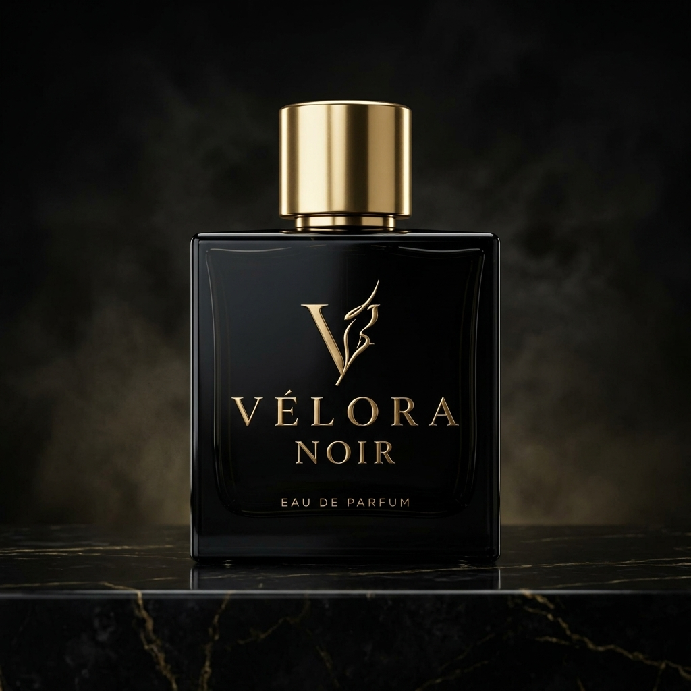

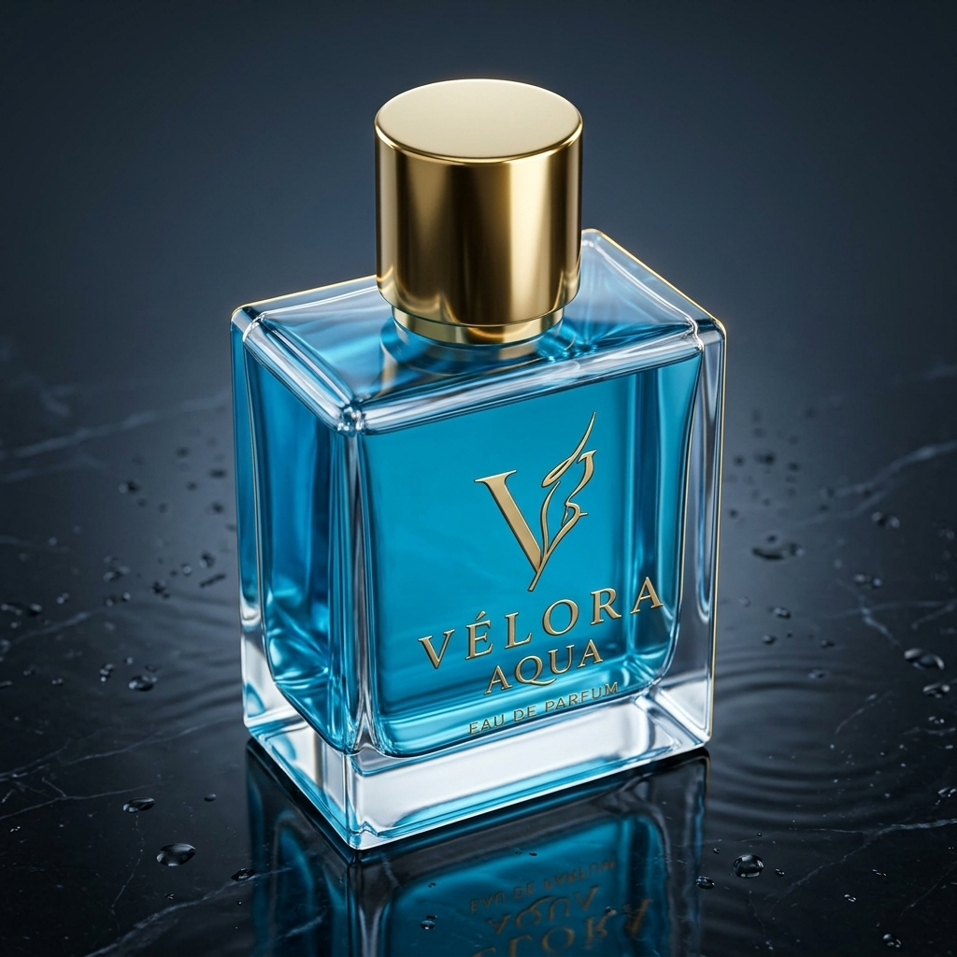
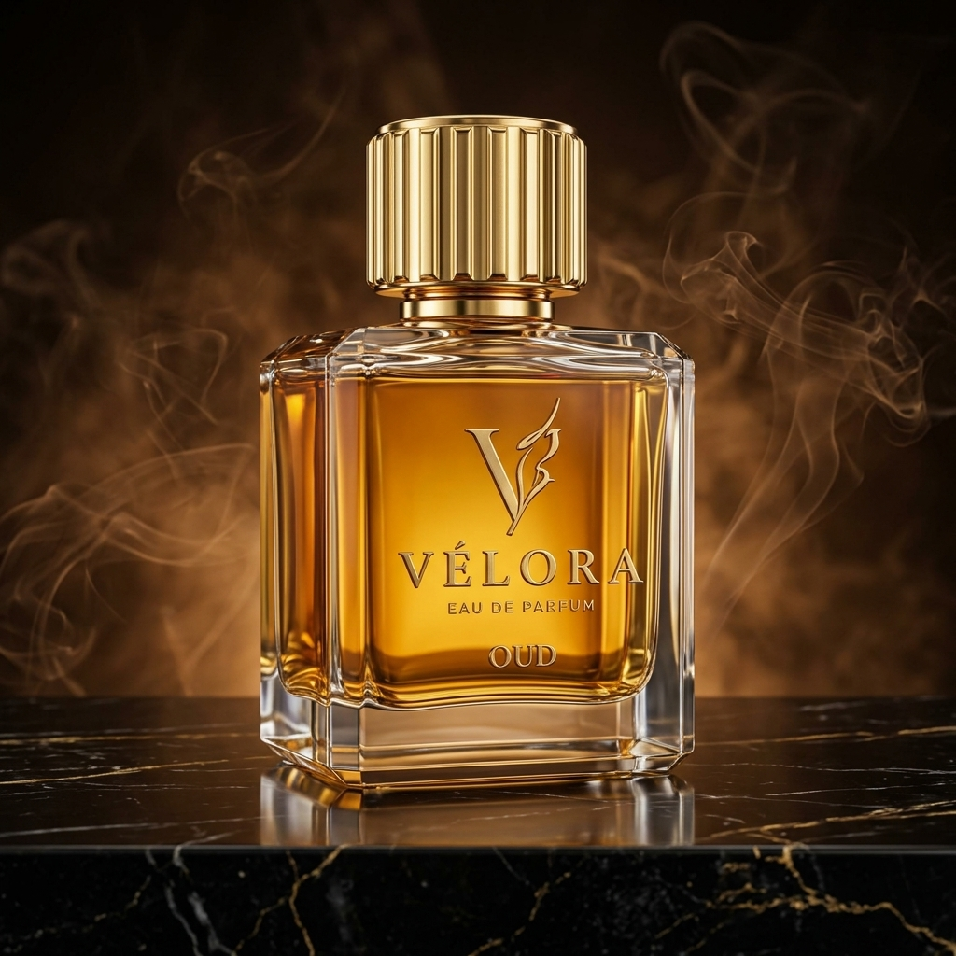
03. PRODUCT CATALOG
The Four Olfactory Masterpieces
VÉLORA NOIR
Dark & Mysterious
Price: ฿1,290
Notes: Pepper, Smoked Cedar, Tonka, Amber
VÉLORA BLOOM
Floral & Sweet
Price: ฿1,190
Notes: Lychee, Damask Rose, Jasmine, Sandalwood
VÉLORA AQUA
Fresh & Oceanic
Price: ฿1,090
Notes: Sea Salt, Mandarin, Marine Accord, Driftwood
VÉLORA OUD
Warm & Woody
Price: ฿1,390
Notes: Saffron, Cambodian Oud, Rosewood, Vetiver

Slide 5
04. ENGINEERING
Front-End Technical Architecture
Semantic HTML5
• Modern landmark tags (<header>, <section>, <article>, <aside>, <footer>)
• Dual modal architecture (Quick View Modal, 2-Column Checkout)
• Native form validation attributes (required, pattern, email)
• Custom inline SVG assets for PromptPay QR and luxury iconography
Modern CSS3
• Custom Properties (CSS variables) for consistent black & gold theming
• CSS Grid & Flexbox for multi-screen responsive design
• Hardware-accelerated animations (smooth slide-in cart, modal scale)
• Dedicated @media print stylesheet for A4 printable official receipts
JavaScript (DOM/BOM)
• Pure Vanilla JavaScript without external framework overhead
• Dynamic catalog rendering from structured product data objects
• Event-driven cart state management synchronized with localStorage
• Interactive Scent Sommelier quiz recommendation engine

Slide 6
05. SMART FEATURE
AI Scent Sommelier Recommendation Engine
Elevating E-Commerce with Interactive Personalization
✦ The Business Problem:
Fragrance is an invisible luxury. Customers online cannot smell the perfumes directly, creating hesitation.
✦ The Technical Solution:
An intuitive Scent Sommelier widget. Users select their desired emotional atmosphere (Dark, Sweet, Marine, Woody).
✦ Algorithm Matching:
JavaScript evaluates the choice, selects the matching edition object, renders scent notes, and generates an instant 'Add to Bag' button.
✦ Customer Value:
Transforms a passive browsing session into an engaging interactive boutique consultation, significantly boosting conversion rates.

Slide 7
06. CHECKOUT FLOW
Bespoke 2-Column Checkout & Voucher Engine
Client & Multi-Channel Payment
✦ Bespoke Delivery Choice
Standard White-Glove (Complimentary) vs. VIP Same-Day Chauffeur (+฿150) with instant price calculation.
✦ Personalized Calligraphy
Complimentary gift option toggle: input recipient name and custom handwritten message for recipient.
✦ PromptPay QR & Slip Upload
Generates Thai Banking QR graphic, Kasikornbank account details, and simulated slip attachment preview.
✦ Smart Card Formatting
Automatically formats 16 digits into spaced 4-digit blocks (#### #### #### ####) with expiry and CVV validation.
Voucher Engine & Bag Summary
✦ Live Manifest Preview
Itemized thumbnails, edition names, and flacon sizes displayed directly alongside order totals.
✦ Interactive Voucher Logic
Supports promo codes: 'VELORA10' (10% Off), 'VIP300' (฿300 Off), and 'MAISON' (15% Off).
✦ Real-time Discount Recalculation
Subtotal, promotional deduction, delivery surcharge, and final total calculate synchronously upon application.
✦ Security Assurance
Displays 256-bit encryption and authentic maison assurance badges.

Slide 8
07. CONFIRMATION & OUTPUT
Deluxe Digital Certificate & Invoice
Authentic Parisian Haute Parfumerie Documentation
✦ Unique Order Reference Ribbon
Generates unique tracking numbers (#VEL-XXXXXX), exact timestamps, and fulfillment progress.
✦ Itemized Commercial Manifest
Shows flacon images, Extrait concentration spec, sizes, unit pricing, and line totals.
✦ Paris Wax Seal Watermark
Artisanal extraction guarantee badge assuring formulation in Grasse, France.
✦ Calligraphy Inscription Display
Renders the customer's personal gift note in elegant italicized typography.
✦ One-Click Print Receipt (@media print)
CSS print stylesheet strips dark backgrounds and headers, outputting a clean, professional A4 PDF invoice.
✦ Client-side Text Export (.txt)
Utilizes Blob and URL.createObjectURL to instantly download a formatted plaintext order record.

Slide 9
08. DEPLOYMENT
Repository & Live Website Links
Production-Ready Deployment
✦ GitHub Source Code Repository:
https://github.com/RexX0Dora1005/VELORA-PERFUME
Complete source tree with commits, standardized asset images, and clean project documentation.
✦ Live GitHub Pages URL:
https://rexx0dora1005.github.io/VELORA-PERFUME/
Fully hosted live web app accessible on any mobile device, tablet, or desktop browser.
✦ Zero Build Step Architecture:
Vanilla HTML5 / CSS3 / JavaScript
No node_modules, bundlers, or compilation required — runs directly in vanilla browsers.

Slide 10
Thank You for Your Attention
“Discover Your Signature Scent — VÉLORA Parfums”
Questions & Feedback Welcomed

