Slide 1


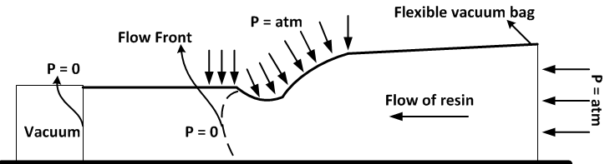
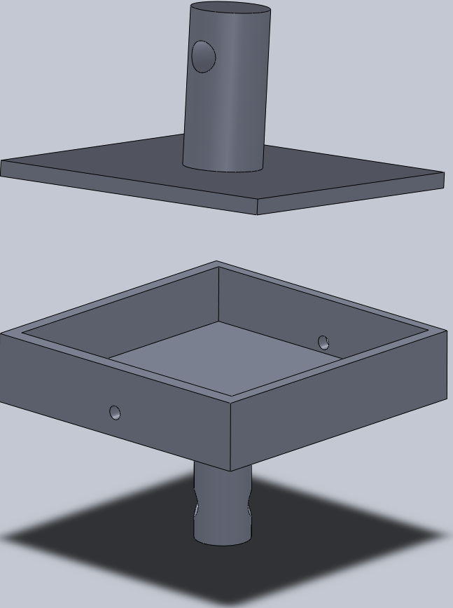
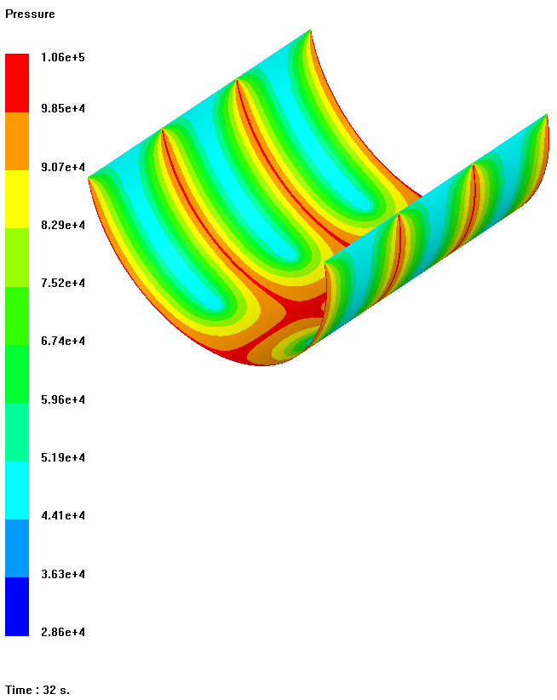
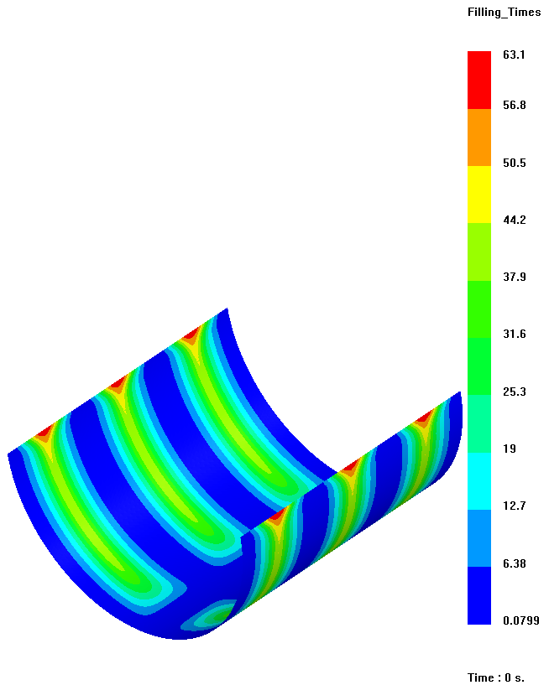
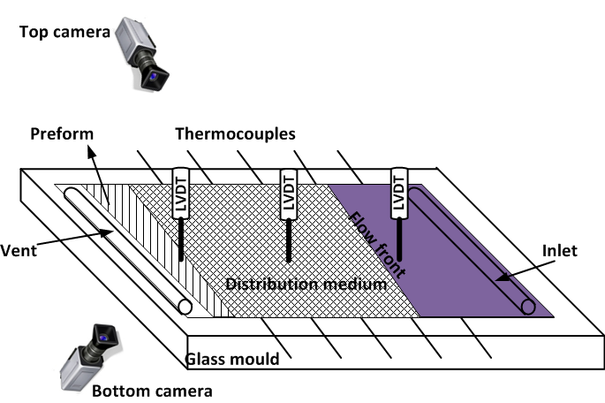

Fluid Structure Interactions Research Group
Permeability and Cure Measurements in the Vacuum Assisted Resin Infusion Process for Validation of PAM-RTM Simulation
A. Aktas, S.W. Boyd and R.A. Shenoi
Faculty of Engineering and the Environment, Fluid Structure Interactions
A.Aktas@soton.ac.uk
Background
This study investigates permeability and cure kinetics in the context of vacuum assisted resin infusion (VARI). The approach is taken as an alternative to the generally accepted permeability measurements based on the Resin Transfer Moulding (RTM) technology. This research forms part of an EPSRC project on novel fire resistant resin systems for the marine industry [1].
A multi-thermocouple system is presented and used to monitor the flow front advancement in the VARI process. The thermocouples are low-cost and durable; and demonstrated their ability to detect the flow front position without needing any temperature difference between the preform, the resin and the mould. Also, the thermocouples provide an in-built monitor of the cure period of the resin after the infusion process. PAM-RTM, a 3D simulation software package developed by the ESI Group, has been selected for simulating the resin flow and modelling the cure.
Analysis of the Vacuum Assisted Resin Infusion Process
The compaction pressure of the flexible vacuum bag and the resin pressure can significantly influence the resin permeability, fibre volume fraction ($V_{f}$) and the reinforcement properties.
Important parameters:
Compaction of preform: dry and wet states
Viscosity of resin
Porosity of preform ($1−V_{f}$)
Flow front advancement
Pressure gradient
Aims
Analysis of the VARI process and identifying the process parameters.
Development of an experimental setup.
Measurement of the permeability of non-crimp glass fibre preforms in the VARI process.
Monitoring of the cure experimentally.
Infusion and cure simulations of the VARI process with PAM-RTM simulation software.
Studying the processability of novel fire resistant resin systems.
Experimental Setup
A compaction test rig is necessary to simulate the VARI process (Figure 3)
Multi-thermocouple system for monitoring flow front and cure (Figure 4)
Monitoring of thickness change (LVDT)
In-built pressure sensors
Monitoring of flow rate
Camera
Figure 1: Compaction mechanism in the VARI process
Compression platen
PAM-RTM Simulation
The flow simulations are based on the classical Darcy`s law approach coupled with the continuity equation using a low Reynolds number Newtonian incompressible flow model under the isothermal conditions in the VARI module of PAM-RTM 2010 software.
Outlet
Inlet
Preform platen
Figure 3: Preform compaction test rig
Figure 4: Monitoring methodology of the VARI process
Figure 2: A case study presenting the pressure and filling times in the VARI process
References
[1] http://gow.epsrc.ac.uk/NGBOViewGrant.aspx?GrantRef=EP/H020926/1
Acknowledgement: This project is supported by the EPSRC
Grant Number: EP/H020926/1
FSI Away Day 2012

