Slide 1
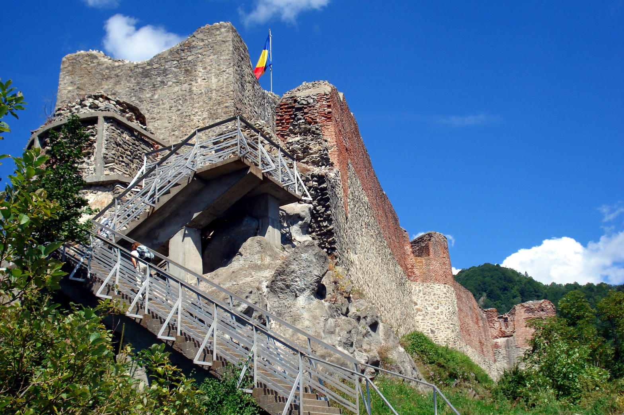
CREW BRIEFING · FIVE MEN
Project Bromania MMXXVII
Dulles. Istanbul. A countryside sleeper. Transylvania.
15–25 September 2027
Notes:
Open with the week and the two jobs. Do not start on prices.

Slide 2
THE DEAL
What this is
Five of us.
Leave Dulles Tuesday night.
Early forties. Fit. Eleven days, not a long weekend.
Turkish TK8 at 9:40pm, 14 Sep, if the 2027 timetable still has it.
Three nights in Karaköy.
About $3,000 each.
Then a night train. Then Brașov as base. Home from Bucharest on the 25th.
One guy holds the card for the big stuff. Dinners are Splitwise.
Notes:
Stress: one card, everyone else shows up.

Slide 3
ALREADY DECIDED
These five things are locked
Dates.
The crossing.
15–25 Sep 2027. October is off.
Night train Istanbul to Sofia, then a van into Romania.
Flights.
The castle.
Turkish ExtraFly. One booking, five names, one suitcase each. Not EcoFly.
Poenari the day after Bran. 1,480 steps. Vlad actually used this one.
Who books.
One admin, one card. Everyone else: passport, bag, show up.
Notes:
Locked calls. October is off.

Slide 4
TWO JOBS
If you only remember one slide
The admin (one guy, one card)
Everyone else
Buys flights, two apartments, the night train, both vans, and the tickets that sell out.
Passport valid through March 2028. One suitcase. Show up when the day says.
Drops every PDF in the group chat.
Pay meals and drinks as you go. Splitwise.
Does not pay for ten days of dinners.
Do not book a second hotel, a second taxi, or a Dracula dinner show.
Notes:
Admin vs crew. Repeat this.

Slide 5
THE WEEK
Read this once
TUE 14
Dulles, 9:40pm. Sleep on the plane.
WED 15
Land Istanbul. One van. Walk. Dinner. No museums.
THU 16
Hagia Sophia at opening. Cistern. Long trousers all day.
FRI 17
Boat in the morning. Turkish bath at 4:30pm — not 9am.
SAT 18
Buy train food. Leave at 4pm. Night train at 8pm.
SUN 19
Wake in Sofia. Coffee. Van to Romania. Do not tour Sofia.
MON 20
Bran (the photo). Râșnov. Brașov town. No cape dinner.
TUE 21
Poenari. Out at 7am. 1,480 steps. Home before dark.
WED 22
Salt mine in the morning. Palace on the way home.
THU 23
Last coffee in Brașov. South to Bucharest.
FRI 24
Old Town dinner. Flight is tomorrow morning.
SAT 25
OTP. Same Turkish ticket home.
Notes:
Walk the week. Pause on Friday 4:30pm and Saturday 4pm.

Slide 6
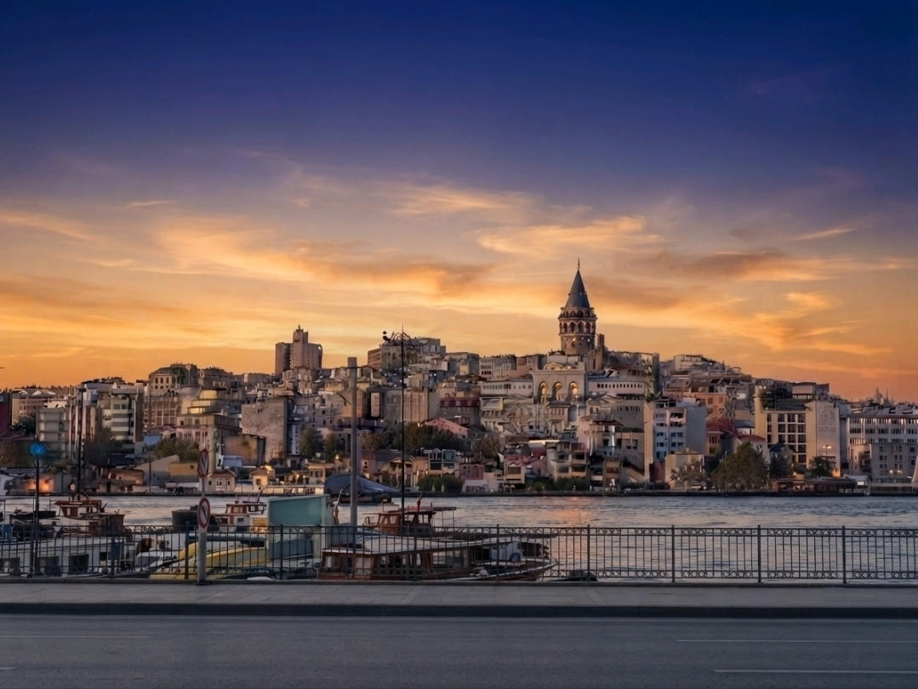
ISTANBUL · THREE NIGHTS
Karaköy, not Sultanahmet
We live on the nightlife side of the water. A whole apartment if we can get one. First night is not for monuments.
Wednesday: land, one van, walk Galata, a real meyhane. Curfew 11:30. Jet lag wins.
Thursday: the old city once, at opening, then we leave.
Friday: the strait, then steam. Pack for the train.
Notes:
Karaköy is the neighborhood. First night is not museums.

Slide 7
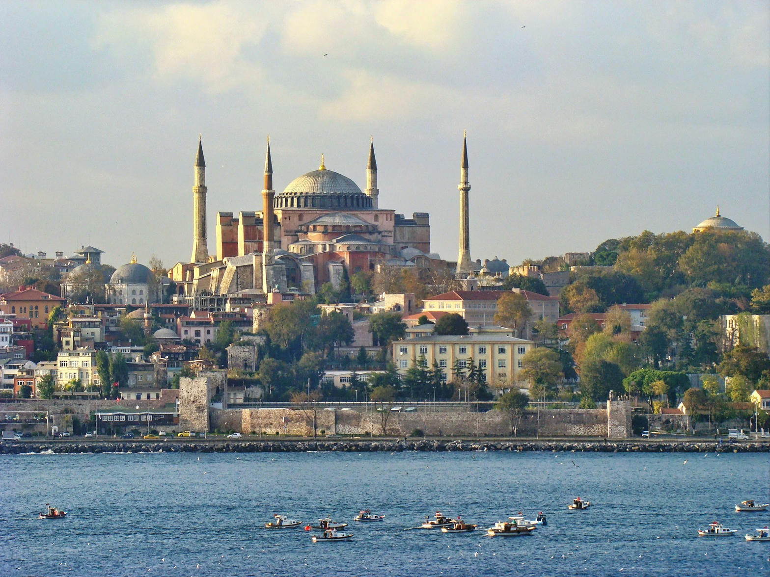
THURSDAY 16 SEP
One day in the empire
Hagia Sophia when it opens. Then the underground cistern. One more museum only if you still have legs.
Long trousers, shoulders covered. Downstairs by 8am.
Gallery ticket is about €25. The museum pass does not work here.
Cistern: yerebatan.com or the window. Never a site named basilica-cistern.com.
Notes:
Hagia Sophia at opening. Fake cistern sites exist.

Slide 8
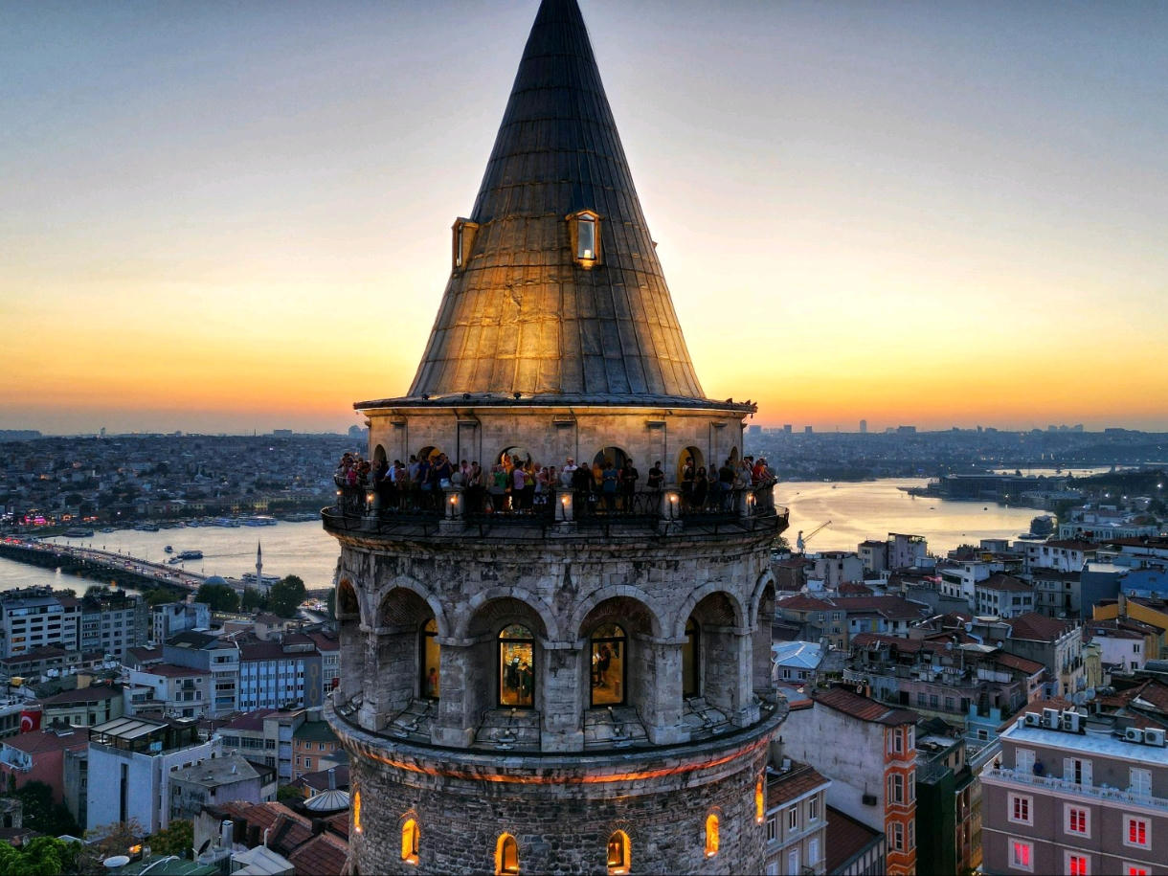
FRIDAY 17 SEP · THE ONE PEOPLE GET WRONG
Boat in the morning. Bath at 4:30.
Men-only hours at Kılıç Ali Paşa are 4:30pm to 11:30pm. Nine in the morning is women’s hours. Do not book 9am.
10:00 — two hours on the Bosphorus. Public ferry or a private boat. No dinner-cruise with a DJ.
16:30 — 16th-century bath, five of you, a very serious man with a mitt. Spare underwear.
20:00 — last Karaköy table. Picnic is tomorrow morning, not tonight.
Notes:
Scream 4:30pm. 9am is women.

Slide 9
THE CROSSING
The night train to Bucharest is closed
The bridge is shut.
Do not buy a 2026 timetable.
Giurgiu–Ruse is closed 5 April to 13 December 2027. That is the only normal train into Bucharest.
An Istanbul–Bucharest sleeper you saw last year will not exist that week.
Real plan.
Backup.
Istanbul–Sofia Express, 8pm from Halkalı. Then a van into Romania.
If the train is sold out: fly Istanbul to Bucharest. Still a trip. Worse story.
Notes:
Friendship Bridge closed all of 2027.

Slide 10
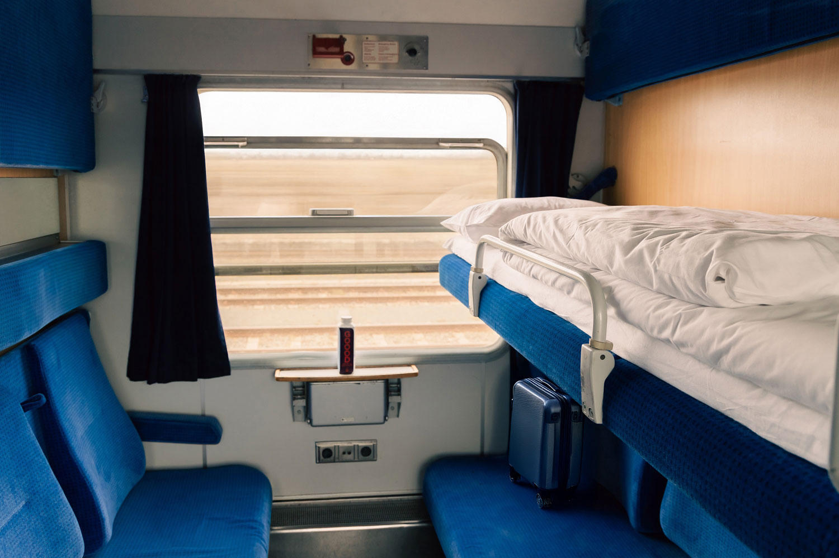
SATURDAY 18 SEP
The countryside sleeper
Three small lockable rooms. Two sharing, two sharing, one alone. There is no restaurant on this train. Complimentary snacks are a pretzel and a chocolate.
Buy food Saturday morning in Karaköy. Cheese, bread, fruit, one bottle. Fridge in the berth.
Leave the apartment at 4pm. Halkalı is 45–70 minutes west. The station is not a grocery store.
Train at 8pm. Passports in your pocket. Heavier guys get the lower beds.
Notes:
No dining car. Leave at 4pm.

Slide 11
TWO CASTLES · THEY ARE NOT THE SAME
Postcard, then the story
Monday · Bran
Tuesday · Poenari
The silhouette everyone already has in their head. Weak link to Vlad. You still go, because the photo is the photo.
Vlad Țepeș rebuilt this citadel in the 1450s. He did not live at Bran. He used this cliff.
· 90 minutes, then leave.
· 1,480 concrete steps. No tram.
· Monday may open at noon — if so, Râșnov first.
· Leave Brașov at 7am. Back before dark.
· Râșnov is the better ruin, ten minutes up the road.
· About 30 lei, cash, at the booth.
· No Dracula dinner show.
· Do not add the high mountain road.
Notes:
Bran is the photo. Poenari is the story.

Slide 12
WHY WE CAME TO ROMANIA
You earn this one
Broken wall, wind, a drop into the Argeș gorge. Forty-five minutes up. At the top: a courtyard the Impaler actually held. Five men in their forties, autumn, nobody selling capes. That is the dude-trip photograph.
Boots. Water. No racing.
The ruin is small. The cliff is the point.
Vidraru Dam for lunch. Same road home.
Notes:
1,480 steps. Out at 7am.

Slide 13
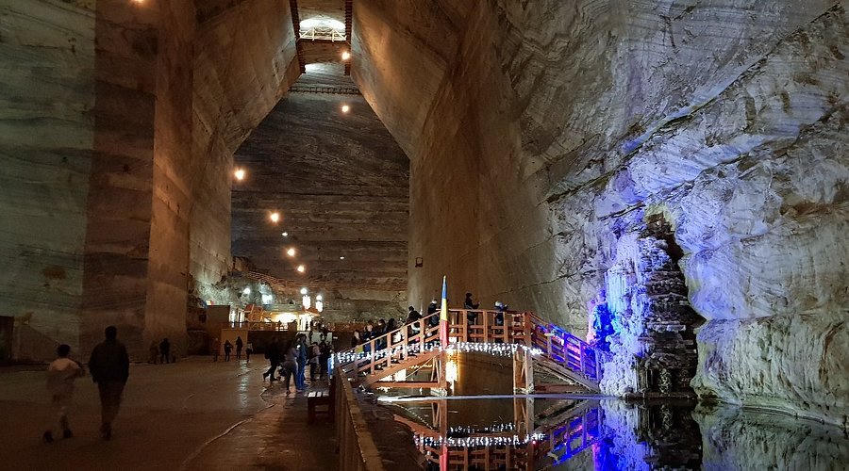
WEDNESDAY 22 SEP
Under the mountain, then a palace
A stadium hollowed out of salt, 208 meters down, air at 13°C. Then, on the corridor home, a royal fever dream of carved wood and armor.
Sweater. Tickets at the mine window, about 60 lei. 90 minutes is enough.
Peleș is timed. Book an afternoon slot. Closed Monday and Tuesday.
Skip the little castle next door.
Notes:
Sweater in the mine. Peleș afternoon.

Slide 14
MONEY
What it actually costs
ON THE CARD, FIVE OF YOU
A HEAD, ON THE CARD
PLAN TO BRING
$11,180
$2,236
$3,000
Flights, ExtraFly
$1,200
Two apartments
$328
Train + two vans
$342
Tickets you buy ahead
$236
Insurance + eSIM
$130
Food and drink
~$750
The $2,236 is the card total — flights, beds, train, vans, tickets, insurance. Food is extra, paid on Splitwise. Prices are 2026 guesses for 2027, not a quote. Walk-up cash (Poenari, the mine) is small and not in the card number.
Notes:
$2,236 on the card. $3,000 all-in. Food is Splitwise.

Slide 15
BAGS
One suitcase. That is the fare.
Buy ExtraFly.
Checked: 23 kg.
That is the row that includes a checked suitcase. EcoFly often has none. Q is just the cheap price, not a different plane.
One bag. Over 23 kg is a fee. Over 32 kg they will not take it.
Cabin: 8 kg.
Wear the boots onto TK8.
55 × 40 × 23 cm. Istanbul weighs this. Pack 7 kg and stop.
Long trousers on the plane — mosque morning is the next day.
Notes:
ExtraFly = suitcase. EcoFly often has none.

Slide 16
BEFORE WE GO
Your job from today
Everyone
The admin
Passport valid through March 2028.
Flights this year. Apartments this week, refundable.
One suitcase that fits ExtraFly. Boots already walked-in.
Night train about eight weeks out (July 2027). Vans after that.
Splitwise on your phone. Enroll in STEP. Do not book a hotel, a taxi, or a cape dinner.
Bath, Hagia Sophia, cistern, Bran, Peleș — two to four weeks before we fly.
Notes:
Passport March 2028. Do not book a second hotel.

Slide 17
SECURITY
Kidnap and ransom: the honest call
You do not need a K&R policy.
Türkiye is Level 2. Romania is Level 1.
Classic kidnap-for-ransom is executives in Mexico or Nigeria, or the Syria border. You are five guys in Karaköy and Brașov. Neither country has a State Department kidnapping flag.
Istanbul: terrorism and arbitrary detention, not ransom. Do not photograph police. Romania is normal-precautions country. Brașov is quiet.
The fake version is the one that gets tourists.
What actually hurts people on a trip like this.
Unmarked taxi, fake police, a nightclub that will not let you leave. Stay together after dark. One van. Nobody walks home alone.
The van on the gorge road. A snatched phone. A padded bar bill. Buy medical and evacuation insurance. Rank worry in that order.
Notes:
K&R: do not buy the policy. Stay together. The van is the real risk.

Slide 18
HOUSE RULES
Do not be the guy
01
Do not be late for 4pm Saturday.
02
Do not book the bath at 9am.
03
Do not buy EcoFly.
04
Do not race the 1,480 steps.
05
Do not add the high mountain road the day of Poenari.
06
Do not book a second hotel or a Dracula show.
07
Show up. That is the whole job.
Notes:
The seven don'ts.

Slide 19
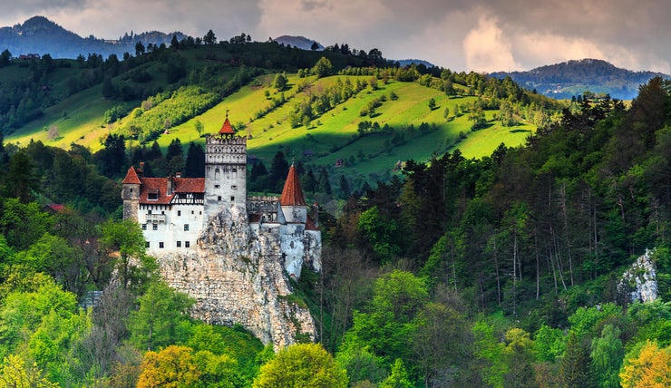
PROJECT BROMANIA MMXXVII
The postcard is Bran. The story is Poenari. The night is the train.
Questions. Then we book.
Notes:
Stop talking. Take questions.

