Slide 1

Neo4j graph database
Havila Pamidi, Neeharika Kasarla, Emmanuel Ndem

Slide 2
Outline
Graph Database
Relational vs Graph database
Neo4j graph database
Cypher query languages
Hands-on Neo4j

Slide 3
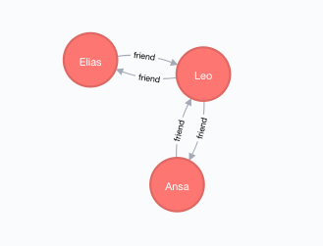
What is Neo4j?
Neo4j is a highly scalable native graph database, purpose-built to leverage not only data but also data relationships.

Slide 4
Graph database
Database that uses graph structures with nodes, edges and properties to store data.
The graph relates the data items in the store to a collection of nodes and edges, the edges representing the relationships between the nodes.
The relationships allow data in the store to be linked together directly and, in many cases, retrieved with one operation.

Slide 5
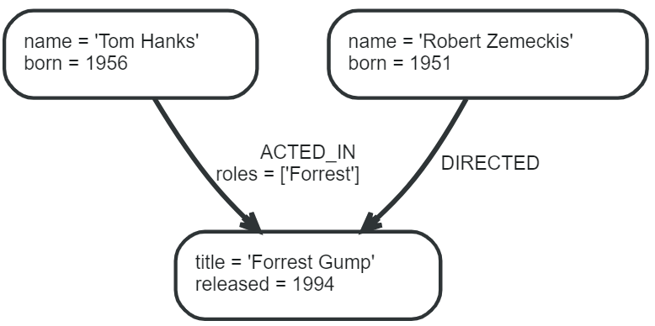
Example of a graph

Slide 6
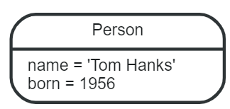
Graph components
Node :
Nodes are often used to represent entities. The simplest possible graph is a single node.
Relationship:
A relationship connects two nodes. Relationships organize nodes into structures, allowing a graph to resemble a list, a tree, a map, or a compound entity.

Slide 7
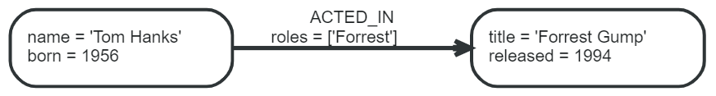
Relationship types
A relationship must have exactly one relationship type.
DIRECTED :
Below example uses ACTED_IN and DIRECTED as relationship types. The roles property on the ACTED_IN relationship has an array value with a single item in it.

Slide 8
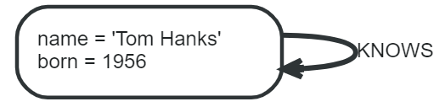
Relationship types
Relationships to itself :
Relationships always have a direction. However, you only have to pay attention to the direction where it is useful. This means that there is no need to add duplicate relationships in the opposite direction unless it is needed in order to properly describe your use case.
Note that a node can have relationships to itself. If we want to express that Tom Hanks KNOWS himself, that would be expressed as:

Slide 9
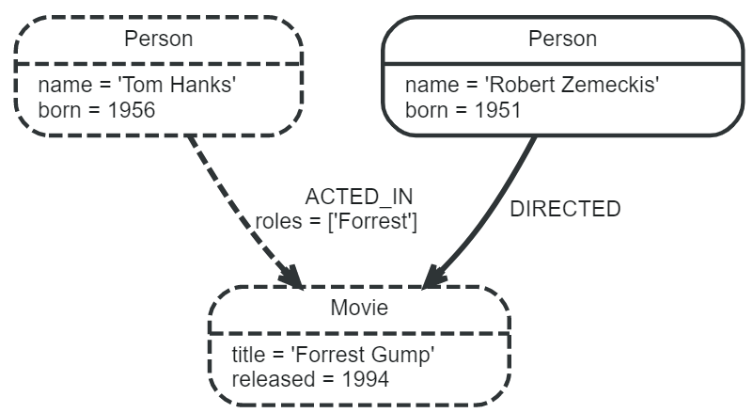
Traversals and paths
A traversal is how you query a graph in order to find answers to questions.
Traversing a graph means visiting nodes by following relationships according to some rules. In most cases only a subset of the graph is visited.
If we want to find out which movies Tom Hanks acted in according to our tiny example database, the traversal would start from the Tom Hanks node, follow any :ACTED_IN relationships connected to the node, and end up with Forrest Gump as the result (see the dashed lines):

Slide 10
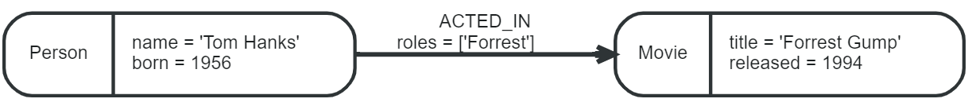
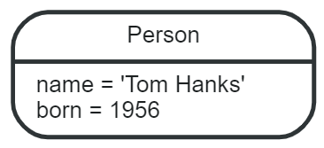
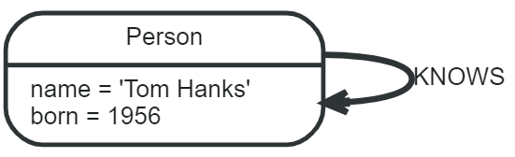
The traversal result could be returned as a path with the length one:
The path above has length one.
The shortest possible path has length zero. It contains a single node and no relationships. For example:
This path has length one:

Slide 11
Schema
A schema in Neo4j refers to indexes and constraints.
Neo4j is often described as schema optional, meaning that it is not necessary to create indexes and constraints. You can create data — nodes, relationships and properties — without defining a schema up front. Indexes and constraints can be introduced when desired, in order to gain performance or modeling benefits.
Indexes :
Indexes are used to increase performance.
Constraints :
Constraints are used to make sure that the data adheres to the rules of the domain.

Slide 12
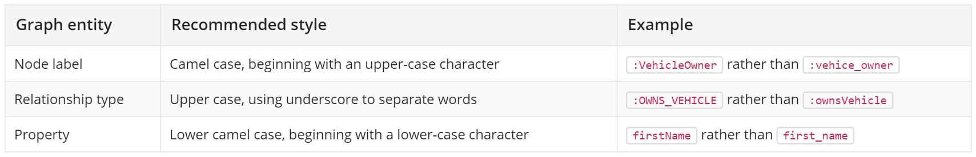
Naming rules and recommendations
Node labels, relationship types and properties are case sensitive, meaning for example that the property name means something different than the property Name. It is recommended to follow the naming conventions described in the following table:

Slide 13
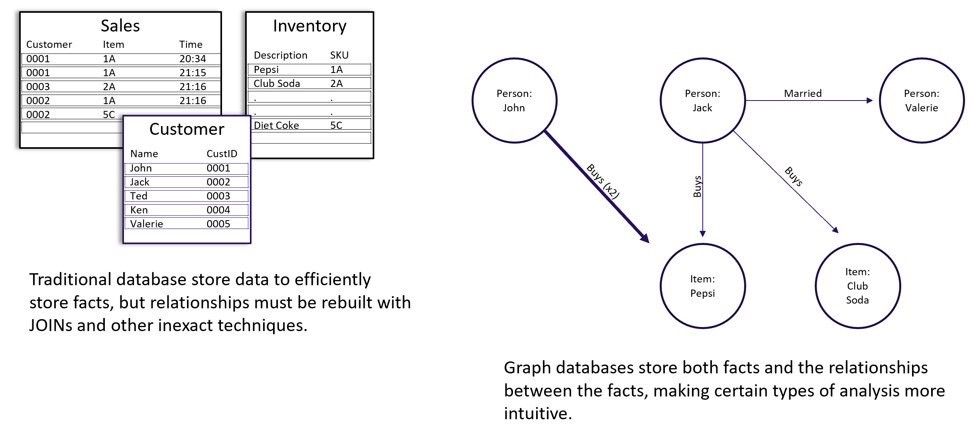
Relational vs Graph database

Slide 14
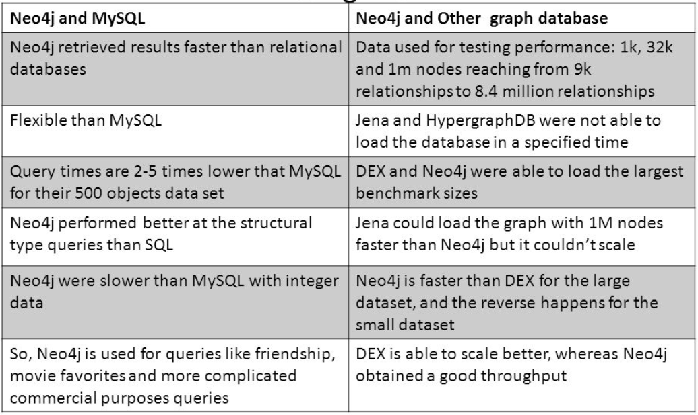
Comparison of neo4j with other databases

Slide 15
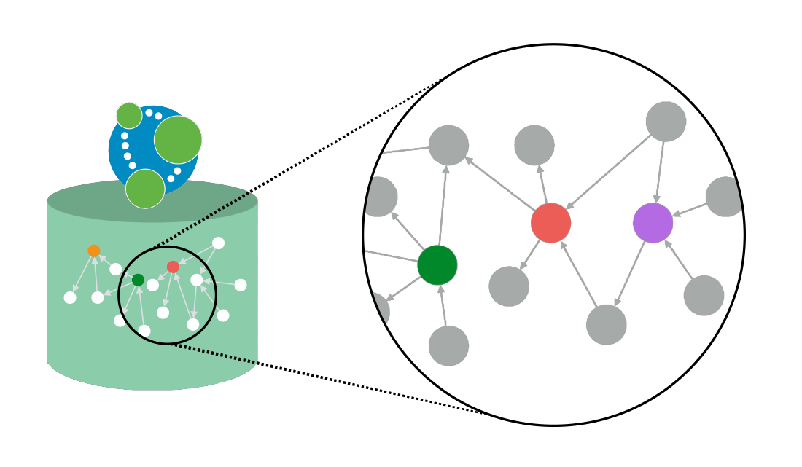
Why Neo4j?
Unlike other databases, Neo4j connects data as it is stored, enabling it to traverse connections orders-of-magnitude faster.

Slide 16
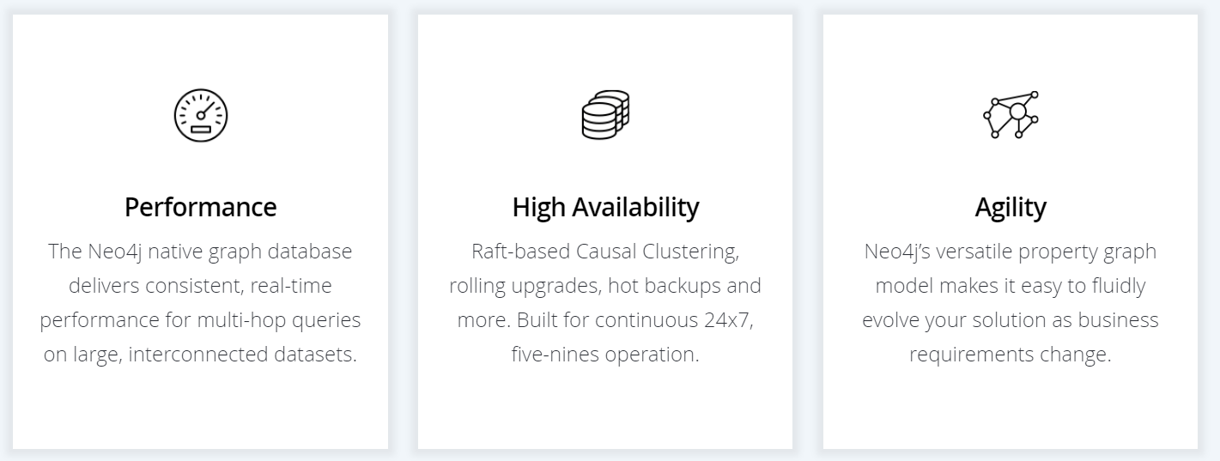
Why neo4j

Slide 17

Why Neo4j

Slide 18
Salient features of Neo4j
Neo4j is schema free – Data does not have to adhere to any convention
ACID – atomic, consistent, isolated and durable for logical units of work
Easy to get started and use
Well documented and large developer community
Support for wide variety of languages
Java, Python, Perl, Scala, Cypher, etc

Slide 19
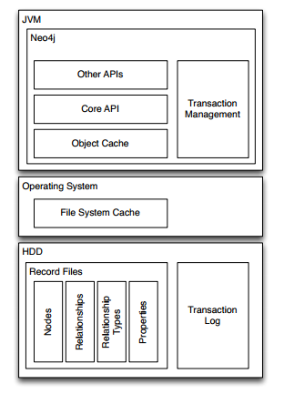
Neo4j Software Architecture

Slide 20
Cypher
Query Language for Neo4j
Easy to formulate queries based on relationships
Many features stem from improving on pain points with SQL such as join tables
Cypher, Neo4j’s query language, is strongly based on patterns. Specifically, patterns are used to match desired graph structures. Once a matching structure has been found or created, Neo4j can use it for further processing.
A simple pattern, which has only a single relationship, connects a pair of nodes (or, occasionally, a node to itself). For example, a Person LIVES_IN a City or a City is PART_OF a Country.
Complex patterns, using multiple relationships, can express arbitrarily complex concepts and support a variety of interesting use cases. For example, we might want to match instances where a Person LIVES_IN a Country. The following Cypher code combines two simple patterns into a slightly more complex pattern which performs this match:
(:Person) -[:LIVES_IN]-> (:City) -[:PART_OF]-> (:Country)

Slide 21
Node syntax
Cypher uses a pair of parentheses to represent a node: ().
Below are some examples of nodes, providing varying types and amounts of detail:
()
(matrix)
(:Movie)
(matrix:Movie)
(matrix:Movie {title: "The Matrix"})
(matrix:Movie {title: "The Matrix", released: 1997})

Slide 22
Relationship syntax
Cypher uses a pair of dashes (--) to represent an undirected relationship.
Directed relationships have an arrowhead at one end (<--, -->).
Bracketed expressions ([…​]) can be used to add details.
This may include variables, properties, and type information:
-->
-[role]->
-[:ACTED_IN]->
-[role:ACTED_IN]->
-[role:ACTED_IN {roles: ["Neo"]}]->

Slide 23
Pattern syntax
Combining the syntax for nodes and relationships, we can express patterns.
The following could be a simple pattern (or fact) in this domain:
(keanu:Person:Actor {name: "Keanu Reeves"} )
-[role:ACTED_IN {roles: ["Neo"] } ]->
(matrix:Movie {title: "The Matrix"} )

Slide 24
Clauses
Cypher statements typically have multiple clauses, each of which performs a specific task, for example:
create and match patterns in the graph
filter, project, sort, or paginate results
compose partial statements
By combining Cypher clauses, we can compose more complex statements that express what we want to know or create.

Slide 25
Creating data
We’ll start by looking into the clauses that allow us to create data.
To add data, we use the clause called CREATE. It will just go ahead and directly create the patterns that you specify.
CREATE (:Movie { title:"The Matrix",released:1997 })
Result:
+----------------------+
| No data returned. |
+----------------------+
Nodes created: 1
Properties set: 2
Labels added: 1

Slide 26
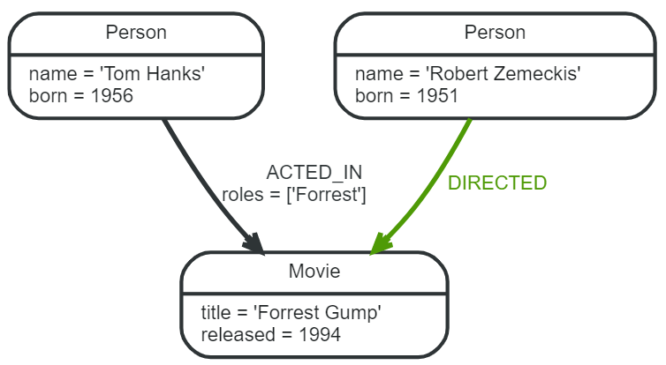
To create more than one element, we can separate the elements with commas or use multiple CREATE statements.
We can also create more complex structures, like an ACTED_IN relationship with information about the character, or DIRECTED ones for the director.
CREATE (a:Person { name:"Tom Hanks", born:1956 })-[r:ACTED_IN { roles: ["Forrest"]}]->(m:Movie { title:"Forrest Gump",released:1994 })
CREATE (d:Person { name:"Robert Zemeckis", born:1951 })-[:DIRECTED]->(m)
RETURN a,d,r,m

Slide 27
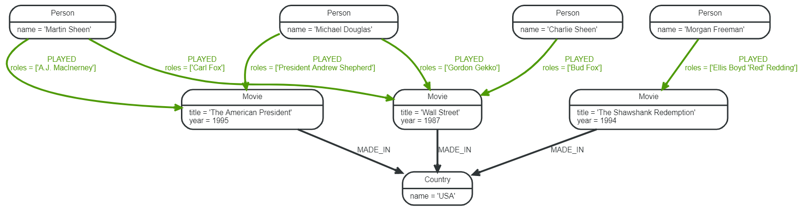
Query
MATCH (n)
WHERE n:Person OR n:Movie
REMOVE n.id

Slide 28
Hands-on Neo4j

Slide 29
Questions?

Slide 30
Thank you!!
Havila Pamidi, Neeharika Kasarla, Emmanuel Ndem

