Slide 1
XTRIM STUDIOS
Where the money went
Commercial performance review · production, merch and advertising · January 2023 – June 2025
Prepared for the Studio Director · 14 September 2026
Notes:
The Director asked: we are busier than ever and there is less money in the bank. Where is it going, and is the ad spend doing anything? This deck answers both.

Slide 2
The answer in six sentences
Each one carries a number you can check in the appendix.
1
Revenue grew 31% in naira, from ₦7.07B in 2023 to ₦9.24B in 2024, but the dollar went from an average of ₦895 to ₦2,492, so that revenue was worth $8.0M in 2023 and only $3.6M in 2024.
2
₦5.96B (30%) of the production work booked since January 2023 had not reached Completed when the data was exported, including ₦1.60B on 175 jobs from 2023–2024 still marked Invoiced.
3
Postponed work has more than doubled, from 5.9% of revenue in 2023 to 13.8% in the first half of 2025.
4
Studio Rental loses money on crew cost alone (-5.3% margin; 83 of 186 jobs), and across the business 182 jobs cost ₦140M more in crew than they earned.
5
The ₦860M spent on ads brought back ₦0.35 of tracked web-shop revenue per ₦1; they pay for themselves only if at least 6.7% of the ₦6.56B of bookings credited to Google, Instagram and TikTok came from a paid ad, and no system records whether they did.
6
Crew, ads and merch stock take only 17.1% of 2024 revenue, so the missing cash sits in what these systems do not record (dollar-priced kit and software, rent, salaries, tax) and in unpaid invoices, which is where finance should look first.
Xtrim Studios · Commercial review 2023 – H1 2025 · all money in naira (₦)
2
Notes:
Read these out. Everything after this slide is the evidence for one of these six lines.

Slide 3
What we worked with, and what we threw away
Fourteen exports from five systems. Nothing was deleted; every rejected row is kept with a reason.
282,171
What was wrong
• 15 statements in the data dictionary are false
• 2024 booking dates are month-first; 2023 are day-first
• 124 duplicate clients re-keyed under new IDs, 58 exact repeats
• 23,054 bot visits (11%) and a 5,200-visit spam burst in the web data
• USD and GBP jobs never converted; now all naira at the daily rate
• Price history with 29 overlapping windows, resolved and enforced by the database
• 319 timesheets for jobs that don't exist; 129 shifts of 26 hours
• 115 jobs with no service type; kept as 'Unknown' because they couldn't be recovered reliably
raw rows across 14 files
2,445
rows quarantined (0.87%), none deleted
6.9%
of revenue (₦1.44B) touched by issues we could not resolve
Xtrim Studios · Commercial review 2023 – H1 2025 · all money in naira (₦)
3
Notes:
The data was bad in ways the handover did not mention: the data dictionary is wrong in fifteen places. The dashboard shows the quarantine tile so anyone can see what was set aside.

Slide 4
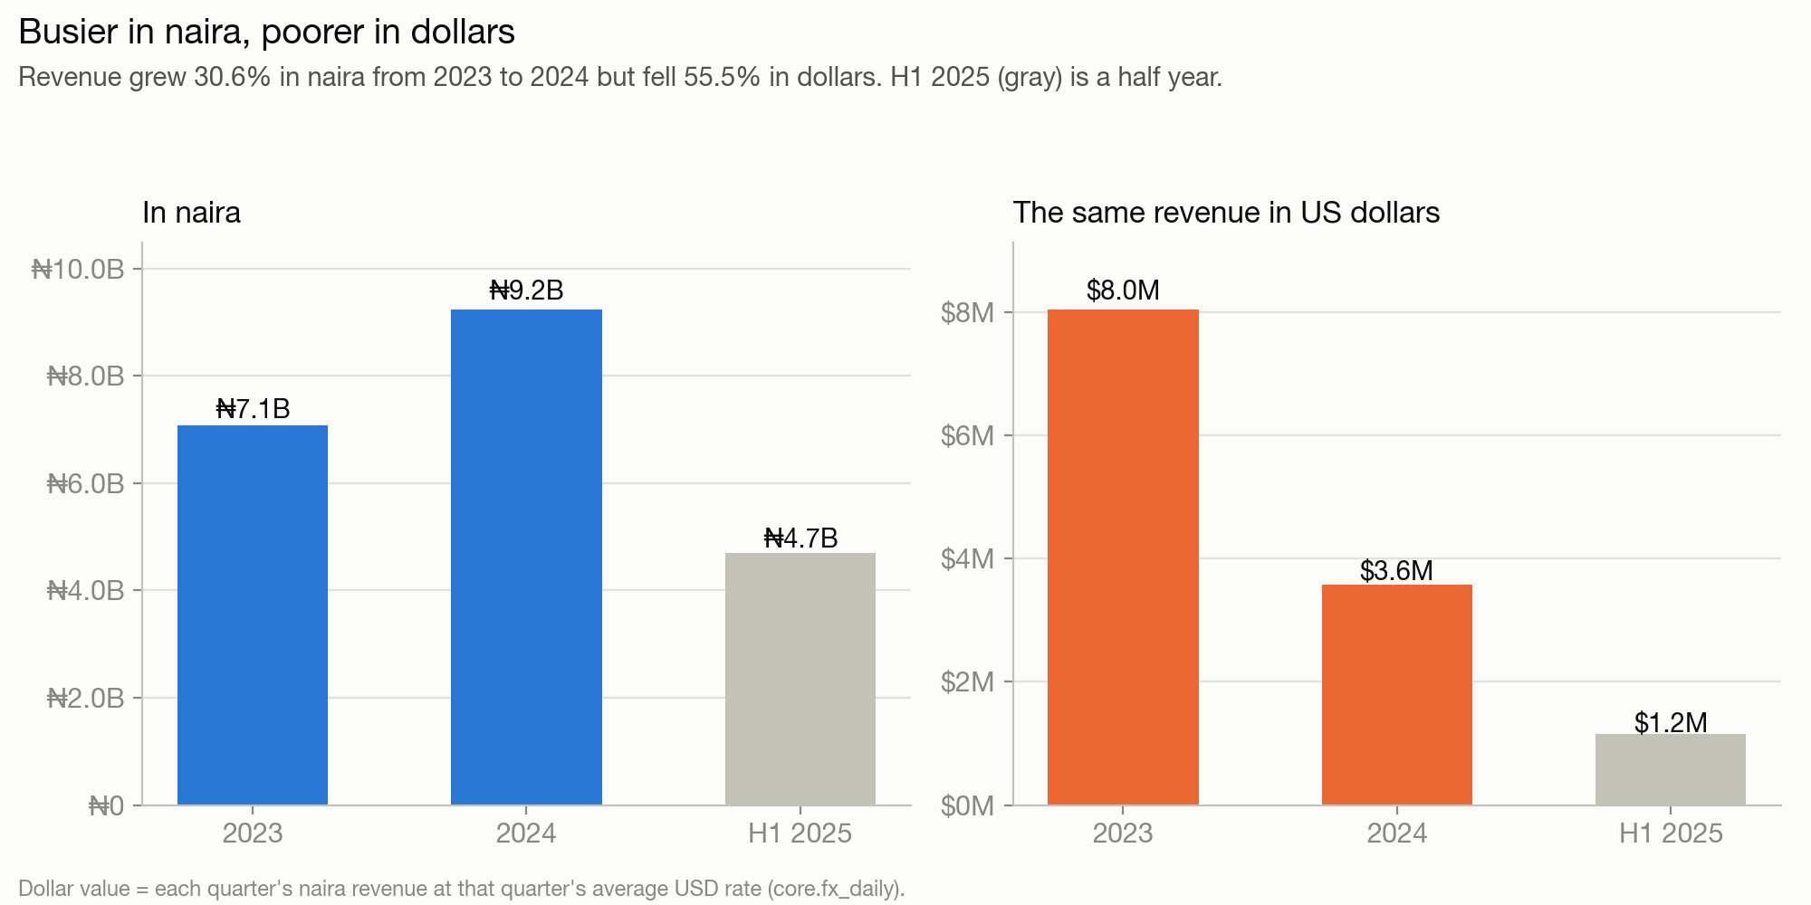
Busier in naira, poorer in dollars
The naira collapse turned real growth into a real-terms decline.
+31%
revenue growth in naira, 2023 → 2024
−56%
the same revenue in dollars
90%
value the naira lost against the dollar (₦465 → ₦4,731)
Xtrim Studios · Commercial review 2023 – H1 2025 · all money in naira (₦)
4
Notes:
Revenue in naira grew every year. But anything priced in dollars (cameras, lenses, software, travel) now costs roughly ten times as many naira as in January 2023. In dollar terms the studio earned less than half as much in 2024.

Slide 5
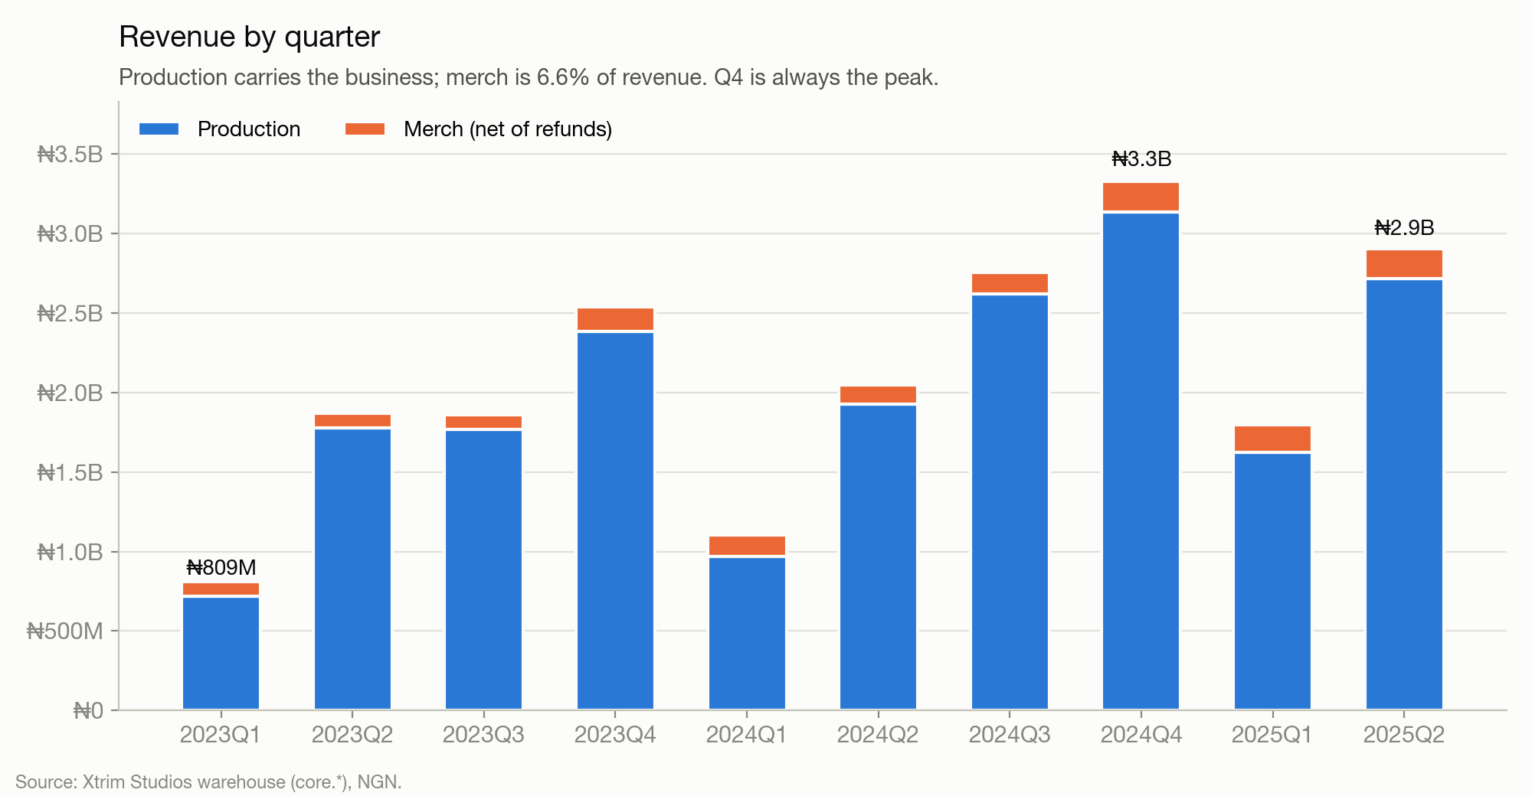
Production carries the business
Revenue by quarter, production and merch.
₦21.02B
total revenue, Jan 2023 – Jun 2025
6.6%
of revenue from merch
+49%
H1 2025 vs H1 2024, in naira
Xtrim Studios · Commercial review 2023 – H1 2025 · all money in naira (₦)
5
Notes:
Q4 is the peak every year; Q1 is the trough. This chart ties exactly to SQL question 1 and to the dashboard.

Slide 6
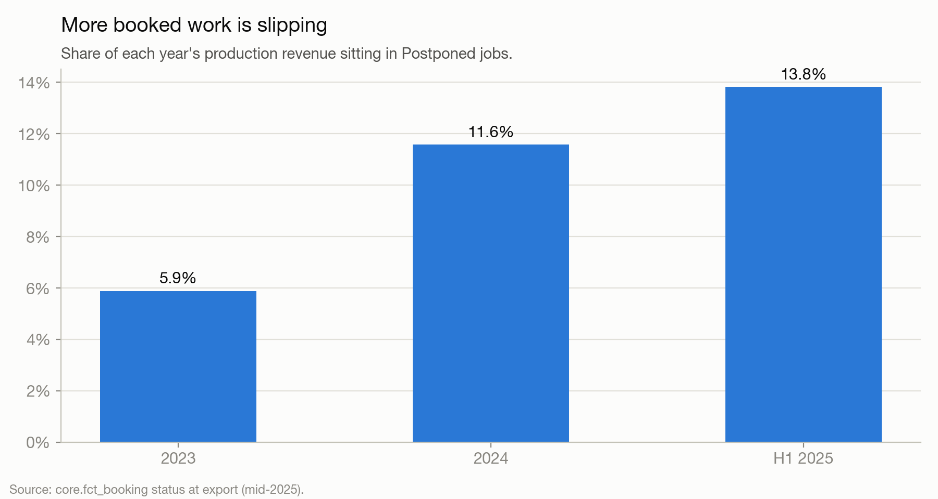
Booked is not banked
Almost a third of production revenue is in jobs that are not complete.
₦5.96B
(30%) invoiced, in production, postponed or no status
₦1.60B
on 175 jobs from 2023–2024 still marked Invoiced
13.8%
of H1 2025 revenue postponed, up from 5.9% in 2023
Xtrim Studios · Commercial review 2023 – H1 2025 · all money in naira (₦)
6
Notes:
Status is a snapshot from mid-2025. We read Invoiced as billed but not paid. If that holds, over a billion naira of 2023–2024 work has not been collected. This is the first thing to reconcile against the bank.

Slide 7
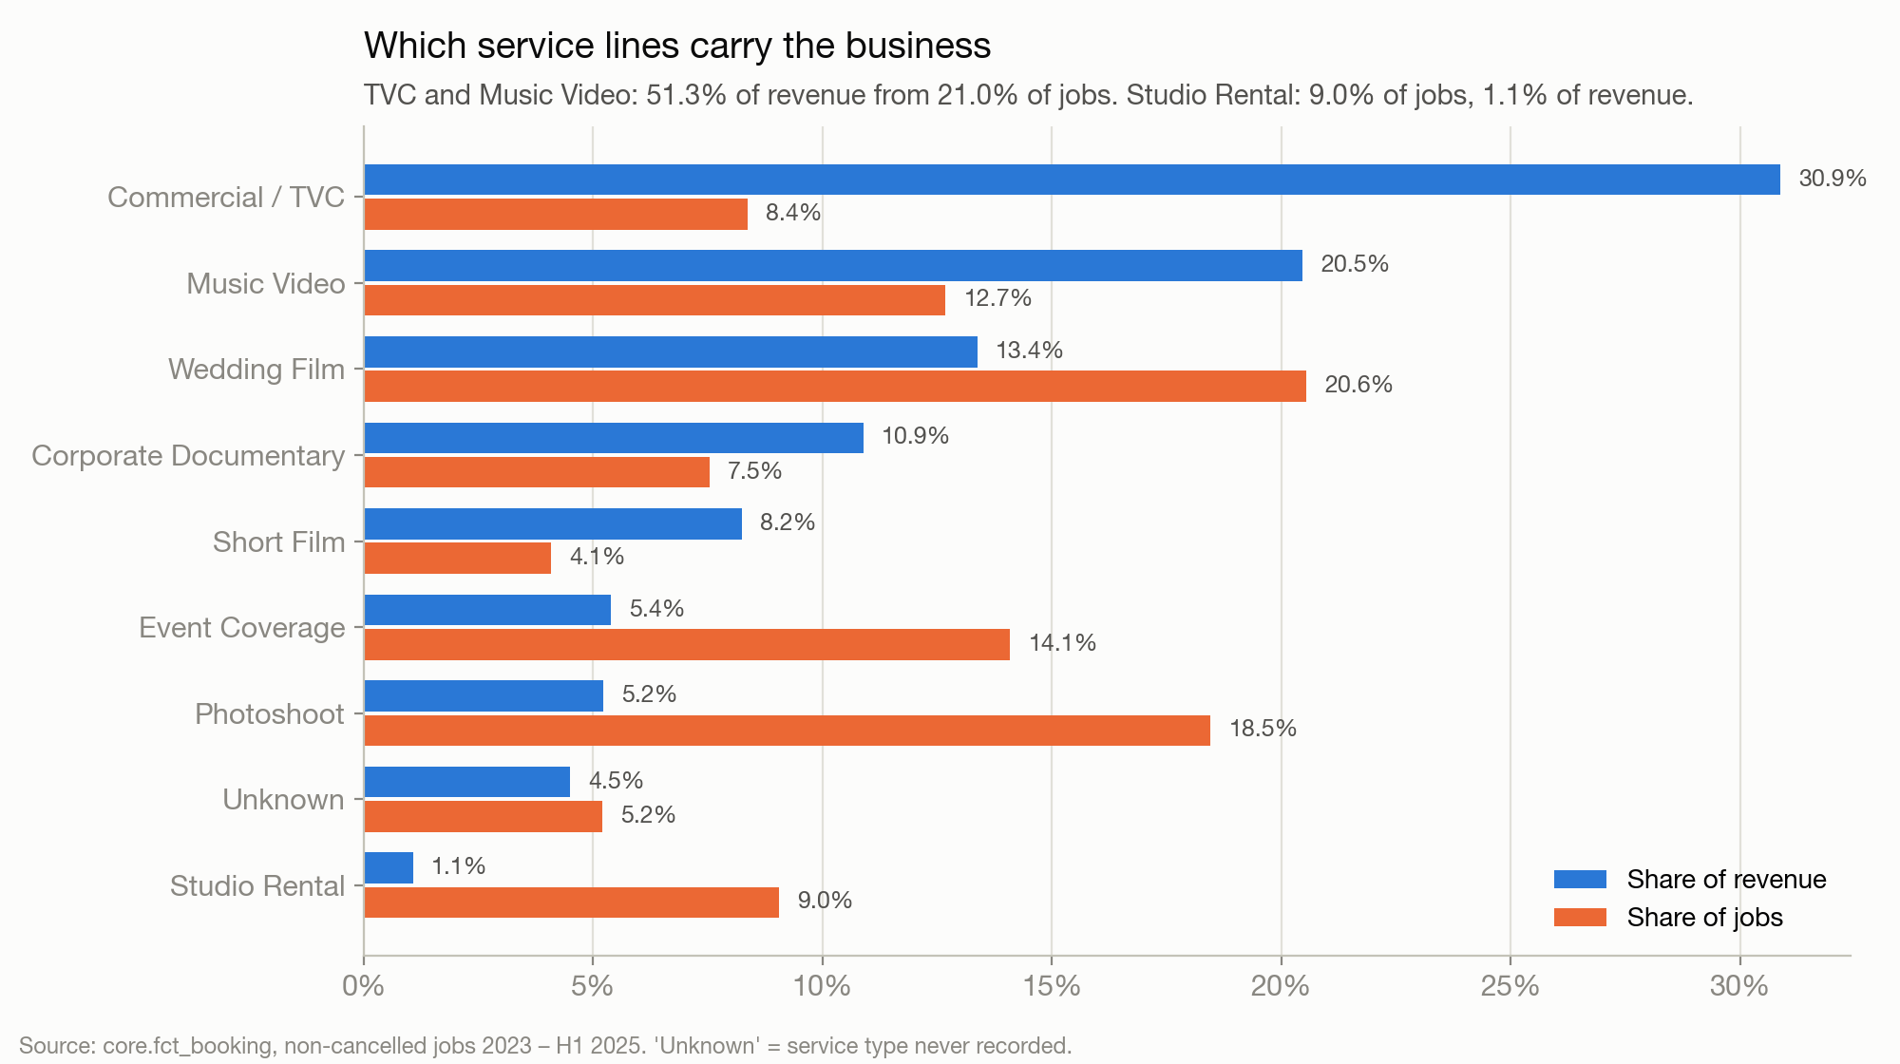
Two service lines earn half the money
Share of revenue vs share of jobs.
51%
of revenue from Commercial / TVC and Music Video, 21% of jobs
423
wedding jobs, the most of any line, but 13% of revenue
1.1%
of revenue from Studio Rental, 9% of jobs
Xtrim Studios · Commercial review 2023 – H1 2025 · all money in naira (₦)
7
Notes:
Carry: Commercial/TVC, Music Video, Wedding Film, Corporate Documentary. Cosmetic: Studio Rental. Photoshoot is busy work: 18.5% of jobs for 5.2% of revenue.

Slide 8
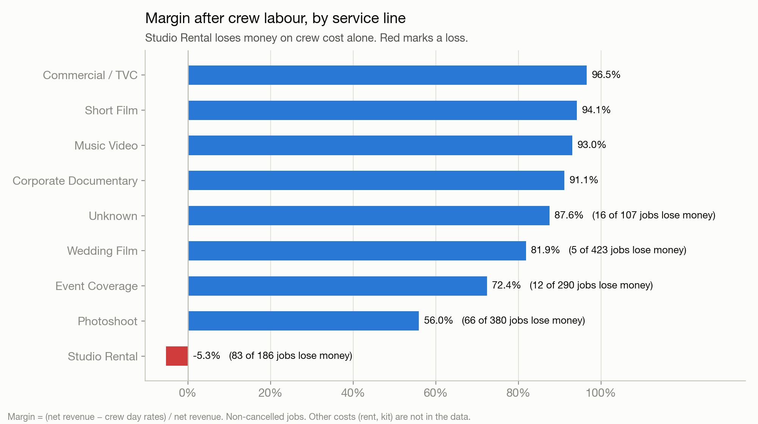
Some jobs cost more in crew than they earn
Margin after crew day rates, by service line.
-5.3%
Studio Rental margin; 83 of 186 jobs lose money
182
loss-making jobs, ₦140M lost in total
147 / 35
genuine losses / losses explained by bad timesheet data
Xtrim Studios · Commercial review 2023 – H1 2025 · all money in naira (₦)
8
Notes:
A loss is 'genuine' if it survives removing crew double-bookings and pricing unknown day rates at half rate. 147 do. The 20 worst jobs are all genuine, mostly Studio Rental and Photoshoot with 4+ crew a day.

Slide 9
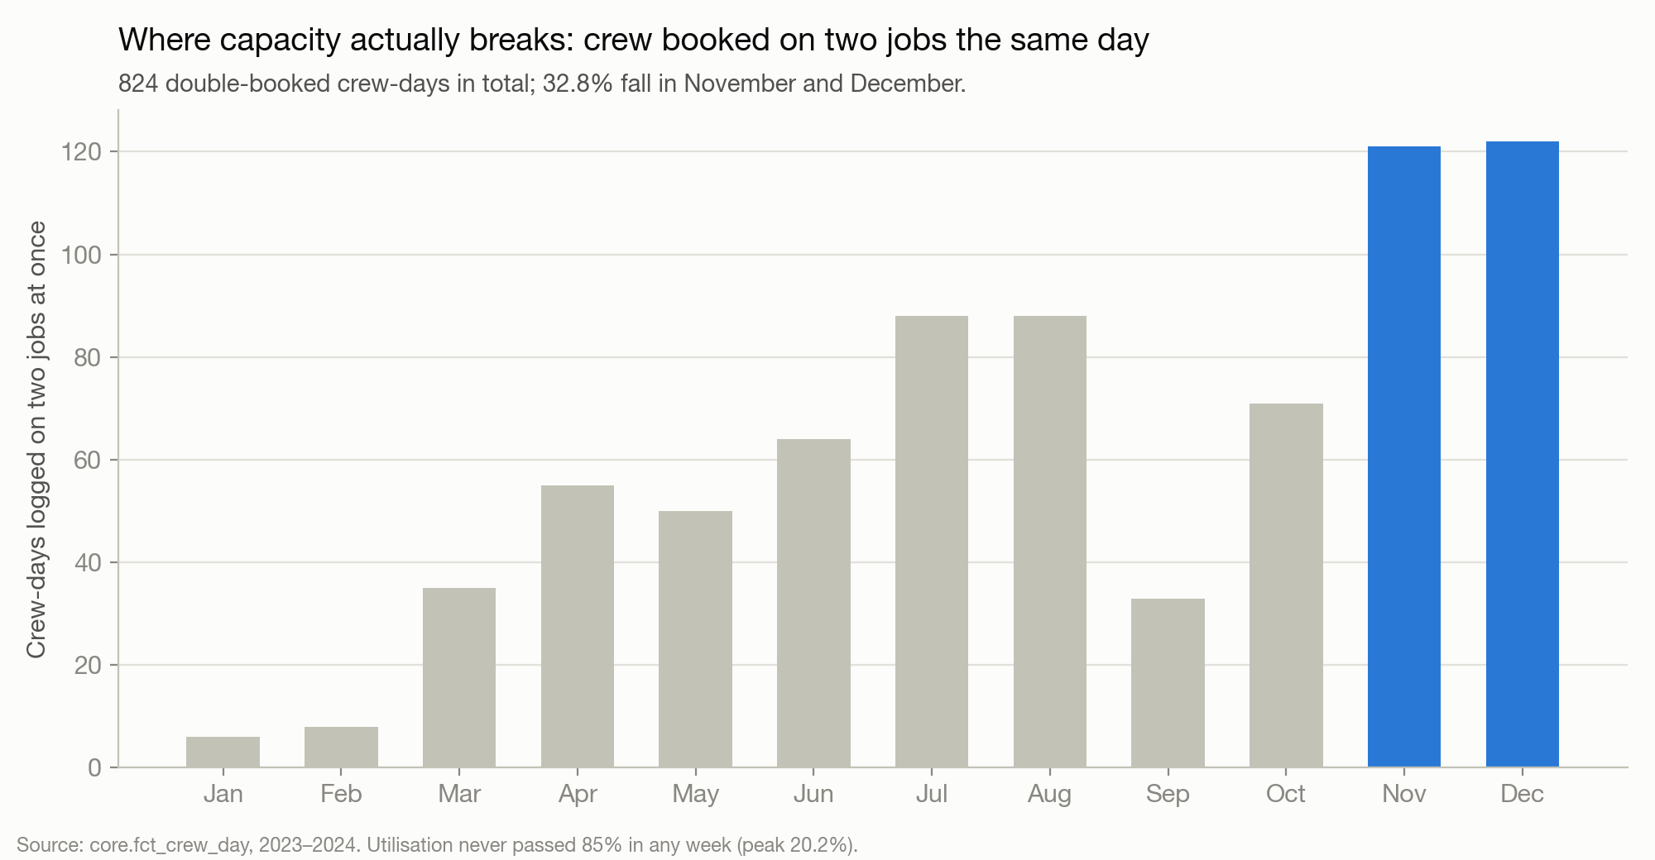
Capacity breaks in November and December
Crew logged on two jobs on the same day, by month.
0
weeks above 85% crew utilisation (peak 20%)
824
crew-days booked on two jobs at once
33%
of those in November and December
Xtrim Studios · Commercial review 2023 – H1 2025 · all money in naira (₦)
9
Notes:
On the brief's formula the studio never runs out of crew. The strain shows up differently: the same people booked on two shoots in one day, concentrated in the peak, and 7.7% of shifts over 12 hours.

Slide 10
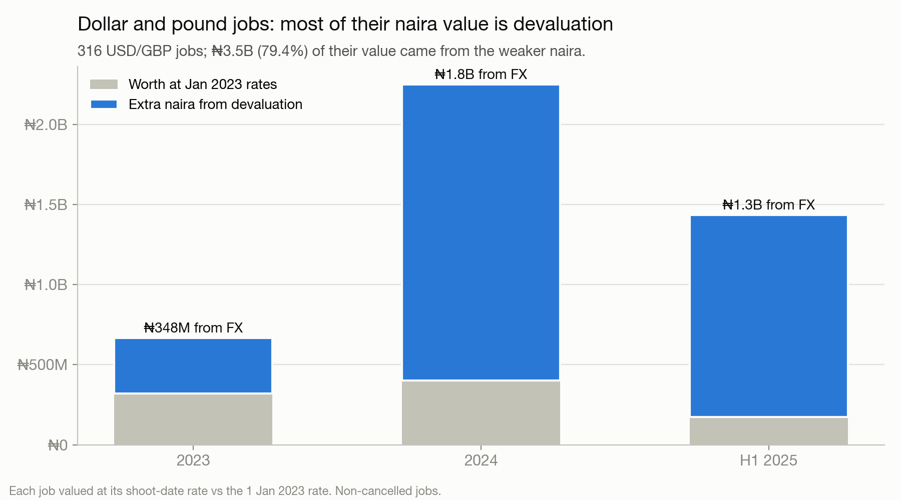
Dollar and pound jobs held their value
Foreign jobs valued at the shoot-date rate vs the 1 January 2023 rate.
₦3.46B
extra naira on 316 USD/GBP jobs from devaluation
79%
of those jobs' naira value is pure exchange rate
39%
of rates used were gap-filled (weekend or missing days)
Xtrim Studios · Commercial review 2023 – H1 2025 · all money in naira (₦)
10
Notes:
Put the other way: had those clients been priced in naira at January 2023 levels, the studio would have lost ₦3.46B. Every naira-priced job lost that kind of value.

Slide 11
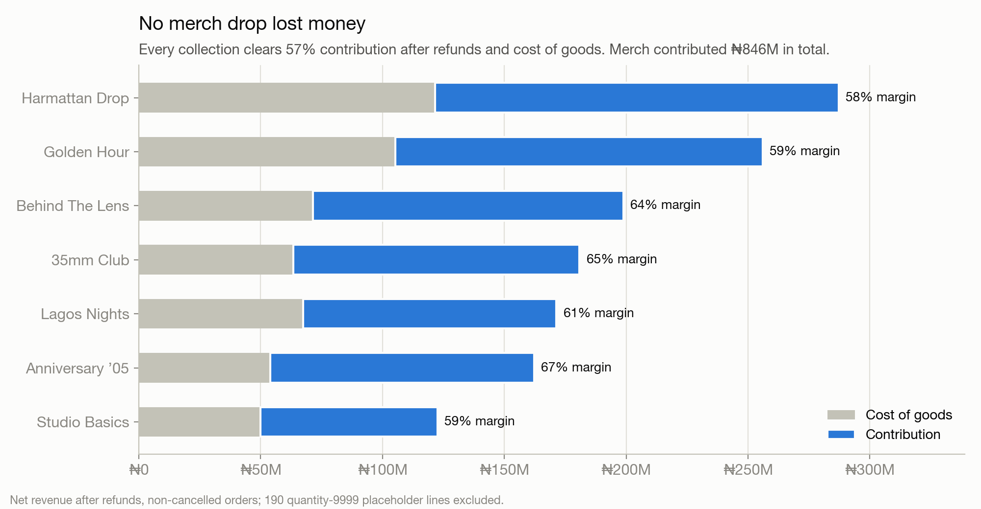
Merch is healthy, but small
Contribution after refunds and cost of goods, by collection.
₦846M
merch contribution (61% of net revenue)
0
collections (drops) that lost money
9.5%
refund rate; no SKU above 2x (highest 1.31x)
Xtrim Studios · Commercial review 2023 – H1 2025 · all money in naira (₦)
11
Notes:
Refund reasons are spread out: changed mind 20.8%, then damaged and wrong size. Discount codes never lowered the price paid in the data, which finance should check.

Slide 12
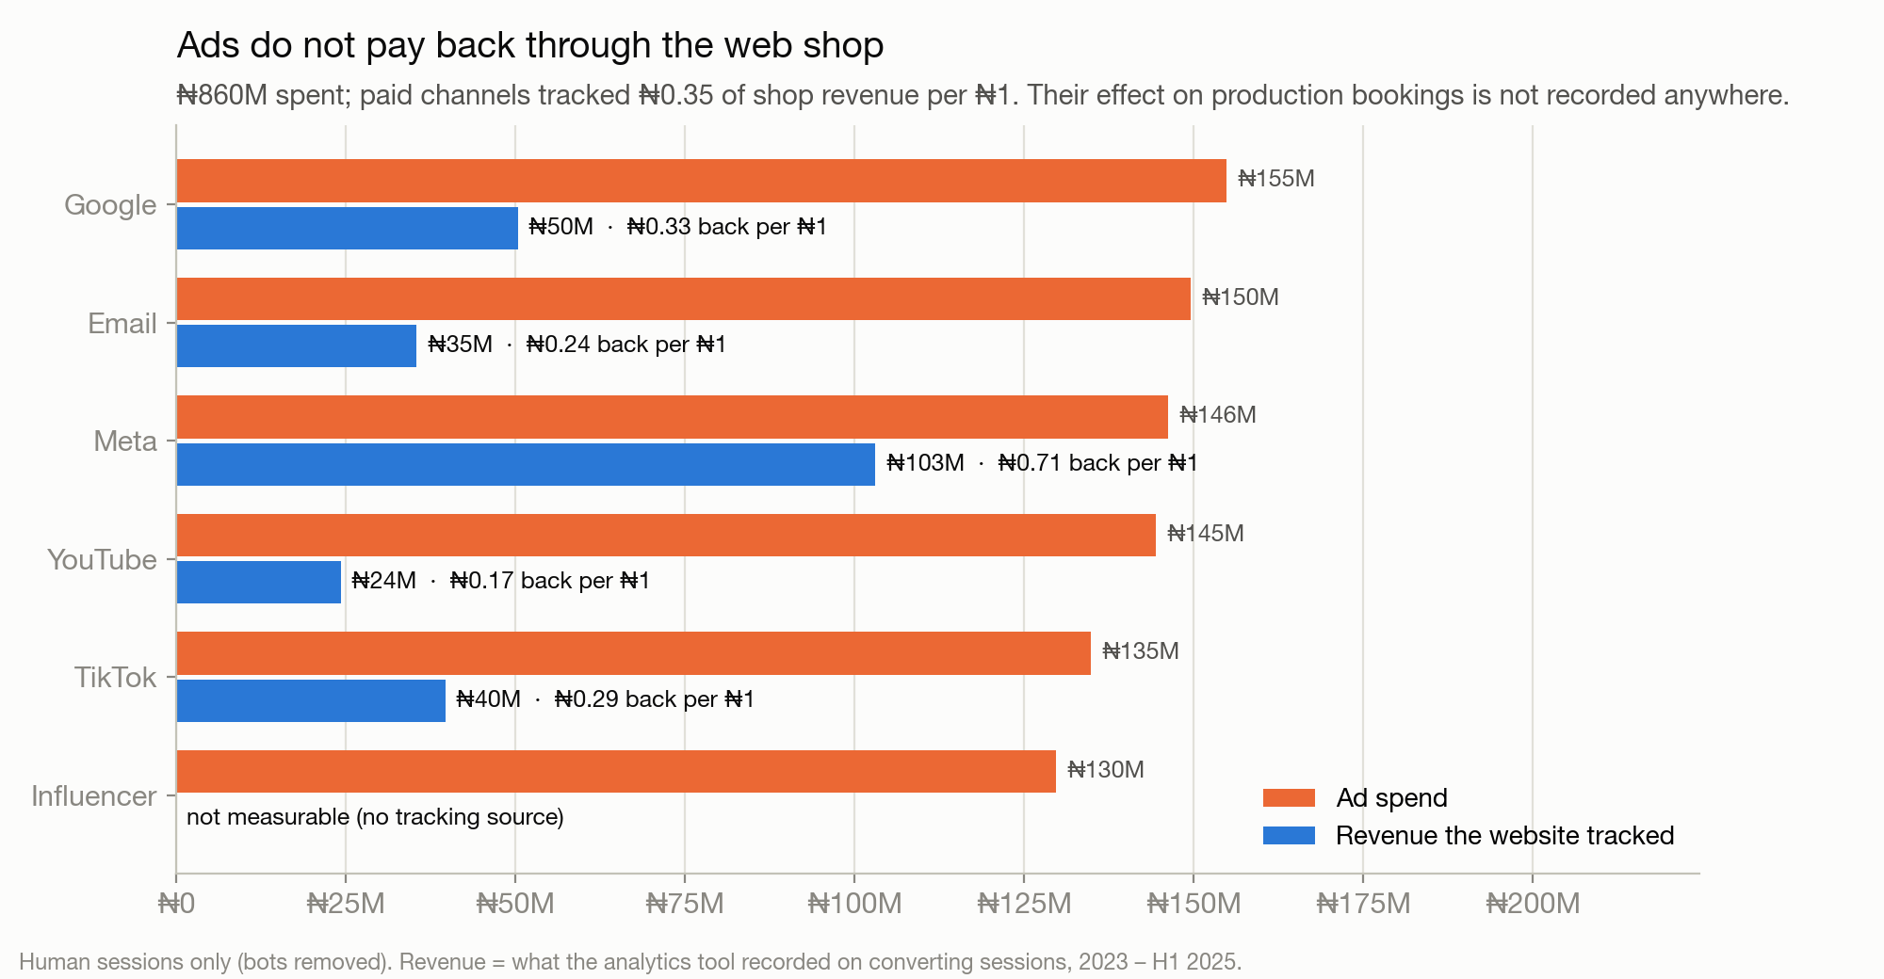
Ads do not pay back through the web shop
Spend vs revenue the website tracked, by channel.
₦0.35
tracked web revenue per ₦1 of paid ads
6.7%
of ₦6.56B social-sourced bookings ads must drive to break even
68%
of recorded sales link to a real order
Xtrim Studios · Commercial review 2023 – H1 2025 · all money in naira (₦)
12
Notes:
Across Google, Meta and TikTok, ₦436M was spent while bookings crediting those platforms were worth ₦6.56B. If even 7% of those came from ads, the spend is justified; but nothing records paid vs organic. Tracking is broken: linked orders are a median 254 days from the visit.

Slide 13
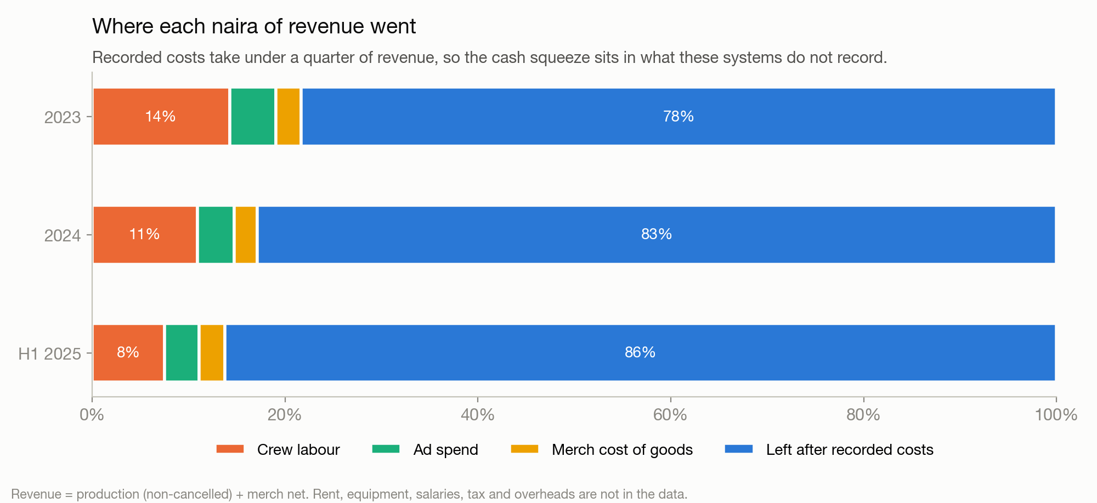
Where each naira went
Recorded costs take under a quarter of revenue.
21.7%
recorded costs ÷ revenue, 2023
17.1%
recorded costs ÷ revenue, 2024
13.8%
recorded costs ÷ revenue, H1 2025
Xtrim Studios · Commercial review 2023 – H1 2025 · all money in naira (₦)
13
Notes:
Crew, ads and merch stock are the only costs in the data. The rest of the squeeze is outside these systems: dollar-priced equipment and software, rent, salaries, tax, and unpaid invoices.

Slide 14
What to do
Five moves, in order of how fast they put cash back.
1
Collect before you grow.
Chase the ₦1.60B of 2023–2024 invoices this quarter, take a deposit at booking, and charge for postponements.
2
Price in dollars where you can.
Quote Commercial, Music Video and international clients in USD or with an exchange-rate clause; it is the one lever that grew in value as the naira fell.
3
Fix or drop loss-making jobs.
Set a minimum price or a crew cap for Studio Rental and Photoshoot so no job costs more in crew than it earns.
4
Test the ads before spending more.
Add 'which ad?' and tracked links to the booking form, give influencers codes, and pause YouTube and Email (the weakest measured returns, ₦294M of spend so far) for eight weeks to see whether bookings move.
5
Book November–December crew in September.
Double bookings cluster in the peak; confirm freelancers early.
Xtrim Studios · Commercial review 2023 – H1 2025 · all money in naira (₦)
14
Notes:
Collection first because it is money already earned. Pricing next. Test ads before cutting or scaling them.

Slide 15
What could change the answer
Read these before quoting any number outside this room.
• No rent, equipment, salary, tax or bank data was provided. The cash explanation is an inference from what is missing, not a measurement; the bank statement would confirm or overturn it.
• Job status is a snapshot from mid-2025. 'Invoiced' is read as billed but unpaid; if finance marks paid invoices differently, the uncollected figure falls.
• 6.9% of revenue (₦1.44B) is touched by data problems that could not be resolved, mostly 107 non-cancelled jobs with no service type. ₦3.87B of bookings have no lead source.
• Merch revenue counts Pending orders (₦302M); if they never ship, merch revenue is that much lower.
Xtrim Studios · Commercial review 2023 – H1 2025 · all money in naira (₦)
15
Notes:
The biggest one is the first: without the bank statement and the cost ledger, the cash story is inference.

Slide 16
How this was built
Every number is reproducible from the raw files with one command.
Raw
Clean
Warehouse
Answer
Analyse
Deliver
14 files
282,171 rows
Python pipeline
93/93 validation checks
PostgreSQL star schema
keys + constraints
14 SQL questions
results/*.csv
findings.json
13 charts
memo · deck · dashboard
8/8 tie-out tests
• Nothing in raw/ is edited by the pipeline; it reads raw_original_backup/ and every rejected row lands in quarantine with a reason.
• Every decision is logged with its evidence: cleaning_report/CLEANING_DECISIONS.md, warehouse/WAREHOUSE_DECISIONS.md.
• The dashboard (Production · Merch · Acquisition) reads the same warehouse and is tested to tie to the SQL answers.
Xtrim Studios · Commercial review 2023 – H1 2025 · all money in naira (₦)
16
Notes:
python run_pipeline.py rebuilds cleaning, warehouse, SQL answers, analysis, charts, memo and this deck.

