Slide 1
PATH
Software Engineering, 2018 Spring Semester
Yu Yanjia
Zhao Yun
Zhao Binqi
feasibility analysis

Slide 2


Contents
Concrete Jungle Explorers
Part One
General Description
Part Two
Object-Oriented Design
Part Three
Logical Design

Slide 3
part one
general description

Slide 4
General description
Concrete Jungle Explorers
CODING AND TESTING
AGILE PROCESS AND PROTOTYPING
TWICE PER WEEK

Slide 5
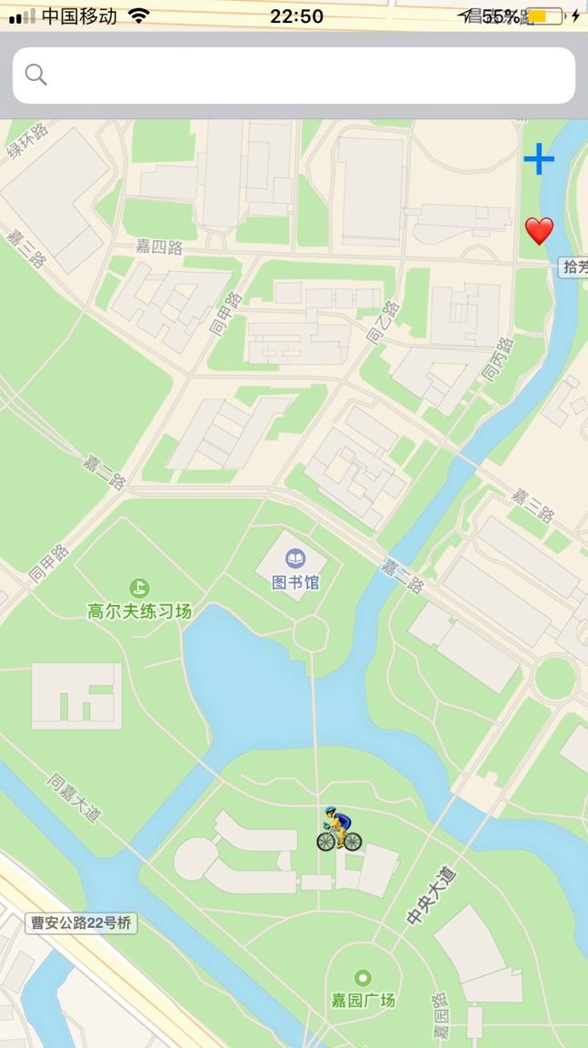


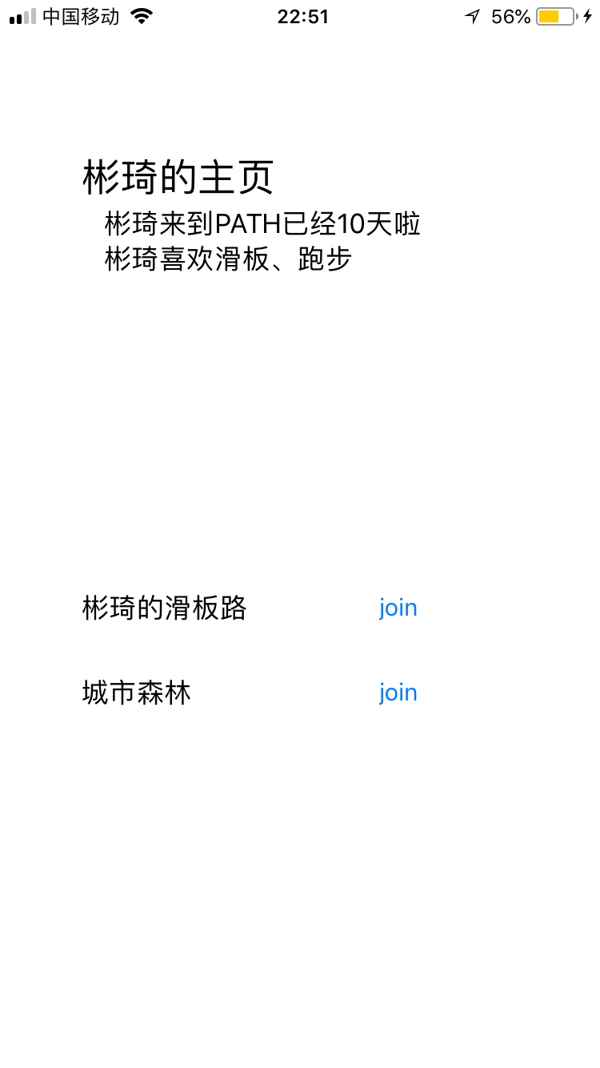

UI DESIGN
MAP KIT
PROTOTYPE
……
PRIOR WORK

Slide 6
TO-be done
Concrete Jungle Explorers
path recording
data base
accelerated prototyping
……

Slide 7
part two
Object-Oriented Design

Slide 8
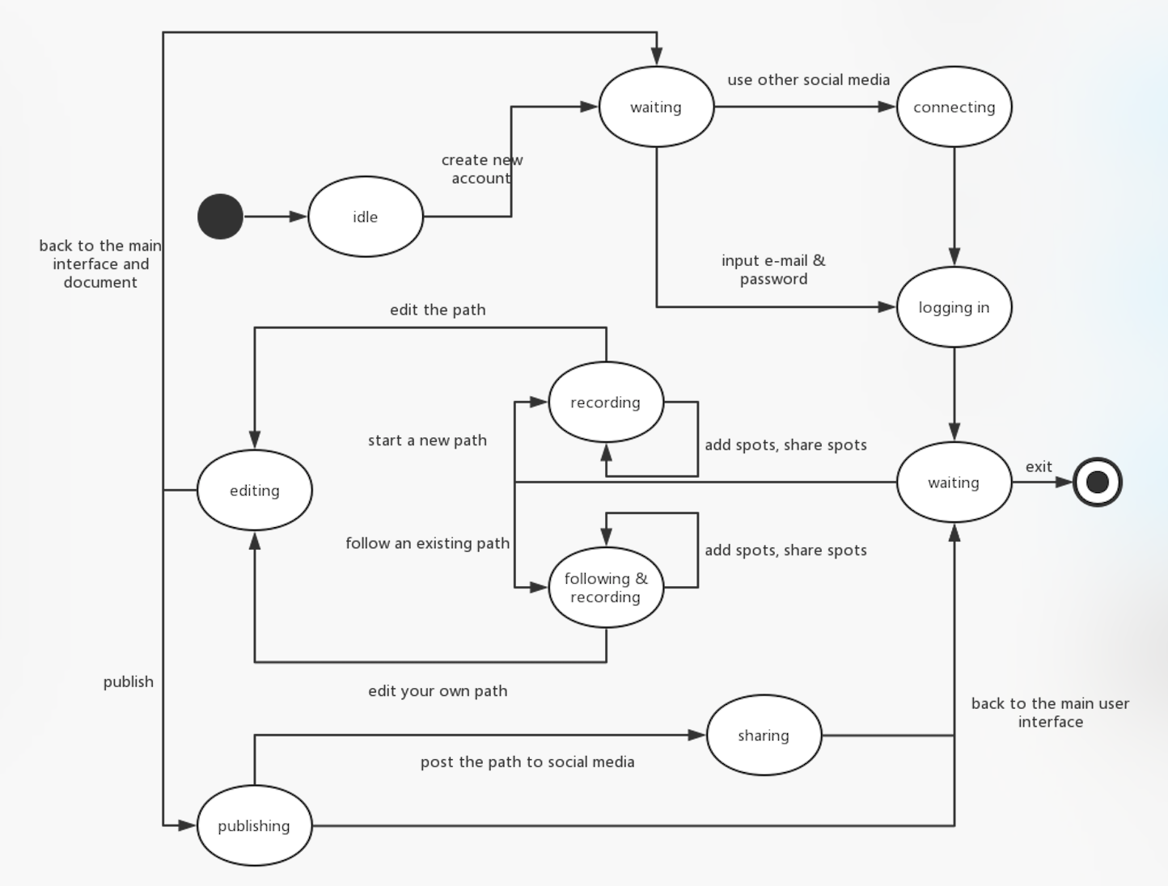
state DIAGRAM
Concrete Jungle Explorers

Slide 10
USE-CASEs
Concrete Jungle Explorers
ACTOR | GOAL | USE CASE NAME
Creator & User | Log in app | Log in(UC-1)
Creator | Create a path | Create(UC-2)
Creator | Publish the path | Publish(UC-3)
User | Select one path and start trip | Select(UC-4)
User | End trip and see result and make comment | End trip(UC-5)
… | … | …

Slide 11
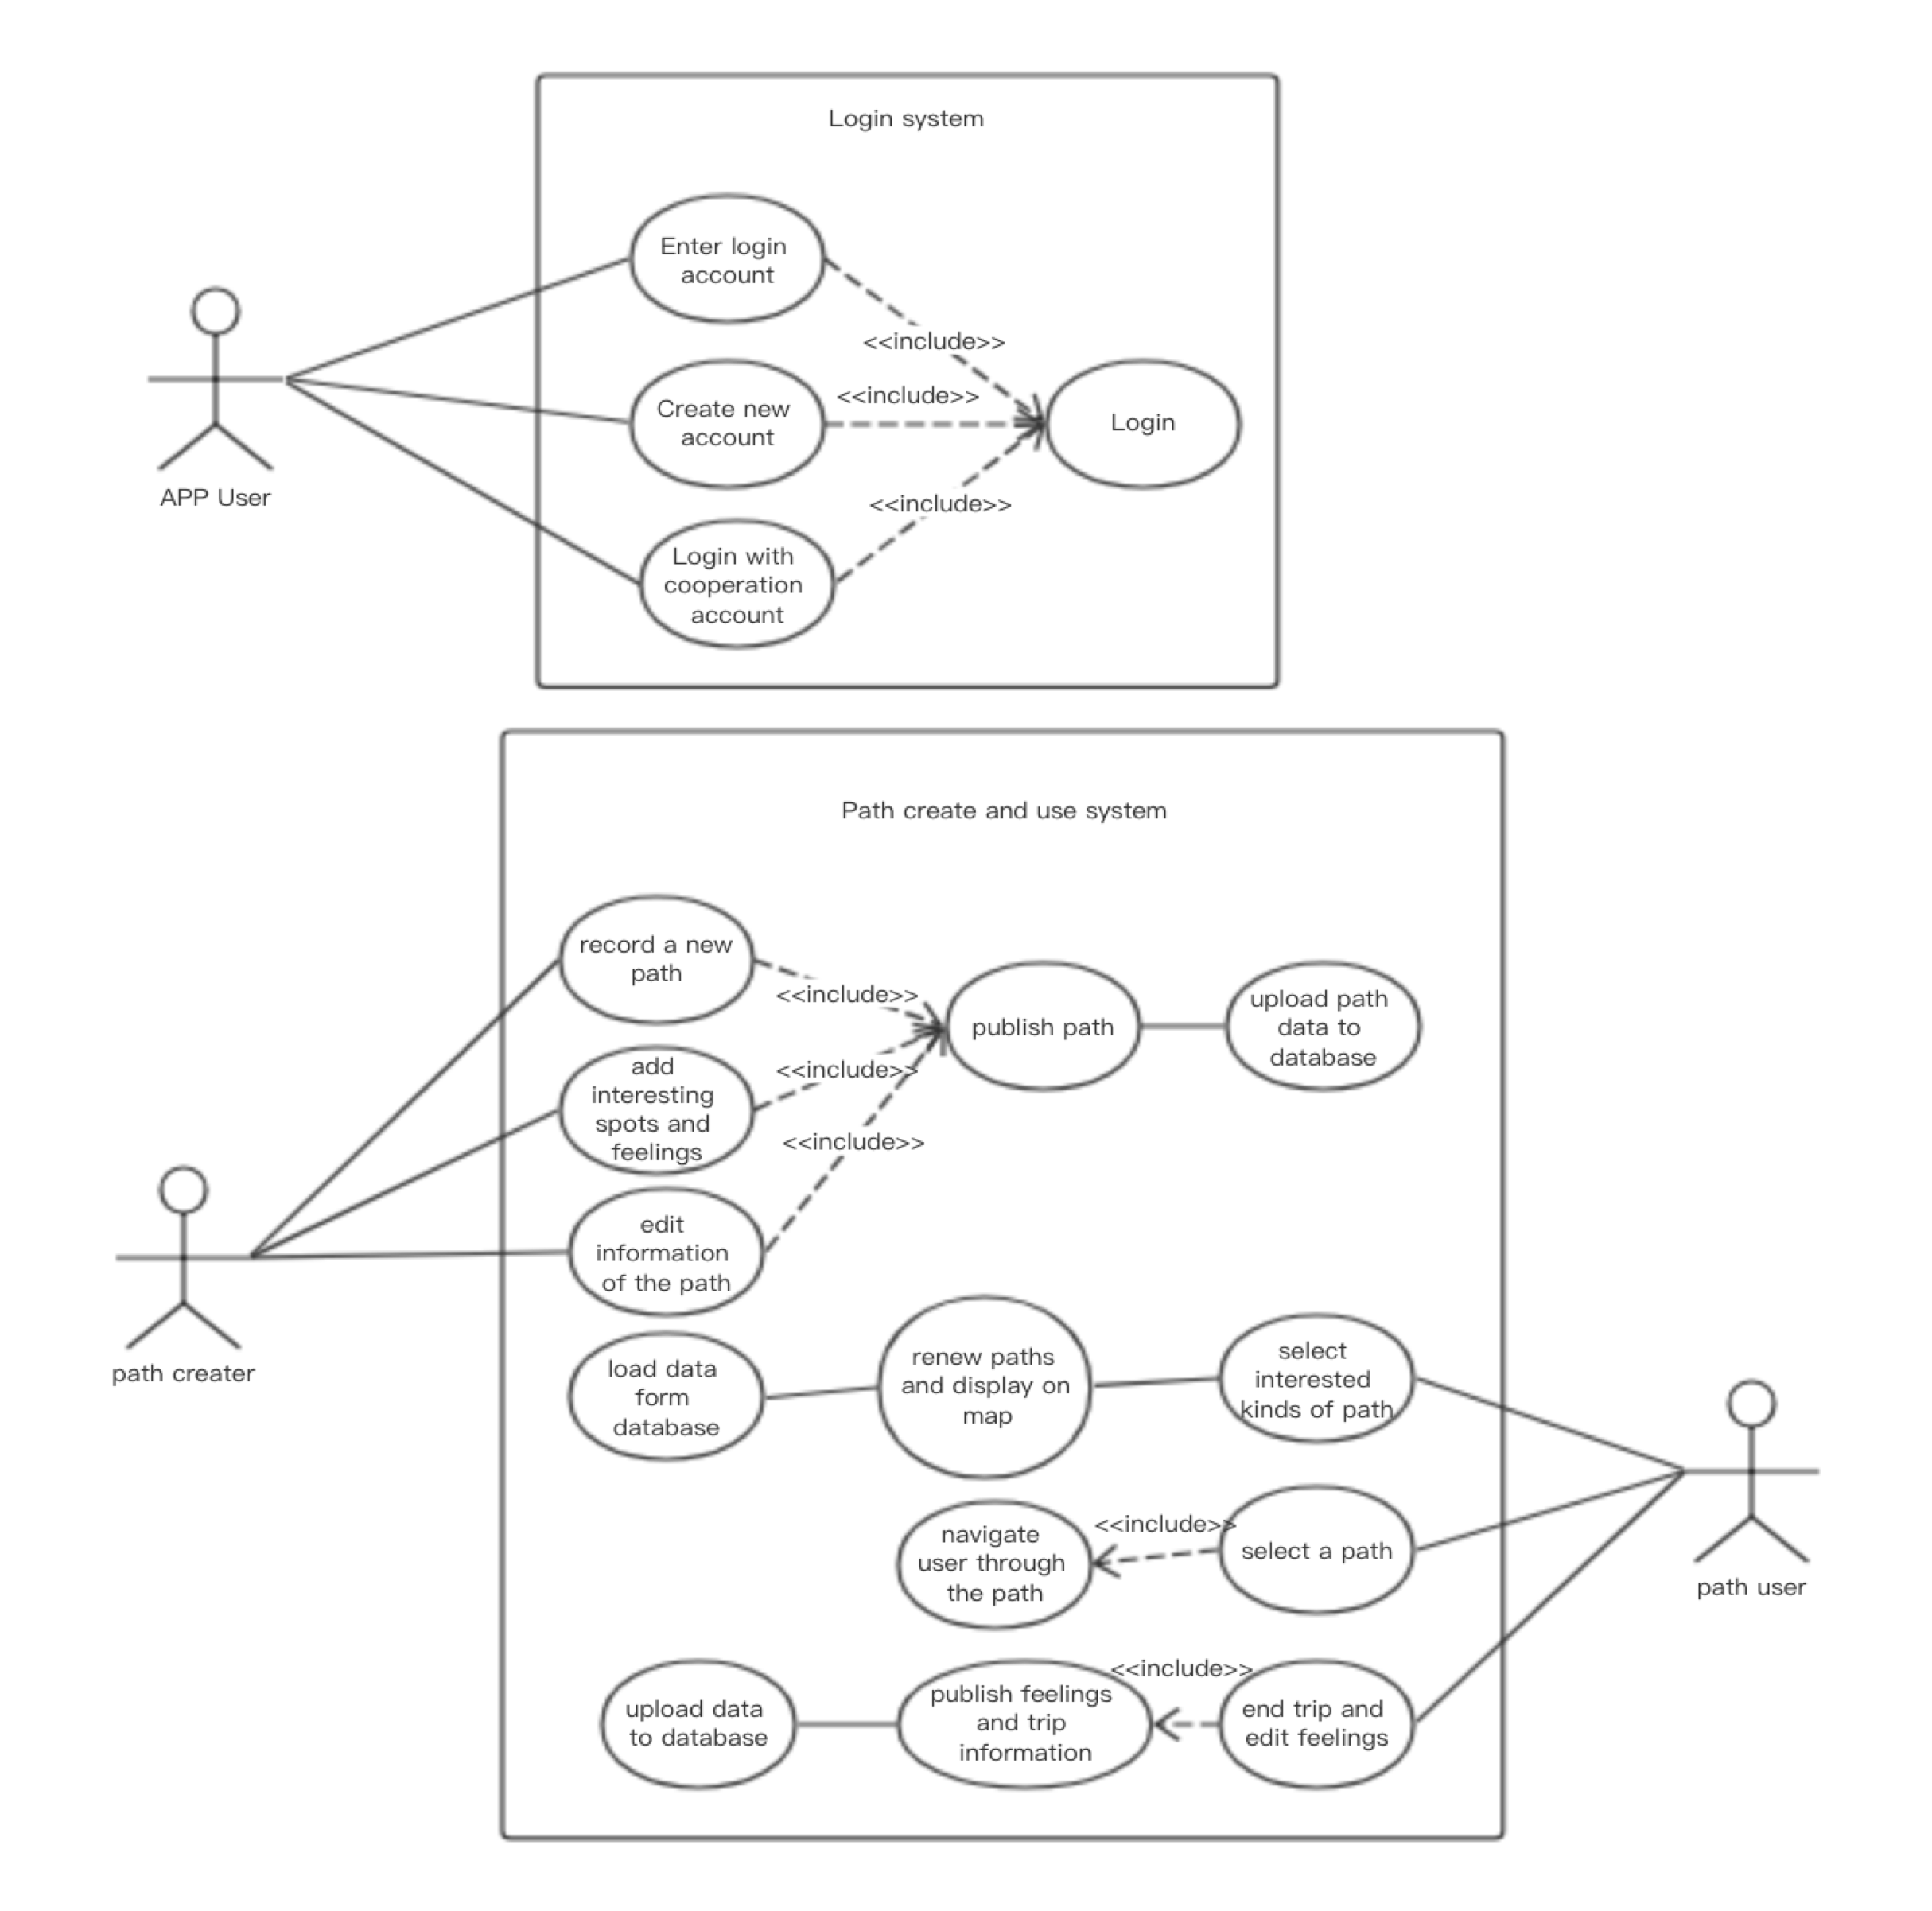
USE-CASE DIAGRAM
Concrete Jungle Explorers

Slide 12
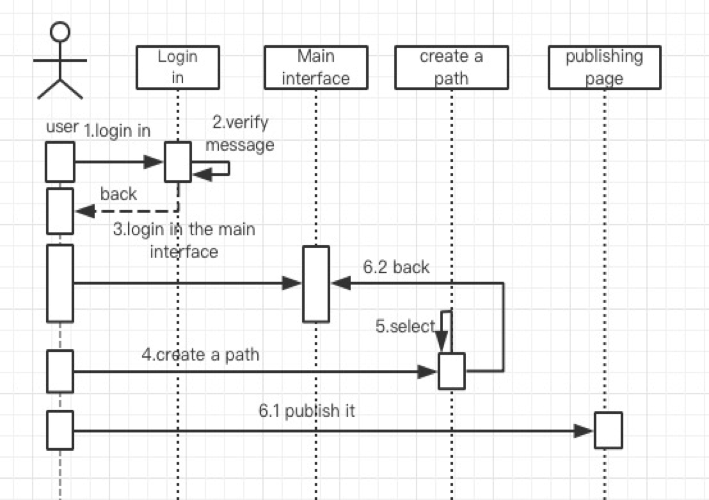
SYSTEM SEQUENCE DIAGRAM (CREATING A PATH)
Concrete Jungle Explorers

Slide 13
part three
logical design

Slide 14
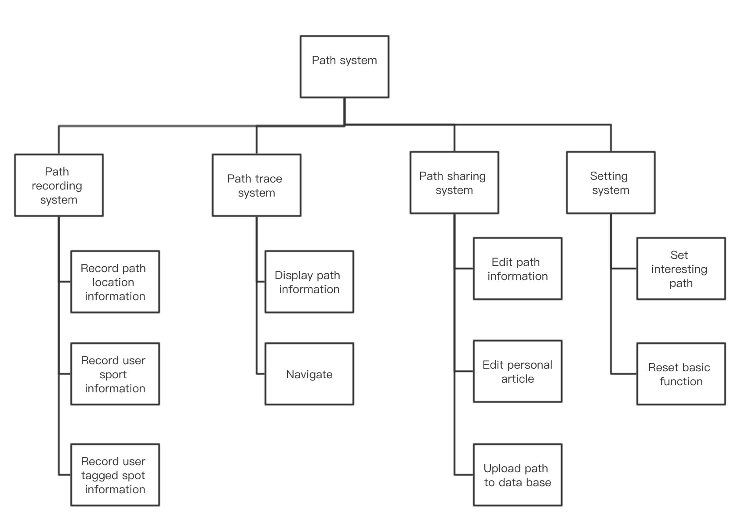
Concrete Jungle Explorers
FUNCTIONAL DECOMPOSITION DIAGRAM

Slide 15
Concrete Jungle Explorers

