Slide 1
PATH
Software Engineering, 2018 Spring Semester
Yu Yanjia
Zhao Yun
Zhao Binqi
final report

Slide 2

what is path?
Concrete Jungle Explorers

Slide 3
part one
To Users

Slide 4
Concrete Jungle Explorers
would like a taste of achievement…
go define you own path
want to tell others about your way of life…
share the path instantly
bored with your current state…
explore the city with the help of PATH
Open PATH not only for fun
But to become a Concrete Jungle Explorer

Slide 5
part two
To itself

Slide 6
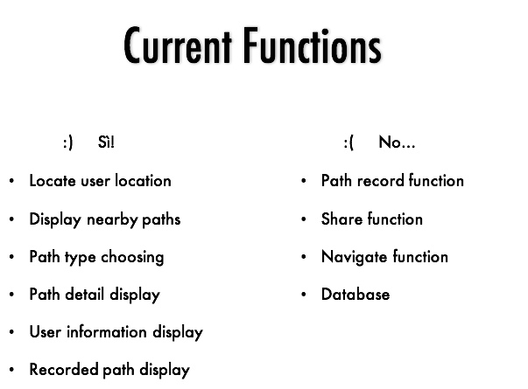
Concrete Jungle Explorers

Slide 7
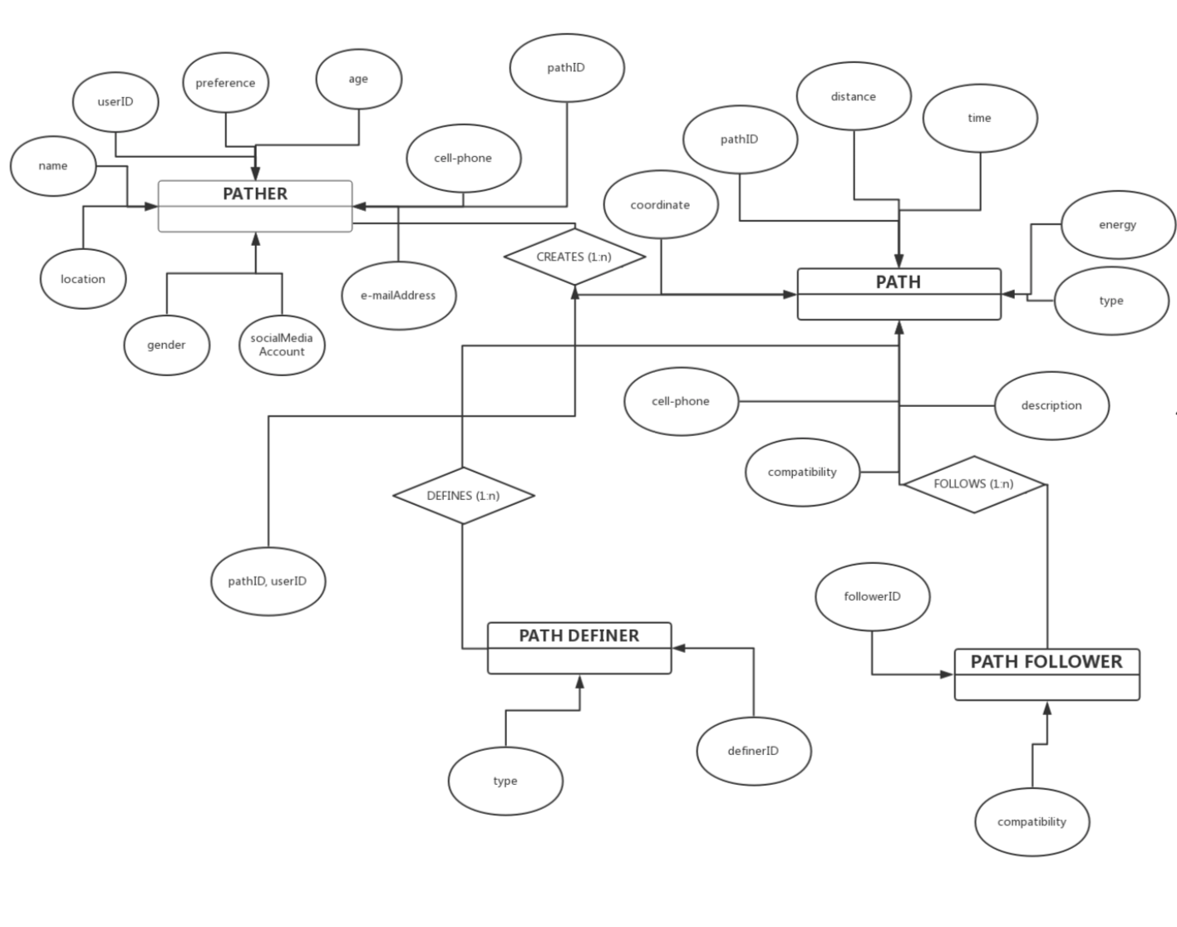
ER DIAGRAM
Concrete Jungle Explorers

Slide 8
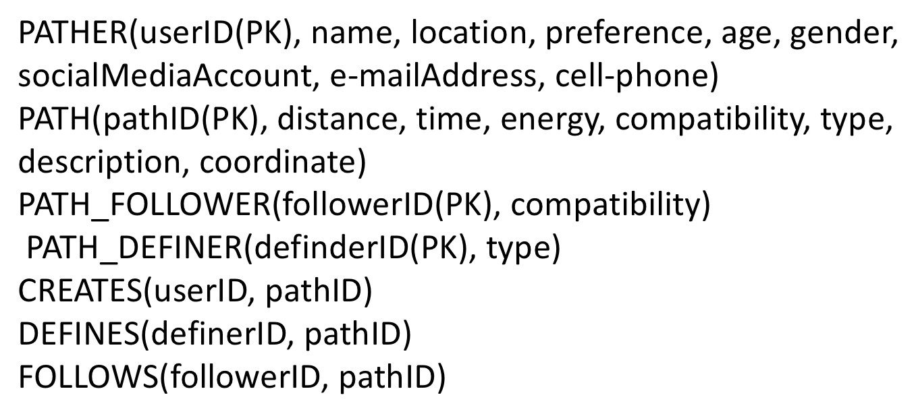
ER MODEL
Concrete Jungle Explorers

Slide 9
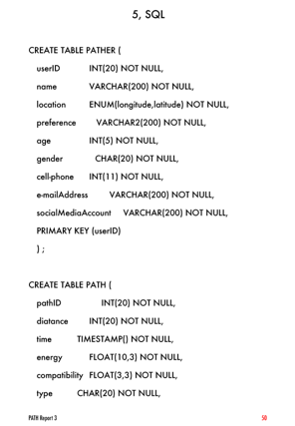
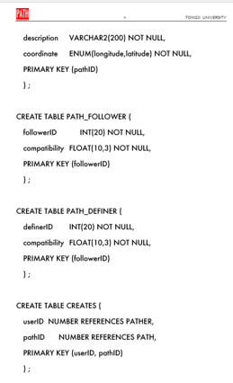
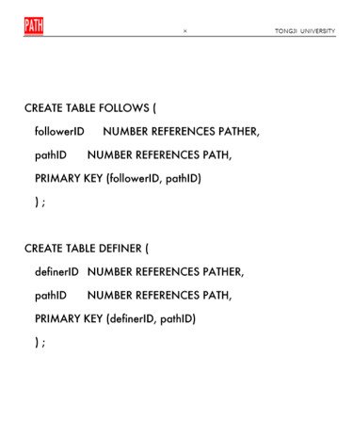
sql
Concrete Jungle Explorers

Slide 10
part three
To us

Slide 11
Concrete Jungle Explorers
“
So, for me, this project not only gives me the experience of creating a software, the improvement my coding skill, but also make me sure that I should be a HARDWARE engineer in the future.
——Yu Yanjia
Anyway, I guess the most valuable lesson I’ve learned from this project apart from the practical programming experiences is that you have to try, don’t be afraid of failing, the biggest failure is that you never try.
——Zhao Yun
I learned the whole process of an app from an idea to the final product, which is really amazing! I have learned to face difficulties and do not give up easily. Under our common efforts, we will definitely solve them!
”
——Zhao Binqi

Slide 12
Concrete Jungle Explorers

