Slide 1
I263 Kickoff Meeting
Emmanuel Rey-herme
I263 Kickoff Meeting
24/10/22

Slide 2
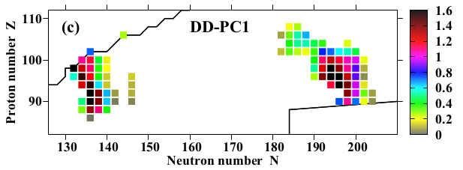
Physics motivation
Prediction of strong octupolar deformations in the ground state of neutron-deficient actinides :
|ΔE_{oct}| (MeV)
N = 136
S. E. Agbemava et al. PRC 96 (2017)
E. Rey-herme
I263 Kickoff Meeting
Page 1

Slide 3
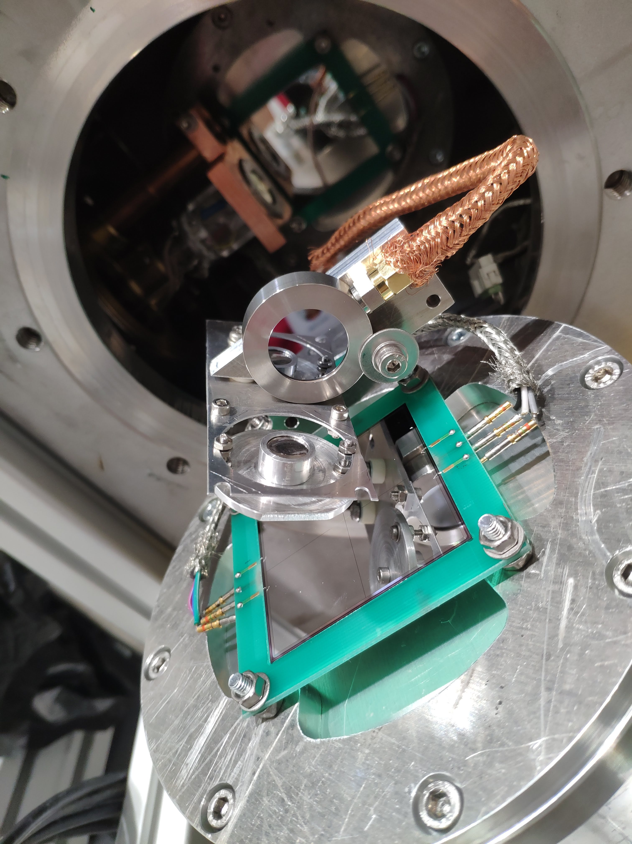
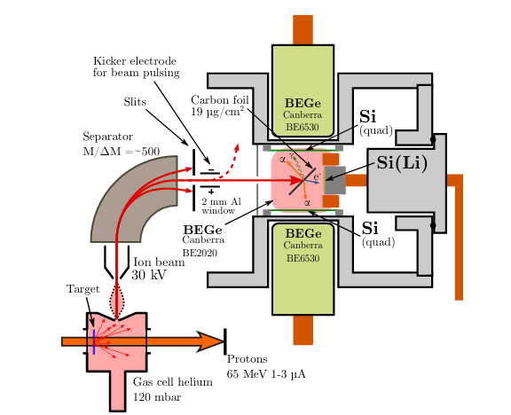
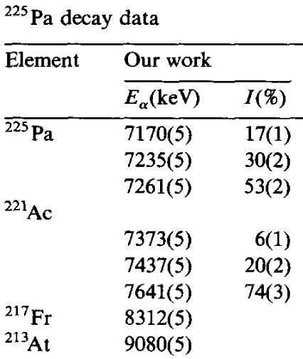
I262 experiment at IGISOL
²³²Th(p,x)Y reaction
≈
Analysis :
²²⁵Pa → ²²¹Ac → ²¹⁷Fr
Existing literature :
(1988) Nuclear Inst. and Methods in Physics Research, B, 31 (3), pp. 483-486
E. Rey-herme
I263 Kickoff Meeting
Page 2

Slide 4
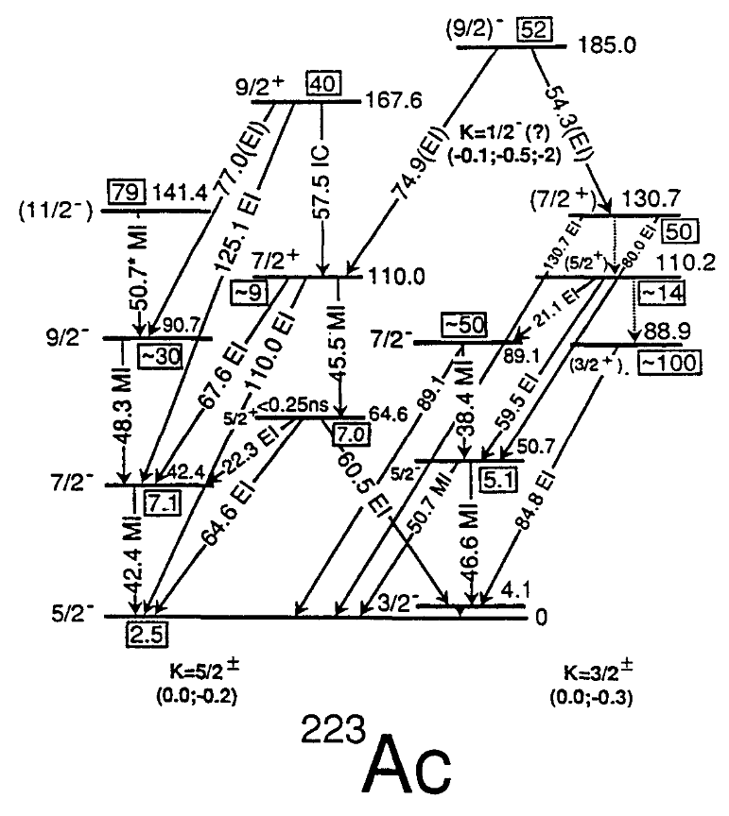
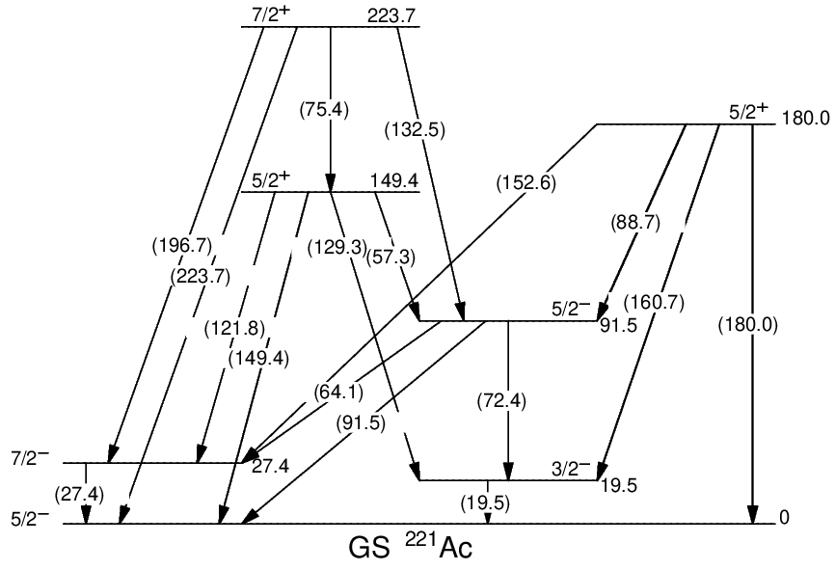
²²⁵Pa decay spectroscopy
14
11.5
9.6
6.5
4.6
2.9
K = 5/2
K = 3/2
²²¹Ac level scheme
Sheline RK, Liang CF, Paris P. Int J Mod Phys A. 1990;05(14):2821‑31.
E. Rey-herme
I263 Kickoff Meeting
Page 3

