Slide 1
I263 Measurement plan
Emmanuel Rey-herme
I263 Measurement plan
19 october 2022

Slide 2
Measurement plan :
- Beam tuning on mass 219
→ No long lived radioactive isotopes expected in the decay chains
- Once beam transportation is optimised → Rotate target
- Use the best of the 2 target to make implantation of long lived isotopes at the switchyard
- Vent switchyard + target cool down and change
- Test both new targets
- Take the best target for decay spectroscopy

Slide 3
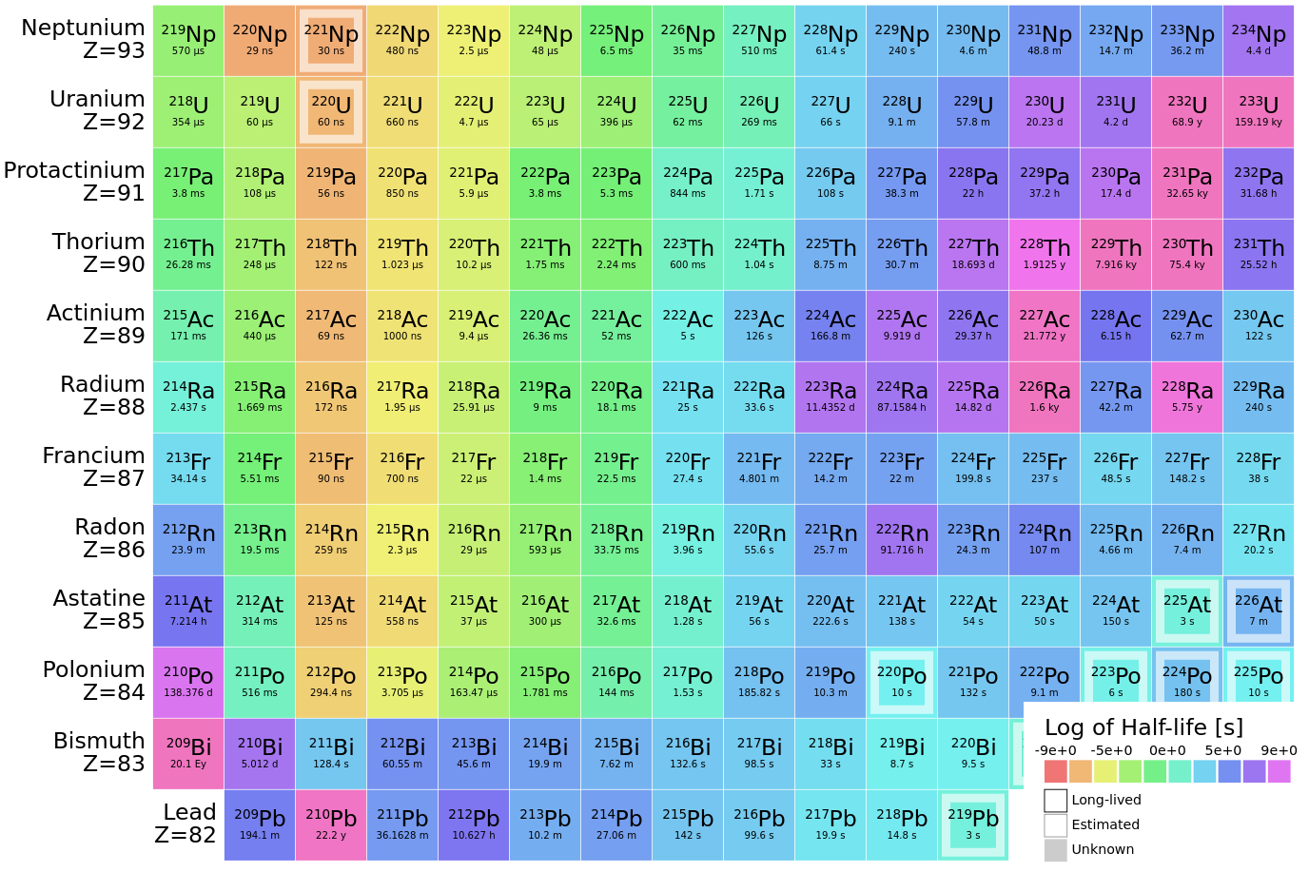
Reference nuclei :

Slide 4
Nuclei of interest :

Slide 5
Decay spectroscopy plan :
Mass :
224
223
227
222
226
221
225

Slide 6
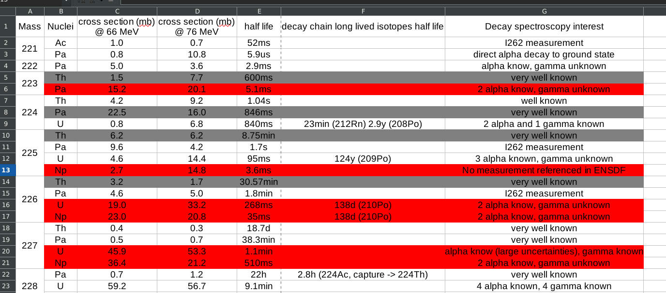
Decay spectroscopy plan :
Mass :
224
225
223
227
222
226
221

