Slide 1
Predicting the Paycheck: What Factors Truly Influence Graduate Earnings?
Aiden Akbarov | STA 4164 | University of Central Florida

Slide 2
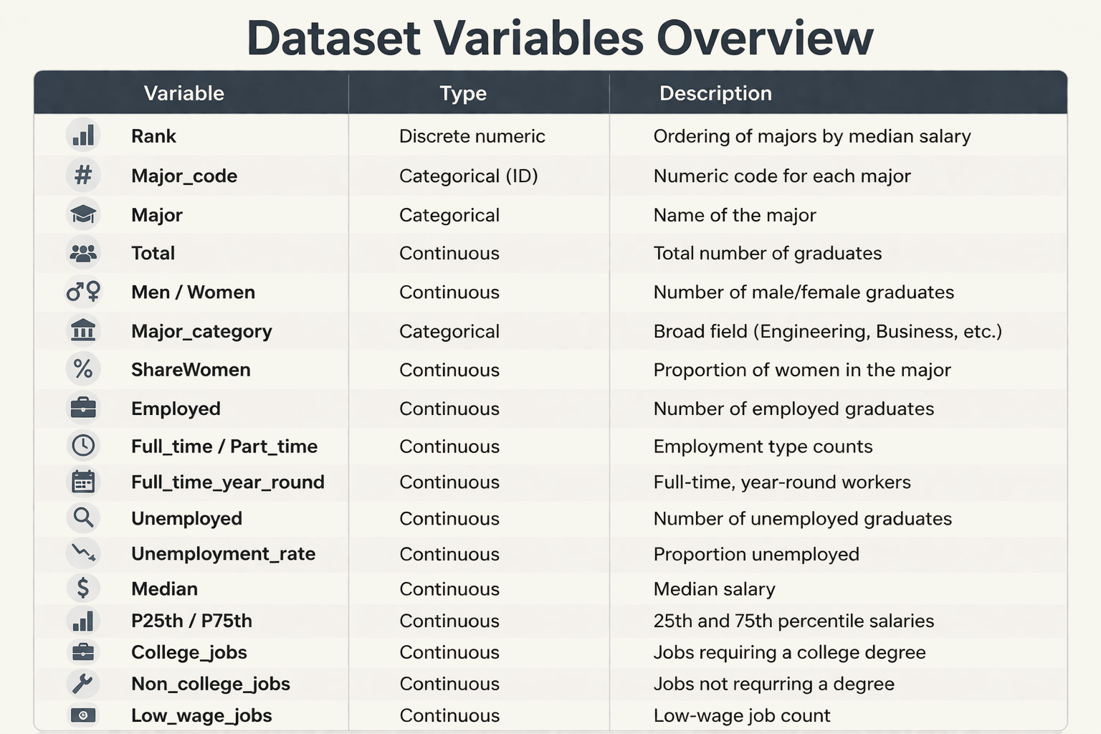
Research Objective
Objective: Identify the characteristics of a major that are associated with higher median earnings
Context: Analyzing 172 academic majors using U.S. Census/ACS survey data
Variables: Looking at gender composition (ShareWomen), job types (Low_wage_jobs), and broad field categories (Major_category).

Slide 3
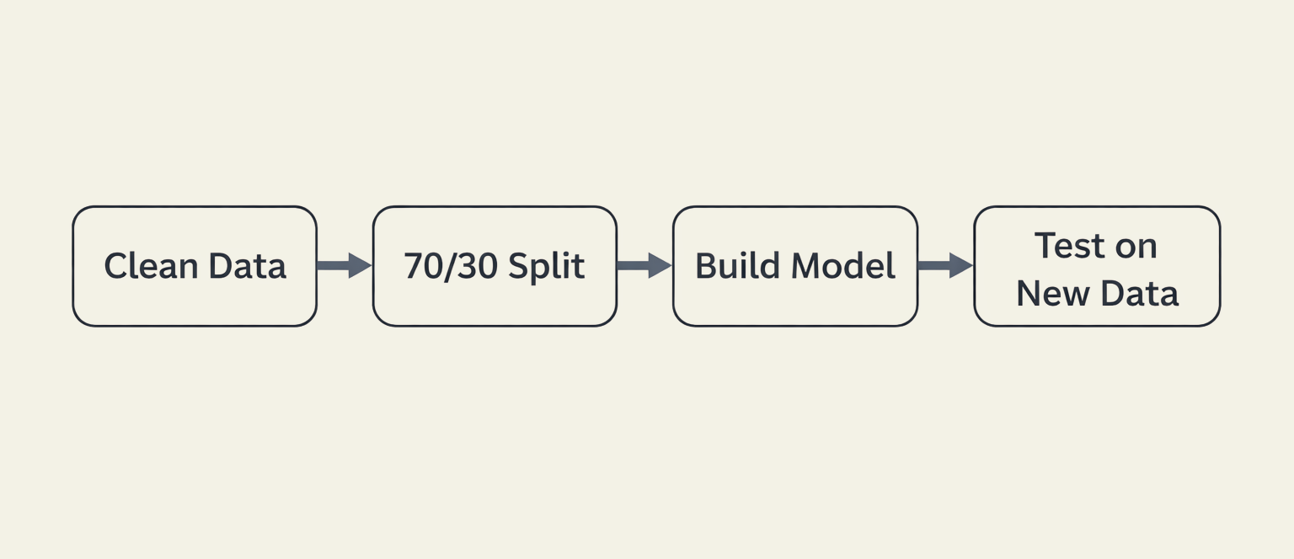
Methodology
Multiple Linear Regression
Data Partitioning (“Training” and “Testing” sets)
“Data Leakage” and Multicollinearity

Slide 4
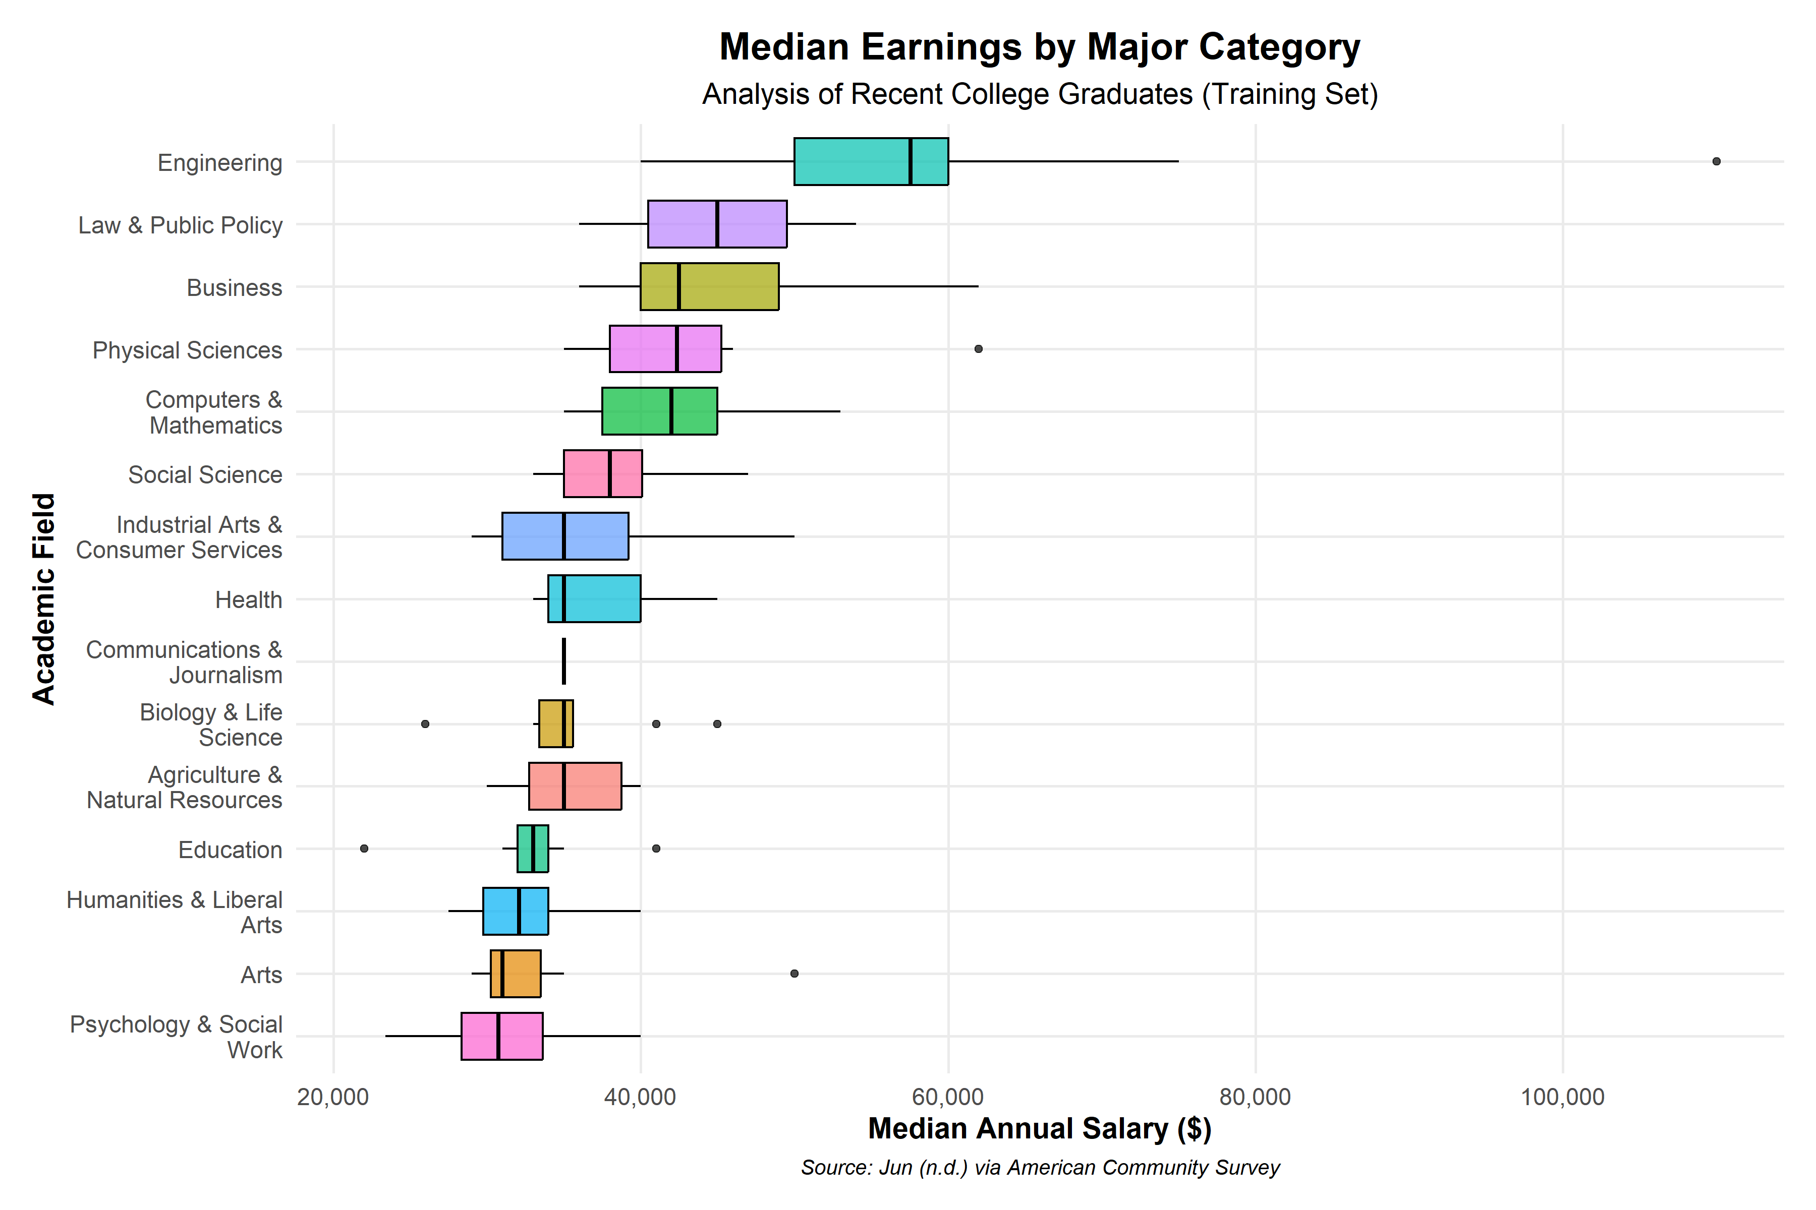
The Landscape of Earnings

Slide 5
Major Category (Engineering) | $20,034
Share of Women | -$15,866
For every 10% increase in female representation in a major, the predicted median salary drops by ~$1,586.
Employment rates and the number of college-level jobs were not significant predictors. The category of the degree is the dominant factor.

Slide 6
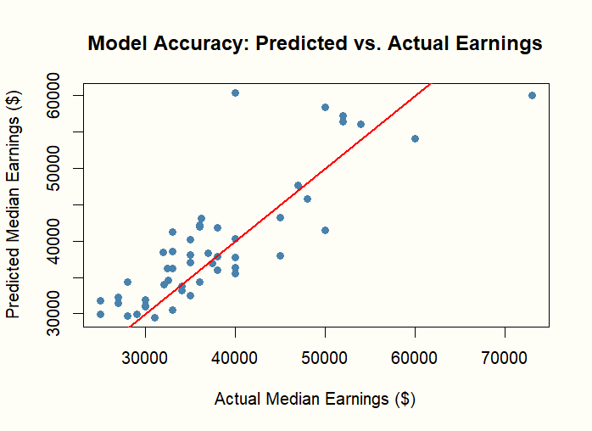
Can We Trust the Model?
The model’s guesses were typically within $4,006 of the actual salary
The “Testing Error” was actually lower than the “Training Error”, proving the model generalizes perfectly to unseen data
The model explains 55% of why graduate salaries differ

Slide 7
Real-World Impacts & Future Steps
This research provides students and advisors with a tool to evaluate the economic reality of their choices.
It highlights that demographic factors (gender mix) are mathematically visible in salary outcomes from day one of graduation.
Future research should include geographic location (Cost of Living) to improve accuracy.
Data allows us to turn career anxiety into evidence-based decisions.

Slide 8
References
Jun, E. (n.d.). data_college_income [Data set]. GitHub. https://github.com/emjun/data_college_income/tree/master
R Core Team. (2024). R: A language and environment for statistical computing. R Foundation for Statistical Computing. https://www.R-project.org/
U.S. Census Bureau. (2012). American Community Survey (ACS) 2010-2012 Public Use Microdata Sample.
Wickham, H. (2016). ggplot2: Elegant Graphics for Data Analysis. Springer-Verlag New York.

