Slide 1
Central Door Locking
Training
Bitoleanu Eugen Andrei Eduard

Slide 2
Project analysis slide 3
State Action
Starting
Secured
Unlocked
Locked
Double Locked
Failed
We await for the admin to enter a
Password and for the program to setup the pins
We ask the user to enter the password,
giving them three tries after which they are moved to the “Failed” state.
The door and window motors unwind, thus unlocking the car. The door motor will run for a second clockwise and the window motor for 3 anti-clock wise, the lights will also flash twice.
The doo motor will wind up once, thus locking the car. The door motor will run for one second. The lights will flash once Thus locking the user out partially.,
The door and window motors wind up again. The door motor will run for another second and the window motors will run for 3 seconds, Thus locking the user out completely.
If the user guesses the password wrong three times, he will be transferred to this state which does not listens for any other input outside of the one from the reset button on the board, thus requiring specialized personal.

Slide 3
Project analysis slide 4
State Analysis
Unlocked
Starting
Secured
Locked
Double Locked
Failed

Slide 4
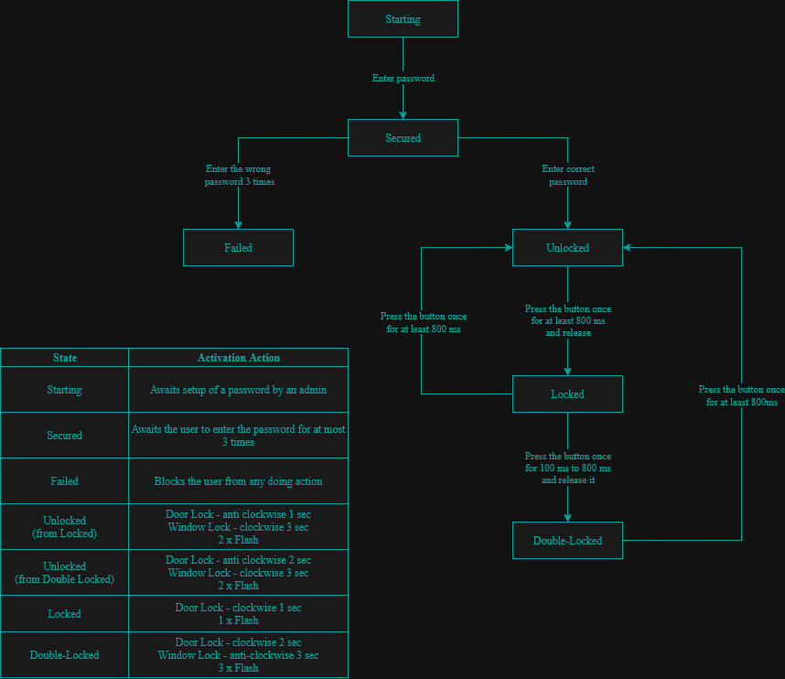
Project analysis slide 4
State Analysis UML

Slide 5
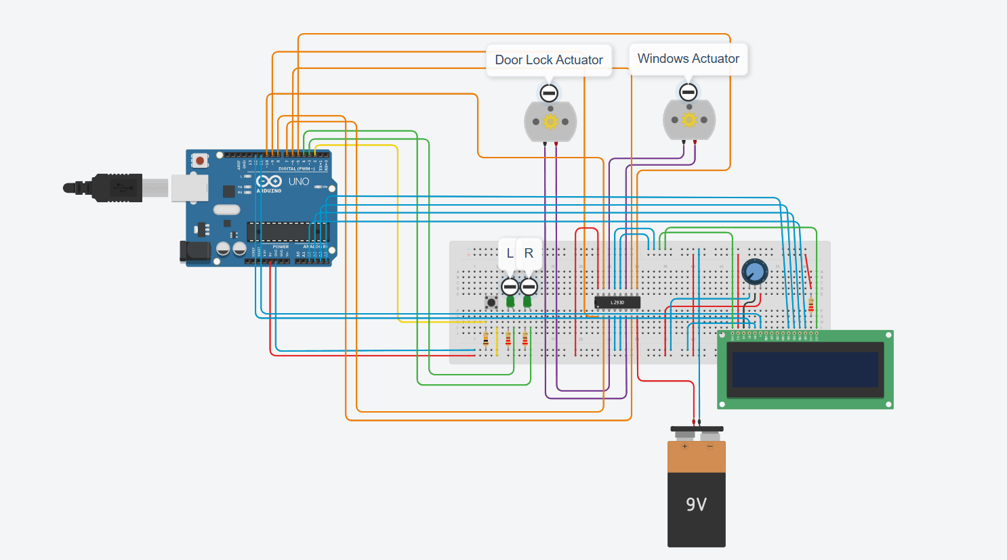
Project analysis slide 4
Central Door Locking
Circuit Diagram

Slide 6
Project analysis slide 4
Central Door Locking
Used Components
Arduino Uno
4 Resistors
Wires
PushButton
2 Leds
2 DC Motors
Potentiometer
LCD
Batery 9V
H-Bridge Motor Driver L293D

Slide 7
Project analysis slide 4
Central Door Locking
PushButton Pin D2
Left Led Pin D3
Right Led Pin D4
LCD Enable Pin D11
LCD RS Pin D12
LCD DB4 Pin A5
LCD DB5 Pin A4
LCD DB6 Pin A3
LCD DB7 Pin A2
Window Motor Enable Pin D5
Window Motor 1 Pin D6
Window Motor 2 Pin D10
Door Lock Motor Enable Pin D9
Door Lock Motor 1 Pin D7
Door Lock Motor 2 Pin D8
Pin Mapping

Slide 8
Project analysis slide 4
Central Door Locking
Main Functions Used
handleButton()
onButtonPressed(pressStart)
onButtonReleased(pressDuration)
startDoorMotor(duration,time)
startWindowMotor(duration,time)
startActionChangeMotors(fromMode,toMode)
updateModeOnLCD(mode)
updateButtonStateOnLCD()
startBlinking(times)
updateBlinking()
readPassword()
Macro functions
test_bit()
set_bit(port,pin)
reset_bit(port,pin)

Slide 9
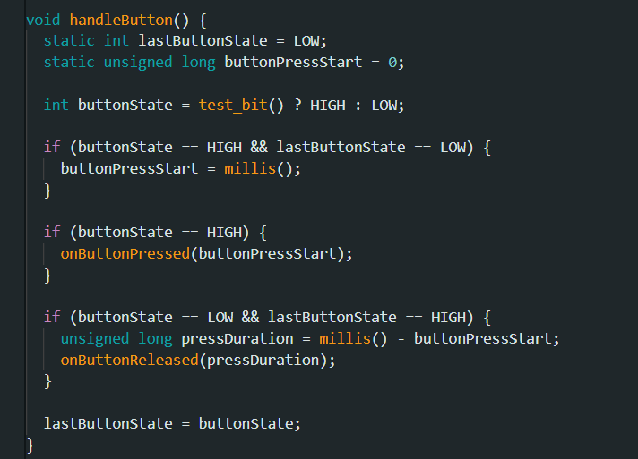
Project analysis slide 4
Central Door Locking
handleButton()
Explanation
This function monitors the button state changes,records press start time and calls onButtonPressed() & onButtonReleased() for press & released actions.

Slide 10
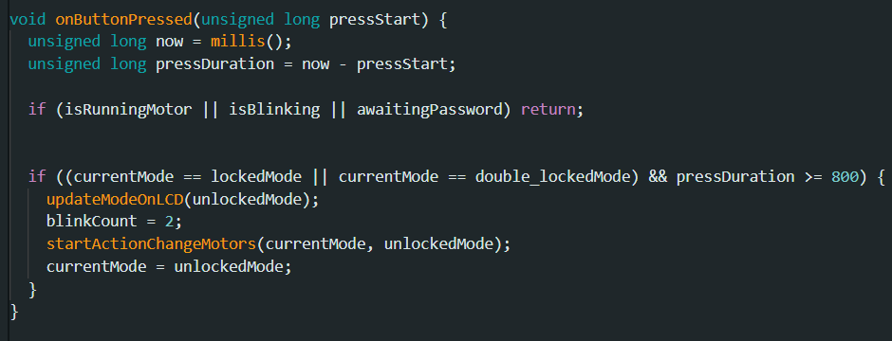
Project analysis slide 4
Central Door Locking
onButtonPressed(pressStart)
Explanation
This function monitors the duration of press button and initiates an unlock action.

Slide 11
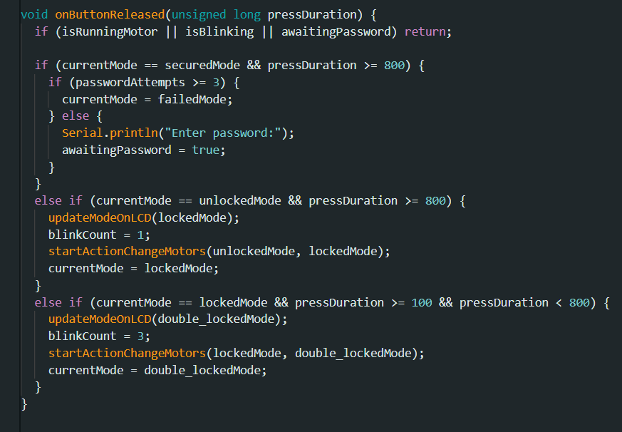
Project analysis slide 4
Central Door Locking
onButtonReleased(pressDuration)
Explanation
This function executes action based on the duration of the button press once released.

Slide 12
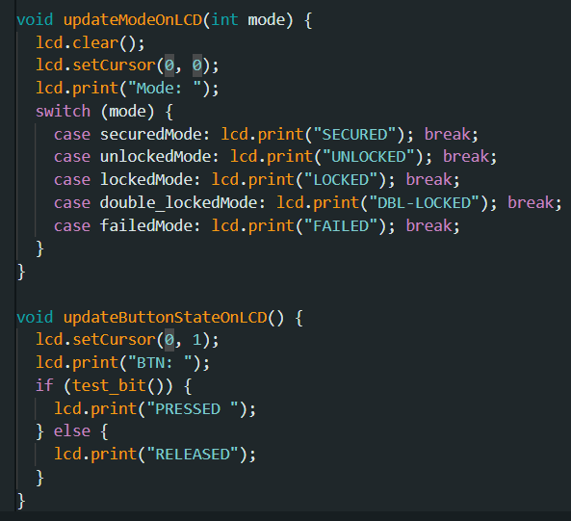
Project analysis slide 4
Central Door Locking
updateModeOnLCD(mode) & updateButtonStateOnLCD()
Explanation
These functions print on LCD the current mode of system and the current state of pushbutton.

Slide 13
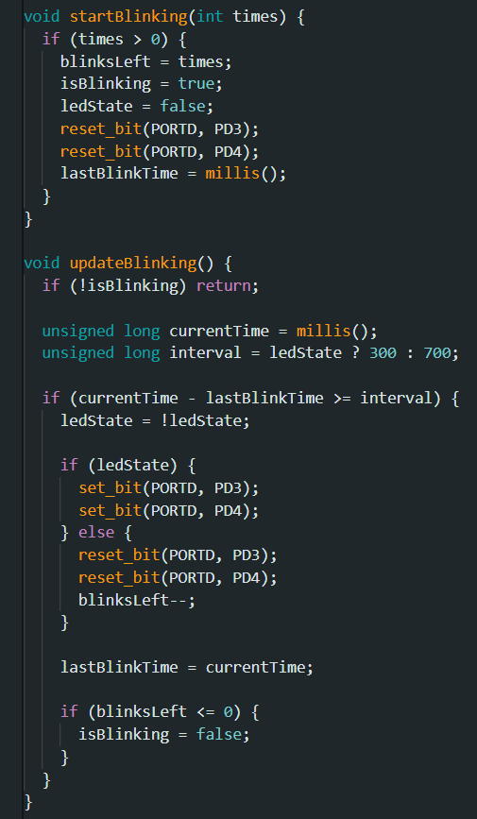
Project analysis slide 4
Central Door Locking
startBlinking(times) & updateBlinking()
Explanation
startBlinking(times) starts the LED blinking process by setting how many times the LEDs will blink.
updateBlinking() controls the blinking duration LEDs and stops when all blinks are completed.

Slide 14
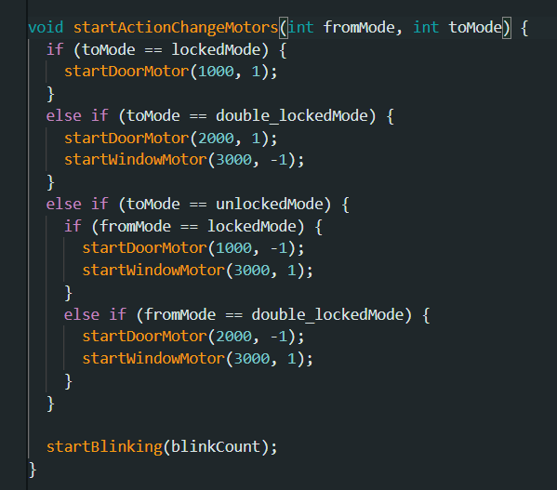
Project analysis slide 4
Central Door Locking
startActionChangeMotors(fromMode,toMode)
Explanation
This function handles the logic for initiating motors based on change mode and starts an LED blinking.

Slide 15
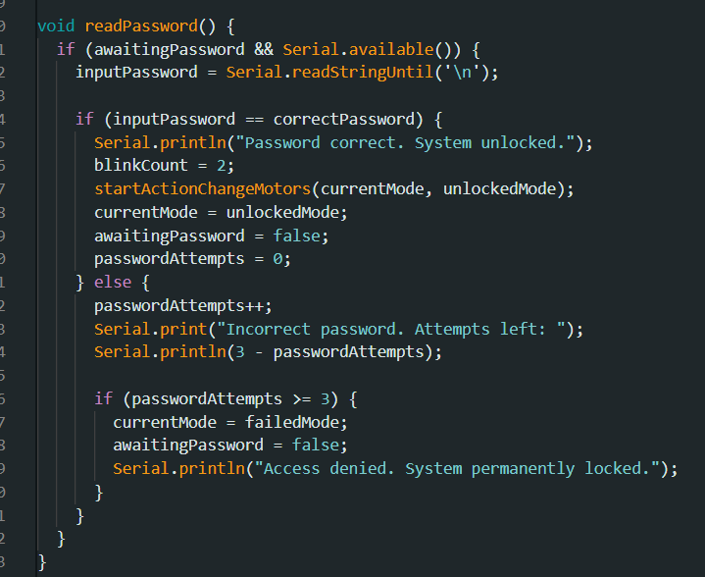
Project analysis slide 4
Central Door Locking
readPassword()
Explanation
This function reads the entered password,checks if it is correct and manages the logic for failed attempts,including locking the system after 3 incorrect tries.

Slide 16
Project analysis slide 4
Central Door Locking
Future upgrades
I2C Protocol Integration
Bluetooth Mobile App Integration
Fingerprint Sensor Integration

Slide 17
Thank You

