Slide 1
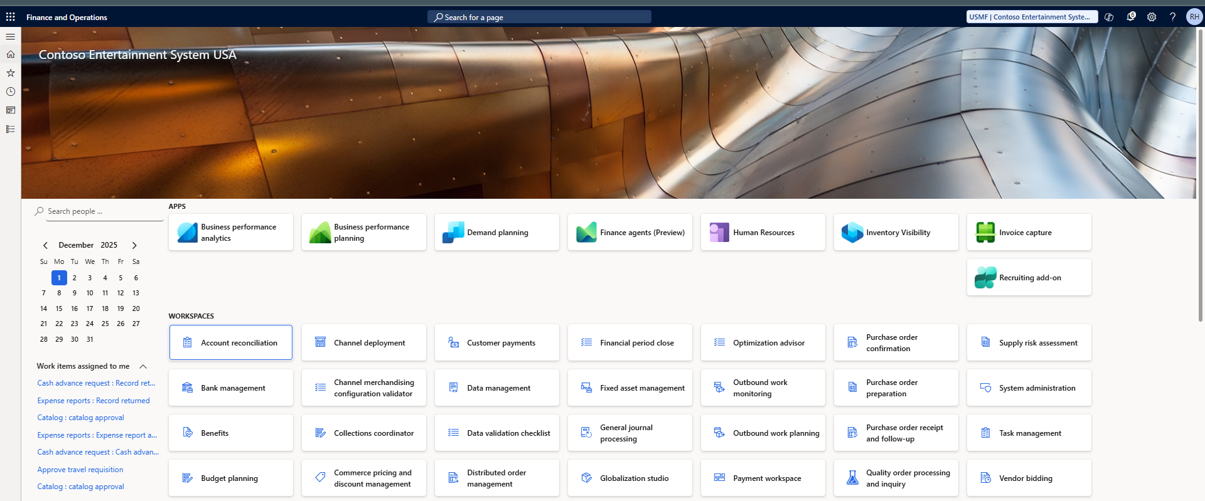
Project 01 – Free Text Invoice
Dynamics 365 Finance | Accounts Receivable
Contoso Entertainment System USA

Slide 2
Component | Detail
System | Microsoft Dynamics 365 Finance (Trial)
Role | System Administrator
Legal Entity | USMF (Contoso Demo)
Customer | P01-0001 – Project01 Test Customer

Slide 3
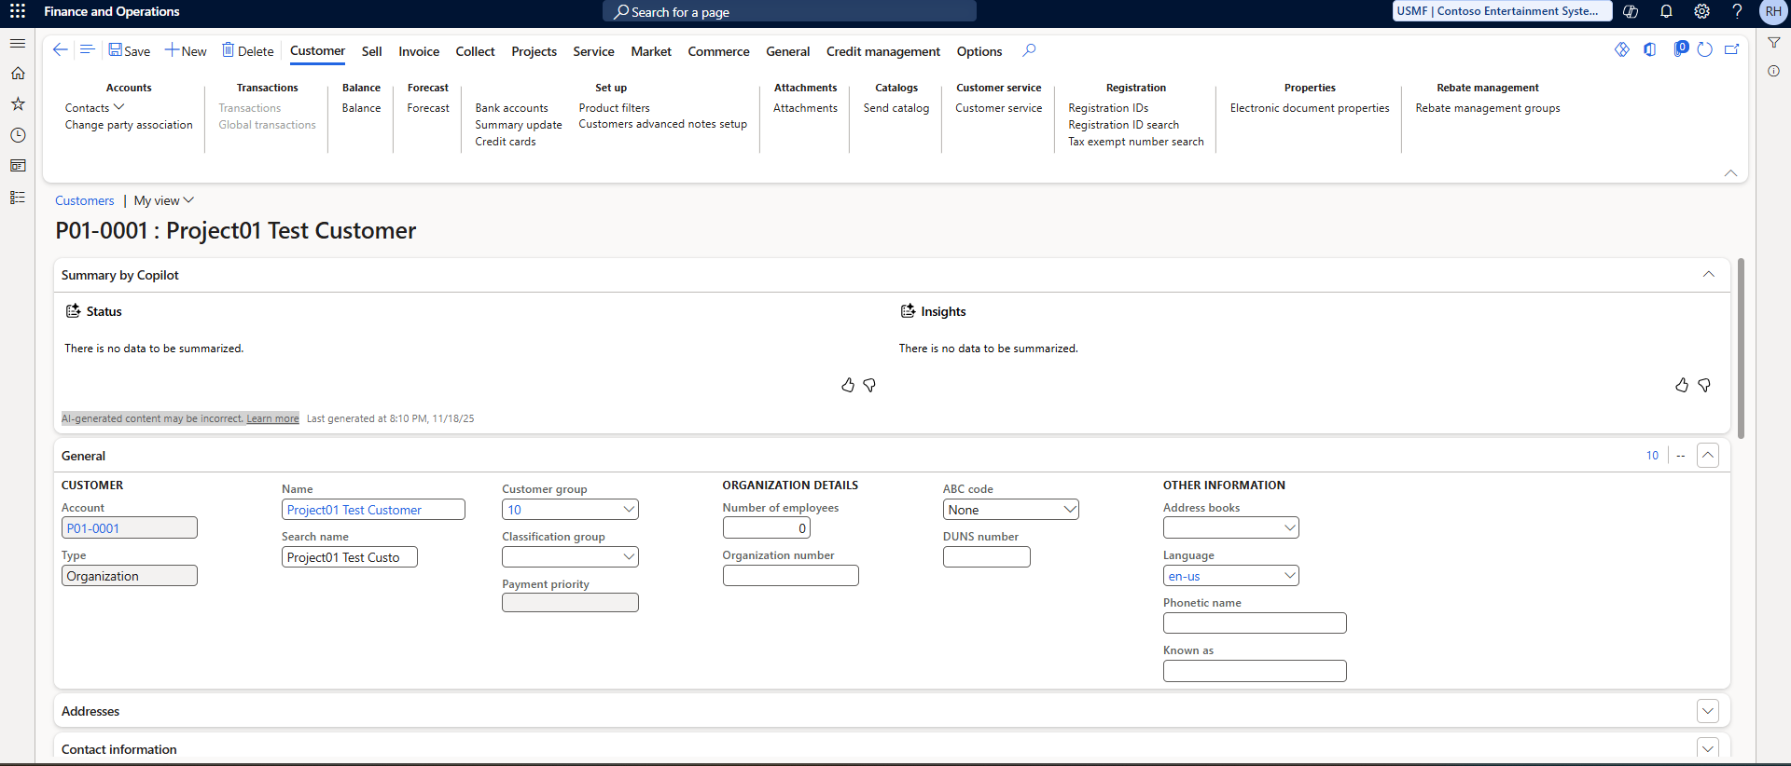
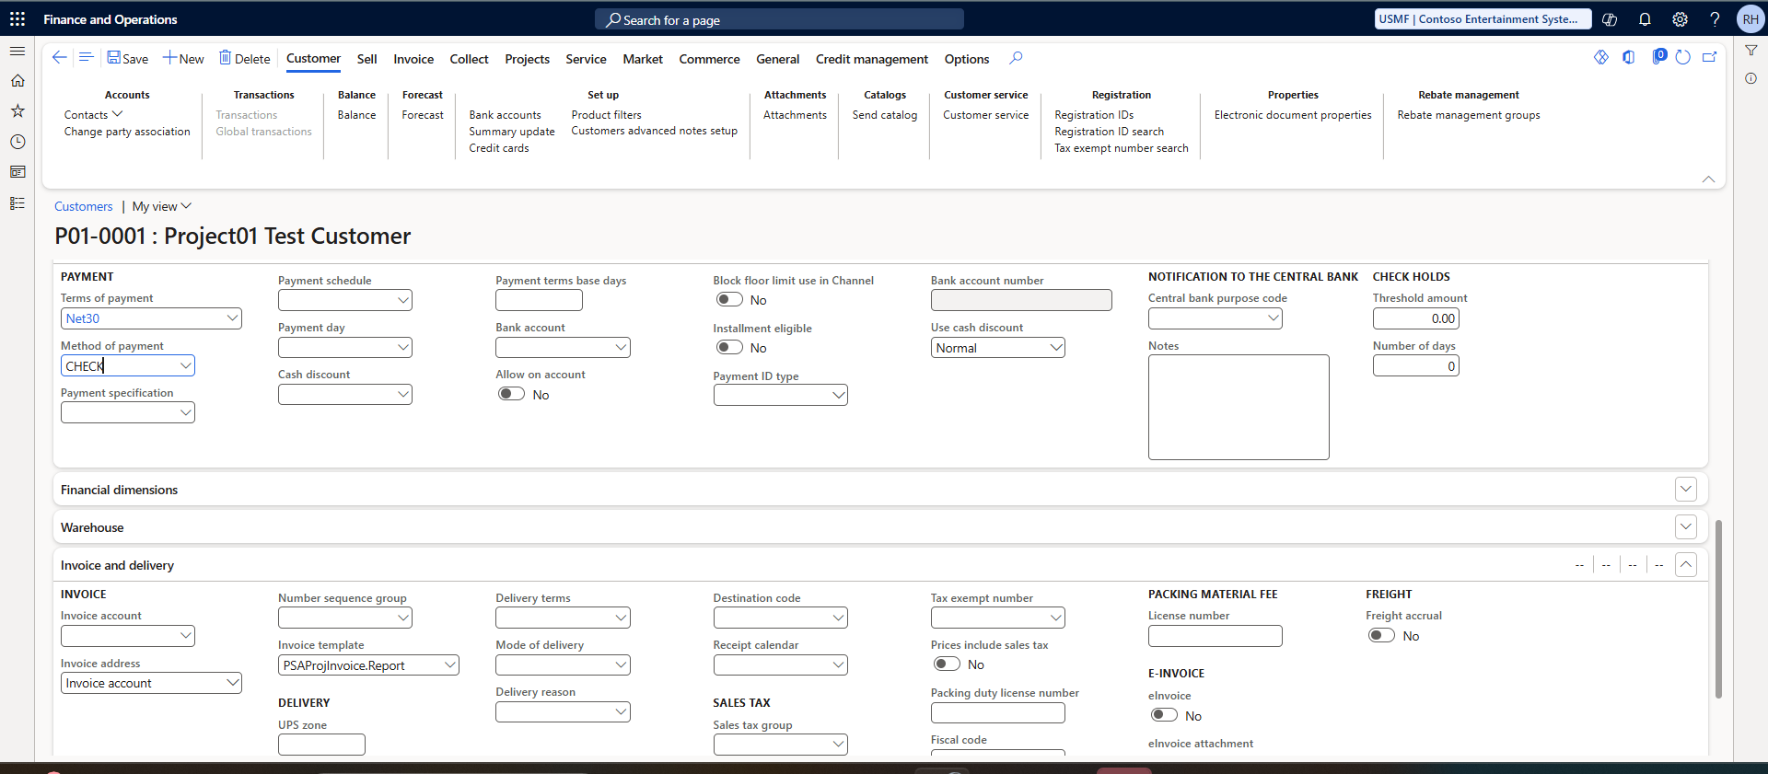
Customer Setup
• Name: Project01 Test Customer
• Customer: P01-0001
• Payment Terms: Net30
• Method: CHECK
• Tax Group: 5Pct
• Customer Group: 10

Slide 4
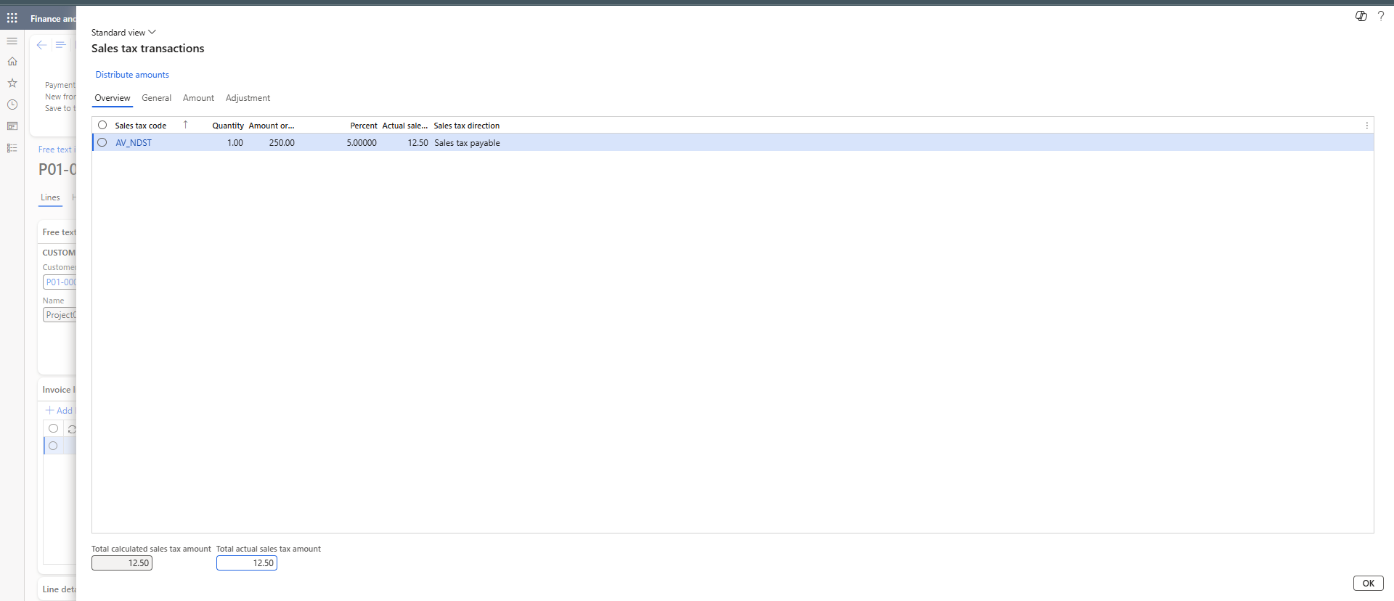
Invoice Details
• Consulting Services
• 250 USD + 12.50 Tax
• No inventory movement
• Service-based billing

Slide 5
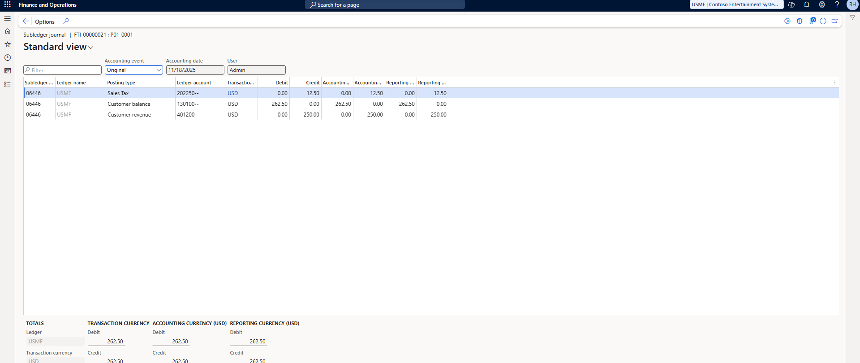
Voucher Posting
• DR Accounts Receivable 262.50
• CR Revenue 250
• CR Sales Tax Payable 12.50

Slide 6
Skills Demonstrated
• AR Cycle
• Tax Logic
• Accounting Distribution
• MB-310 Key Concepts

