Slide 1

SMART INDIA HACKATHON 2026
SIH 2026 IDEA SUBMISSION · PROBLEM STATEMENT 118
Problem Statement ID: 118
Problem Statement Title: Development of Wearable Wristband for Detection of Toxic Gas (H₂S) with Colorimetric Response & Optical Readout
Theme: Clean & Green Technology / Industrial Safety & Mining
PS Category: Hybrid (Intrinsically Safe Hardware + Edge-AI Software)
Team ID: [Registered Team ID]
Team Name: RageB8
Project Name: SARVAS by RageB8 (Self-Actuating Resilient Vapor-Adsorbing Sensor)

Slide 2
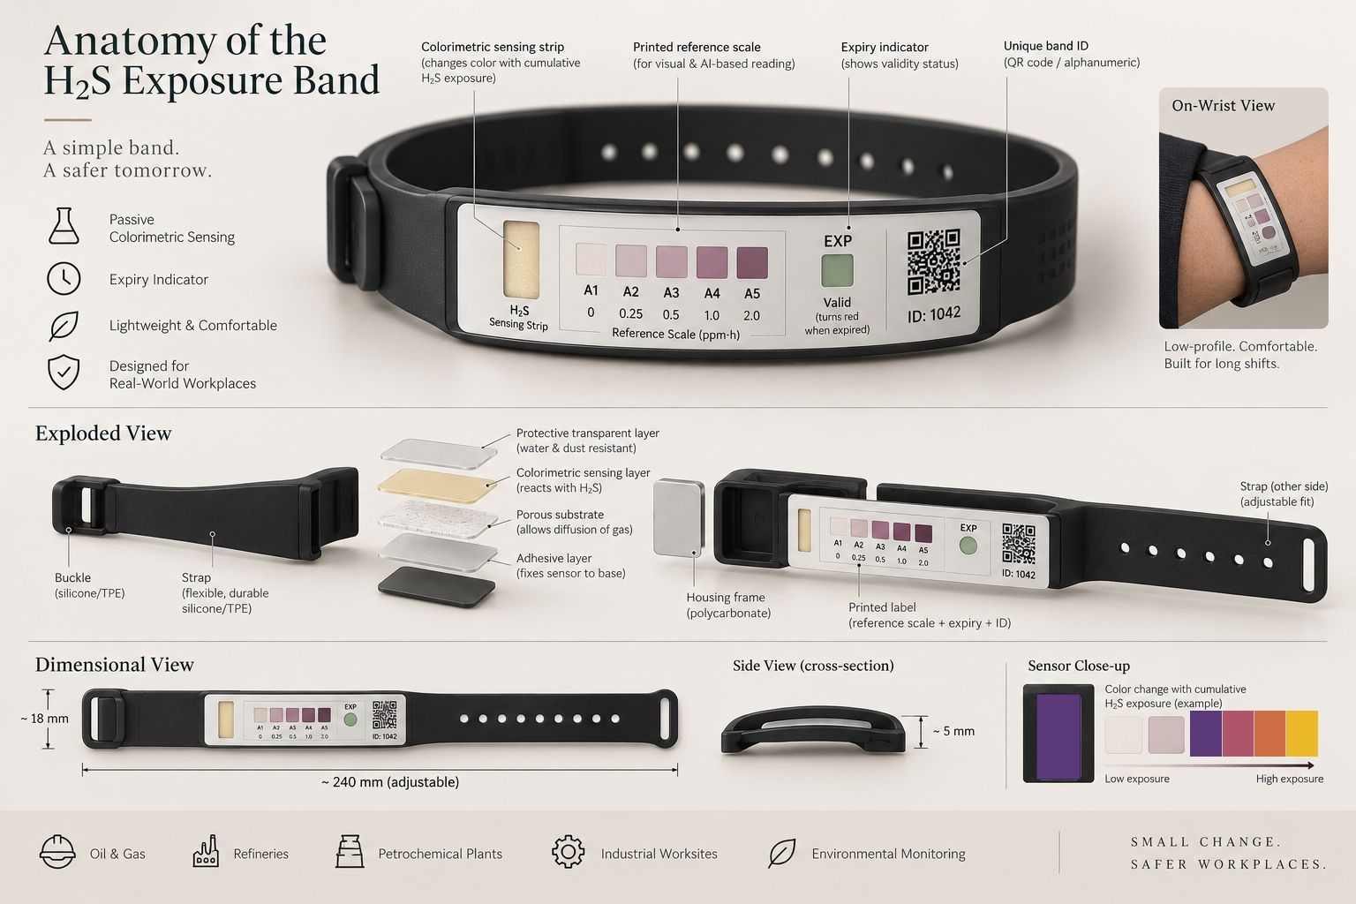
PROPOSED SOLUTION: SARVAS by RageB8
RageB8
• The Silent Industry Hazard: Electronic detectors only alarm during high leaks (>10 ppm). In reality, refinery and sewer workers breathe 1–9 ppm of toxic H₂S all day. This causes smell fatigue, respiratory illness, and lung damage without any alarm sounding.
• 1. Zero-Power Dual-Zone Smart Wristband: Battery-free wristband with two safe mineral zones: Silver for trace chronic exposure (0.1–10 ppm·h) and Copper for high shift limits (10–160 ppm·h). It forms permanent metal sulfides (Ag₂S & CuS) that never fade over time.
• 2. Built-In Color Calibration Target: Printed gray and white reference color swatches right next to the sensor strips allow any smartphone camera to automatically adjust for yellow sodium lamps, dark plant lighting, or bright sunlight.
• 3. Instant Seal-Breach & Dirt Protection: A smart visual dot stays chalk-white when sealed and turns blue if moisture leaks before use, rejecting damaged badges. A breathable outer membrane allows gas in while repelling water, dust, and oil splashes.
• 4. Fast Kiosk & Mobile Scan at Shift End: Workers scan their wristband at the exit turnstile kiosk or on a mobile phone in under 3 seconds. The system immediately calculates the shift dose and logs compliant audit records for safety officers.

Slide 3
TECHNICAL APPROACH & SYSTEM ARCHITECTURE
RageB8
1. Stage 1 - Dual-Zone Chemical Sensor: Dual Silver and Copper reaction pads sealed under a breathable micro-porous membrane. Toxic H₂S gas diffuses in and precipitates permanent, non-fading Ag₂S and CuS minerals, eliminating the fading flaw of organic dyes.
2. Stage 2 - Smart Camera Normalization: Standard mobile or kiosk camera captures the band. The algorithm automatically detects the printed reference scale, corrects for uneven factory lighting, and straightens tilted camera angles.
3. Stage 3 - Precision Color Analysis (CIEDE2000): Computes true perceptual color change (ΔE₀₀) using international color standards. A multi-tier filter automatically rejects non-wristband objects, bare skin, or mud smudges instead of raising false gas alarms.
4. Stage 4 - Heat & Humidity Compensation: Dynamic thermodynamic model automatically normalizes for tropical heat (15°C to 45°C) and moisture (20% to 80% RH), guaranteeing identical dosage accuracy across hot summers and coastal refineries.
5. Stage 5 - Secure Safety Dashboard & Sync: Operates 100% offline at the gate. When online, it securely synchronizes worker shift history to the plant dashboard, generating automated DGMS and OSHA regulatory compliance reports.

Slide 4
FEASIBILITY, RISKS & MITIGATION STRATEGIES
RageB8
• High Manufacturing & Cost Feasibility: Made using standard cellulose paper, safe water-based reagents, and simple band clips. Unit manufacturing cost is under ₹1 (₹0.85) per badge, making 100% daily workforce coverage financially practical.
• Challenge 1 - Harsh Plant Lighting & Camera Variances: [Mitigation] Printed on-band reference swatches give the smartphone camera a known baseline, delivering consistent, reliable dosage readings across both budget ₹7,000 Android phones and flagship devices.
• Challenge 2 - Surface Soot, Grease & Mud Contamination: [Mitigation] Breathable protective cover repels liquid muck. Furthermore, our optical engine checks the specific color shift of metal sulfides—surface dirt only drops brightness without the chemical hue and is flagged as dirt.
• Challenge 3 - Common Interfering Gases (SO₂, CO, Methane): [Mitigation] Silver and copper salts react selectively with sulfides. Common refinery gases like Carbon Monoxide, Methane, and Sulfur Dioxide do not trigger the reaction, preventing false alarms.
• Challenge 4 - Badge Swapping & Pouch Seal Quality: [Mitigation] Each band features a unique QR code linked to worker shift records. The built-in moisture dot turns blue if a storage pouch is torn, enabling quick visual rejection before shift start.

Slide 5
IMPACT, STATUTORY COMPLIANCE & ECONOMIC BENEFITS
RageB8
• 100% Workforce Inclusion (Social & Humanitarian Impact): Electronic detectors cost ₹30,000–₹1,00,000 each, so plants give them only to 10–15% of permanent staff. At under ₹1 per badge, SARVAS allows refineries to protect 100% of workers, including contract laborers.
• Radical Cost Reduction (>85% OPEX Savings): Eliminates costly sensor-head replacements, toxic span calibration gases, and daily charging docks. For a 2,500-worker facility, SARVAS saves crores of rupees annually while logging continuous personal exposure records.
• 100% Intrinsically Safe (ATEX / IECEx Zone 0): Zero batteries, zero wires, and zero electronic components on the worker's wrist. It carries 0% electrical spark or explosion risk, making it physically safe for the most volatile hydrocarbon fuel tanks.
• Statutory Health Compliance (OSHA & DGMS Ready): Calibrated to international 8-hour shift safety limits (ACGIH 8.0 ppm·h). Generates 1-click official audit records for Indian Directorate General of Mines Safety (DGMS) and factory inspectors.
• Validated Across 303 Test Samples: Extensively validated across 303 laboratory sample points across 10 blocks (varying concentrations, 15–45°C temps, humidity, lighting, and age), achieving high accuracy within ±8% to ±12% of reference values.

Slide 6
RESEARCH FOUNDATIONS, STANDARDS & REFERENCES
RageB8
1. Permanent Metal-Sulfide Chemistry: Engel et al. (Sensors, 2019) demonstrated that organic dyes fade over time in air, whereas inorganic silver and copper salts form permanent, non-fading sulfide precipitates (Ag₂S and CuS) ideal for shift dosimetry.
2. Colorimetric Science & Perceptual Tolerances: ISO/CIE 11664-6:2014, 'Colorimetry — Part 6: CIEDE2000 Colour-Difference Formula' & ISO 11664-2 for lighting-independent perceptual color quantification.
3. Occupational Exposure Limits & Health Standards: ACGIH (2024), 'Threshold Limit Values: H₂S TLV-TWA 1.0 ppm (8.0 ppm·h shift limit), STEL 5.0 ppm' | OSHA 29 CFR 1910.1000 Table Z-2 for toxic gas ceiling limits.
4. Indian Statutory Safety Guidelines: Directorate General of Mines Safety (DGMS) Tech Circular No. 02 of 2019 | Oil Industry Safety Directorate OISD-GDN-166 for personal protective equipment and toxic gas exposure records.
5. Direct-Reading Dosimeter Testing Principles: NIOSH NMAM Method 6013 for hydrogen sulfide sampling and colorimetric measurement on solid sorbent substrates.
6. Open Prototype Code & 303-Sample Calibration Dataset: Live Interactive Prototype, computer vision scanner, and 303-sample calibration matrix: https://github.com/Reya-Doshi/118

