Slide 1
We, FalconX, presenting…

Slide 2
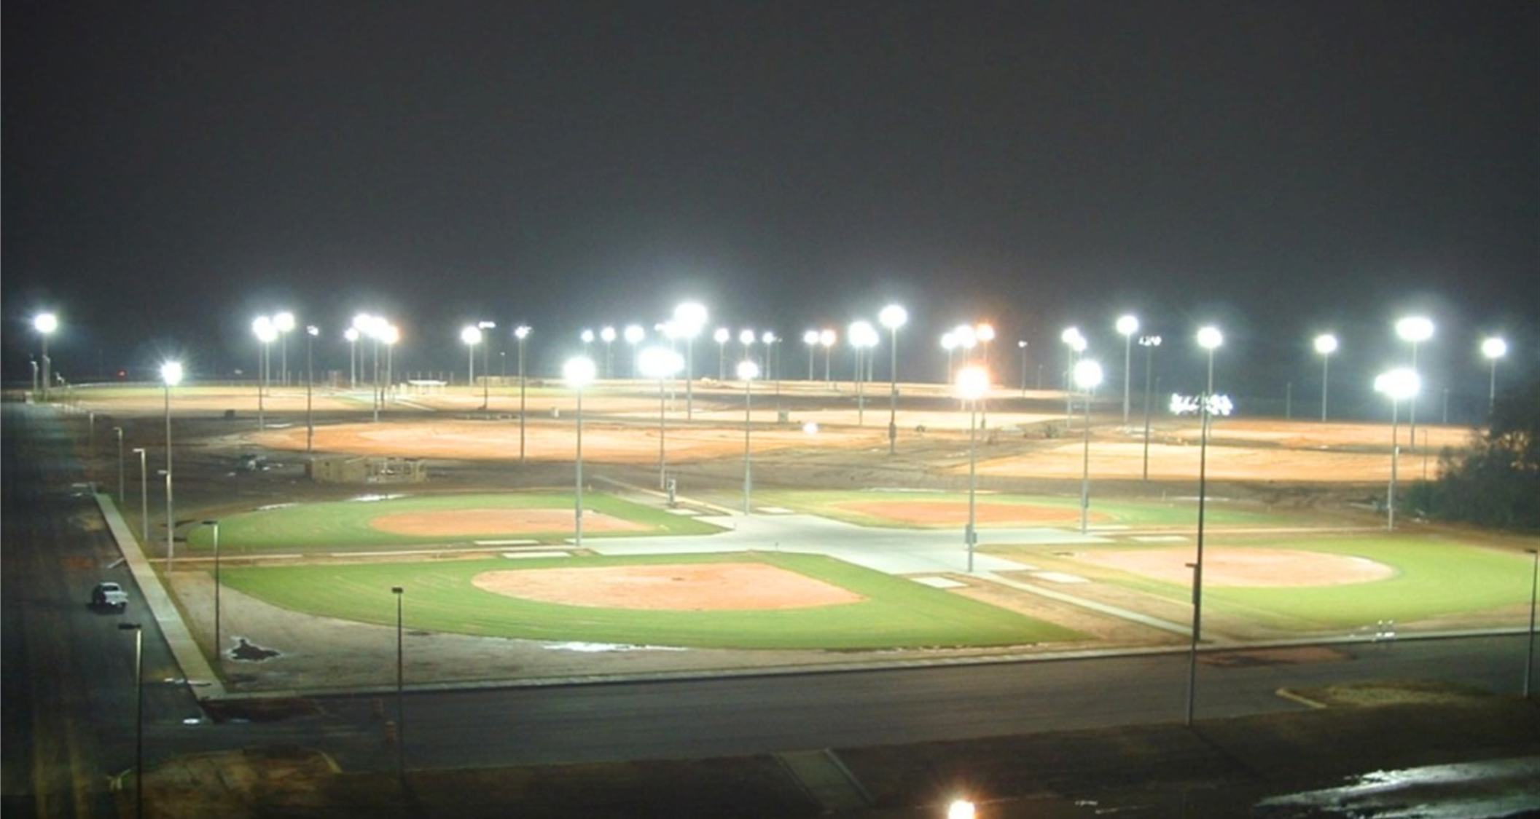
A message about
Light Pollution

Slide 3
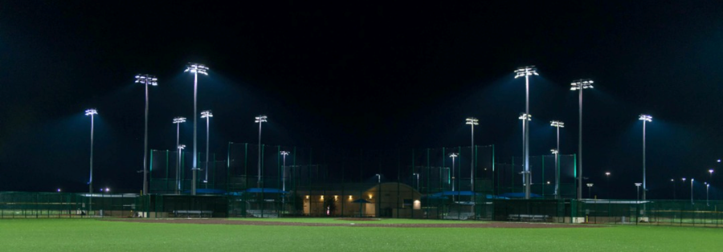
Alokbarta
Alokbarta

Slide 4
But first, what is actually
Light Pollution?
Light pollution is the human-made alteration of outdoor light levels from those occurring naturally. When an excessive quantity of light is emitted from a more than sufficient source, it is also defined as light pollution.

Slide 5
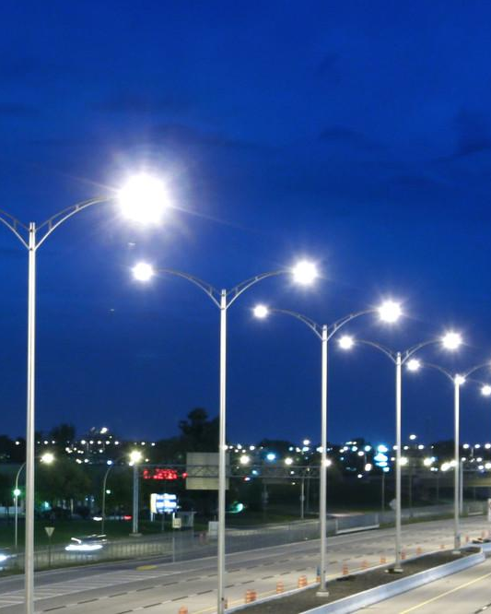
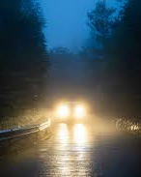
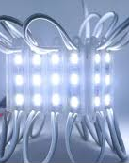
The sources of light pollution
Lampposts
Vehicle Light
LED Glow Lights
And so many!

Slide 6
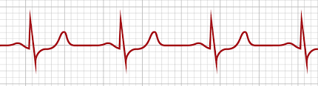



Effects of Light Pollution
To human, light pollution might cause,
disruption of the circadian rhythm
sleep disorders such as insomnia and delayed sleep-phase syndrome
Diabetes, Heart disease
depression, hypertension, attention deficit disorder, obesity

Slide 7
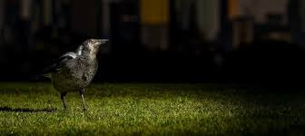
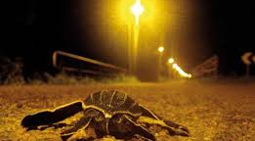
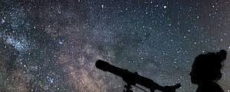
Effects of Light Pollution
To nature, light pollution might cause,
impacts animal behaviors, such as migration patterns,
wake-sleep habits, and habitat formation
sea turtles and birds guided by moonlight during
migration get confused, lose their way, and often die
Stargazing problem

Slide 8
Project Alokbarta
Our journey can be described into three steps:
Field Data Collection
Experiment, observe old solutions and invent new ones
Sharing our findings among others (via Science Expos, Research paper etc.)

Slide 9
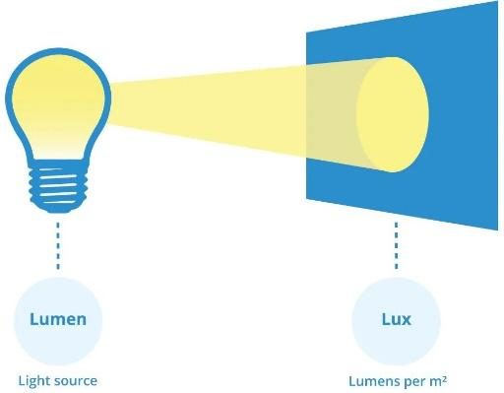
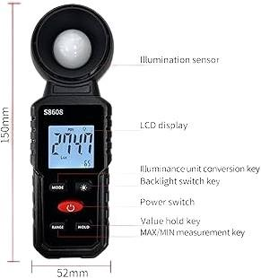
Step-1: Data Collection
Lumen & Lux
Lux Meter

Slide 10
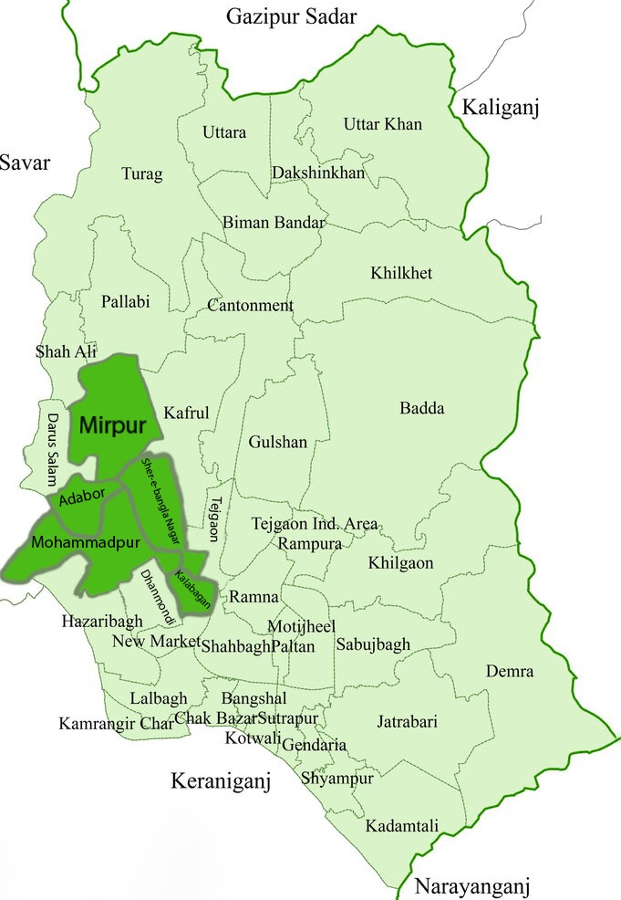
Step-1:
Data Collection
Our main
research areas
(Among Dhaka City)

Slide 11
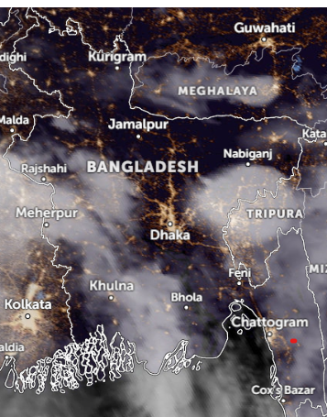

Why Dhaka City?
Most affected area in Bangladesh
Most densely-populated area

Slide 12
Findings
General Building Area | Observation Number | Mean value SUM of every data Total observations | IES* Standard Illumination Level
Shop
Conventionals with counters | 39 | 1358.92 | 500
Supermarkets | 2 | 259.85 | 500
Conventionals with wall display | 33 | 1751.06 | 500
General | 34 | 794.68 | 500
Staff Restaurants
Centre cafeterias, dining room | 26 | 515.91 | 300
*IES – Illuminating Engineering Society

Slide 13

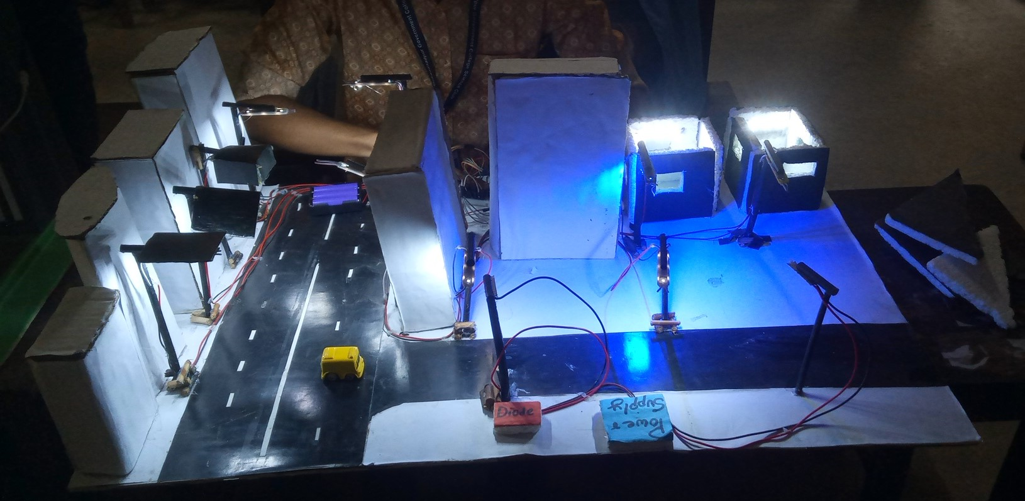
Step-2: Experiment, observe old solutions and invent new ones
Solution Model
Ensuring proper light anglement and height
Using proper shades for street lights
Using more silver-plated Glass
Controlling street lights by using AI and sensor
Using Proper color light

Slide 14
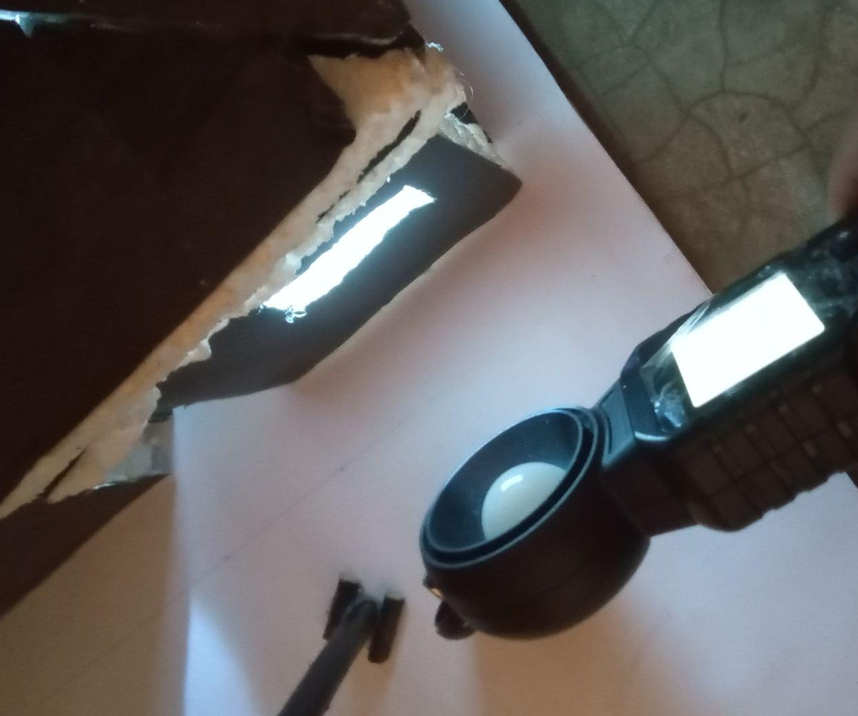
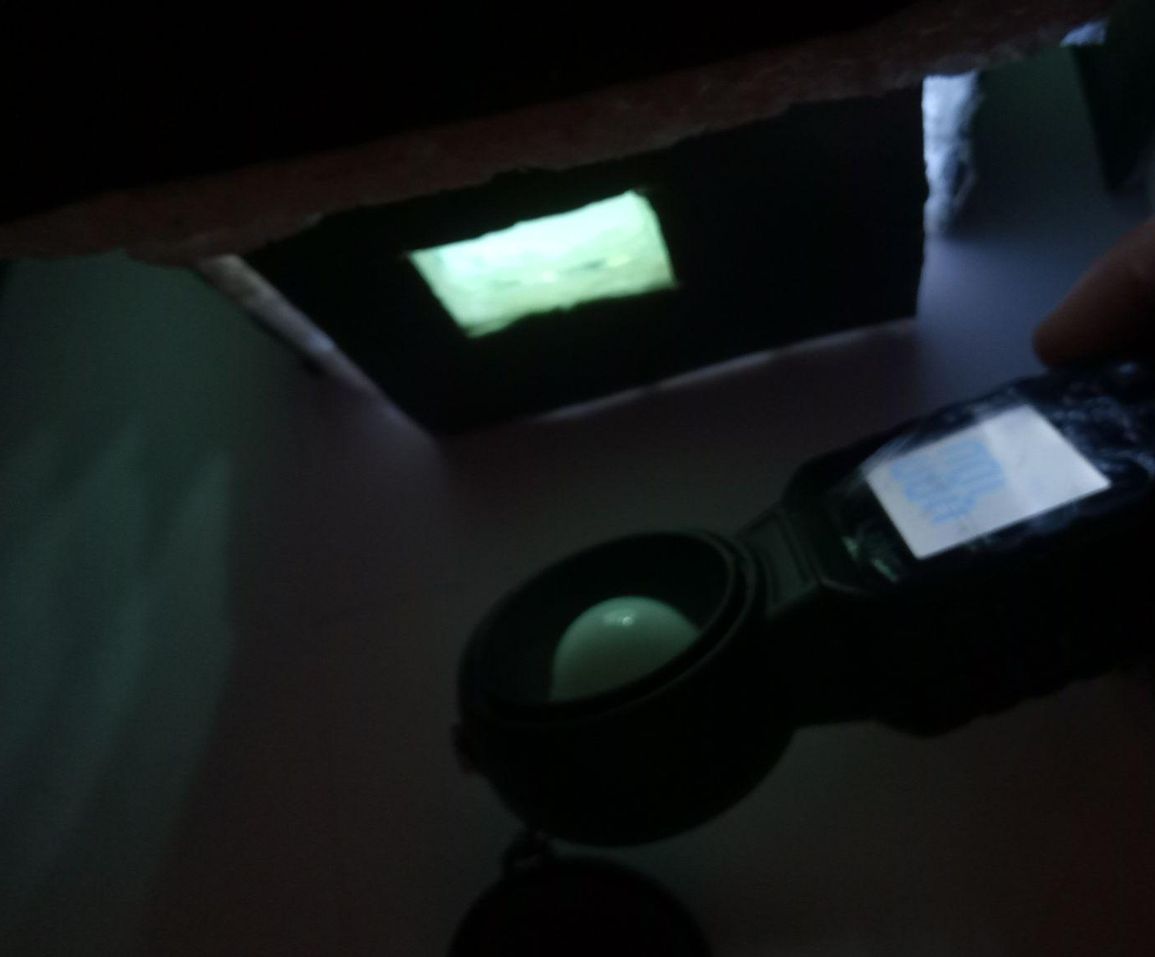
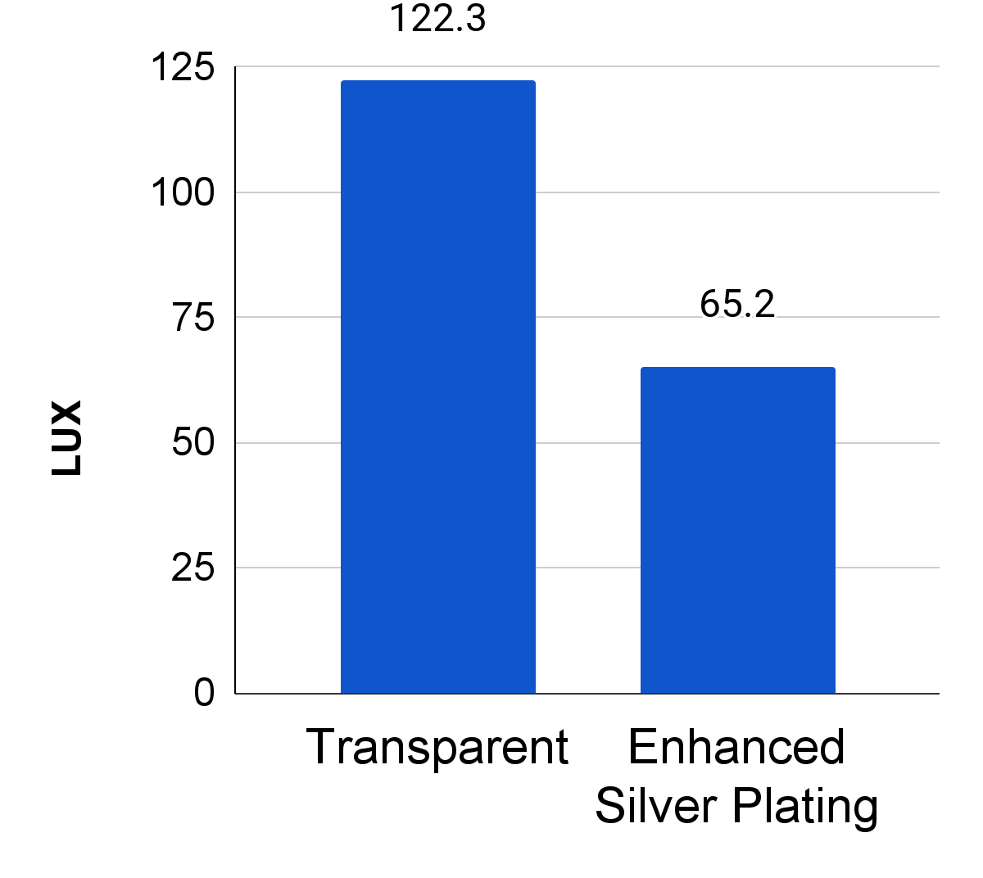
Our suggested solution
Solution-1: using more silver-plated glass
Transparent Glass
One-way Reflective Glass
Comparison

Slide 15
Our suggested solution
Solution-2: maintaining advancing schedule to reduce light pollution as well as energy loss
Shopping Malls/Shop | Available/Active | Work Hour (hr) | Area (sqft) | Extra Lighting (hr)
Basundara shopping complex | 10 A.M- 9 P.M | 11hr | 1,91,200 | 2hr
Jamuna Future Park | 11 A.M- 8 P.M | 9hr | 42,00,000 | 1hr
Dhaka New Market | 10 A.M - 9P.M | 11hr | 5,60,683 | 2hr
Rapa Plaza | 10 A.M - 8 P.M | 10hr | 1,00,000 | 1hr
Average |  | 10.25hr | 1237970.75 | 1.5hr
Current Schedule of Shopping Malls
Schedule | Light Requirement (lumens/sqft) | Energy Requirement (watt/sqft) | Avg Area (sqft) | Time (Lighting hour) | Consumption (kw/hr) | Savings (kw/hr)
Current (10A.M-8:30PM) | 69.67728 | 0.753 | 12,37,970.75 | 2.5hr | 2330.4799 | 1398.28 (60%)
Suggesting (10A.M-7P.M) | 69.67728 | 0.753 | 12,37,970.75 | 1hr | 932.19
Energy consumption of shopping malls (current vs suggesting)

Slide 16
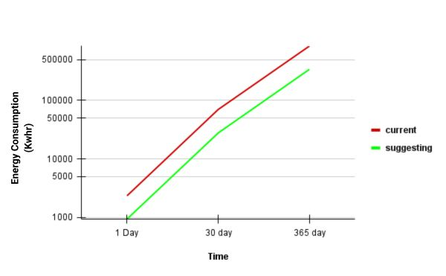
Our suggested solution
Solution-2: maintaining advancing schedule to reduce light pollution as well as energy loss
Comparison of energy-consumption

Slide 17
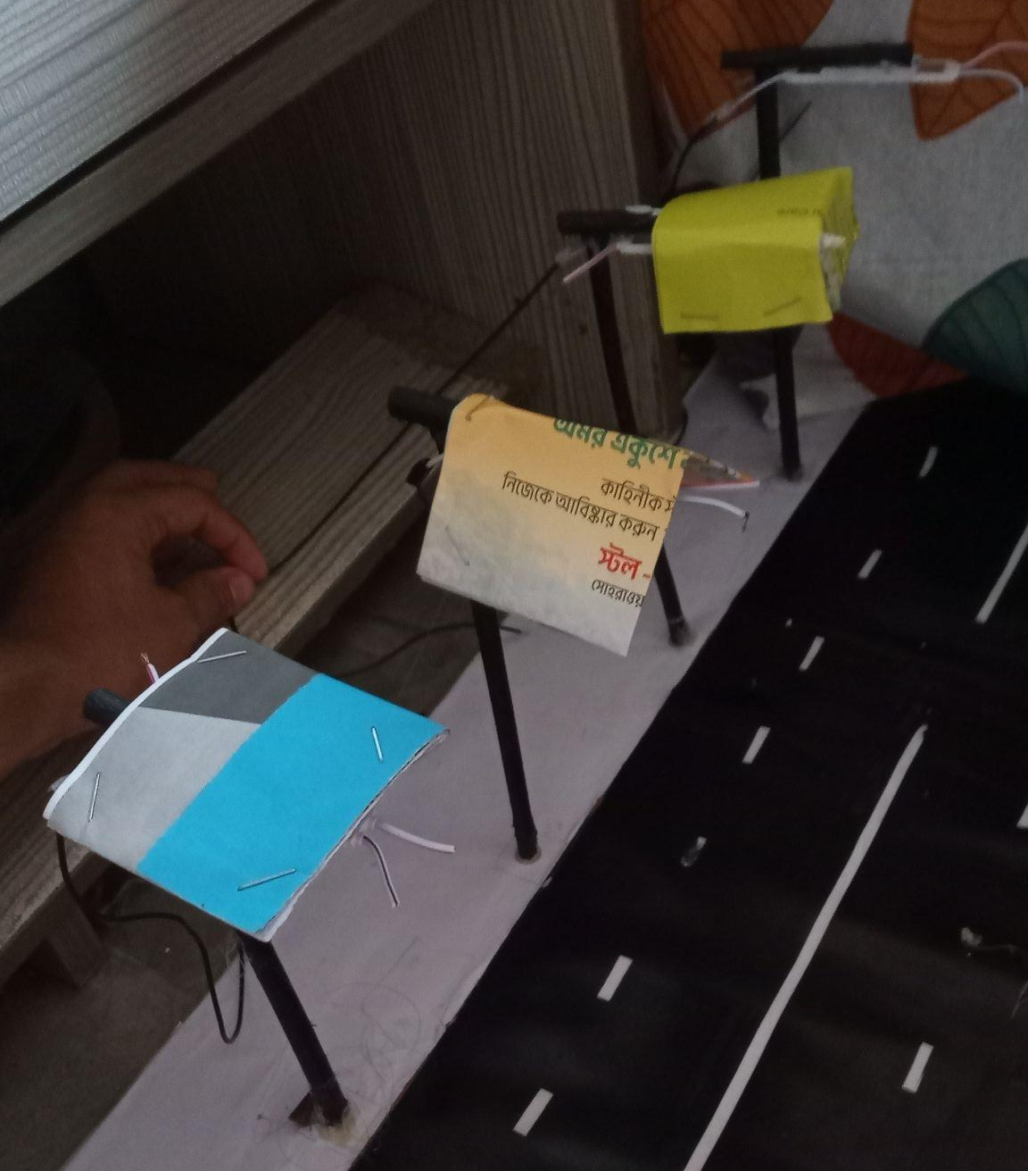
Our suggested solution
Solution-3: using proper shades for street lights
Without cover
Entirely Covered
Two-sided (Triangular)
One-sided (Flat)

Slide 18
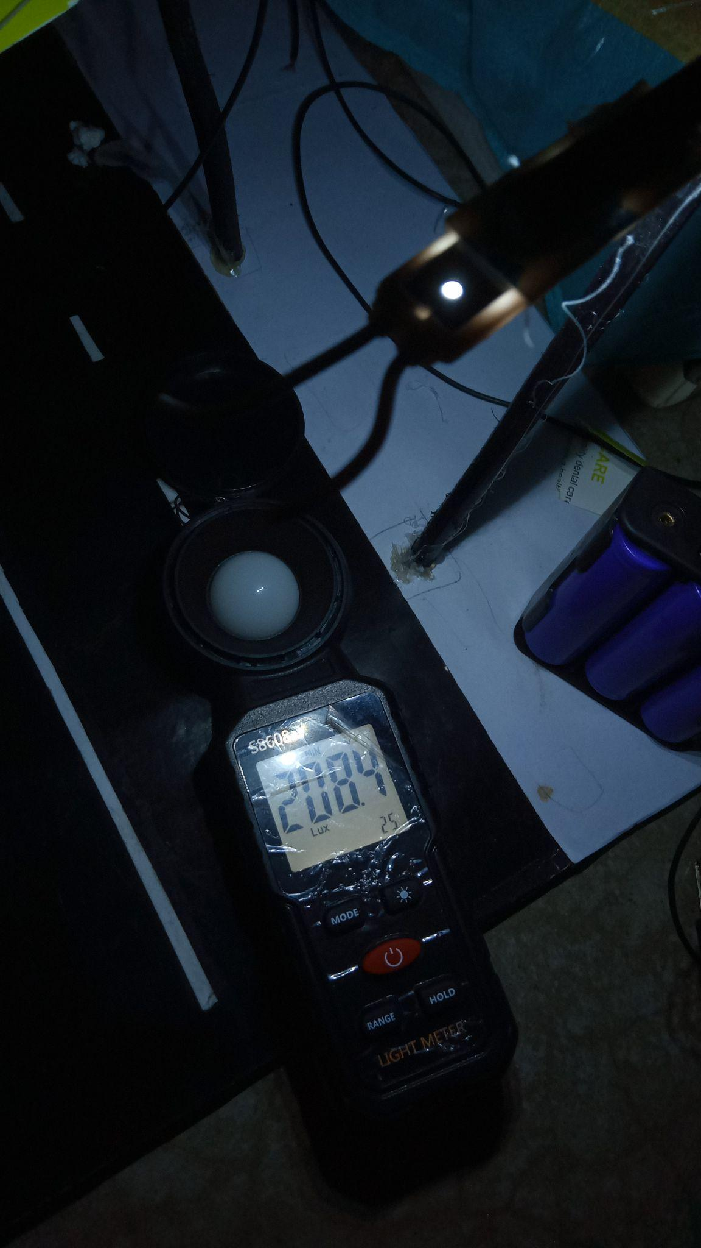
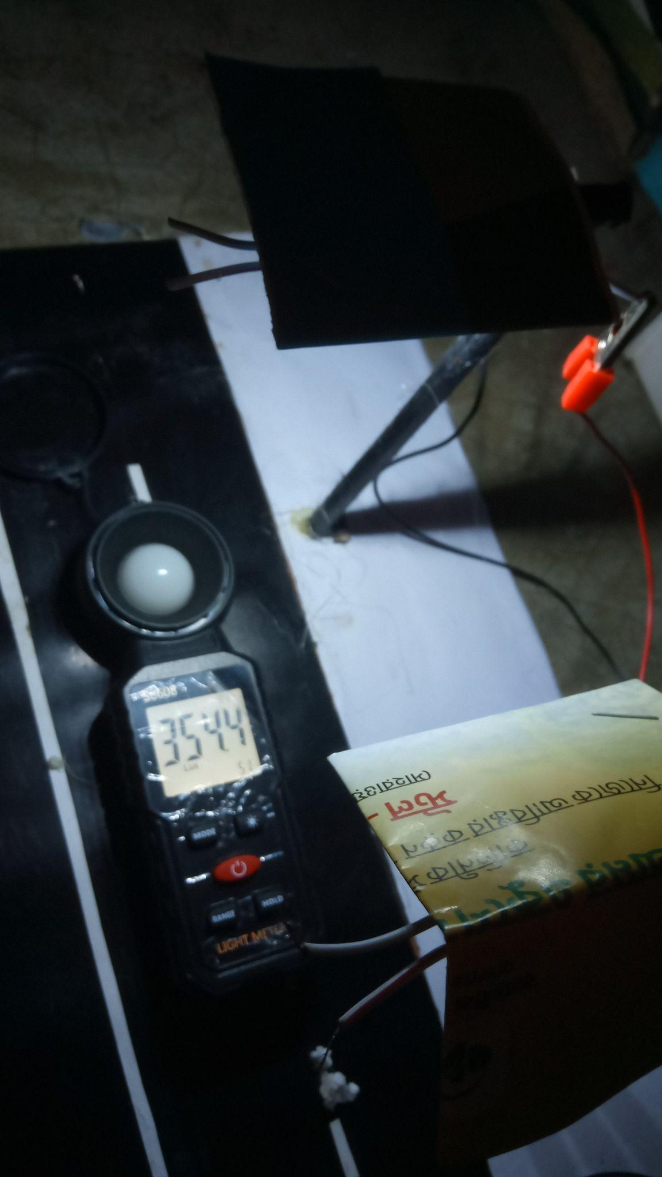
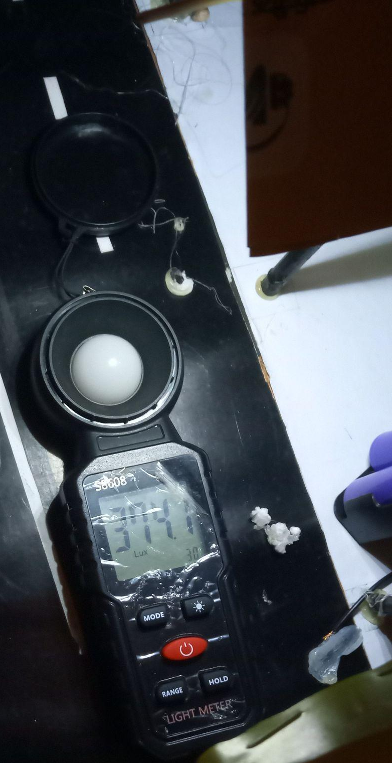
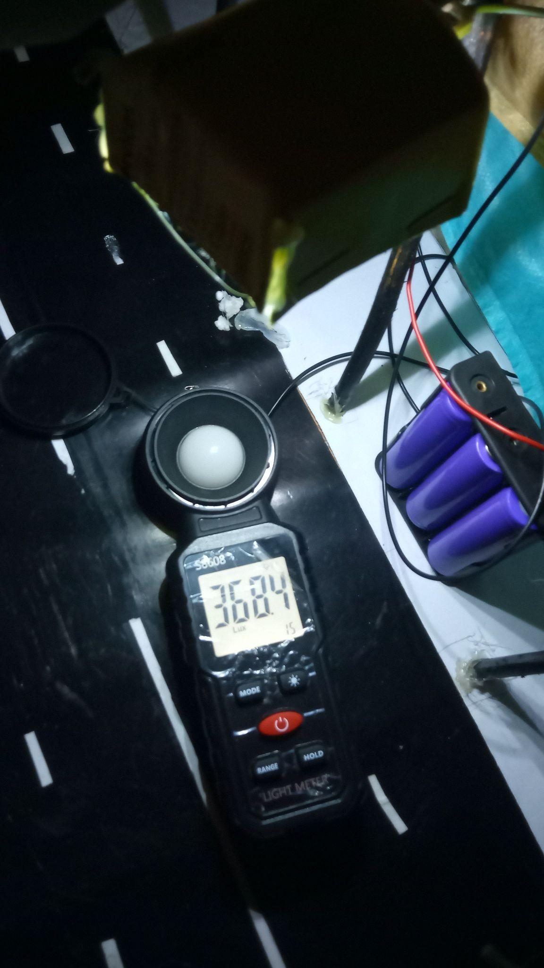
Our suggested solution
Solution-3: using proper shades for street lights
Without cover
One-sided
(Flat)
Two-sided
(Triangular)
Entirely
Covered

Slide 19
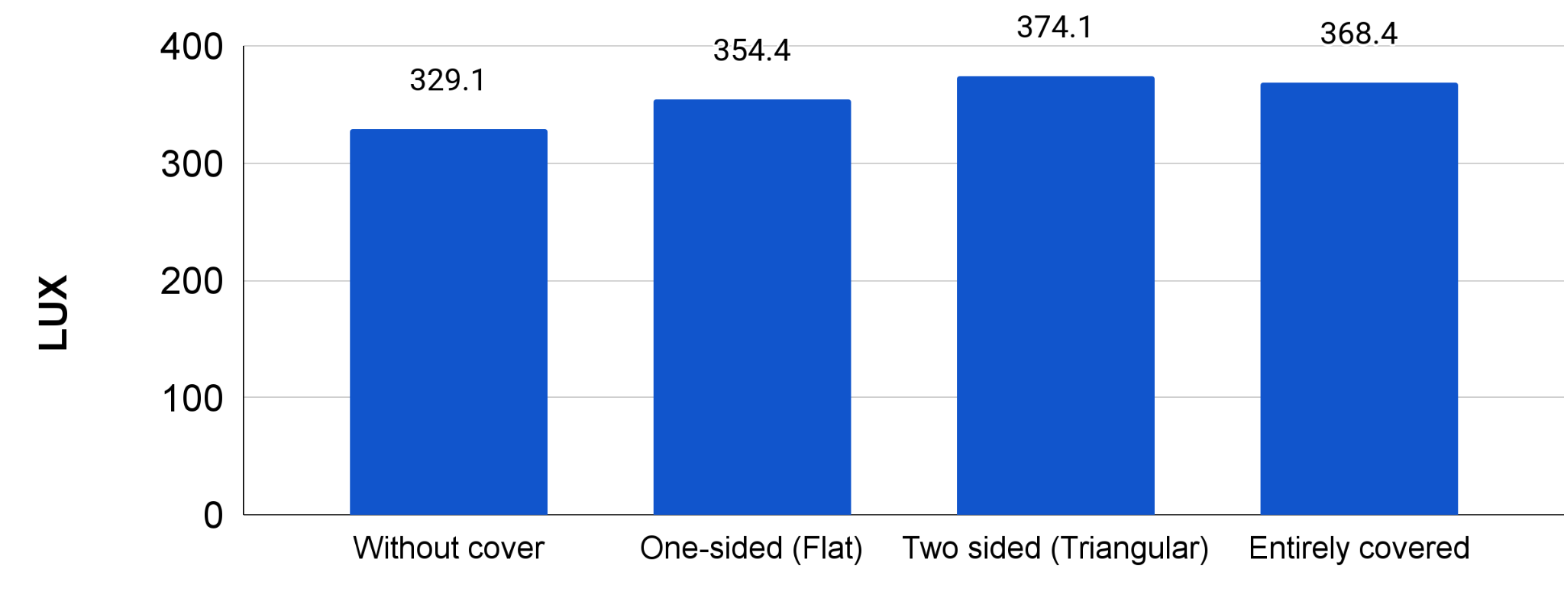
Our suggested solution
Solution-3: using proper shades for street lights
Comparison

Slide 20
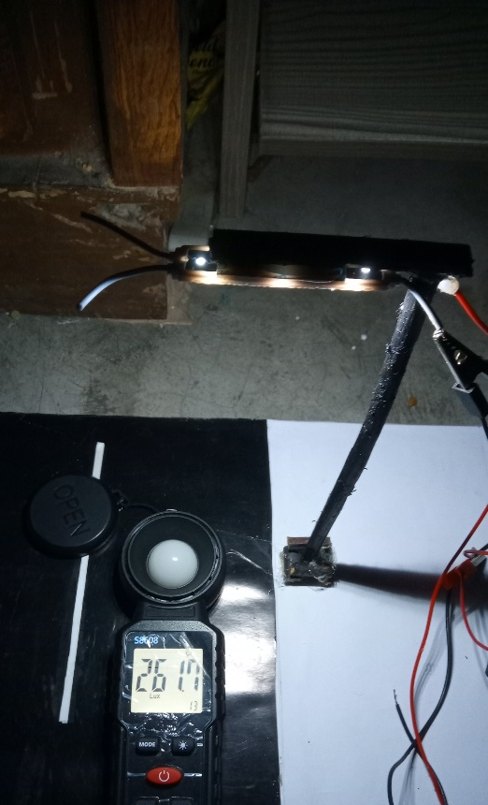
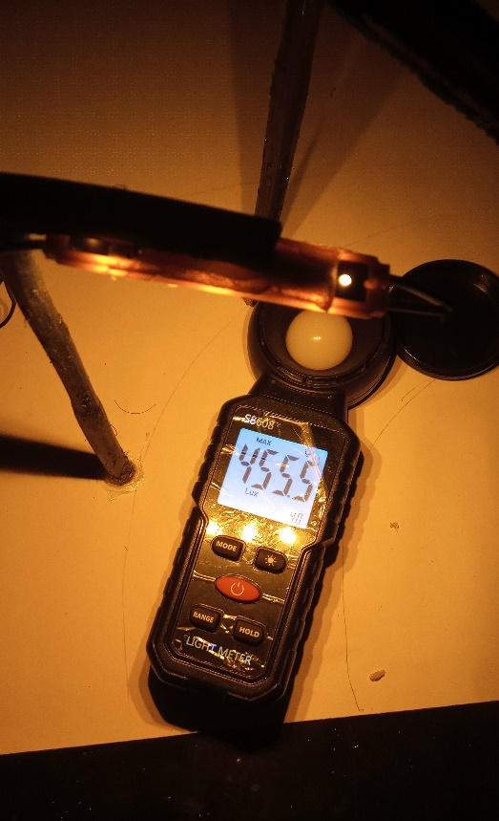
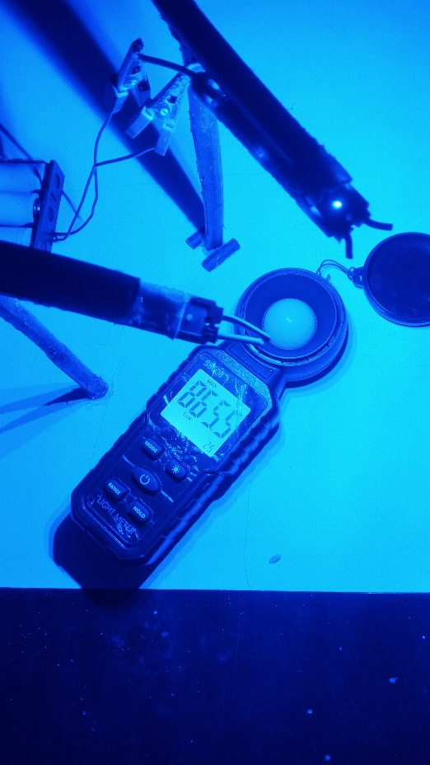
Our suggested solution
Solution-4: using proper light color
White LED
Yellow/Orange
LED
Blue LED

Slide 21
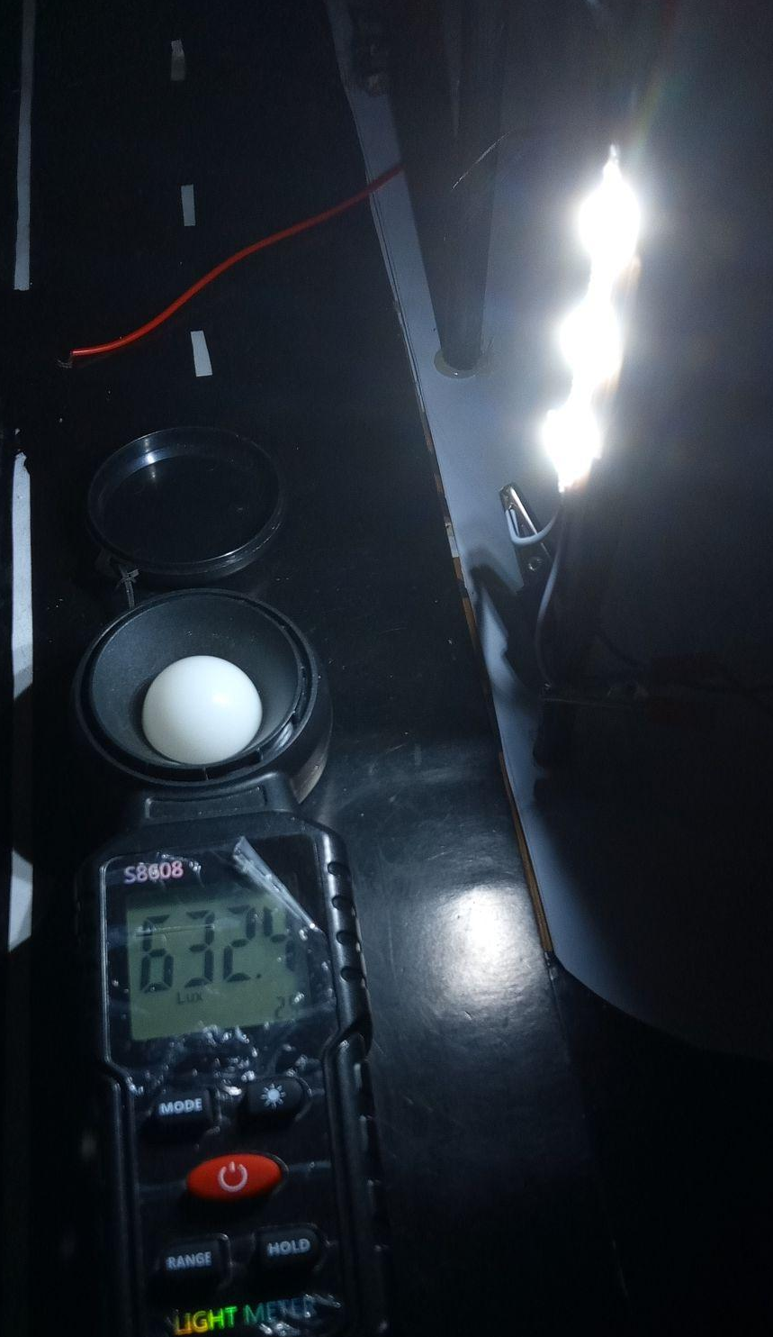
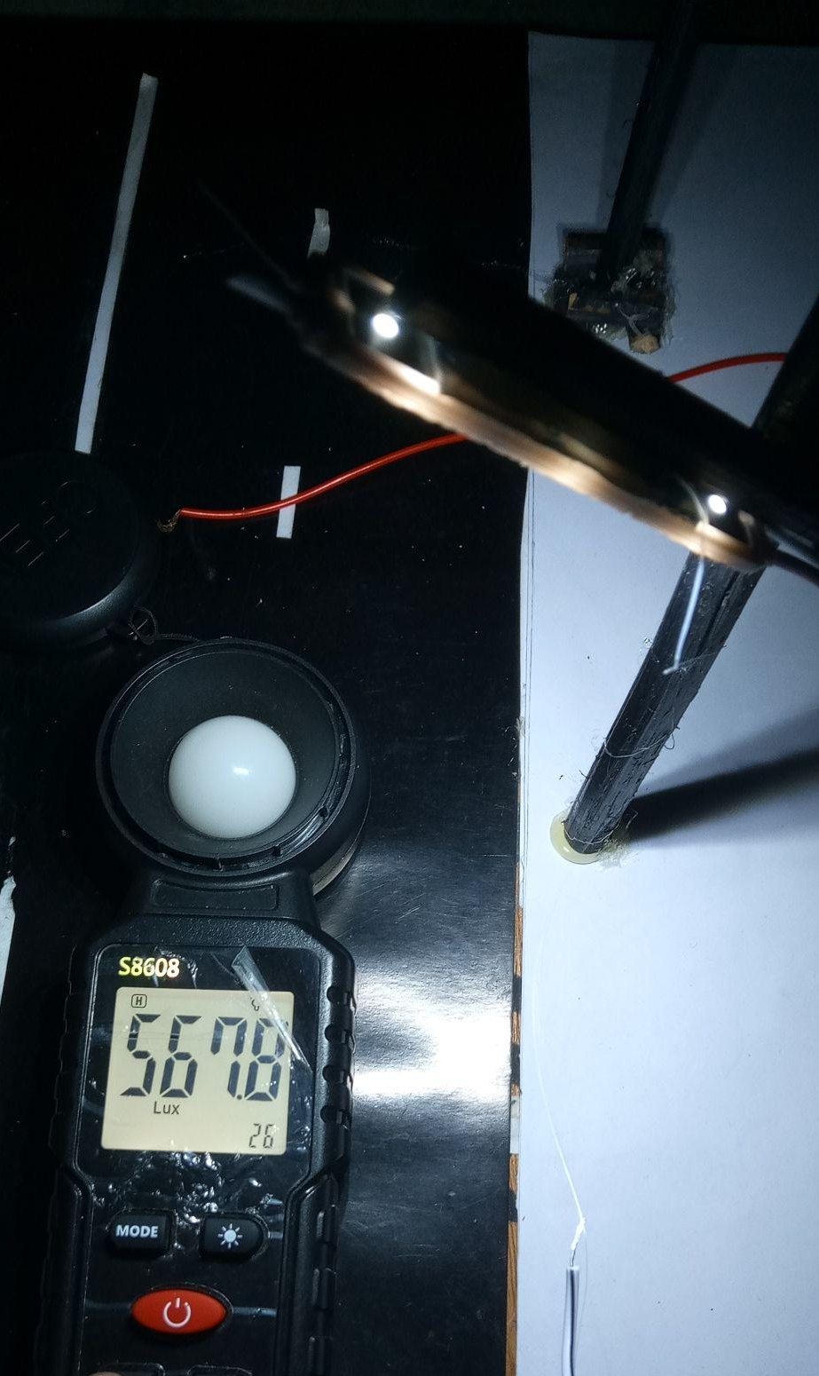

Our suggested solution
Solution-5: ensuring proper light anglement and height
Perpendicular
(90 degree)
45 degree
angled
6 inch long
8 inch long

Slide 22
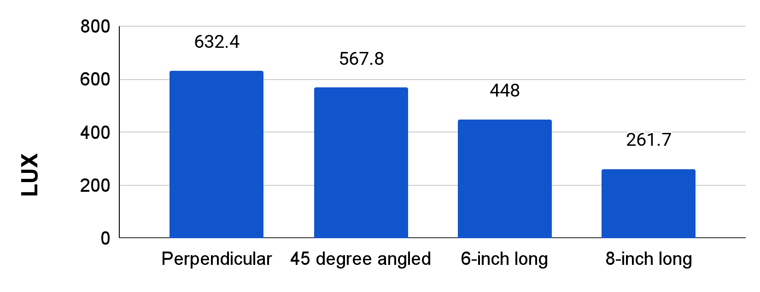
Our suggested solution
Solution-5: ensuring proper light anglement and height
Comparison

Slide 23
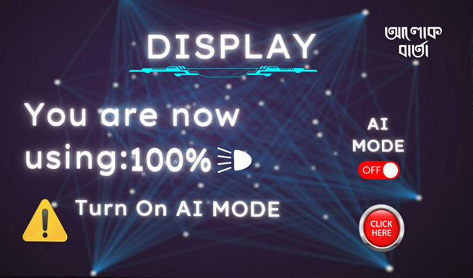
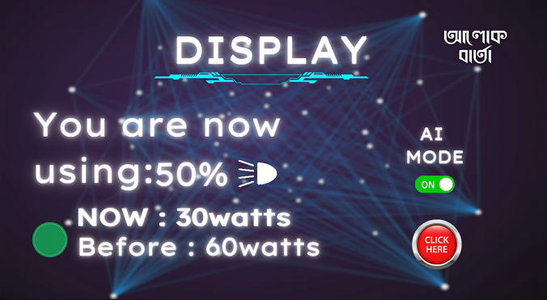
Our suggested solution
Solution-6: controlling street lights by using AI and sensor

Slide 24
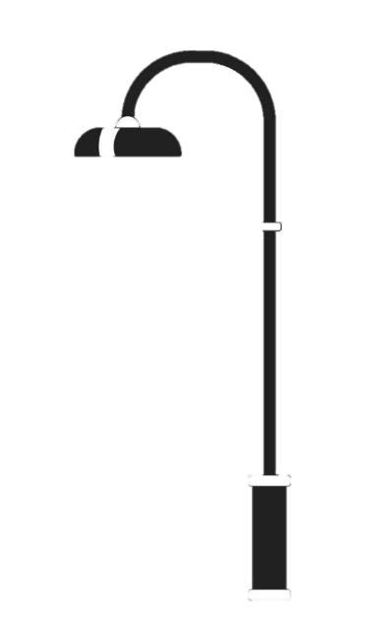

Our suggested solution
Solution-6: controlling street lights by using AI and sensor

Slide 25
Our suggested solution
Solution-6: controlling street lights by using AI and sensor

Slide 26
Our suggested solution
Solution-6: controlling street lights by using AI and sensor

Slide 27
Our suggested solution
Comparison (all in one)
Lamppost model / LED position details | Distance from lux meter (inch) | Angle to the ground (degree) | Light Color | Lower Range | Average | Higher Range
Perpendicular | 5 | 90 | White | 602.2 | 632.4 | 632.4
45 degree angled | 6.5 | 45 | White | 565 | 567.8 | 579
8 inch tall | 8 | 0 | White | 233.6 | 261.7 | 267.3
White LED (6 inch tall) | 6 | 0 | White | 283.7 | 448 | 455.6
Blue LED | 6 | 0 | Blue | 570.6 | 638 | 865.5
Yellow/orange LED | 6 | 0 | Yellow | 374.1 | 390.9 | 455.5
Without cover | 7 | 0 | White | 208.4 | 329.1 | 334.7
One-sided cover (Flat) | 7 | 0 | White | 258.9 | 354.4 | 357.2
Two-sided cover (Triangular) | 7 | 0 | White | 270.2 | 374.1 | 388.1
Entirely covered | 7 | 0 | White | 188 | 368.4 | 385.3
Transparent glass (less silver plating) | 2 inch behind window | 90 | White | 89 | 122.3 | 202
Glass with enhanced silver plating | 2 inch behind window | 90 | White | 48 | 65.2 | 73.7

Slide 28


For real-life implementation, we require-
Getting enough Fund/Manpower
Implying by government

Slide 29
?
?
Open Floor

Slide 30
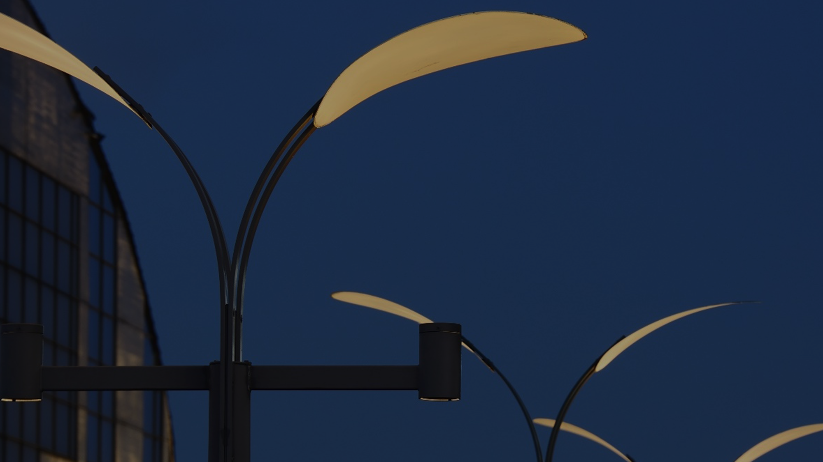
Use artificial light, in an efficient way!

Slide 31

Presented by-
FalconX

Slide 32
Presented by-
MD Reyad Hasan
Motaher Hossain Siam
Mohammad Nehal Alam
Rayat Ahmed
S.M. Safayat Hossain
Mohammad Abdus Sami
Rahat Hossain Prince

