Slide 1

Markowitz portfolio optimization
Balancing risk & return

Slide 2
Introduction
Markowitz Portfolio Optimization is a financial theory that seeks to construct a diversified investment portfolio by balancing assets to maximize expected return for a given level of risk, considering the correlation between assets.
The primary objective is to strike a balance between risk and return, allowing investors to build diversified portfolios that optimize their expected returns based on their risk tolerance.

Slide 3
Assets
BTC USD (Bitcoin - USD): Bitcoin is a decentralized digital currency, known for its limited supply and decentralized blockchain technology. It is a popular cryptocurrency and a store of value.
IDEA.NS (Vodafone Idea Limited): Vodafone Idea Limited is a telecom company in India, providing services such as mobile telephony, wireless broadband, and enterprise services.
MATIC-INR (Polygon - INR): Polygon (MATIC) is a blockchain scalability platform that aims to enhance the performance and usability of decentralized applications (DApps) on the Ethereum network.
MINDACORP.NS (Minda Corporation Limited): Minda Corporation Limited is an Indian company engaged in the manufacturing of automobile components, including safety and security systems.
MRNA (Moderna Inc.): Moderna Inc. is a biotechnology company known for its development of mRNA-based vaccines, including the COVID-19 vaccine.

Slide 4
NIFTYBEES.NS (NIFTY BeES): NIFTY BeES is an exchange-traded fund (ETF) in India that tracks the performance of the Nifty 50 index, representing the NSE of India's benchmark index
PIDILITIND.NS (Pidilite Industries Limited): Pidilite Industries Limited is an Indian company involved in the manufacturing and marketing of adhesives, sealants, and construction chemicals.
QQQ (Invesco QQQ Trust): The Invesco QQQ Trust is an ETF that tracks the performance of the Nasdaq-100 Index, composed non-financial companies listed on the Nasdaq Stock Market.
SPY (SPDR S&P 500 ETF Trust): SPDR S&P 500 ETF Trust is an ETF that aims to track the performance of the S&P 500 index, representing a broad range of large-cap U.S. stocks.
TSLA (Tesla Inc.): Tesla Inc. is an American electric vehicle and clean energy company known for its electric cars, energy storage solutions, and solar products

Slide 5
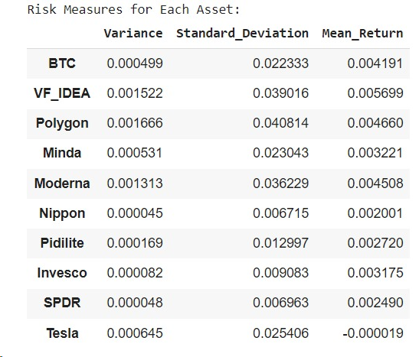
Returns and Risk Measures
These are the calculated Return and Risk measures of each asset over a period of 3 months

Slide 6
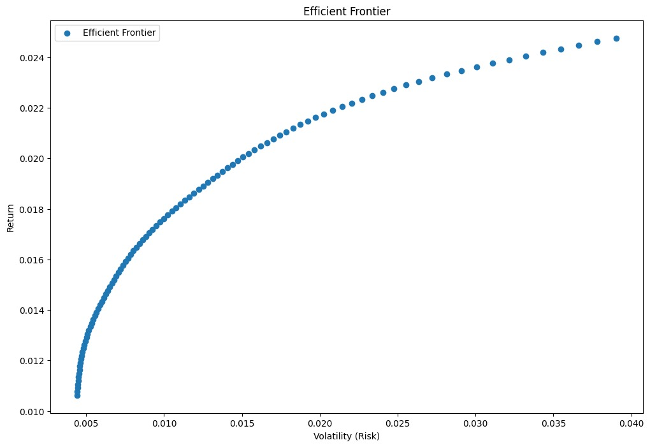
Efficient Frontier
We have chosen two points on the efficient frontier representing two different risk tolerance levels.
- target_risk_low = 0.1
- target_risk_high = 0.3

Slide 7
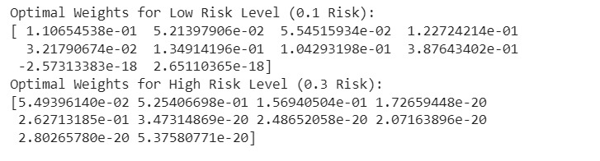
Optimal Portfolio Weights for Each Chosen Points

Slide 8
Trade-Off Between Risk and Return
Optimal Weights for Low Risk Level (0.1 Risk): The portfolio is tilted towards assets with lower volatility. Noteworthy is the substantial allocation to low-risk assets, potentially providing stability to the portfolio. The allocation suggests a preference for more conservative assets, minimizing the impact of market fluctuations.
Optimal Weights for High Risk Level (0.3 Risk): The portfolio exhibits a higher allocation to riskier assets with greater potential returns. This allocation strategy embraces a higher risk tolerance, seeking to capitalize on market opportunities. The mix implies a willingness to endure higher volatility in exchange for the potential for increased returns.
Trade-off Analysis: - Low Risk (0.1), Lower potential returns but reduced exposure to market volatility, suitable for conservative investors. High Risk (0.3), Higher potential returns but with an increased level of risk, catering to more aggressive investors.

Slide 9
Limitations of Markowitz Optimization
Markowitz optimization exhibits sensitivity to input parameters, particularly expected returns and covariance matrices, which can lead to significant variations in portfolio allocations with minor changes in these inputs. Moreover, the assumption of normality in asset returns limits its applicability, as real-world market returns often deviate from this distribution. Additionally, Markowitz optimization is designed for a single period, overlooking dynamic market conditions and evolving investor preferences over time.
However, despite these limitations, Markowitz optimization remains valuable in real-world applications. It continues to serve as a foundational framework for diversification strategies, helping investors balance risk and return in their portfolios. Furthermore, it provides a baseline framework for modern portfolio theory, even as newer models emerge, and supports risk management strategies by identifying optimal risk-return trade-offs for investors with diverse risk appetites.

Slide 10
Conclusion
In conclusion, the Markowitz Portfolio Optimization provides valuable insights into constructing efficient portfolios, showcasing the trade-off between risk and return.
By analyzing optimal weights for different risk tolerance levels, investors can strategically balance stability and potential returns. Understanding this fundamental trade-off is essential for crafting portfolios aligned with individual risk preferences and long-term financial goals.
The systematic approach offered by portfolio optimization equips investors to make informed decisions, building well-balanced and risk-adjusted investment strategies that adapt to the evolving investment landscape for sustained financial well-being.

