Slide 1
TECHNICAL ANALYSIS UNDERSTANDING MARKET TRENDS AND PREDICTIONS

Slide 2
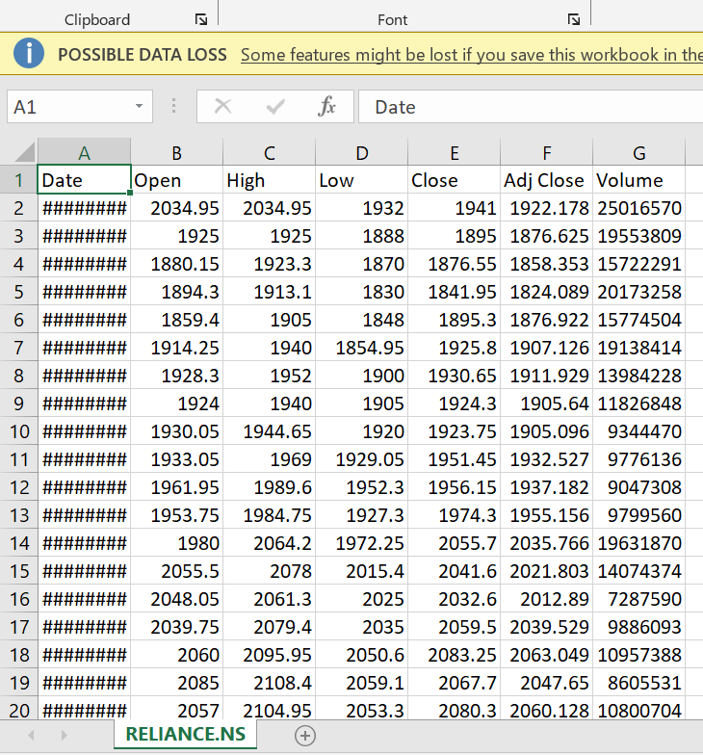
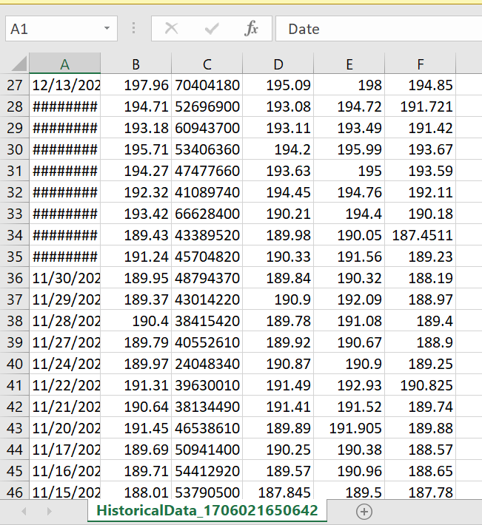
INTRODUCTION
Our objective is to perform technical analysis on Reliance and Apple stocks. We tried to develop a predictive methodology for bullish and bearish positions and compare the accuracy between these two prominent stocks.
Reliance Dataset
Apple stock data

Slide 3
TECHNICAL INDICATORS
01
02
03
04
Moving Average
RSI
MACD
Bollinger Bands

Slide 4
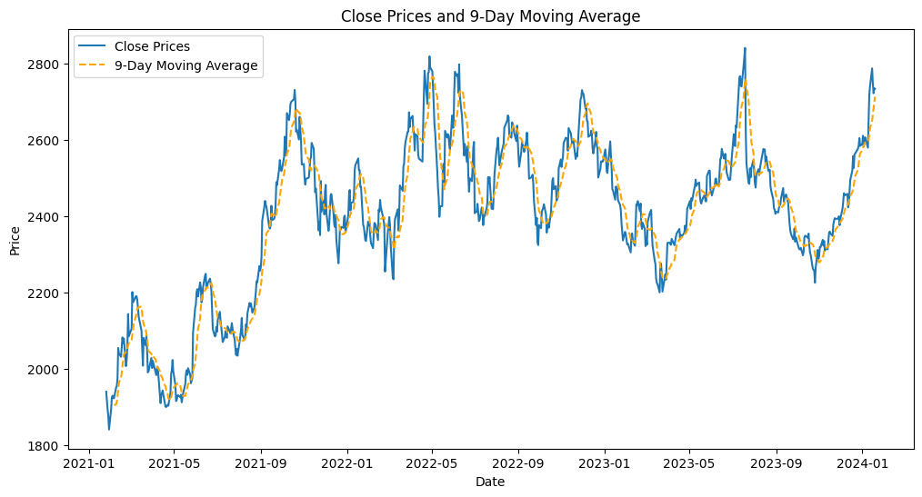
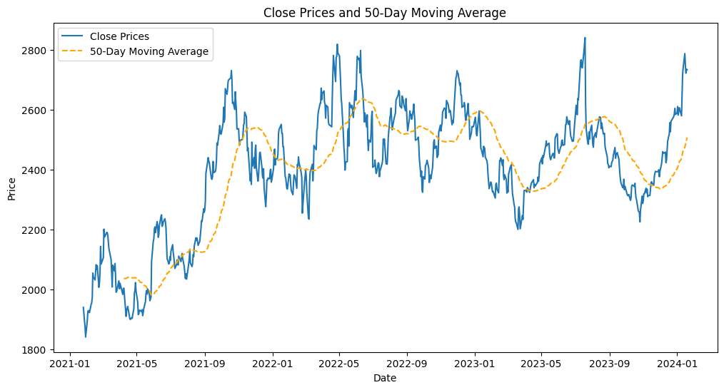
Moving Average
A moving average is a statistic that captures the average change in a data series over time. In finance, moving averages are usually used in technical analysis to keep track of price trends for specific securities.

Slide 5
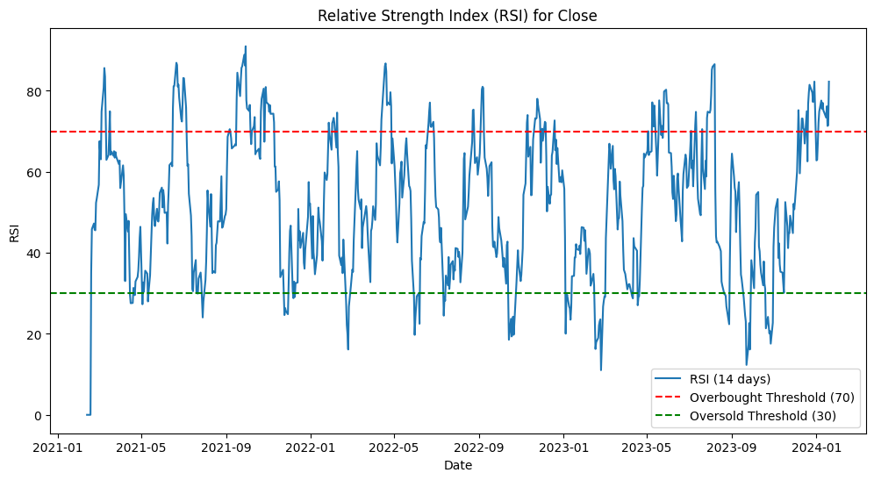
RSI
The Relative Strength Index (RSI) is a momentum oscillator that measures the speed and change of price movements. The RSI oscillates between 0 and 100. Traditionally the RSI is considered overbought when above 70 and oversold when below 30.

Slide 6
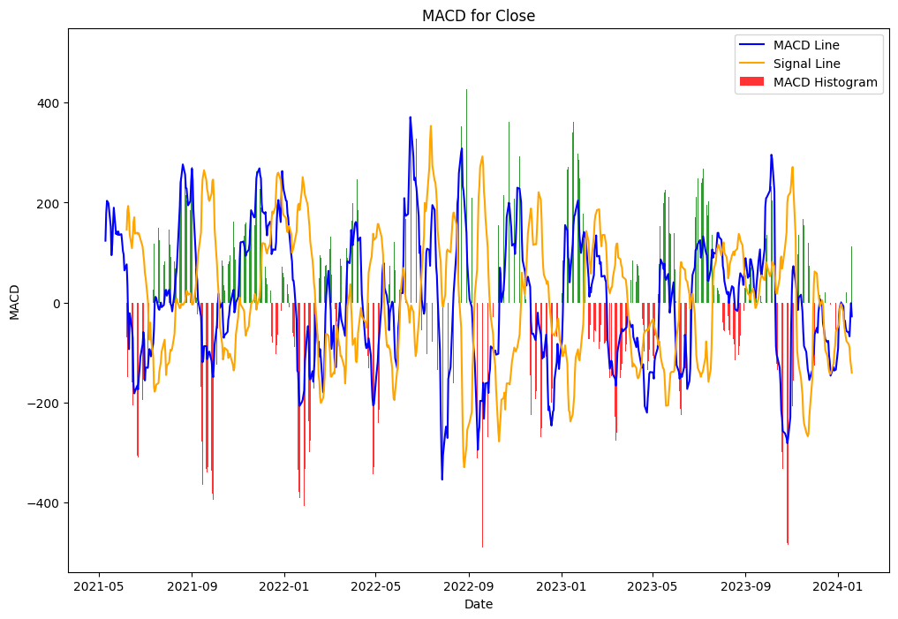
MACD
Moving Average Convergence/Divergence indicator is a momentum oscillator is used to trade trends. Although it is an oscillator, it is not usually used to identify over bought or oversold conditions. On the chart, It appears as two lines which oscillate without boundaries.

Slide 7
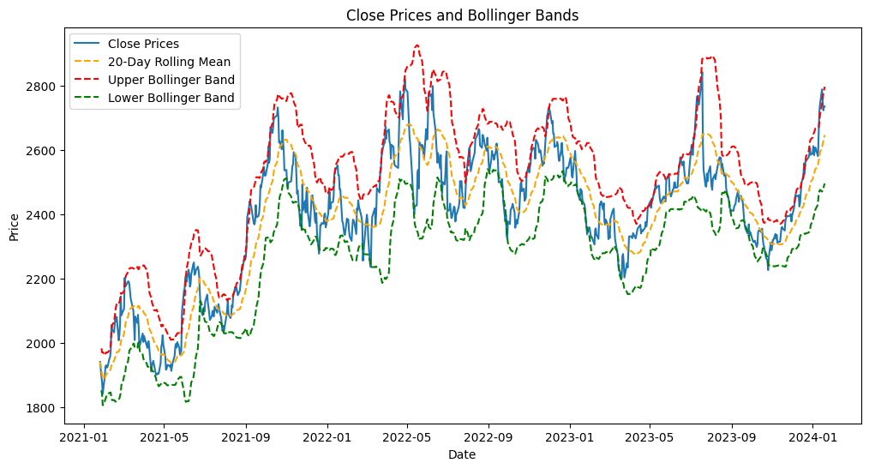
Bollinger Bands
Bollinger Bands is a technical analysis tool to generate oversold or overbought signals.
Three lines compose Bollinger Bands: A simple moving average, or the middle band, and
an upper and lower band.

Slide 8
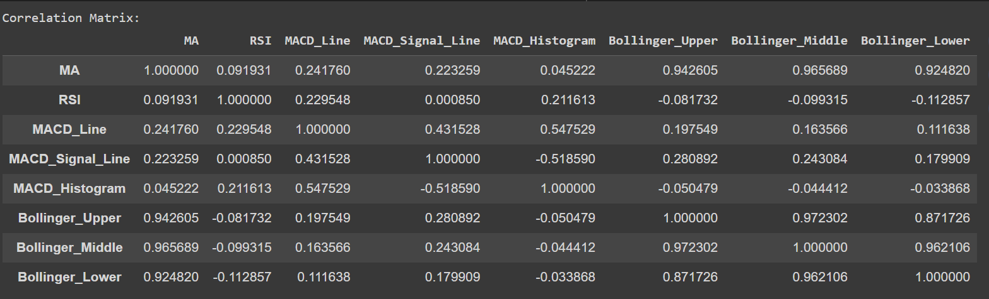
Correlation Analysis
Correlation is a statistic that measures the degree to which two variables move in relation to each other. In finance, the correlation can measure the movement of a stock with that of a benchmark index

Slide 9
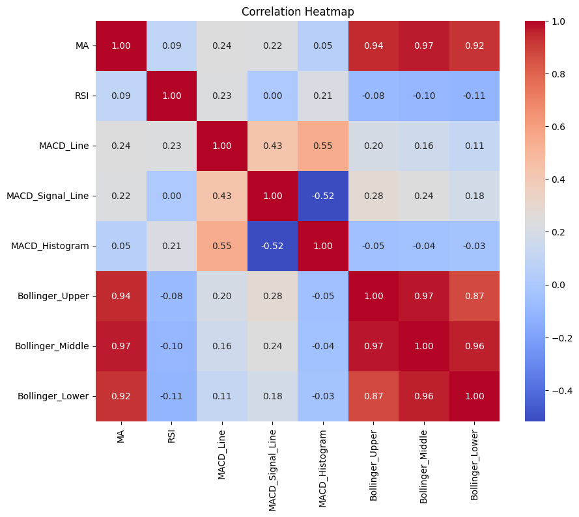
Correlation Heatmap

Slide 10
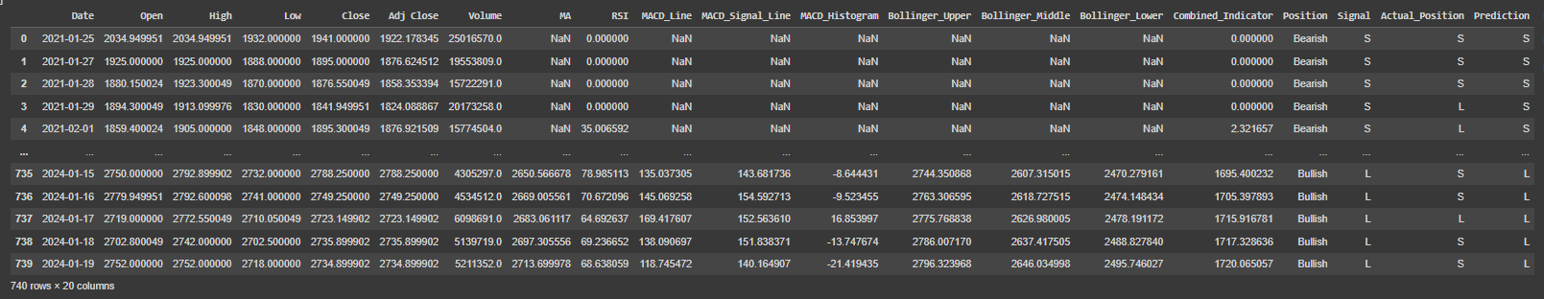
Combined Indicator
Combining indicators that calculate different measurements based on the same price action, and then combining that information with your chart studies will very quickly have a positive effect on your trading. The perfect combination of indicators is not the one that always points in the same direction, but the one that shows complimentary information. Knowing which indicator to use under which circumstances is a very important part of trading.
Results using Combined Indicators:

Slide 11
Methodology for Predictions
Bullish Position
Bullish trends coincide with positive market sentiment, requiring vigilant monitoring of news and economic indicators for signs of optimism. Identifying bullish momentum involves observing shorter-term moving averages, like the 50-day, crossing above longer-term ones, such as the 200-day. A bullish outlook is confirmed with a drop in RSI from overbought levels (above 70), while potential bullish trends are marked by Bollinger Bands squeezing and an upper band breakout. Also, a bullish MACD crossover signals increasing upward momentum.
Bearish Position
Bearish trends coincide with negative market sentiment, necessitating vigilant monitoring of news, economic indicators, and overall market conditions for indications of pessimism. Identification of bearish momentum involves observing instances where shorter-term moving averages cross below longer-term counterparts, signaling potential downtrends. A bearish outlook is confirmed by RSI rising from oversold levels (below 30), and potential bearish trends are marked by Bollinger Bands squeezing, followed by a lower band breakdown. Also, a bearish MACD crossover signals increasing downward momentum.

Slide 12
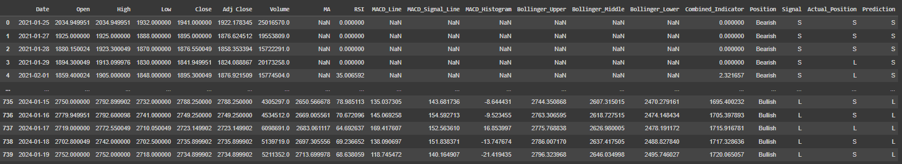
RESULTS
Reliance Stock Data Accuracy: 48.38 %
Apple Stock Data Accuracy: 50.64 %
These accuracy percentages provide insights into the reliability of our predictive model for both Reliance and Apple stocks, allowing for a comparative assessment of their forecasting performance.

Slide 13
THANKS!
Do you have any questions?
GROUP 24 Dasari Manihas (B21AI011) Dhyan Yajnik (B21AI054)
Rahul Naik (B21AI009)
Kovidh Pothireddy (B21AI026)

