Slide 1
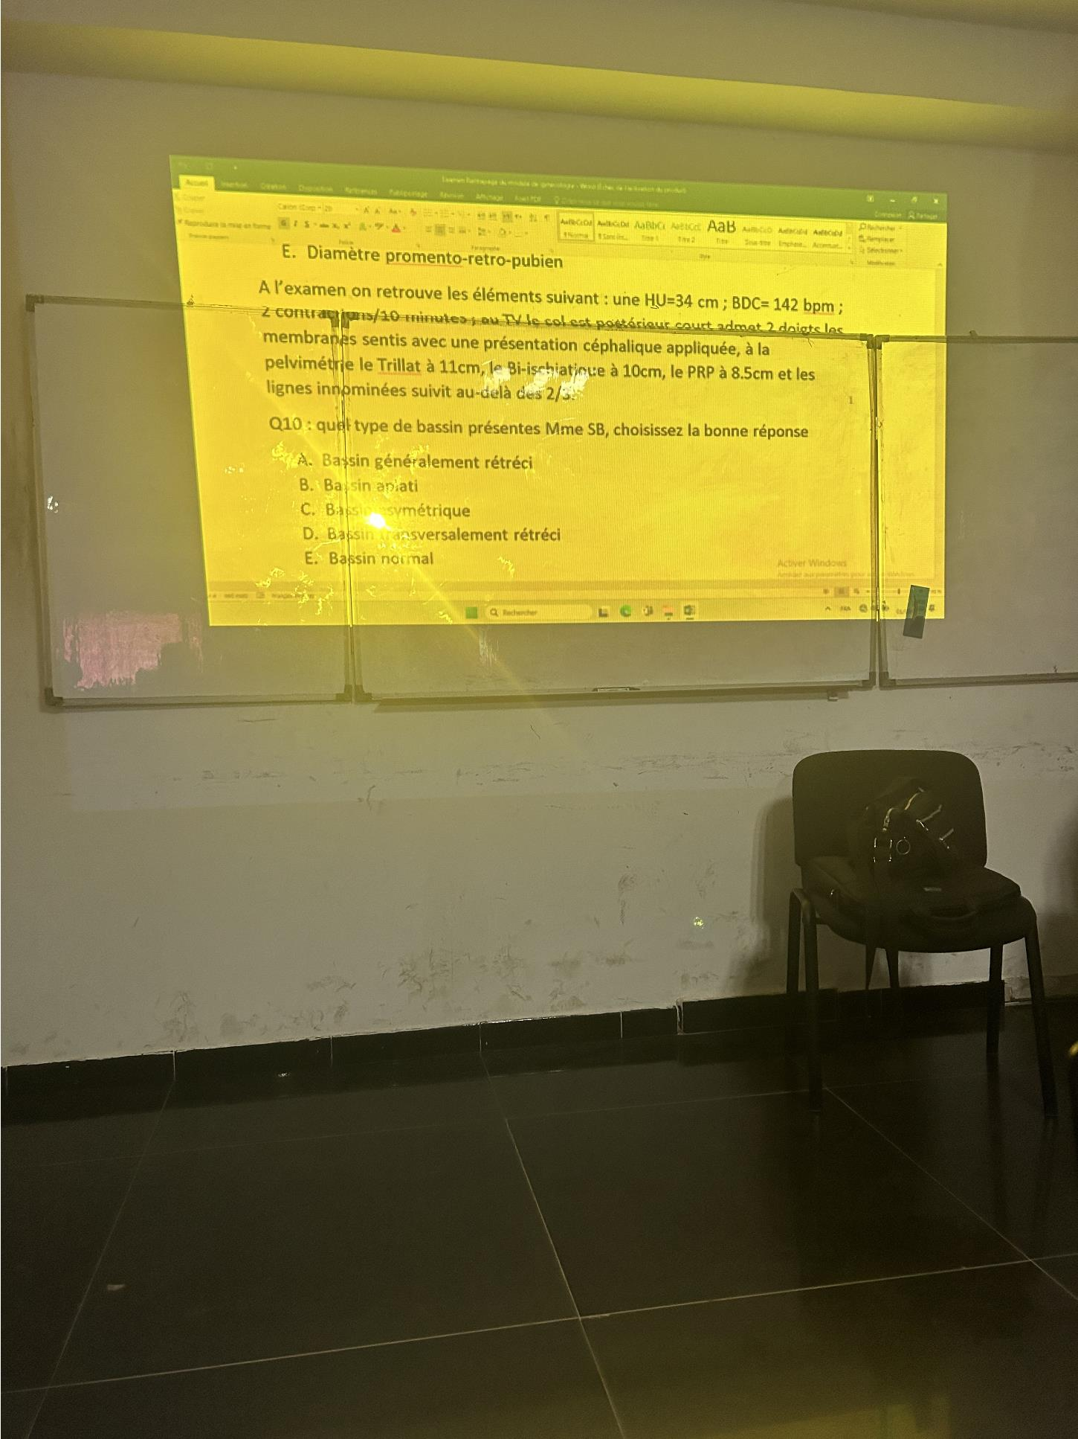
Evaluation Only. Created with Aspose.PDF. Copyright 2002-2025 Aspose Pty Ltd.

Slide 2
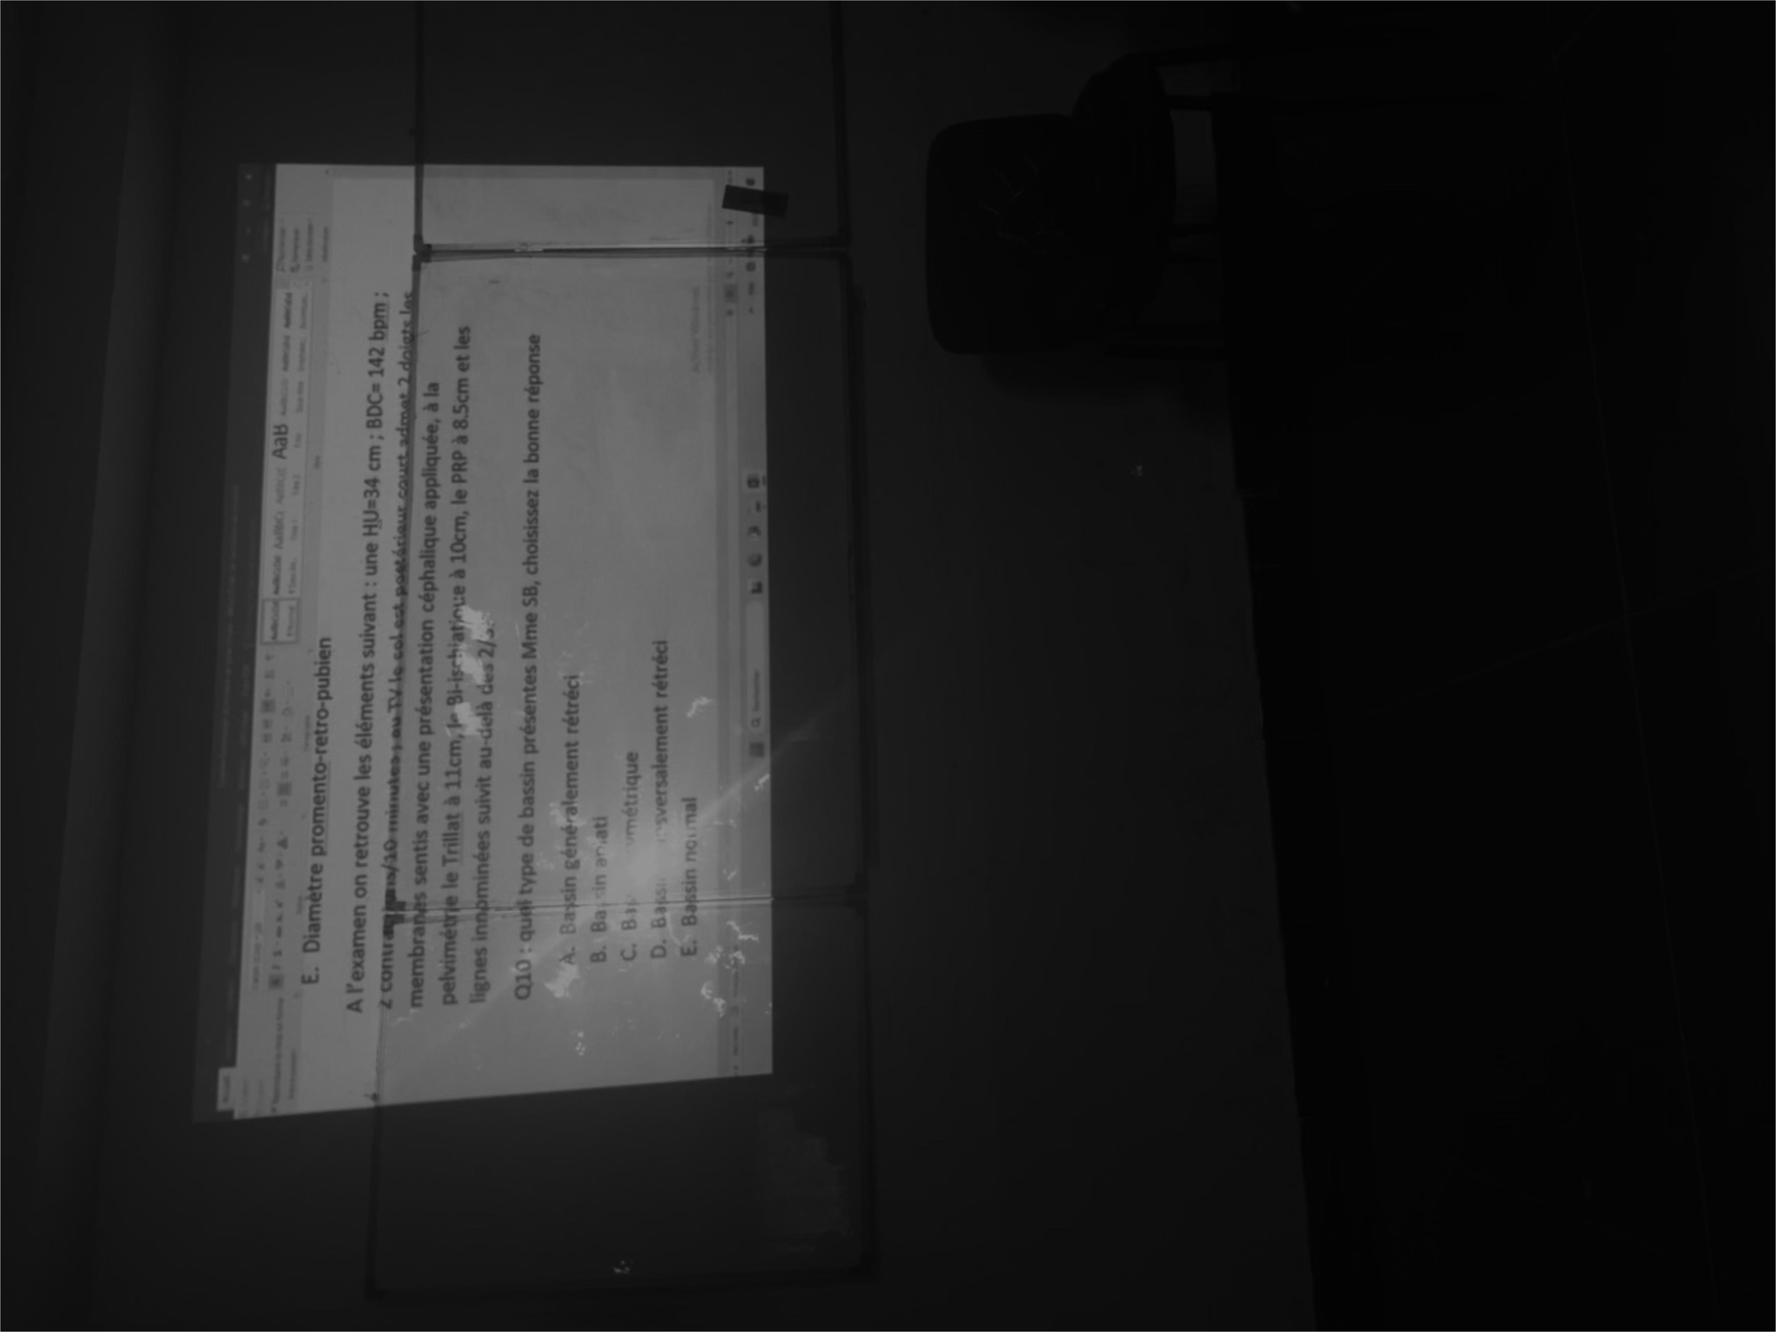
Evaluation Only. Created with Aspose.PDF. Copyright 2002-2025 Aspose Pty Ltd.

