Slide 1
Final Project HOTEL CANCELLATION BOOKING PREDICTION
Reyhan Ryanafi
(JCDS01 BKS)

Slide 2
Project Brief Description
Hotel industry is one industry that can utilize data and machine learning in helping management to increase revenue. one of them by using machine learning as a tool to take preventive action against the possibility of a consumer to cancel their bookings.
So in this project I use booking data from a hotel in Portugal that is used to take insight and design a simple machine learning model.

Slide 3
Project Brief Description (Cont.)
Project Objectives
Create and choose one of several machine learning models, to predict hotel cancellation bookings.
Create a web application using the flask, from a model that was created and selected previously.

Slide 4
Dataset Information
Dataset Source : Kaggle.com
Dataset Info : https://www.sciencedirect.com/science/article/pii/S2352340918315191#bib1
Total Rows : ± 111.000 rows
Total Features / Columns : 39 features
Total Features Used (Model & Web App) : 9 features

Slide 5
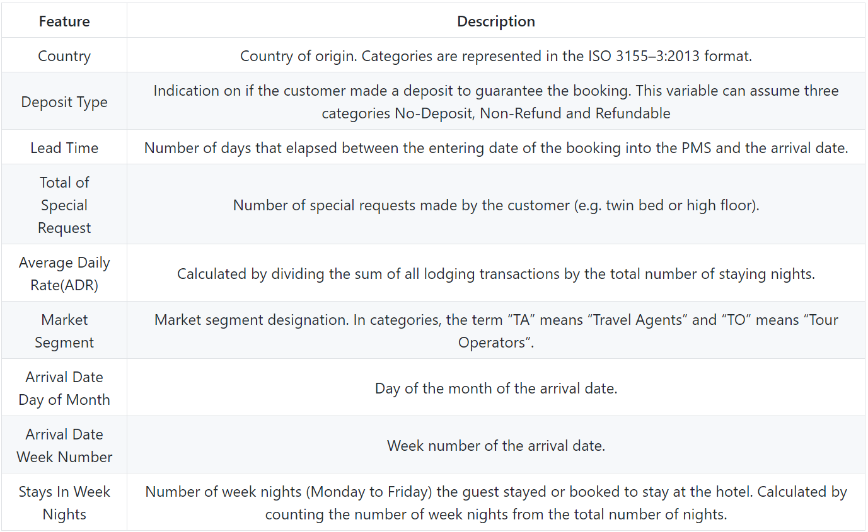
Features / Columns Desc.

Slide 6
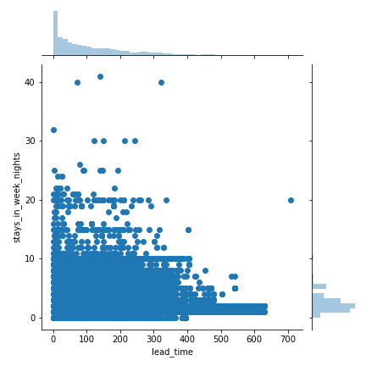
Data insights
Jointplot Between Stays In Week Nights & Lead Time

Slide 7
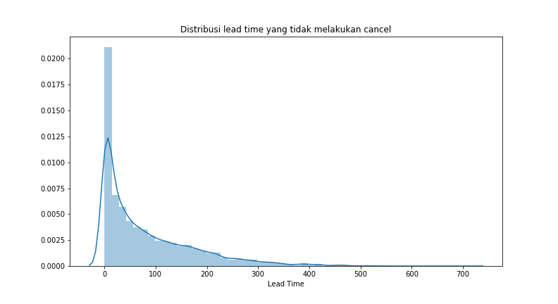
Data insights (Cont.)

Slide 8
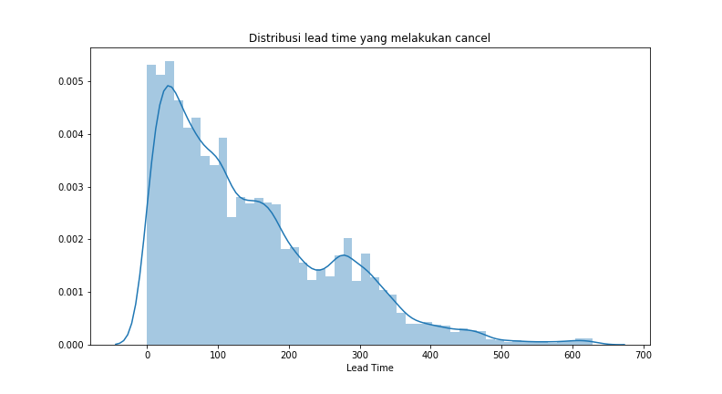
Data insights (Cont.)

Slide 9
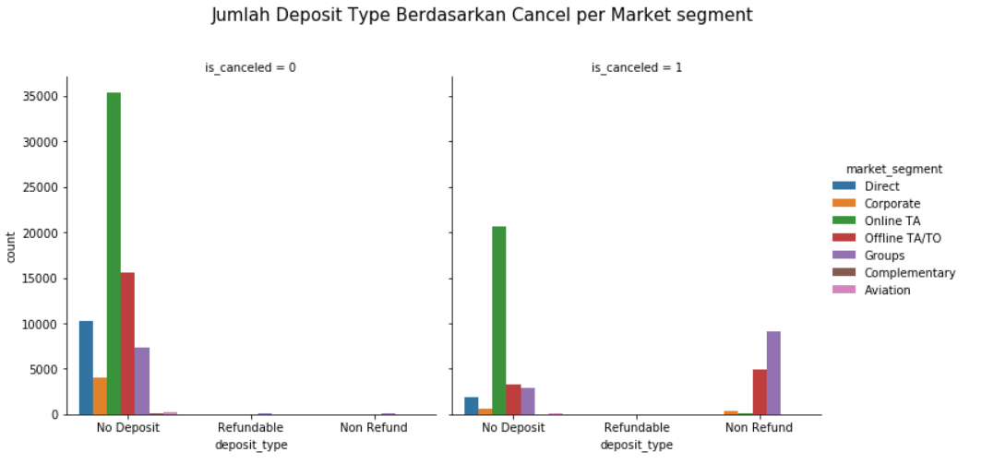
Data insights (Cont.)

Slide 10
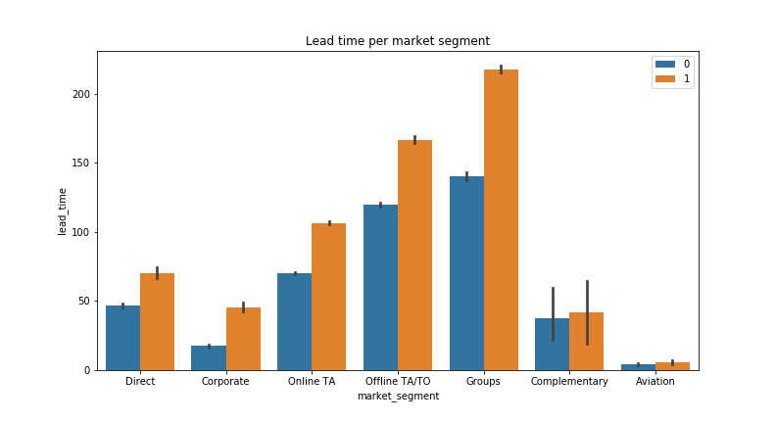
Data insights (Cont.)

Slide 11
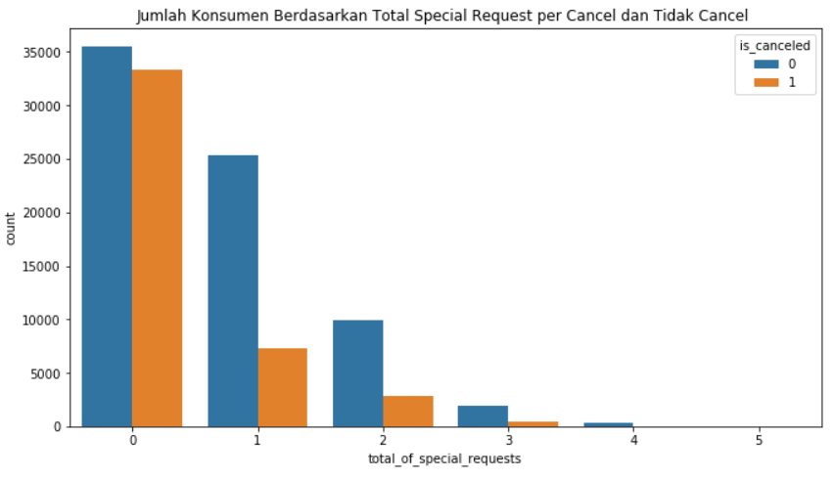
Data insights (Cont.)

Slide 12
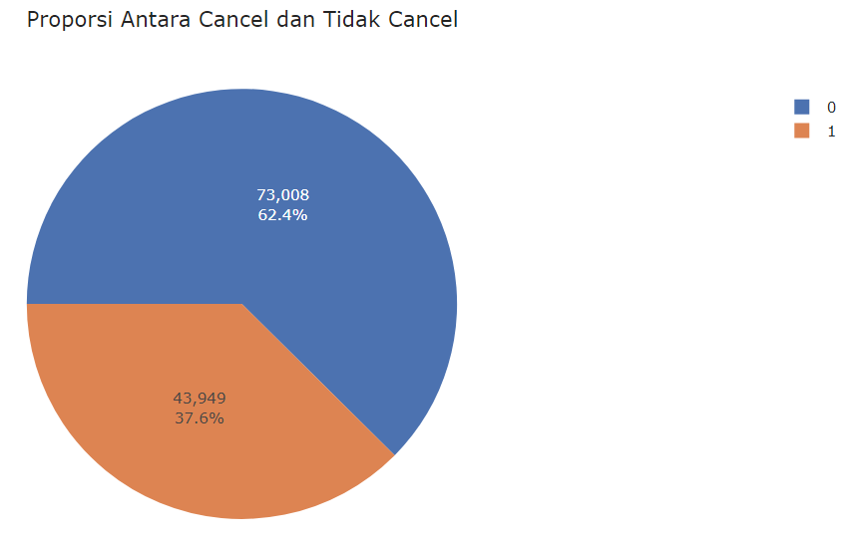
Data insights (Cont.)

Slide 13
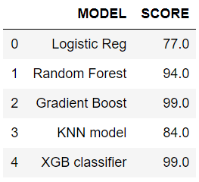
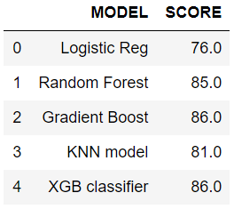
Machine Learning Models (Cont.)
Best Model Chosen
Logistic Regression
Random Forest Classifier
Gradient Boost Classifier
K-Nearest Neighbour
XGBoost Classifier
Train Data
Test Data

Slide 14
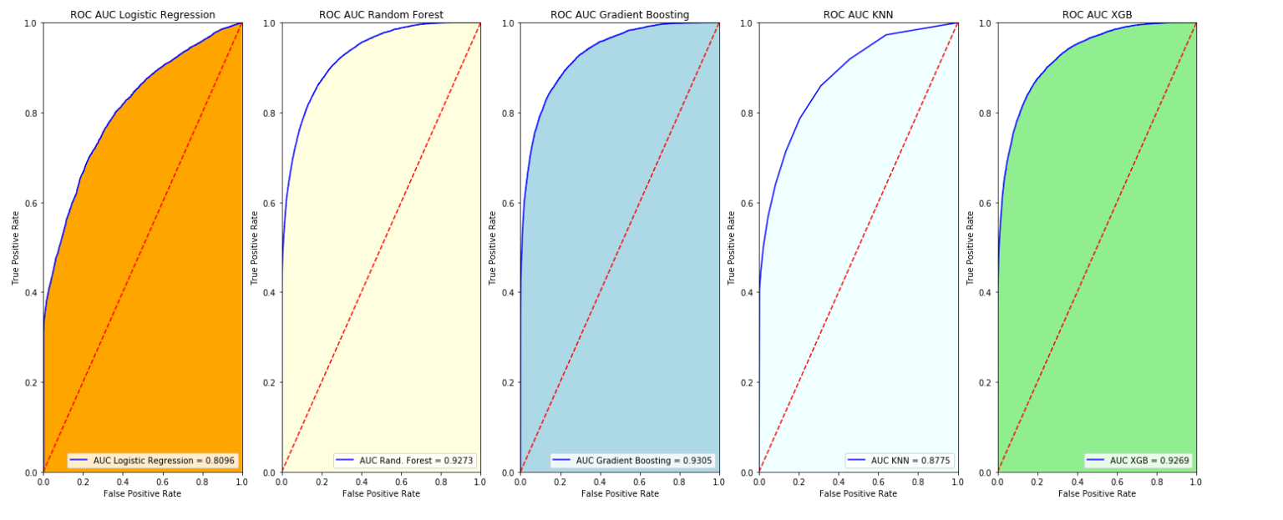
Machine Learning Models (Cont.)
2 Models Considered
Gradient Boost Classifier, AUC : 0.9305 (Chosen)
XGBoost Classifier, AUC : 0.9269

Slide 15
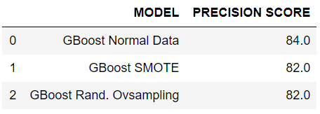
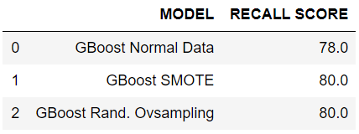
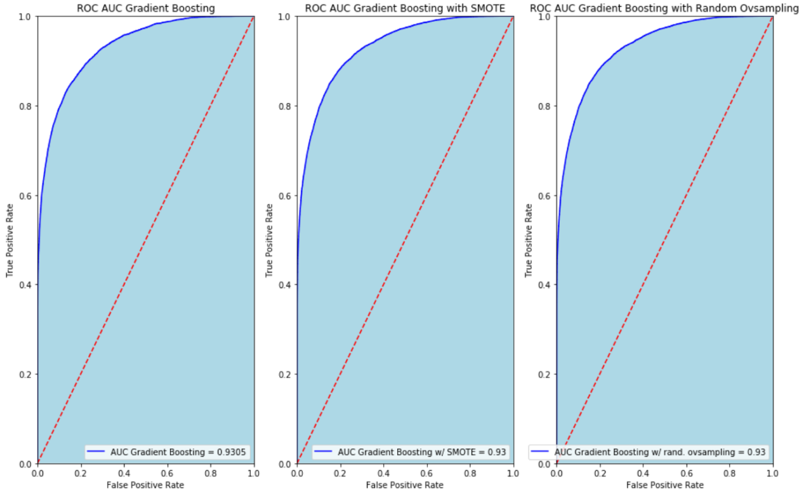
Machine Learning Models (Cont.)
Oversampling (Normal data VS SMOTE & Random Oversampling)

Slide 16
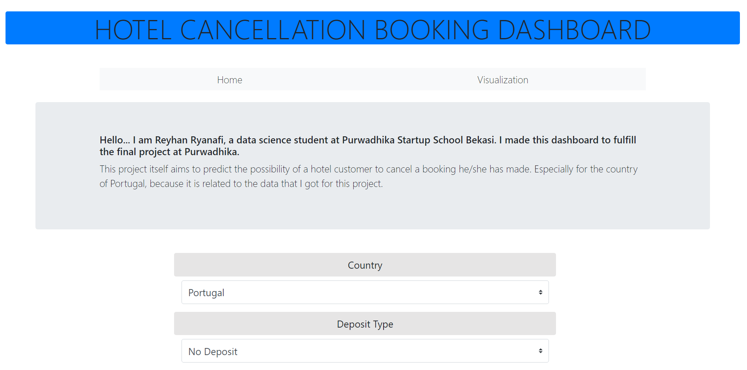
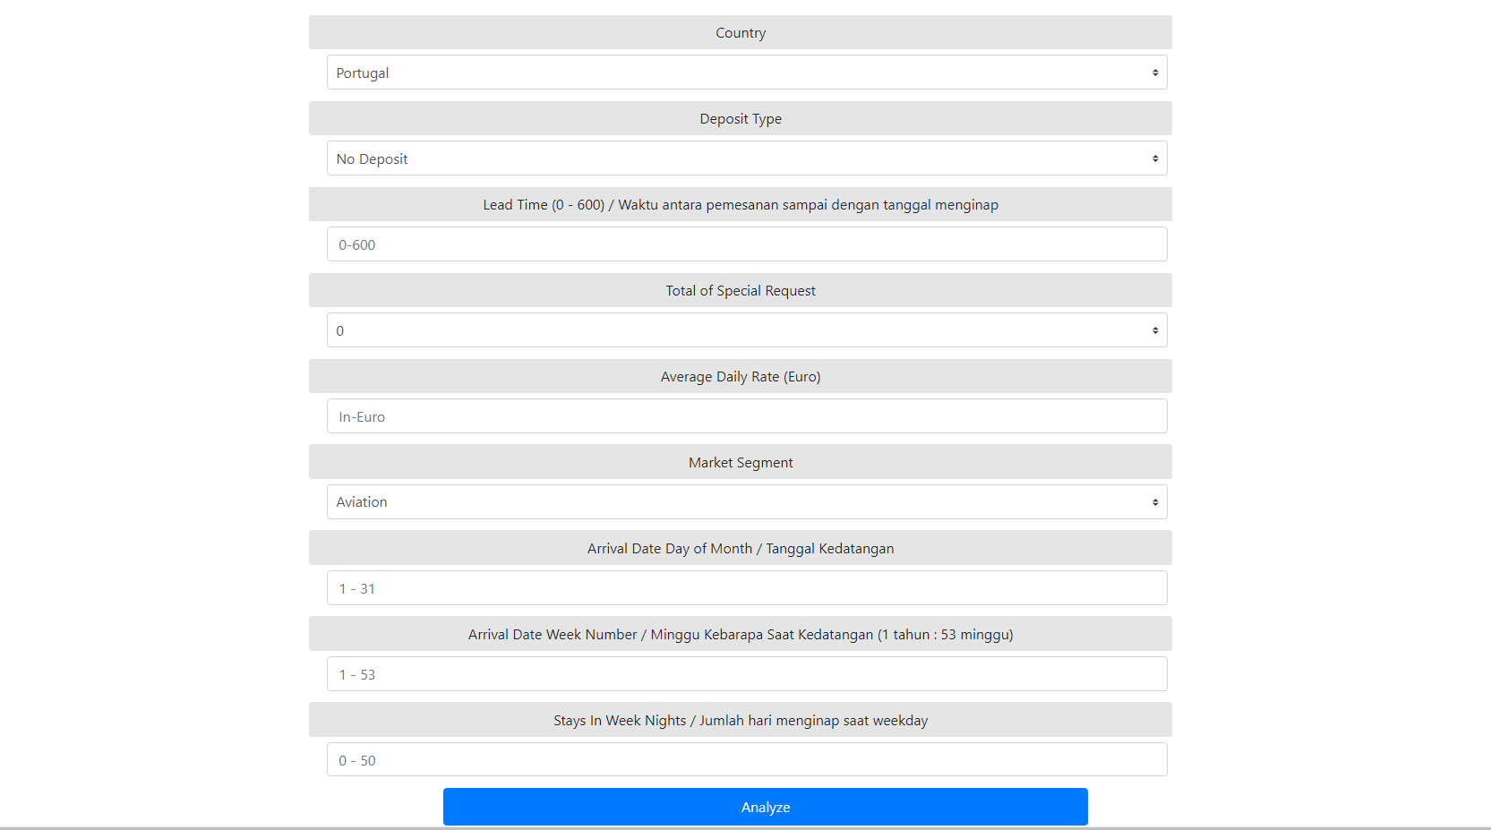
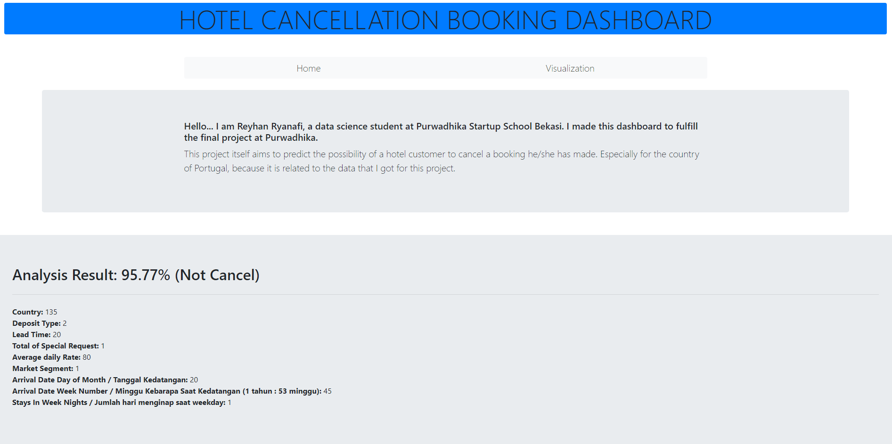
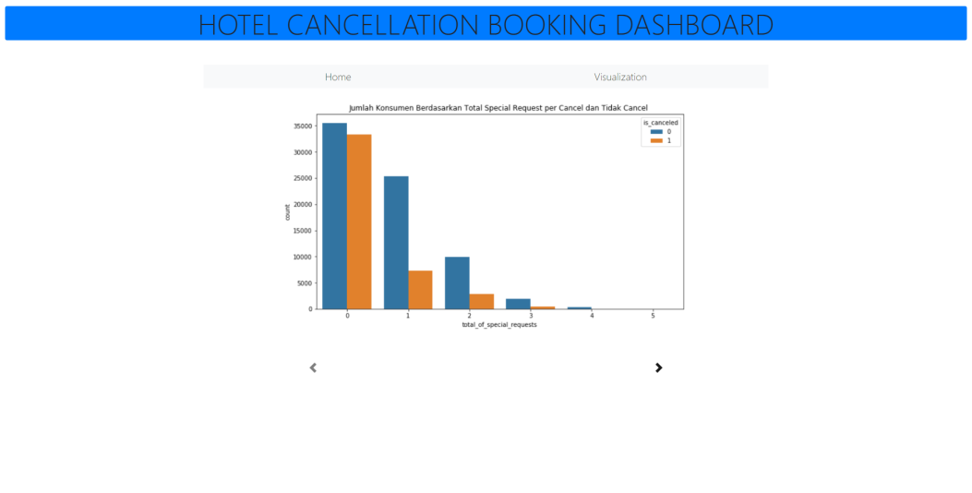
Web App

