Slide 1
SNOW 3G
A word-oriented synchronous stream cipher
Applications
In 3GPP UMTS
UEA2
UIA2
2. In LTE
128-EEA1
128-EIA1
Designed for integrity and confidentiality
Initialization mode: FSM output to LFSR
Keystream mode: additional clocking of FSM and LFSR
[Reference]: Liliya Kraleva, Chaoyun Li. ”On the SNOW stream ciphers”. In: PROCEEDINGS of the 2021 Symposium on Information Theory and Signal Processing in the Benelux; 2021; pp. 122 - 129

Slide 2
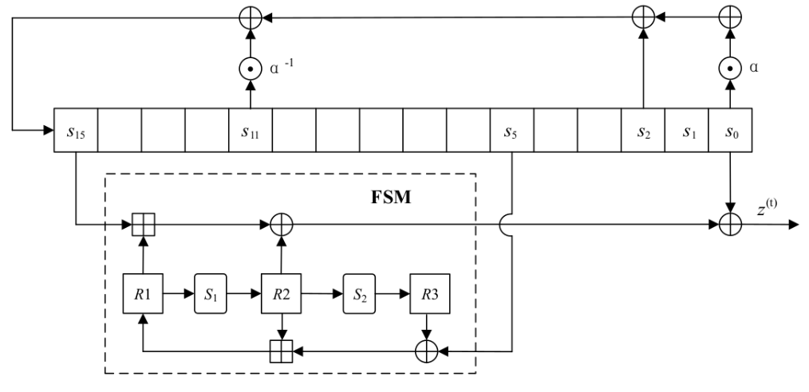
SNOW 3G Cipher Scheme
Applications is a word-oriented synchronous cipher used in 3GPP UMTS and LTE algorithms, employing an initialization mode followed by a keystream mode.
Initialization involves a Finite State Machine (FSM) output fed to a Linear Feedback Shift Register (LFSR).
Keystream mode includes another clocking of FSM and LFSR.

Slide 3
Applications
3GPP UMTS
UEA2
User Equipment Authentication
Authenticating users and ensuring confidentiality and integrity of communication between user’s device and networks
UIA2
User Identity Authentication
128-EEA1
Encryption Algorithm
Secure and efficient encryption of user data, verification of confidential transmitted information integrity
LTE
128-EIA1
Integrity Algorithm

