Slide 1
Topic-based Sentiment analysis of Online retailers reviews (Amazon)
R. Bazargani
M. Ardestani
Amirkabir University of Technology (AUT)
Department of computer science

Slide 2
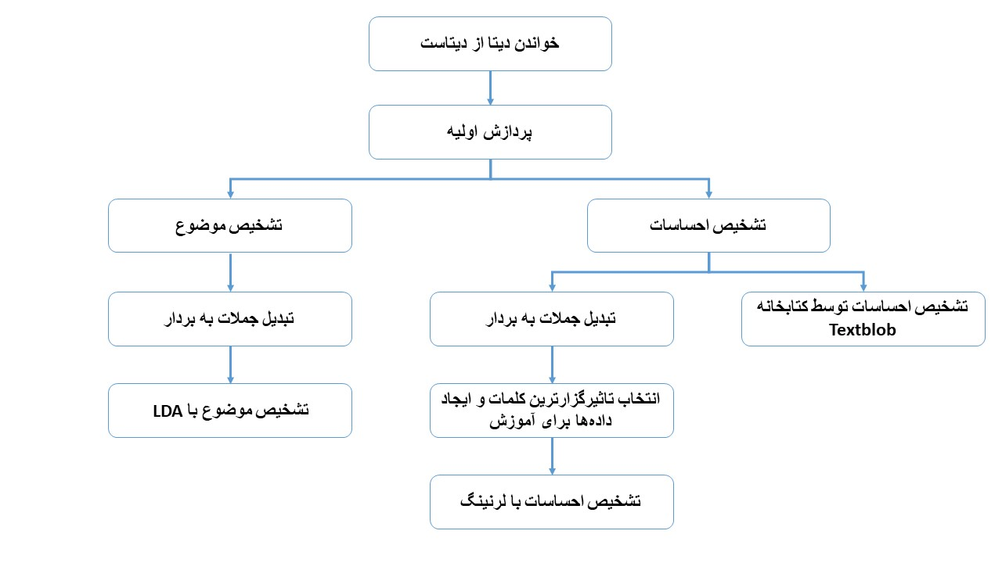
outline
Overview
Preprocessing
Sentiment Analysis
Extracting topics
Web / GitHub repo
Contributions

Slide 3

Overview
P1) Finding sentiment analysis of reviews
P2) Extracting topics of reviews
Business plan and purpose?
Finding a summary usually has a lot of challenges.
Even for humans

Slide 4

Preprocessing
1) Text cleaning
2) Stemming
3) Vectorizer

Slide 5
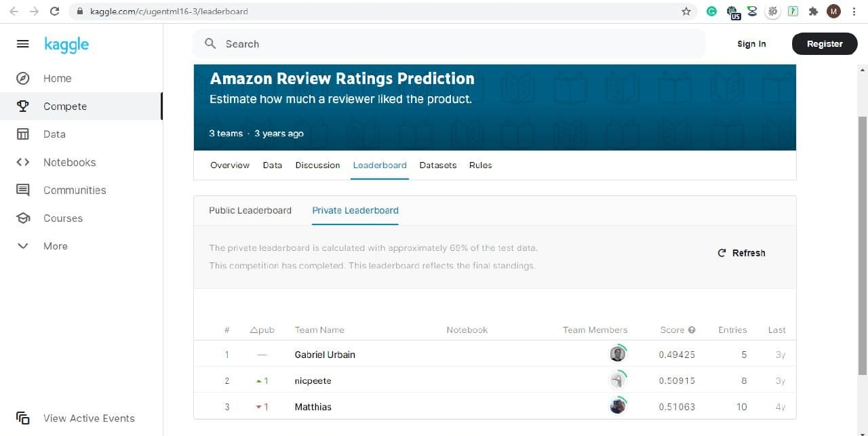
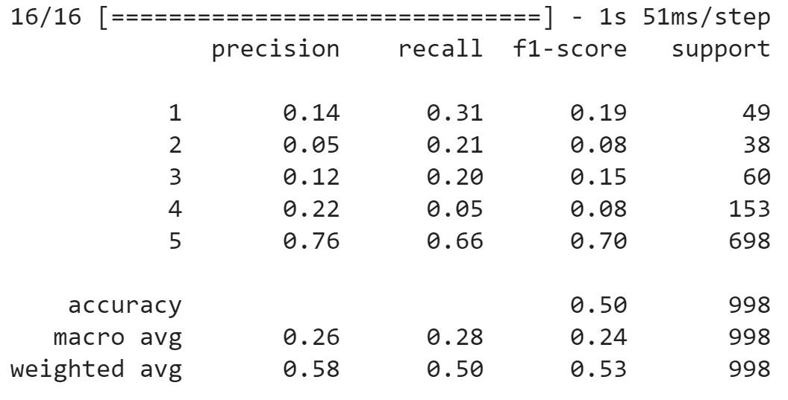
Sentiment Analysis
Part1) Textblob
Part2)
Machine learning with Keras
chi square
concatenate vote, verified

Slide 6
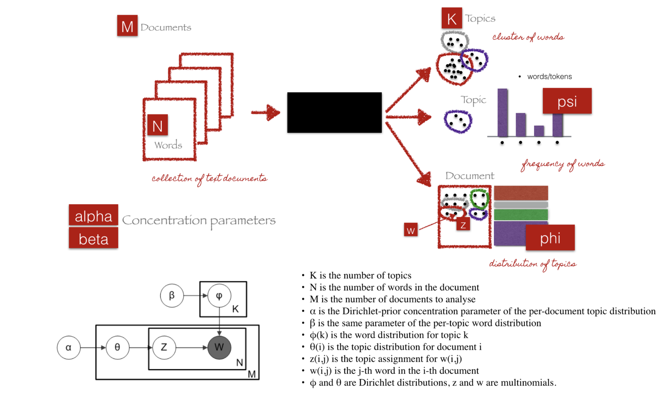
Extracting topics
LDA

Slide 7
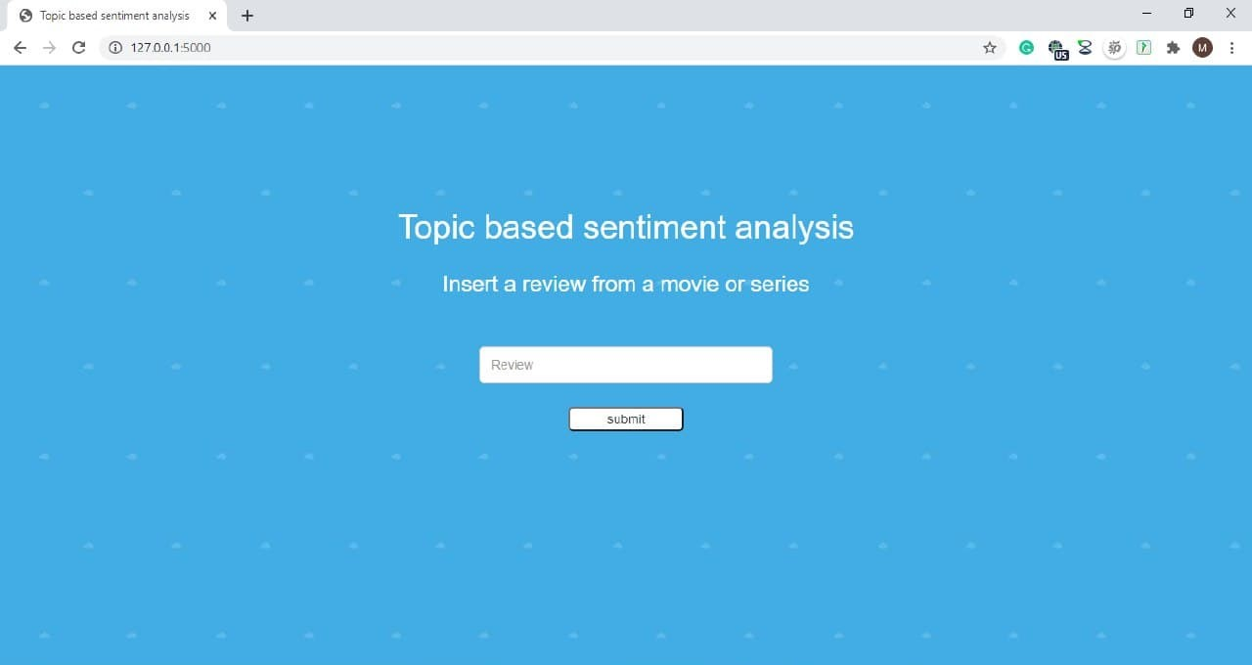
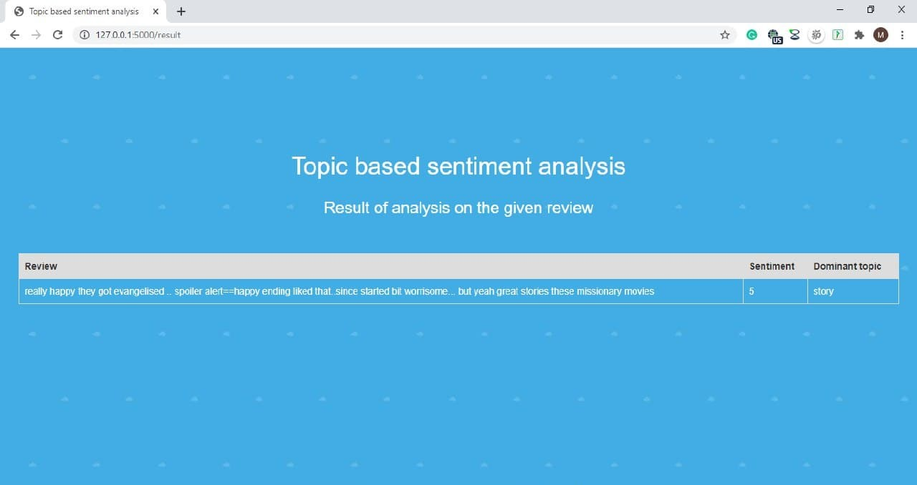
User interface
+ Website

Slide 8
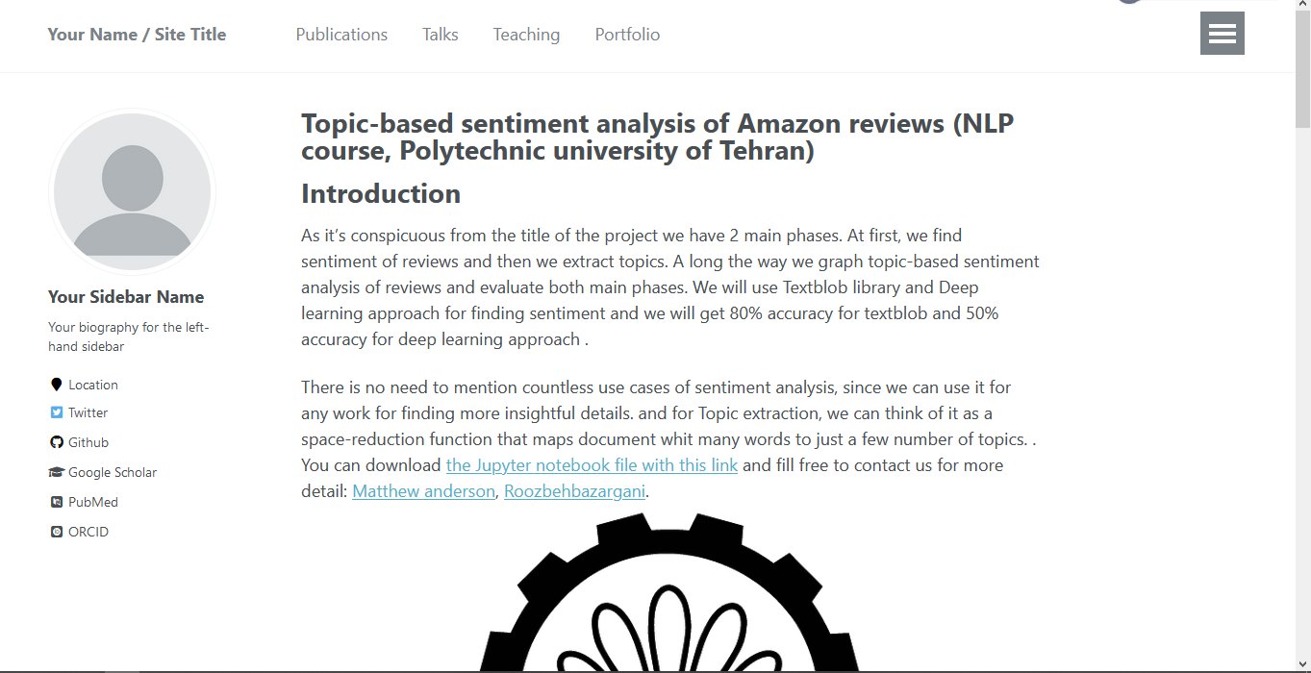
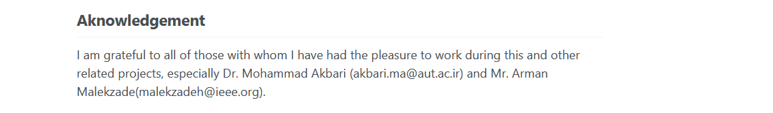
GitHub repo

Slide 9
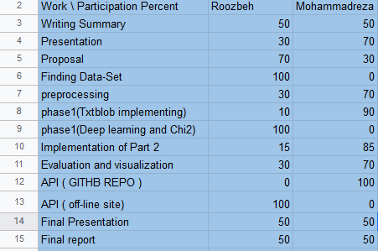
Contribution chart

Slide 10
Thanks for your attentions

