Slide 1
Recognition of Hand Motions Using sEMG Signals
Bachelor’s Degree Project
Student: Reza Sanaeinejad
Supervisor: Dr. Mehran Jahed
Department of Electrical Engineering
Sharif University of Technology
Khordad 1405 (May–June 2026)
Bachelor’s degree project | Continuous wrist kinematics using sEMG
1
Notes:
Translated from the supplied 15-slide presentation. All research claims and reported values are retained. Technical qualifications appear in TECHNICAL_NOTES.md.

Slide 2
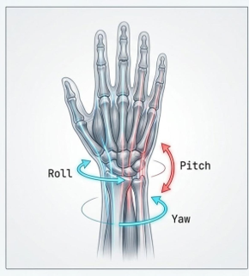
Project Overview and Key Objectives
The principal objective is to develop a deep learning model for continuously estimating three wrist angles from surface electromyography (sEMG) signals.
The project estimates motion continuously rather than performing discrete classification.
Roll: inward and outward rotation
Pitch: upward and downward wrist flexion
Yaw: leftward and rightward wrist deviation
Dataset: NinaPro DB2, including movement data and muscle signals sampled at 2,000 Hz.
Bachelor’s degree project | Continuous wrist kinematics using sEMG
2
Notes:
Translated from the supplied 15-slide presentation. All research claims and reported values are retained. Technical qualifications appear in TECHNICAL_NOTES.md.

Slide 3
Phase 1 Baseline Model Development
Objective: construct a baseline architecture that is robust to sEMG noise and prevents data leakage under an intra-subject protocol.
1 Preprocessing
2 Windowing strategy
3 Baseline architecture
Butterworth low-pass filtering (5 Hz) and signal rectification using the absolute value.
600-sample windows (300 milliseconds) provide the complete temporal context of muscular contraction.
A hybrid CNN-LSTM with Huber loss addresses abrupt changes at movement boundaries.
→
→
Bachelor’s degree project | Continuous wrist kinematics using sEMG
3
Notes:
Translated from the supplied 15-slide presentation. All research claims and reported values are retained. Technical qualifications appear in TECHNICAL_NOTES.md.

Slide 4
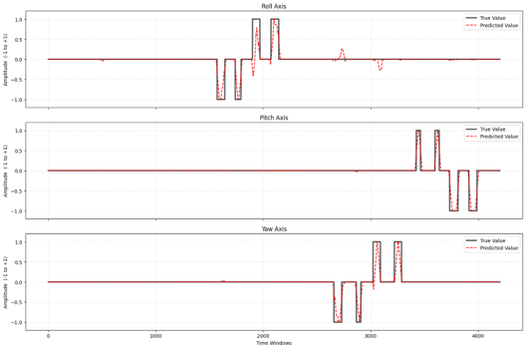
Phase 1 Evaluation Stability for a Single Subject
The Phase 1 results show that combining convolutional and recurrent networks provides a good understanding of one individual’s movements.
Reason for proceeding to Phase 2
Principal limitation: the model was trained exclusively on data from one particular user (intra-subject).
Scientific need: real-world models must generalize across different individuals.
This fundamental limitation motivated pooling data from several users and testing the network’s capabilities.
Baseline model output: satisfactory accuracy for one particular user.
Bachelor’s degree project | Continuous wrist kinematics using sEMG
4
Notes:
Translated from the supplied 15-slide presentation. All research claims and reported values are retained. Technical qualifications appear in TECHNICAL_NOTES.md.

Slide 5
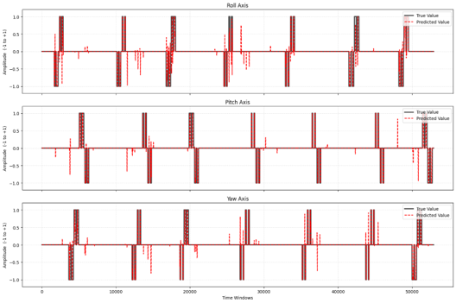
Phase 2 Evaluation of a General Inter Subject Model
Data from seven different subjects were pooled, with more than 52,000 training windows. Anatomical diversity increased substantially.
Version 1
Architecture: Conv1D layers and a conventional unidirectional recurrent layer.
Approximately 134,000 parameters.
Reason for proceeding to Phase 3
Principal limitation: despite the deep architecture, the model exhibited oscillations and confusion when handling diverse data and failed to identify a stable pattern across users.
Scientific need: improve the model to capture more complex patterns and resist inter-subject variation.
Bachelor’s degree project | Continuous wrist kinematics using sEMG
5
Notes:
Translated from the supplied 15-slide presentation. All research claims and reported values are retained. Technical qualifications appear in TECHNICAL_NOTES.md. The source slide reports more than 52,000 training windows; the report instead states more than 107,000 training windows and approximately 52,000 test windows. This discrepancy is preserved and documented.

Slide 6
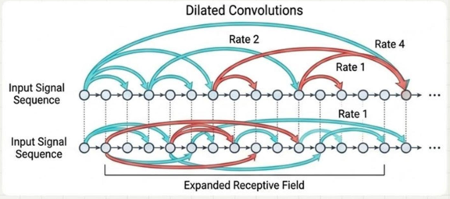
Phase 3 Spatiotemporal Improvements and Validation
Inter subject validation protocols
The model was evaluated using two rigorous approaches:
1. Leave-One-Subject-Out
2. Global Repetition Split
Architectural development
Dilated convolutions: dilation rates of 1, 2, and 4 capture a much broader temporal range without increasing the computational burden.
Savitzky–Golay filtering removes noise during postprocessing without eliminating the peaks.
Bachelor’s degree project | Continuous wrist kinematics using sEMG
6
Notes:
Translated from the supplied 15-slide presentation. All research claims and reported values are retained. Technical qualifications appear in TECHNICAL_NOTES.md.

Slide 7
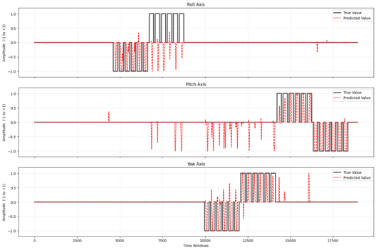
Phase 3 Leave One Subject Out Results
Leave One Subject Out protocol
The model is trained on all subjects except one and then tested on the held-out subject. This process is repeated for each subject to evaluate performance on unseen data.
Problem observed in the curves
The model has considerable difficulty accurately predicting the actual values for a new subject. The predicted curves (red) contain substantial noise and fail to follow the principal patterns and peaks of the actual signal (black). This indicates inadequate generalization to new individuals.
Phase 3 output under the Leave-One-Subject-Out protocol
Bachelor’s degree project | Continuous wrist kinematics using sEMG
7
Notes:
Translated from the supplied 15-slide presentation. All research claims and reported values are retained. Technical qualifications appear in TECHNICAL_NOTES.md.

Slide 8
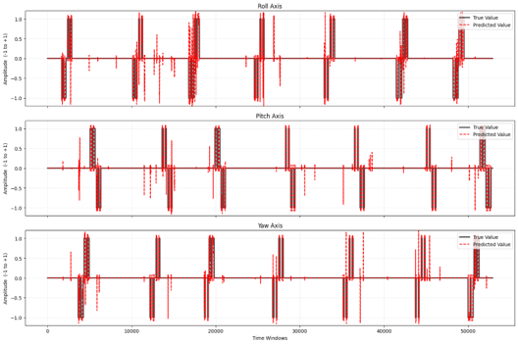
Biological Signal Variation and the Project’s Change of Approach
Reason for proceeding to the final phase
Phase 3 demonstrated a scientific finding: covariate shift in sEMG signals across individuals is so substantial that constructing a fully general model that works for a new person without fine-tuning is practically impossible.
Overall solution: return to a subject-specific intra-subject approach in Phase 4, while constructing a fully continuous and physiological model. Discrete labels are converted into smooth biomechanical motions, with the aim of bringing the error close to zero.
Phase 3 output under the Global Repetition Split protocol
Bachelor’s degree project | Continuous wrist kinematics using sEMG
8
Notes:
Translated from the supplied 15-slide presentation. All research claims and reported values are retained. Technical qualifications appear in TECHNICAL_NOTES.md.

Slide 9
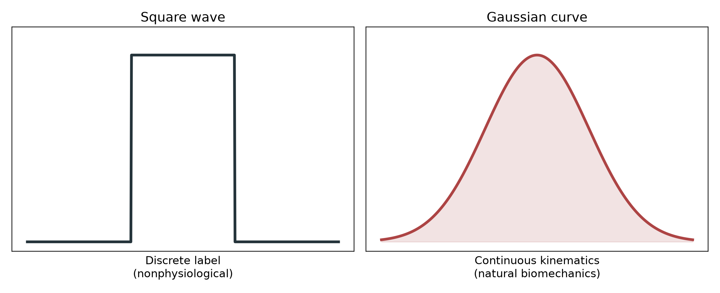
Phase 4 Continuous and Physiological Kinematics
Objective: move beyond simple classification and obtain accurate, smooth motion estimates that resemble the actual biomechanics of the human hand.
Innovation 1 Target Label Smoothing
A human hand cannot change its angle instantaneously in a square-wave step.
The earlier networks produced high-frequency oscillations when attempting to predict step functions.
A Gaussian low-pass filter with sigma = 400 transformed the target values into continuous curves.
The neural network learned to predict gradual acceleration, reaching a peak, and a smooth stop.
Bachelor’s degree project | Continuous wrist kinematics using sEMG
9
Notes:
Translated from the supplied 15-slide presentation. All research claims and reported values are retained. Technical qualifications appear in TECHNICAL_NOTES.md.

Slide 10
Final Model Architecture and Its Rationale
Input noise
Why combine CNN and LSTM
GaussianNoise improves robustness to sensor noise.
A standalone CNN does not capture the movement sequence. A standalone LSTM is computationally demanding and extracts features poorly from highly fluctuating raw signals.
The hybrid architecture combines the strengths of both approaches.
1 Conv1D × 2 and L2 regularization
Extract high-frequency spatial features.
2 BatchNormalization and MaxPooling
Accelerate convergence and reduce dimensionality.
3 SpatialDropout1D 0.2
Prevent overfitting in spatial feature maps.
4 LSTM 64 units
Capture complex long-term temporal dependencies.
5 GlobalAveragePooling1D
Aggregate feature maps.
6 Dense 64 to 3
Provide linear regression for three motion axes.
Bachelor’s degree project | Continuous wrist kinematics using sEMG
10
Notes:
Translated from the supplied 15-slide presentation. All research claims and reported values are retained. Technical qualifications appear in TECHNICAL_NOTES.md.

Slide 11
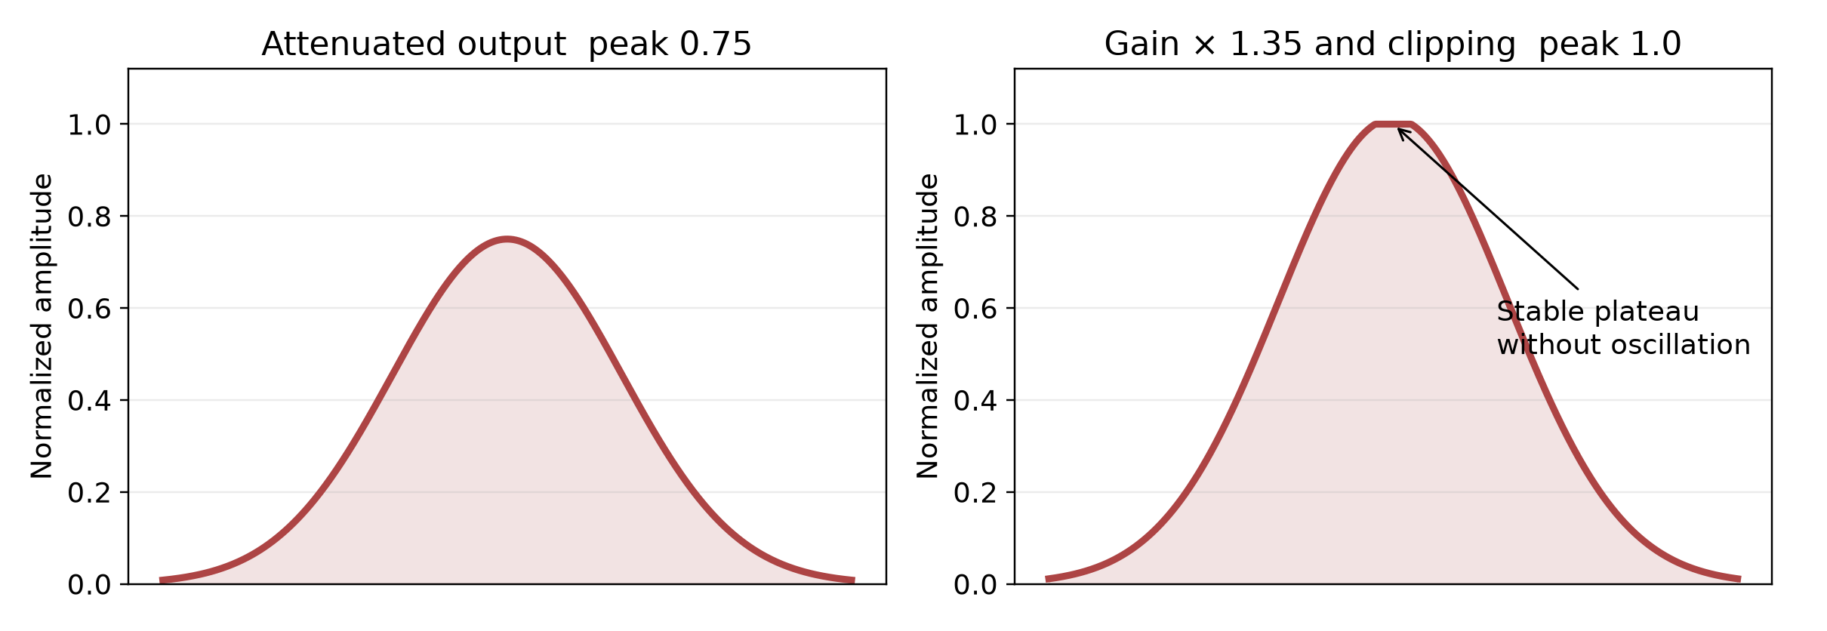
Innovation 2 Gain Calibration for Amplitude Attenuation
Challenge
Solution and outcome
The MSE loss function causes conservative network behavior. The predictions are temporally aligned, but their amplitudes do not reach the absolute values of ±1.
A gain calibration factor was applied to the model output:
y_pred_calibrated = y_pred_smoothed × 1.35
The outputs were then clipped to the permitted range [−1, +1].
At the final joint angle, this technique produces a completely flat, stable plateau and prevents oscillation.
Bachelor’s degree project | Continuous wrist kinematics using sEMG
11
Notes:
Translated from the supplied 15-slide presentation. All research claims and reported values are retained. Technical qualifications appear in TECHNICAL_NOTES.md.

Slide 12
Quantitative Evaluation of the Final Model on Test Data
Using learning rate reduction strategies such as ReduceLROnPlateau, the final model reached its optimal state at epoch 35.
Motion axis | RMSE | Pearson correlation (CC)
Roll (rotation) | 0.1306 | 0.8707
Pitch (flexion) | 0.0753 | 0.9634
Yaw (deviation) | 0.1244 | 0.8949
Bachelor’s degree project | Continuous wrist kinematics using sEMG
12
Notes:
Translated from the supplied 15-slide presentation. All research claims and reported values are retained. Technical qualifications appear in TECHNICAL_NOTES.md. The source notebook computes these metrics on smoothed predictions before gain calibration. Saved sample predictions are calibrated and clipped.

Slide 13
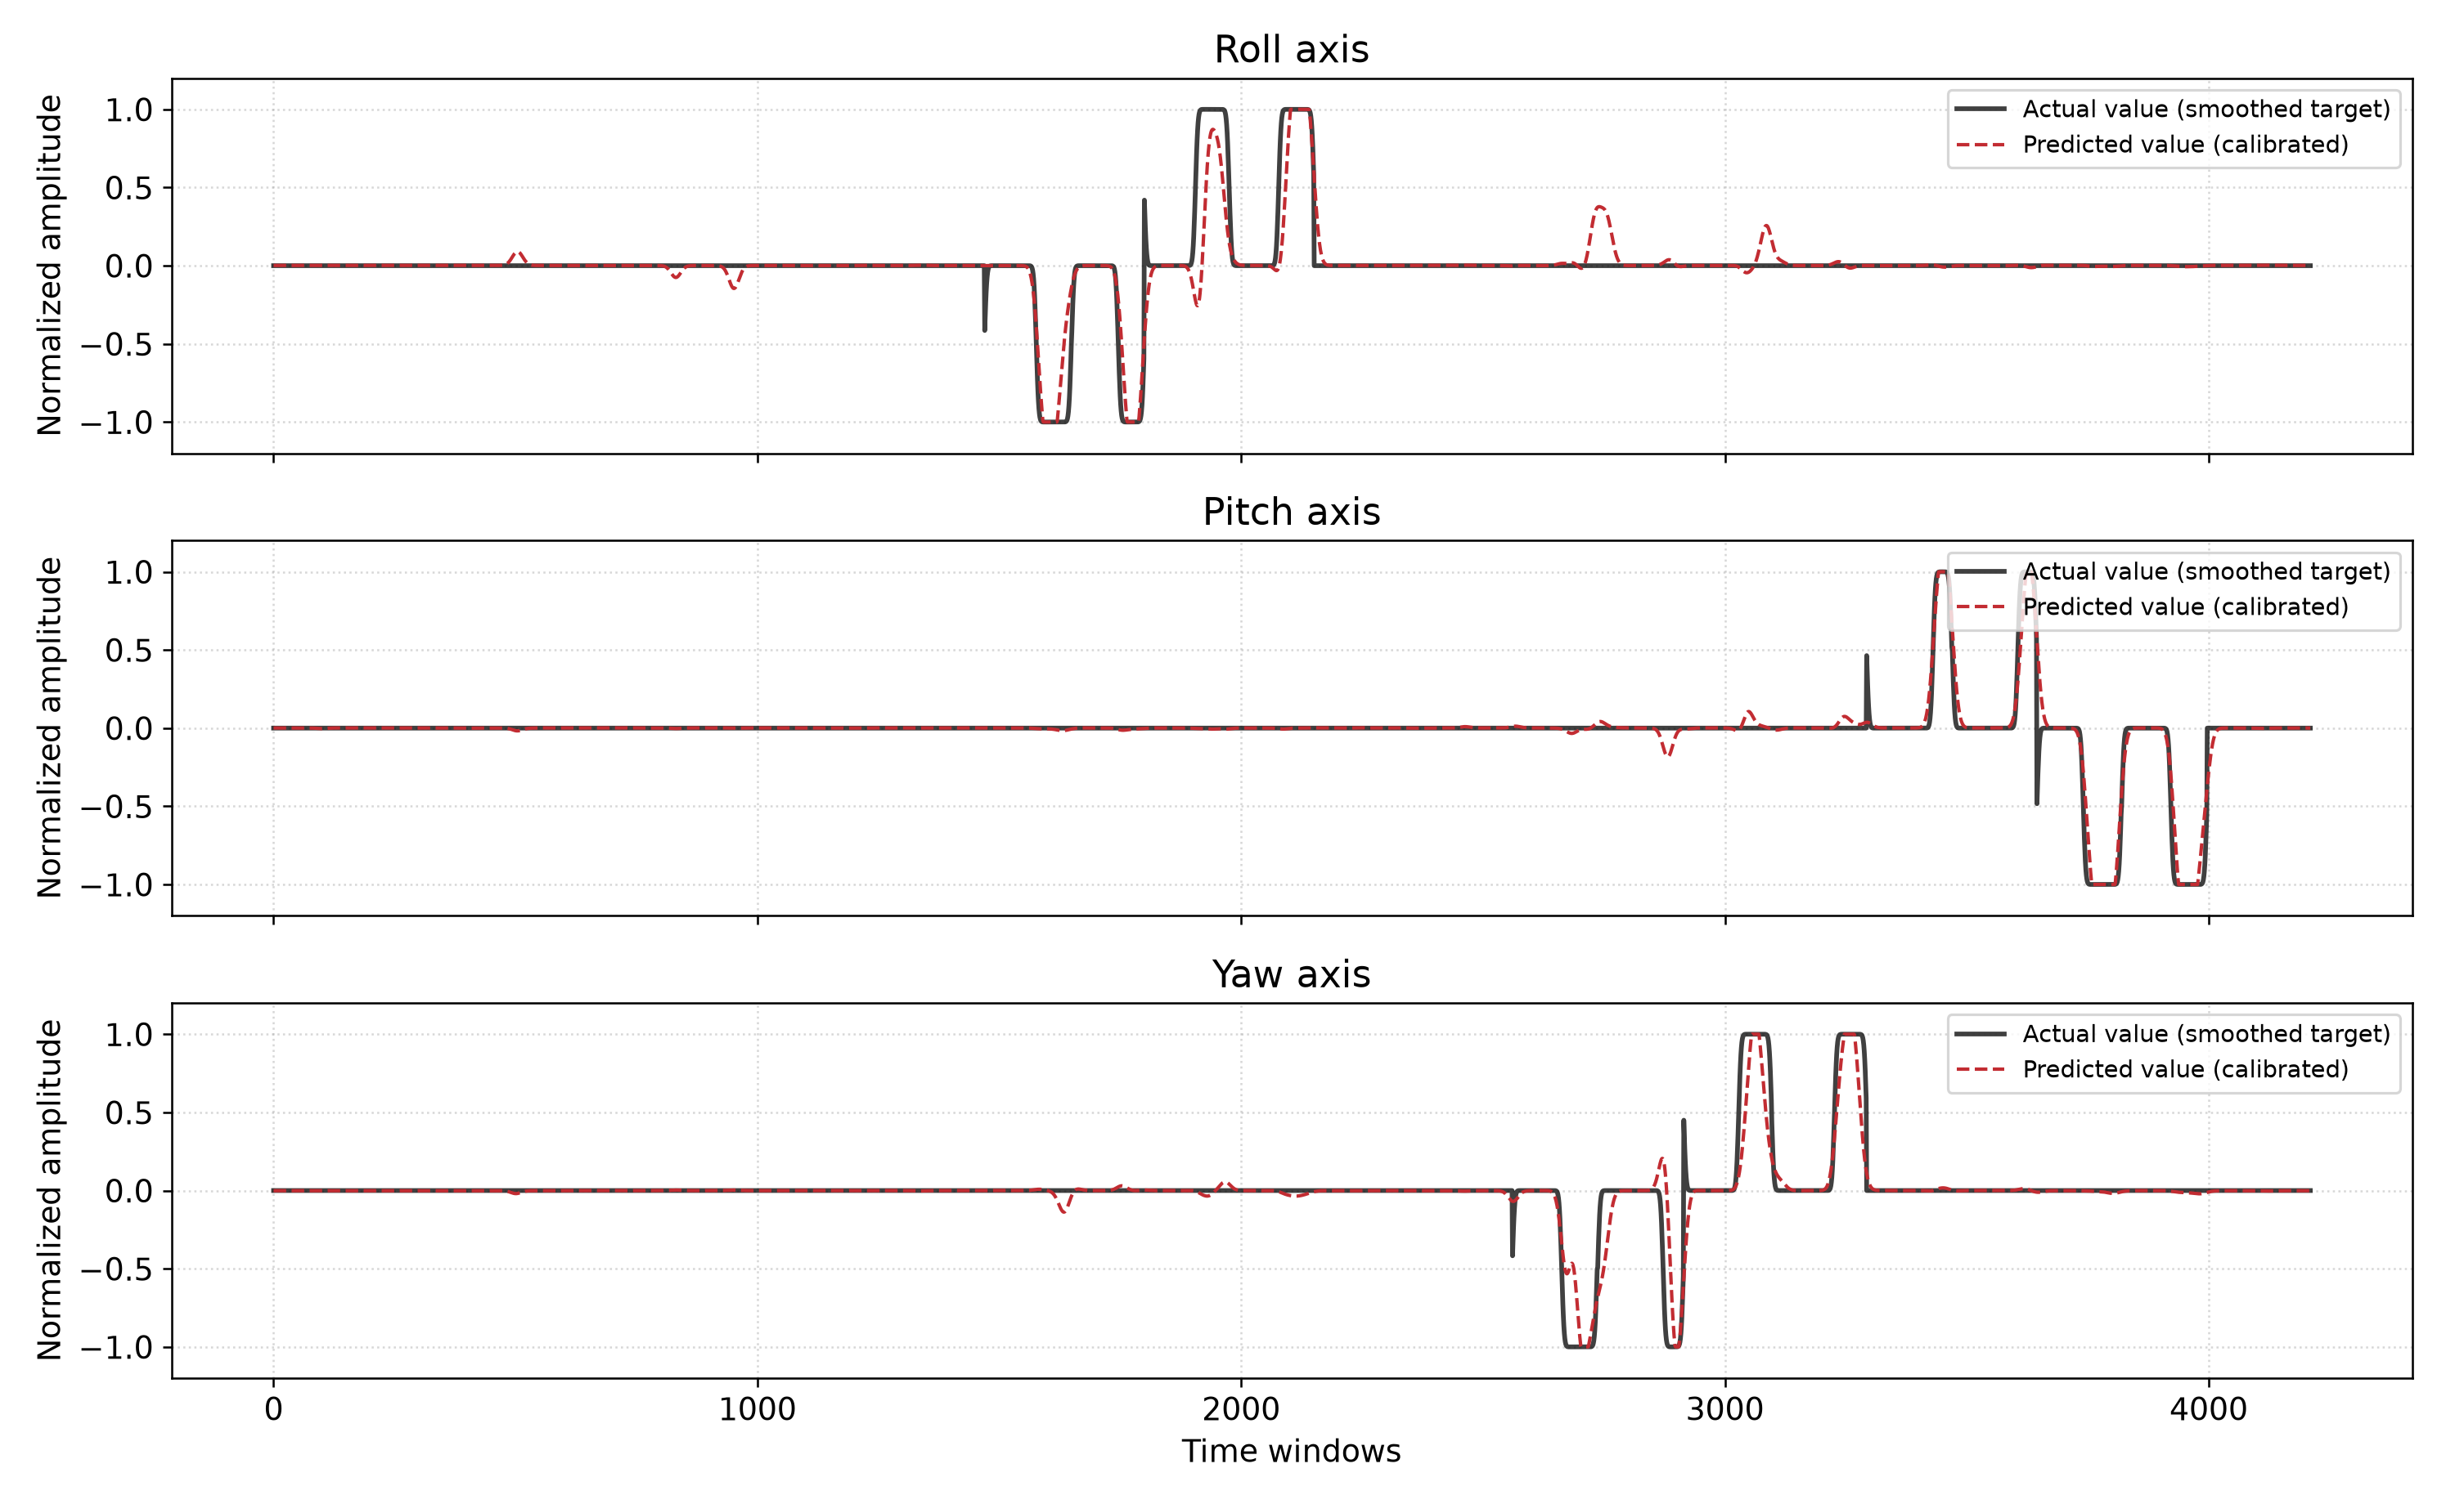
Agreement Between Actual and Predicted Angles
Bachelor’s degree project | Continuous wrist kinematics using sEMG
13
Notes:
Translated from the supplied 15-slide presentation. All research claims and reported values are retained. Technical qualifications appear in TECHNICAL_NOTES.md. English reconstruction from the unchanged exported target and calibrated prediction arrays. All 4,211 saved observations are shown.

Slide 14
Overview of the Project’s Development
The project progressed through a scientific process from simple classification to accurate continuous estimation.
Architectural development
Transition to continuous estimation
A natural balance between CNN for spatial features and LSTM for temporal sequences.
Overcoming the limitations of stepwise labels and obtaining smooth biomechanical trajectories using Gaussian filtering.
Scientific transparency
Biomechanical engineering
Demonstrating covariate shift in EMG signals and consciously selecting the intra-subject approach for the highest attainable accuracy.
Introducing gain calibration to stabilize extreme motion values in real-time prosthesis implementations.
Bachelor’s degree project | Continuous wrist kinematics using sEMG
14
Notes:
Translated from the supplied 15-slide presentation. All research claims and reported values are retained. Technical qualifications appear in TECHNICAL_NOTES.md.

Slide 15
Supplementary Verification of the Final Implementation
The supplied final model contains 45,923 parameters: 45,731 trainable parameters and 192 BatchNormalization statistics.
Verified configuration
Evidence boundaries
Two Conv1D layers with 32 and 64 filters use dilation rate 1.
The recurrent layer is a unidirectional 64-unit LSTM.
The effective initial learning rate is 0.00025.
The saved model metadata records Keras 3.14.0.
The raw NinaPro recording and executable Phase 1–3 implementations are absent.
Targets in the supplied Phase 4 code are smoothed movement-code surrogates. They are not direct Cyberglove wrist-angle samples.
Bachelor’s degree project | Continuous wrist kinematics using sEMG
15
Notes:
Supplementary technical analysis based on the supplied notebook, model configuration, save metadata, and archived model summary.

Slide 16
Extended Evaluation of the Saved Calibrated Predictions
All 4,211 saved observations are retained. Errors are in normalized target-amplitude units.
Axis | RMSE | MAE | Pearson CC | R squared
Roll | 0.1181 | 0.0315 | 0.8766 | 0.7659
Pitch | 0.0554 | 0.0142 | 0.9697 | 0.9392
Yaw | 0.1059 | 0.0269 | 0.8981 | 0.7967
These results evaluate the exported predictions after gain and clipping. The original reported table evaluates smoothed predictions before calibration.
Bachelor’s degree project | Continuous wrist kinematics using sEMG
16
Notes:
Supplementary evaluation of unchanged exported arrays. Calculations are in results/extended_analysis/sample_diagnostics.json.

Slide 17
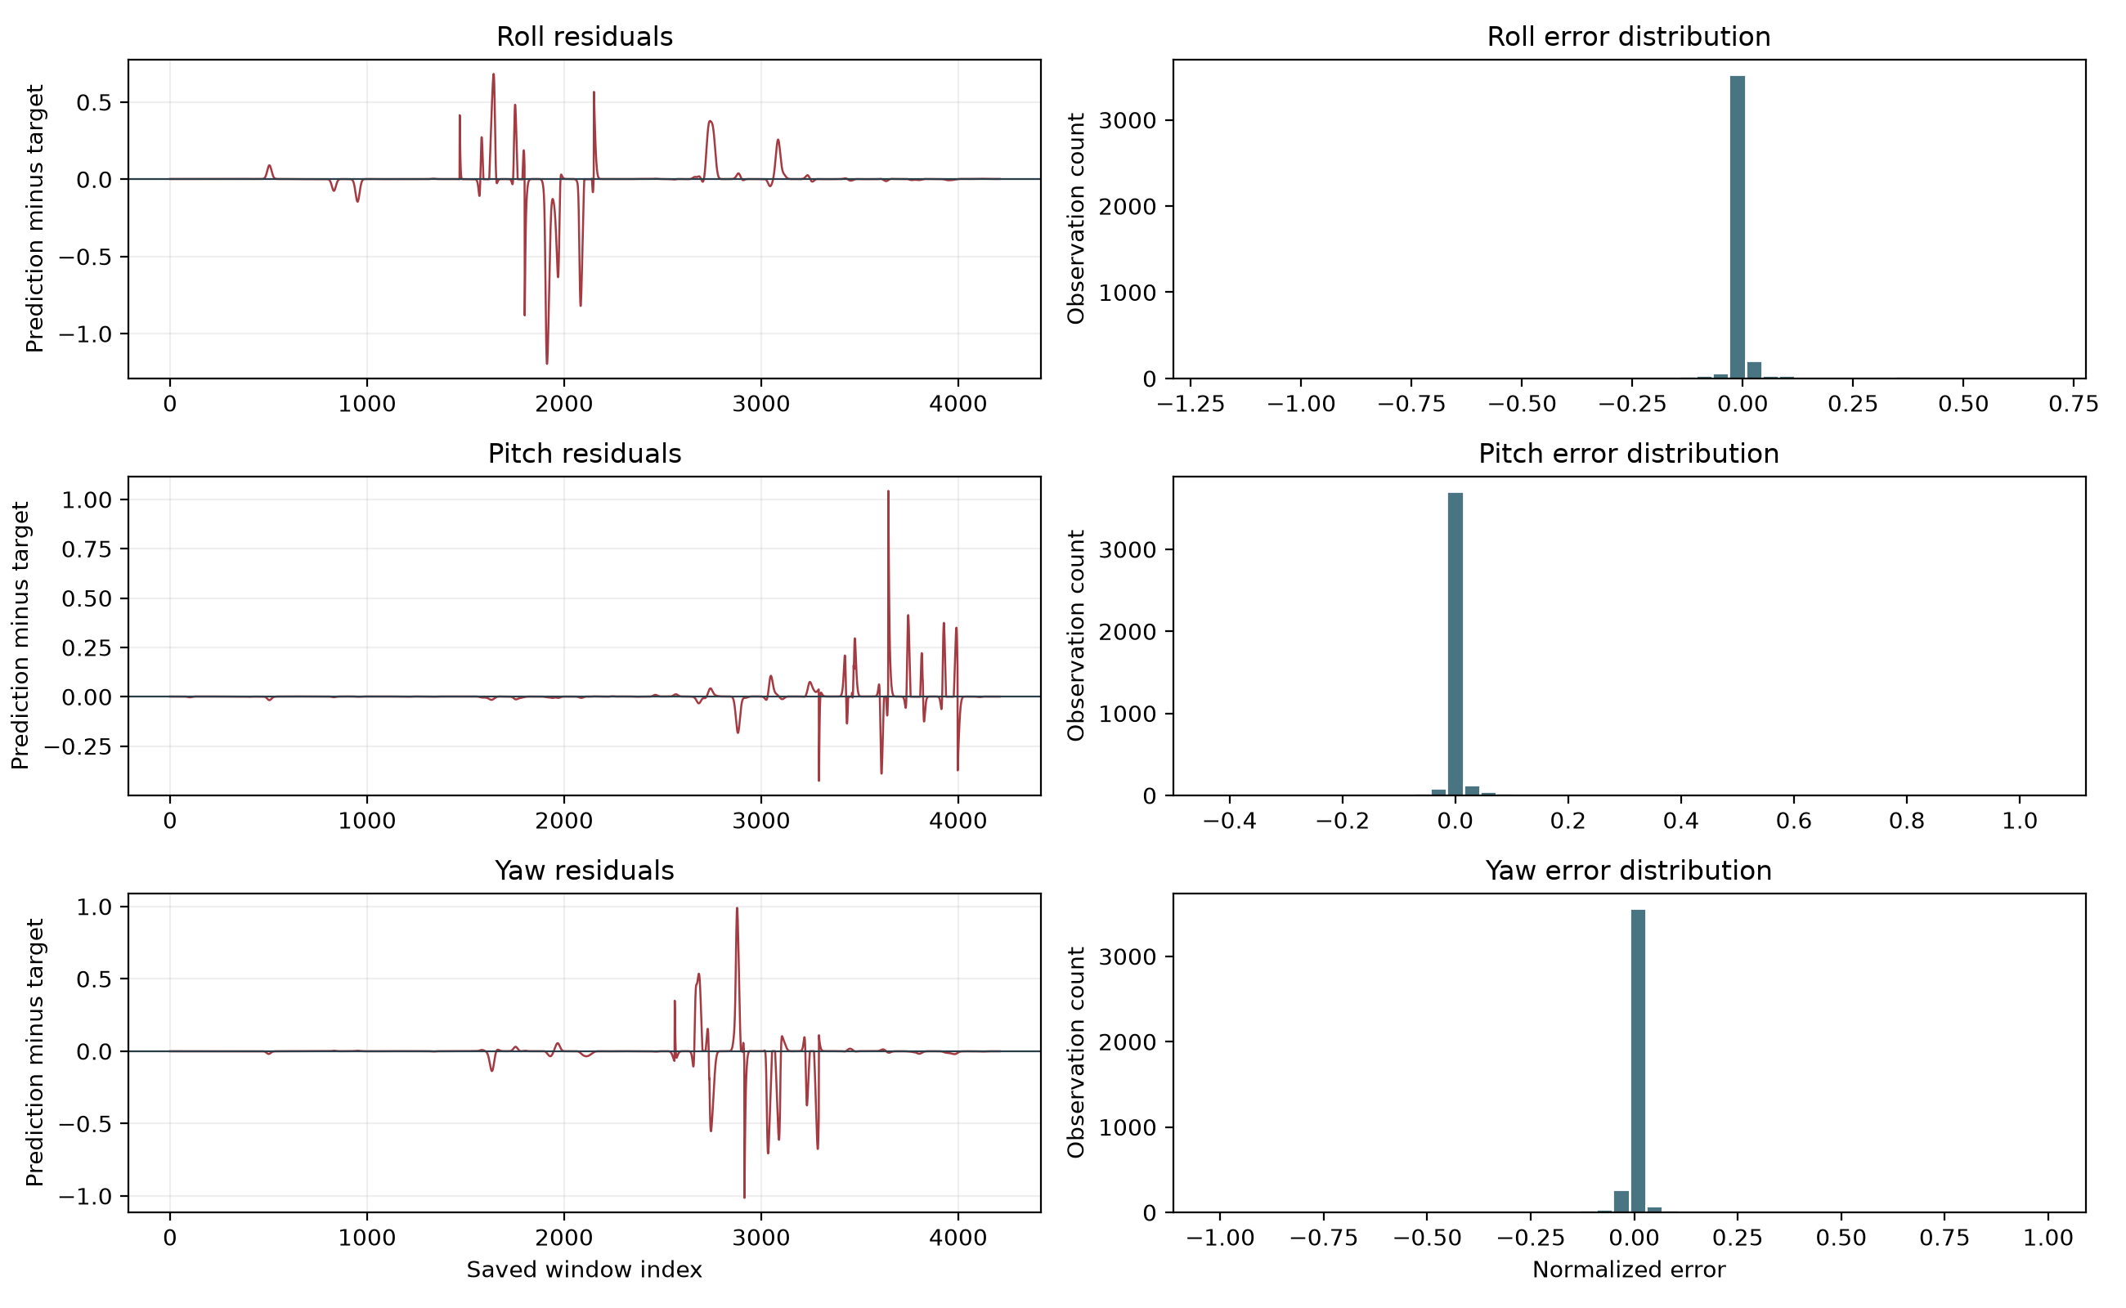
Residual Errors and Their Distribution
High overall correlation coexists with occasional large errors. Maximum absolute errors are 1.1960 for Roll, 1.0428 for Pitch, and 1.0137 for Yaw.
Bachelor’s degree project | Continuous wrist kinematics using sEMG
17
Notes:
Supplementary descriptive diagnostics. The arrays do not identify the physical causes of individual residual peaks.

Slide 18
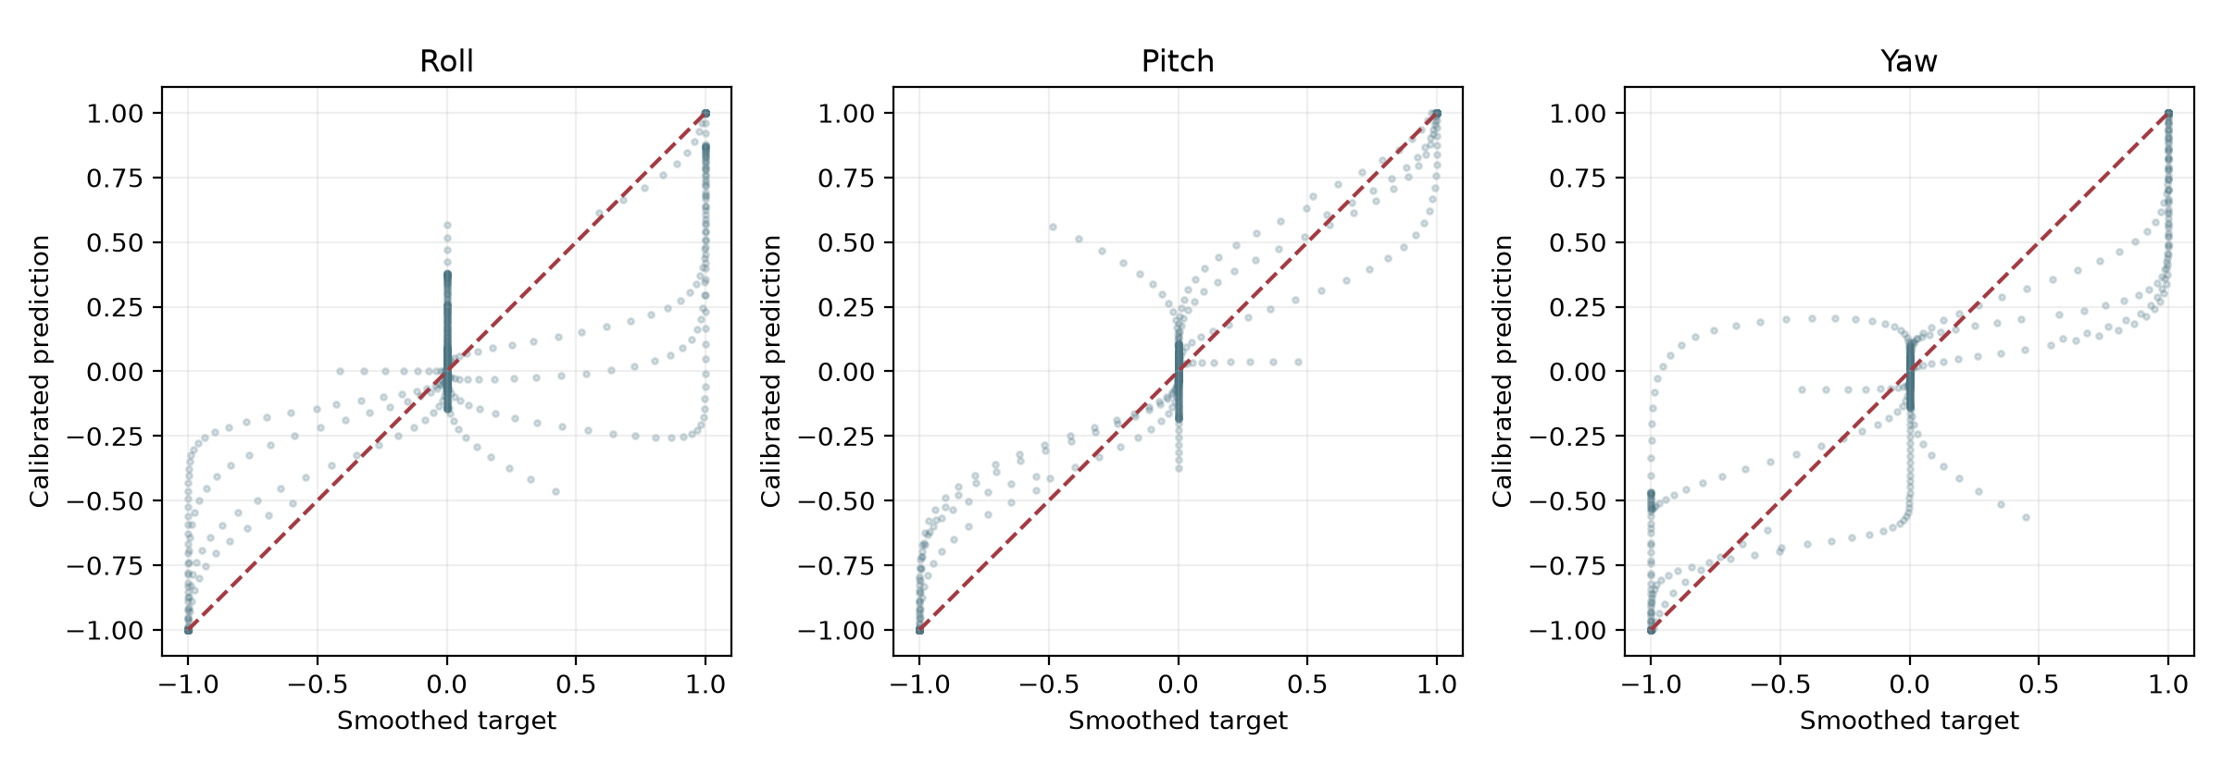
Amplitude Agreement Between Targets and Predictions
The diagonal represents exact agreement. Dense near-zero clusters and clipping bands require interpretation alongside residual and activity-conditioned errors.
Bachelor’s degree project | Continuous wrist kinematics using sEMG
18
Notes:
Supplementary scatter analysis of all saved calibrated predictions. No samples are excluded and no significance test is claimed.

Slide 19
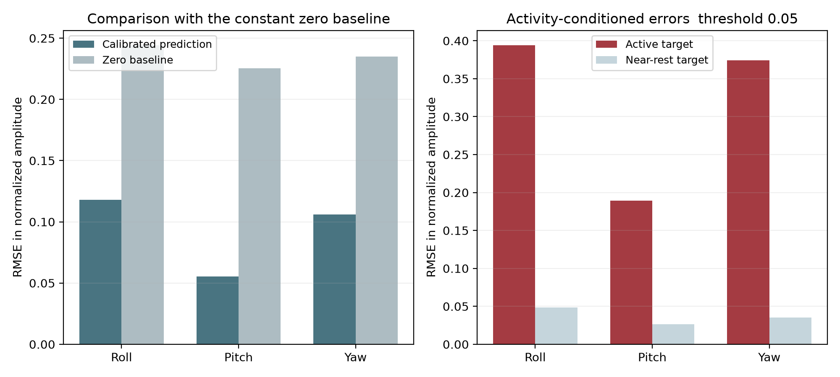
Activity Conditioned Errors and the Zero Baseline
Active means |target| > 0.05 for each axis. Only 6.8–7.6% of observations are active by this definition; active-state error exceeds near-rest error.
Bachelor’s degree project | Continuous wrist kinematics using sEMG
19
Notes:
The activity threshold is a diagnostic convention, not a physiological activation threshold. An inactive axis may coexist with motion on another axis.

Slide 20
Methodological Findings and Evaluation Independence
Targets and causality
Validation and provenance
Movement-code smoothing defines the targets. Physical angle accuracy has not been established.
Forward-backward filtering and centered Gaussian smoothing require future samples and therefore describe offline processing.
The test arrays are also used for model selection. Independent validation and final testing are needed.
The archived training-window count and batch count are inconsistent at the current batch size. Stored outputs cannot certify one consistent current-code run.
Bachelor’s degree project | Continuous wrist kinematics using sEMG
20
Notes:
Supplementary audit findings detailed in Chapters 6 and 8. Original research claims remain in the preceding translated slides.

Slide 21
Reproducibility Checks and the Next Research Experiments
Completed checks
Proposed experiments
13 regression and diagnostic tests passed.
Synthetic-recording preprocessing matches the source operations exactly.
The model, arrays, and video retain their source checksums.
Isolate training, validation, and final test repetitions.
Use synchronized measured kinematic targets.
Compare architecture and postprocessing choices under identical partitions.
Measure causal streaming delay and functional control performance.
The proposed experiments have not been performed on the missing raw dataset.
Bachelor’s degree project | Continuous wrist kinematics using sEMG
21
Notes:
Supplementary research design. Regression checks validate software behavior; they do not replace independent training or deployment experiments.

Slide 22
References
[1] M. Atzori, A. Gijsberts, I. Kuzborskij, S. Elsig, A.-G. M. Hager, O. Deriaz, C. Castellini, H. Müller, and B. Caputo, "Characterization of a Benchmark Database for Myoelectric Movement Classification," IEEE Transactions on Neural Systems and Rehabilitation Engineering, vol. 23, no. 1, pp. 73–83, 2015.
[2] A. Gijsberts, M. Atzori, C. Castellini, H. Müller, and B. Caputo, "Movement Error Rate for Evaluation of Machine Learning Methods for sEMG-Based Hand Movement Classification," IEEE Transactions on Neural Systems and Rehabilitation Engineering, vol. 22, no. 4, pp. 735–744, 2014.
[3] T. Bao, S. A. R. Zaidi, S. Xie, P. Yang, and Z. Zhang, "A CNN-LSTM Hybrid Framework for Wrist Kinematics Estimation Using Surface Electromyography," arXiv preprint arXiv:1912.00799, 2019.
[4] F. Quivira, T. Koike-Akino, Y. Wang, and D. Erdogmus, "Translating sEMG Signals to Continuous Hand Poses Using Recurrent Neural Networks," in Proc. IEEE EMBS International Conference on Biomedical & Health Informatics (BHI), 2018, pp. 166–169.
[5] J. Du, Z. Liu, W. Dong, W. Zhang, and Z. Miao, "A Novel TCN-LSTM Hybrid Model for sEMG-Based Continuous Estimation of Wrist Joint Angles," Sensors, vol. 24, no. 17, p. 5631, 2024.
[6] A. Ameri, M. A. Akhaee, E. Scheme, and K. Englehart, "Regression Convolutional Neural Network for Improved Simultaneous EMG Control," Journal of Neural Engineering, vol. 16, no. 3, 036015, 2019.
[7] M. Atzori, M. Cognolato, and H. Müller, "Deep Learning with Convolutional Neural Networks Applied to Electromyography Data: A Resource for the Classification of Movements for Prosthetic Hands," Frontiers in Neurorobotics, vol. 10, p. 9, 2016.
Bachelor’s degree project | Continuous wrist kinematics using sEMG
22
Notes:
Translated from the supplied 15-slide presentation. All research claims and reported values are retained. Technical qualifications appear in TECHNICAL_NOTES.md.

