Slide 1
Router

Slide 2
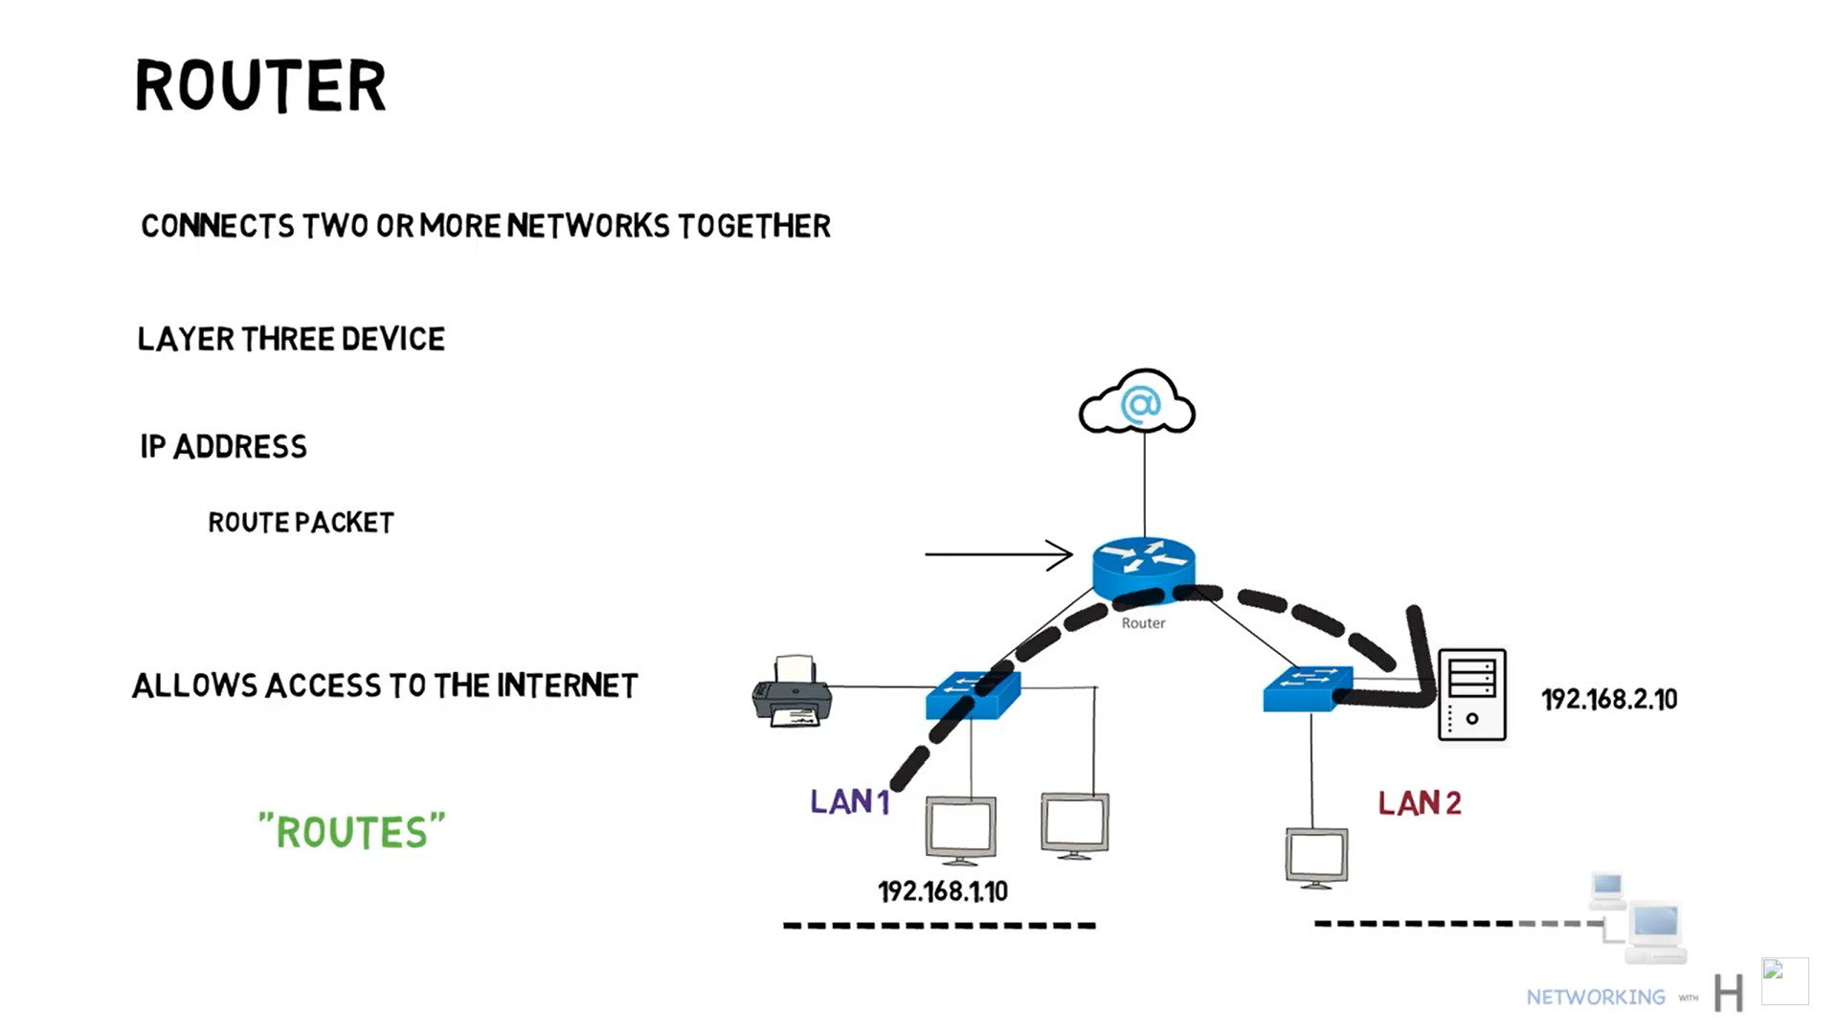


Slide 3
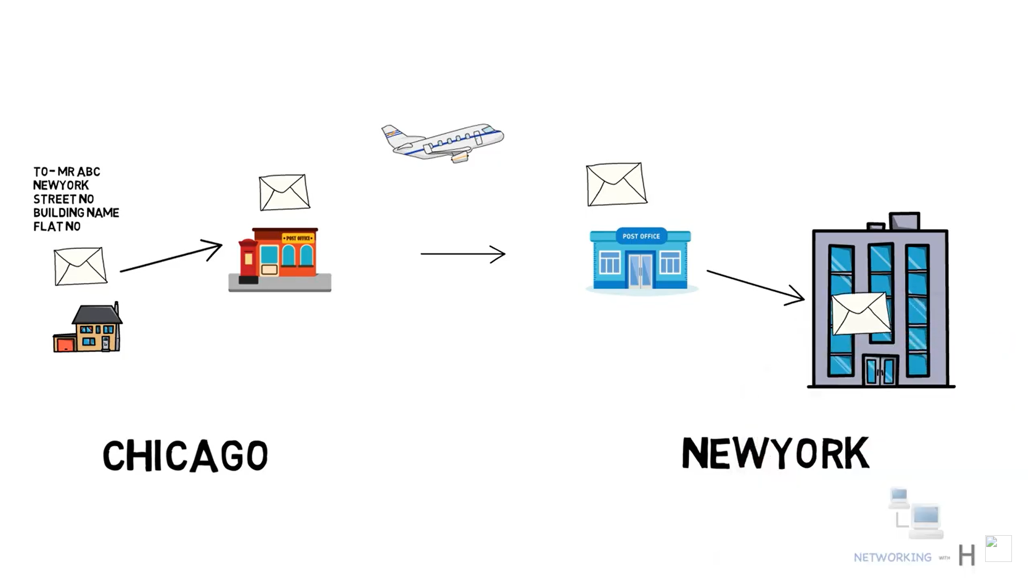

Slide 4
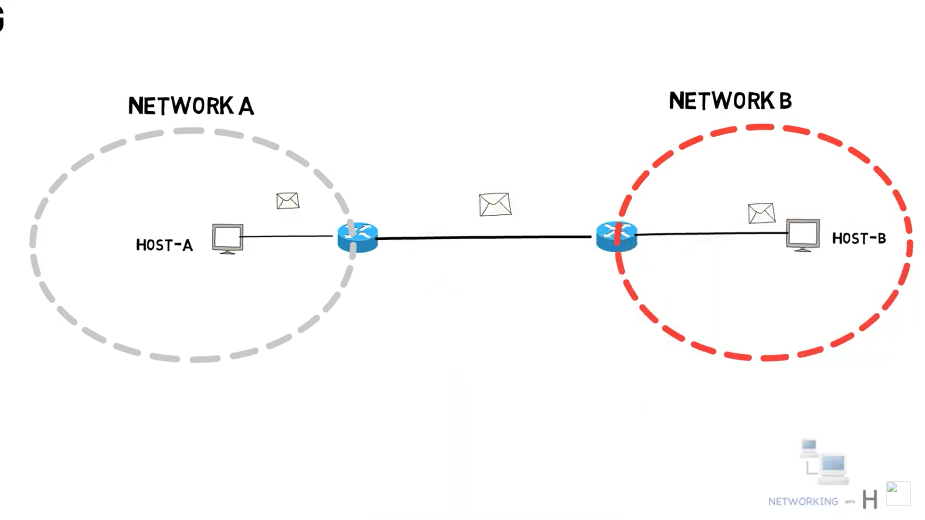

Slide 5
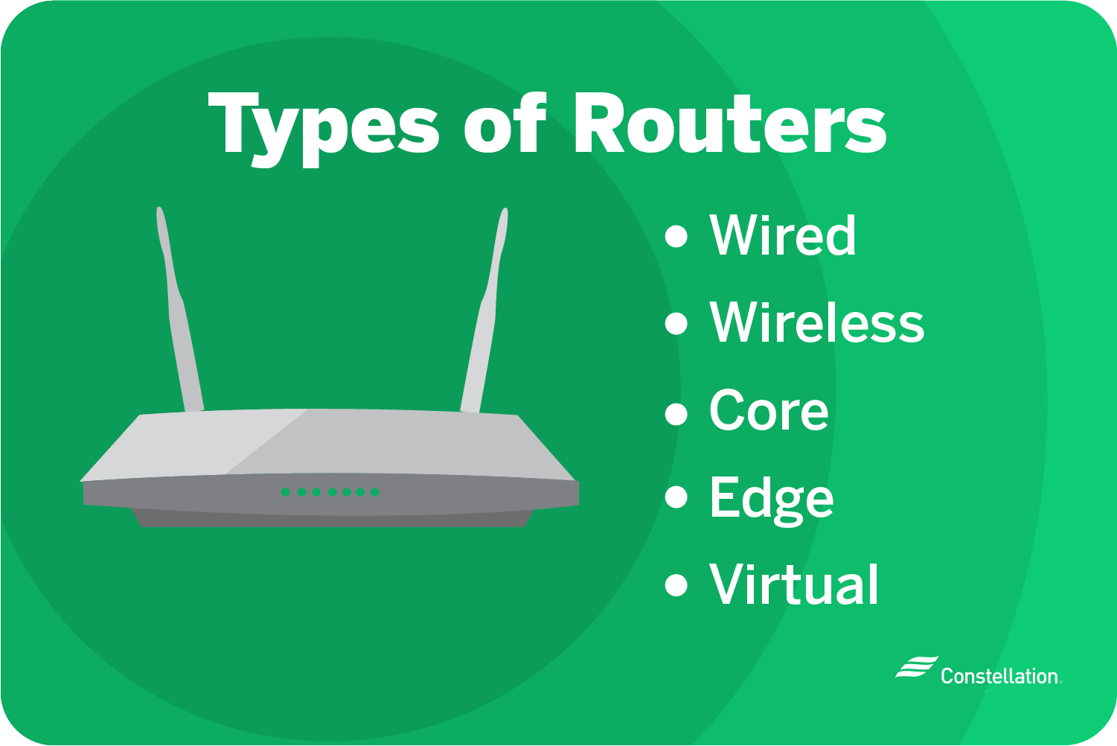

Slide 6
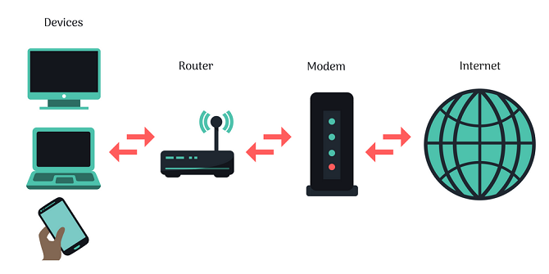

Slide 7
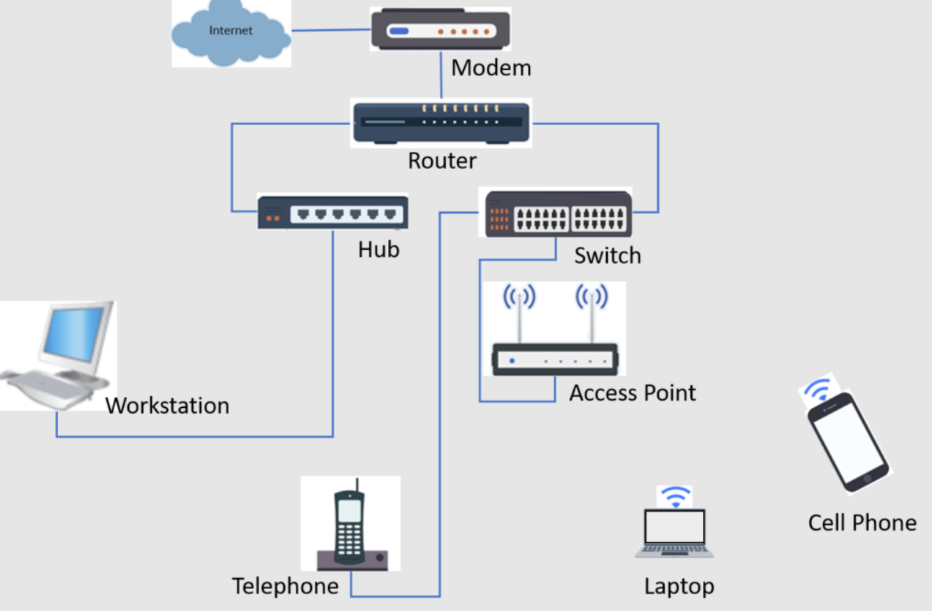

Slide 8
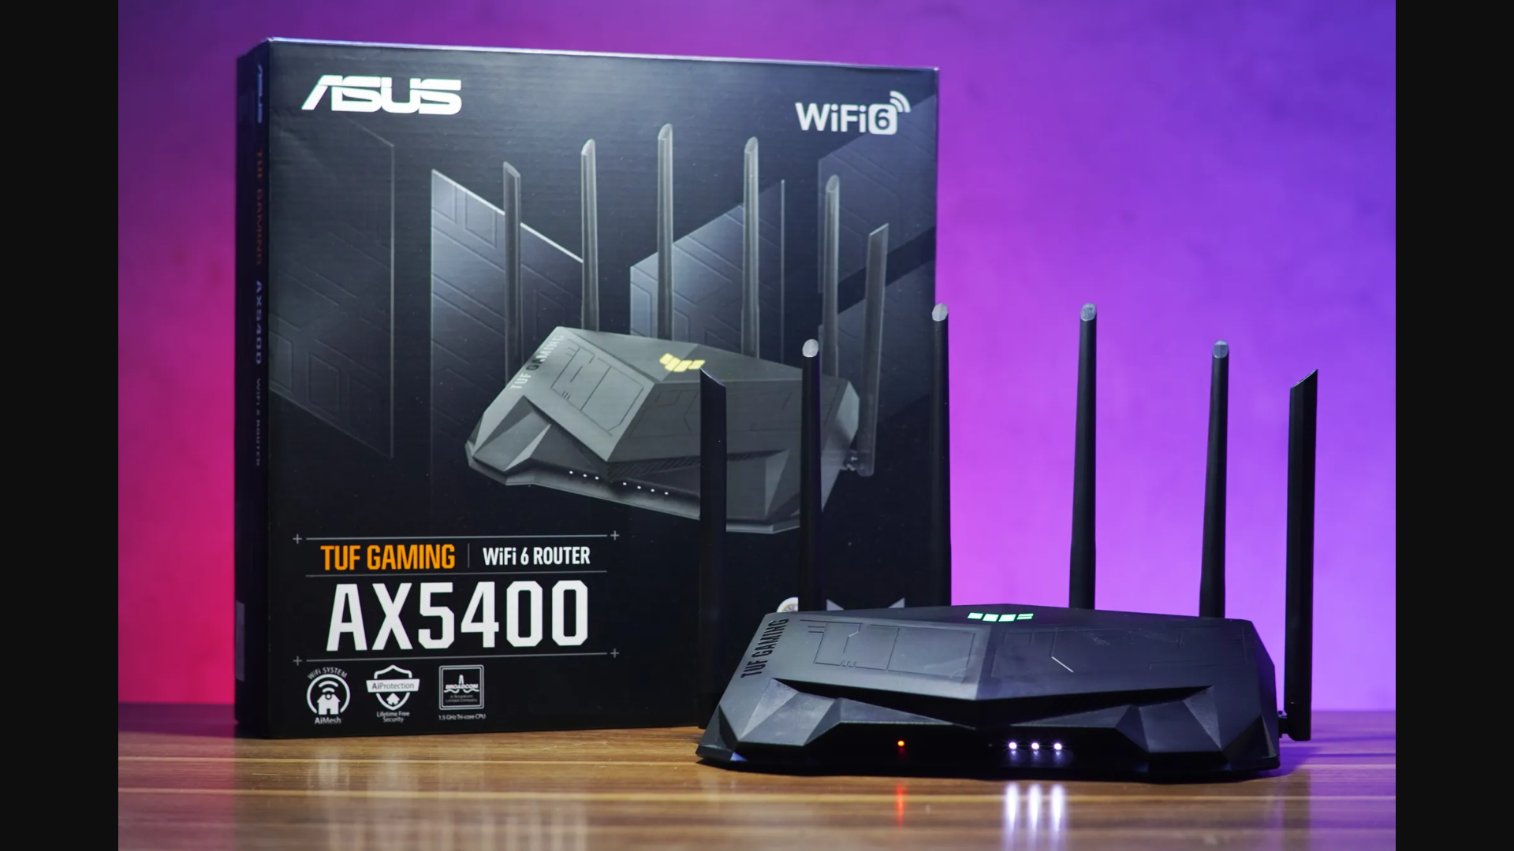

Slide 9
Presenters
Reza Poudineh
Mahmoud Poudineh
Ali Davoudi

Slide 10
Thank you for your time ;)

