Slide 1
102architect
B-MAT-100

Slide 2
Geometric transformations
In graphics programming, objects can usually
Move
Change size
Turn
Change shape
This can be done using geometric transformations
Translation
Scaling
Rotation
Reflection
…

Slide 3
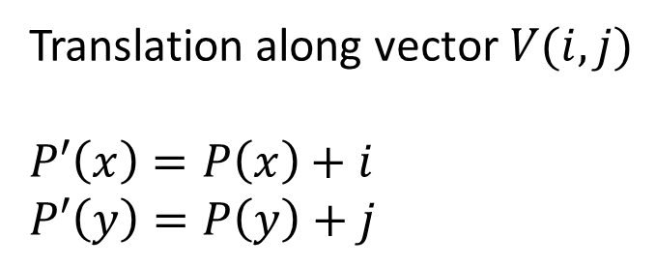
Translation
y
V
Translation along vector $V(i, j)$
$$P′\left(x\right)=P\left(x\right)+i$$
$$P′\left(y\right)=P\left(y\right)+j$$
P
P’
O
x

Slide 4
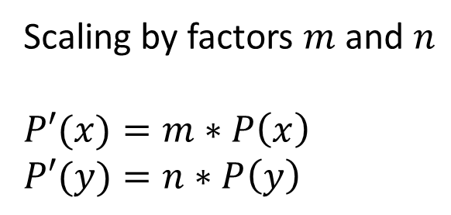
Scaling
y
Scaling by factors $m$ and $n$
$$P′(x)=m∗P\left(x\right)$$
$$P′(y)=n∗P\left(y\right)$$
P’
P
O
x

Slide 5
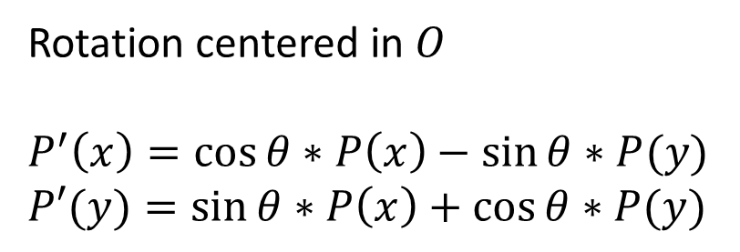
Rotation
y
Rotation centered in $O$
$$P^{′}\left(x\right)=\cos{θ}∗P\left(x\right)−sin⁡θ∗P(y)$$
$$P′(y)=\sin{θ}∗P\left(x\right)+cos⁡θ∗P(y)$$
P’
θ
P
O
x

Slide 6
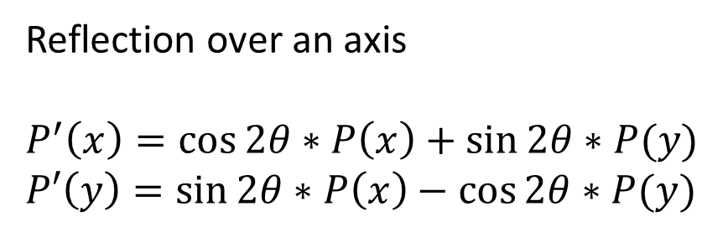
Reflection
y
Reflection over an axis
$$P^{′}\left(x\right)=\cos{2θ}∗P\left(x\right)+sin⁡2θ∗P(y)$$
$$P′\left(y\right)=\sin{2θ}∗P\left(x\right)−cos⁡2θ∗P(y)$$
P’
θ
P
O
x

Slide 7
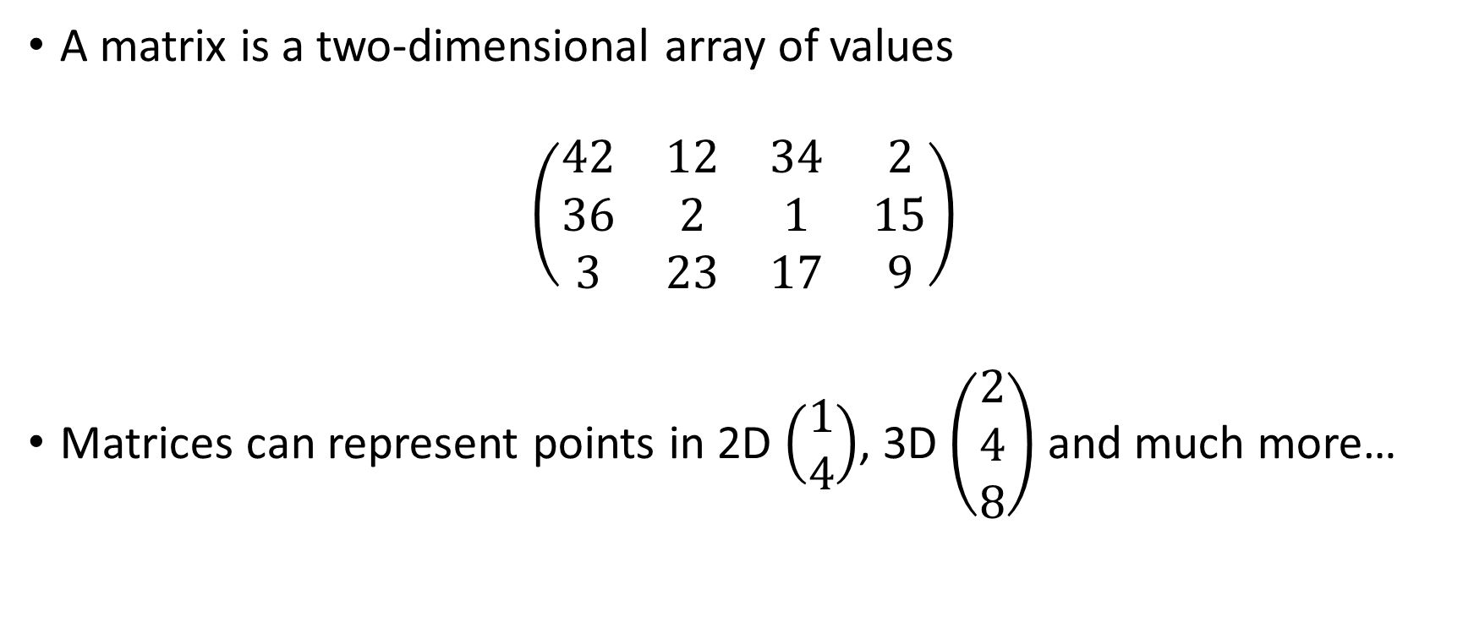
Matrices
A matrix is a two-dimensional array of values
$$\left(\begin{matrix}42 & 12 & 34 & 2 \\ 36 & 2 & 1 & 15 \\ 3 & 23 & 17 & 9\end{matrix}\right)$$
Matrices can represent points in 2D $\left(\begin{matrix}1 \\ 4\end{matrix}\right)$, 3D $\left(\begin{matrix}2 \\ 4 \\ 8\end{matrix}\right)$ and much more…

Slide 8
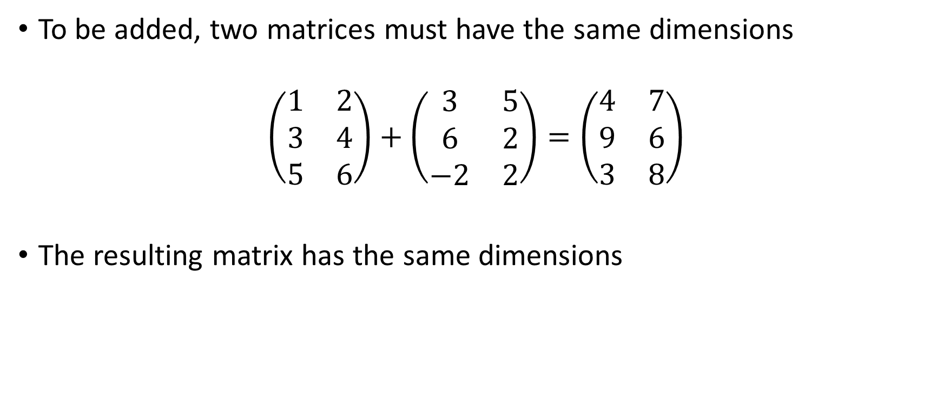
Addition of two matrices
To be added, two matrices must have the same dimensions
$$\left(\begin{matrix}1 & 2 \\ 3 & 4 \\ 5 & 6\end{matrix}\right)+\left(\begin{matrix}3 & 5 \\ 6 & 2 \\ −2 & 2\end{matrix}\right)=\left(\begin{matrix}4 & 7 \\ 9 & 6 \\ 3 & 8\end{matrix}\right)$$
The resulting matrix has the same dimensions

Slide 9
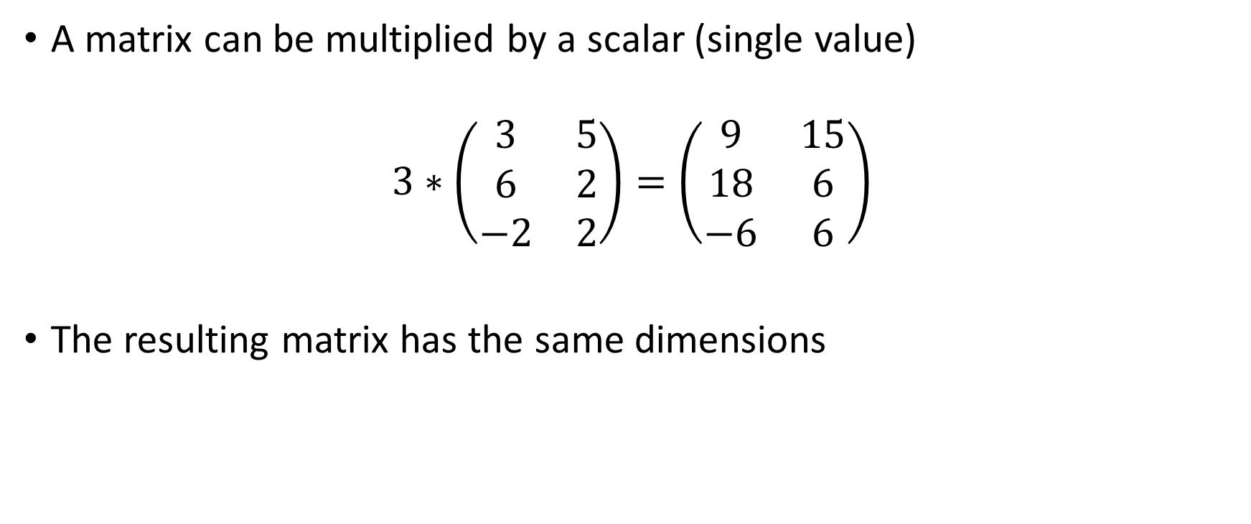
Multiplication by a scalar
A matrix can be multiplied by a scalar (single value)
$$3∗\left(\begin{matrix}3 & 5 \\ 6 & 2 \\ −2 & 2\end{matrix}\right)=\left(\begin{matrix}9 & 15 \\ 18 & 6 \\ −6 & 6\end{matrix}\right)$$
The resulting matrix has the same dimensions

Slide 10
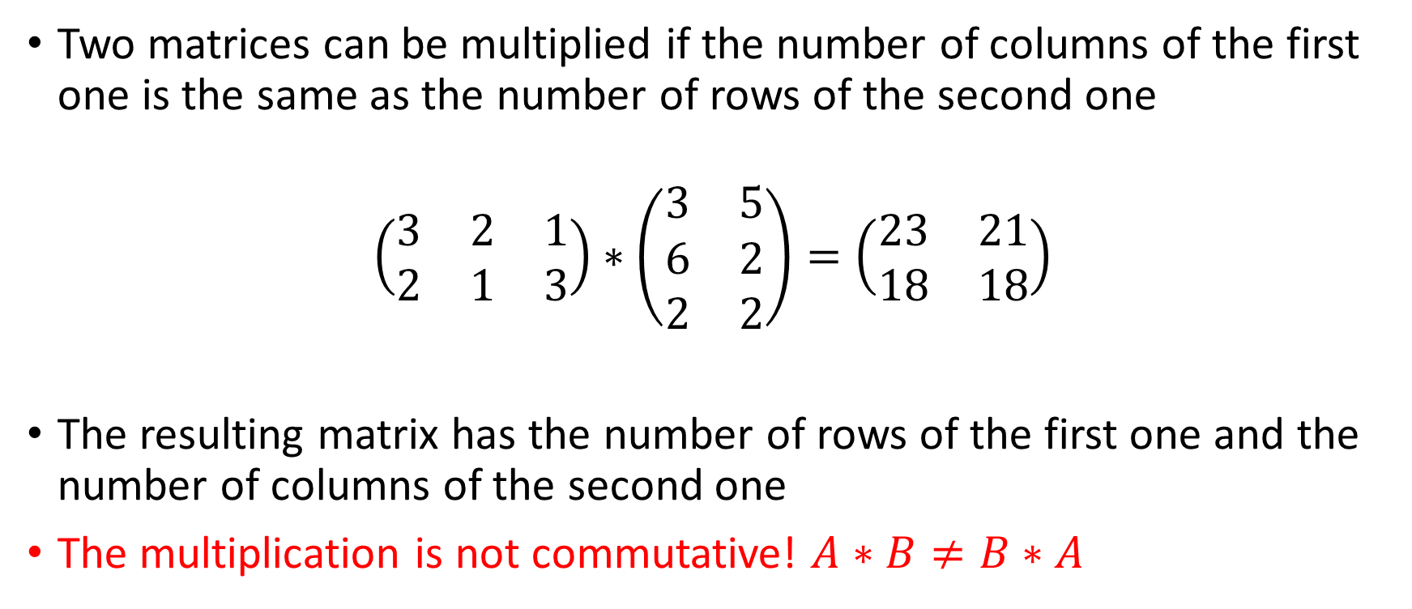
Multiplication of two matrices
Two matrices can be multiplied if the number of columns of the first one is the same as the number of rows of the second one
$$\left(\begin{matrix}3 & 2 & 1 \\ 2 & 1 & 3\end{matrix}\right)∗\left(\begin{matrix}3 & 5 \\ 6 & 2 \\ 2 & 2\end{matrix}\right)=\left(\begin{matrix}23 & 21 \\ 18 & 18\end{matrix}\right)$$
The resulting matrix has the number of rows of the first one and the number of columns of the second one
The multiplication is not commutative! $A∗B≠B∗A$

Slide 11
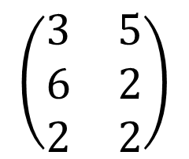

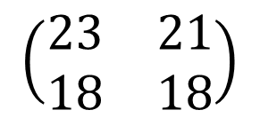
How to multiply matrices
$$\left(\begin{matrix}3 & 5 \\ 6 & 2 \\ 2 & 2\end{matrix}\right)$$
$$\left(\begin{matrix}3 & 2 & 1 \\ 2 & 1 & 3\end{matrix}\right)$$
$$\left(\begin{matrix}23 & 21 \\ 18 & 18\end{matrix}\right)$$
$$\left(3∗3\right)+\left(2∗6\right)+\left(1∗2\right)=9+12+2=23$$

Slide 12
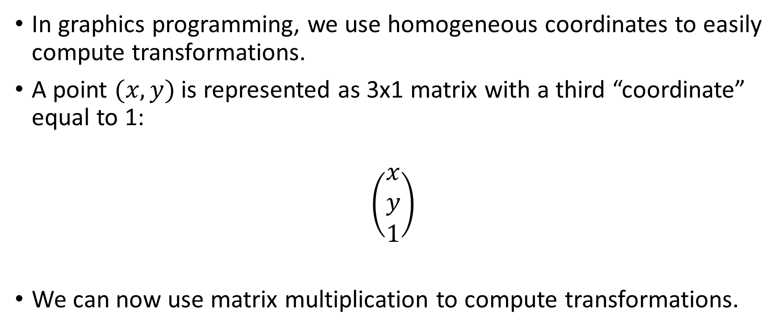
Homogeneous coordinates
In graphics programming, we use homogeneous coordinates to easily compute transformations.
A point $(x, y)$ is represented as 3x1 matrix with a third “coordinate” equal to 1:
$$\left(\begin{matrix}x \\ y \\ 1\end{matrix}\right)$$
We can now use matrix multiplication to compute transformations.

Slide 13
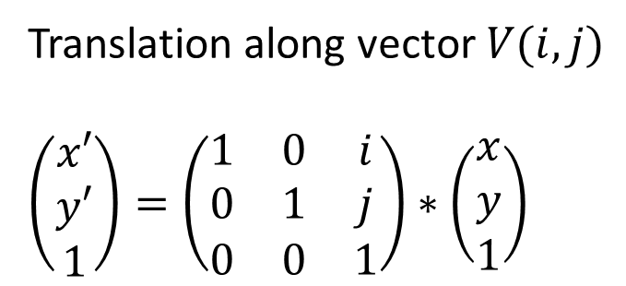
Translation
y
V
Translation along vector $V(i, j)$
$$\left(\begin{matrix}x′ \\ y′ \\ 1\end{matrix}\right)=\left(\begin{matrix}1 & 0 & i \\ 0 & 1 & j \\ 0 & 0 & 1\end{matrix}\right)∗\left(\begin{matrix}x \\ y \\ 1\end{matrix}\right)$$
P
P’
O
x

Slide 14
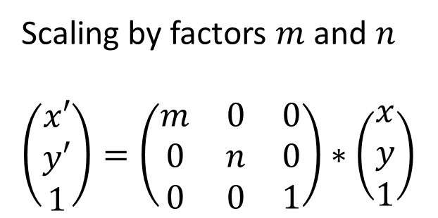
Scaling
y
Scaling by factors $m$ and $n$
$$\left(\begin{matrix}x′ \\ y′ \\ 1\end{matrix}\right)=\left(\begin{matrix}m & 0 & 0 \\ 0 & n & 0 \\ 0 & 0 & 1\end{matrix}\right)∗\left(\begin{matrix}x \\ y \\ 1\end{matrix}\right)$$
P’
P
O
x

Slide 15
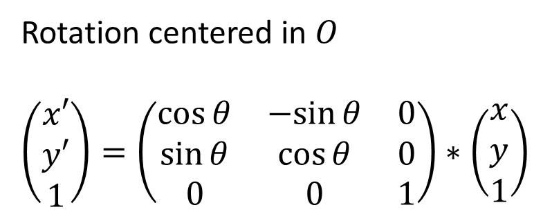
Rotation
y
Rotation centered in $O$
$$\left(\begin{matrix}x′ \\ y′ \\ 1\end{matrix}\right)=\left(\begin{matrix}\cos{θ} & −sin⁡θ & 0 \\ \sin{θ} & \cos{θ} & 0 \\ 0 & 0 & 1\end{matrix}\right)∗\left(\begin{matrix}x \\ y \\ 1\end{matrix}\right)$$
P’
θ
P
O
x

Slide 16
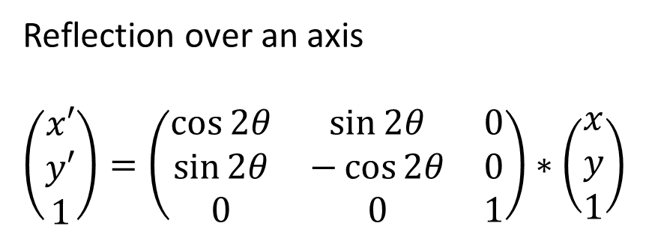
Reflection
y
Reflection over an axis
$$\left(\begin{matrix}x′ \\ y′ \\ 1\end{matrix}\right)=\left(\begin{matrix}\cos{2θ} & sin⁡2θ & 0 \\ \sin{2θ} & −\cos{2θ} & 0 \\ 0 & 0 & 1\end{matrix}\right)∗\left(\begin{matrix}x \\ y \\ 1\end{matrix}\right)$$
P’
θ
P
O
x

Slide 17
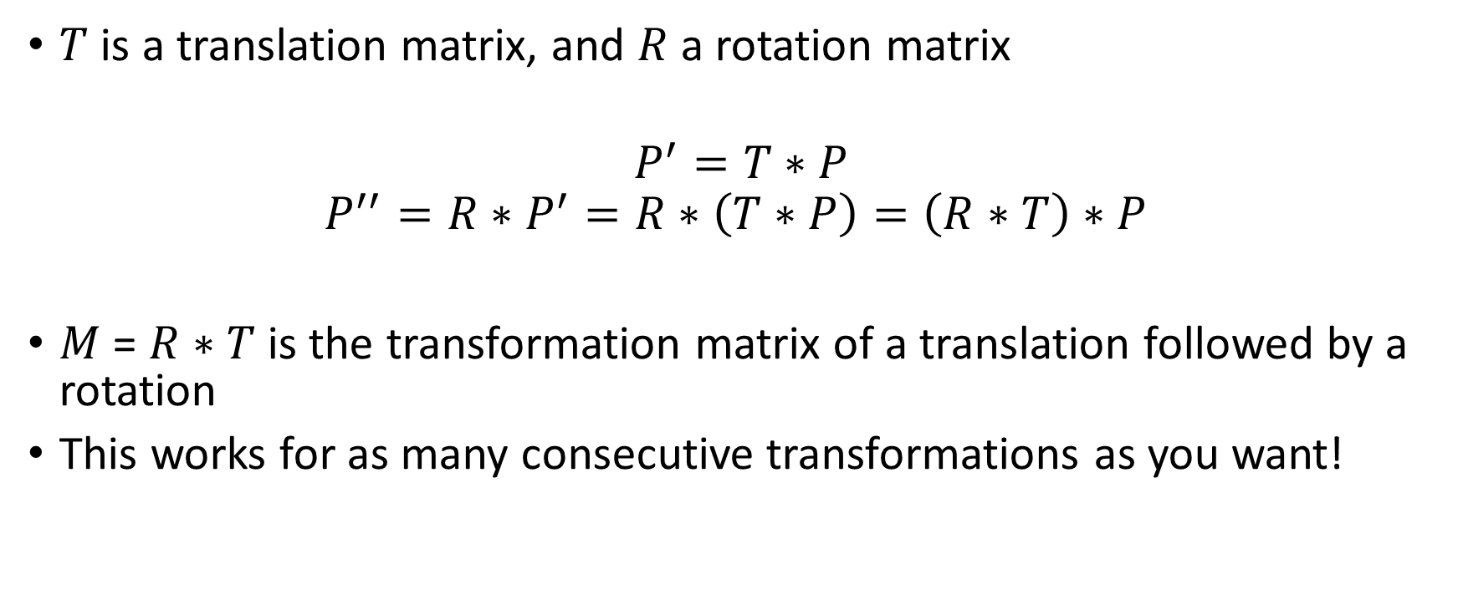
Composed transformations
$T$ is a translation matrix, and $R$ a rotation matrix
$$P^{′}=T∗P \\ P^{′′}=R∗P^{′}=R∗\left(T∗P\right)=\left(R∗T\right)∗P$$
$M$ = $R∗T$ is the transformation matrix of a translation followed by a rotation
This works for as many consecutive transformations as you want!

Slide 18
102architect
Inputs
x, y: original coordinates
At least one transformation
Outputs
The matrix of the (composed) transformation
The resulting transformed coordinates
Using a matrix calculus library is considered cheating

Slide 19
Suggested bonuses
Graphical interface showing transformation of several points / figures
Additional transformations
Shear mapping
Projection
…
3D

