Slide 1
104intersection
B-MAT-100

Slide 2
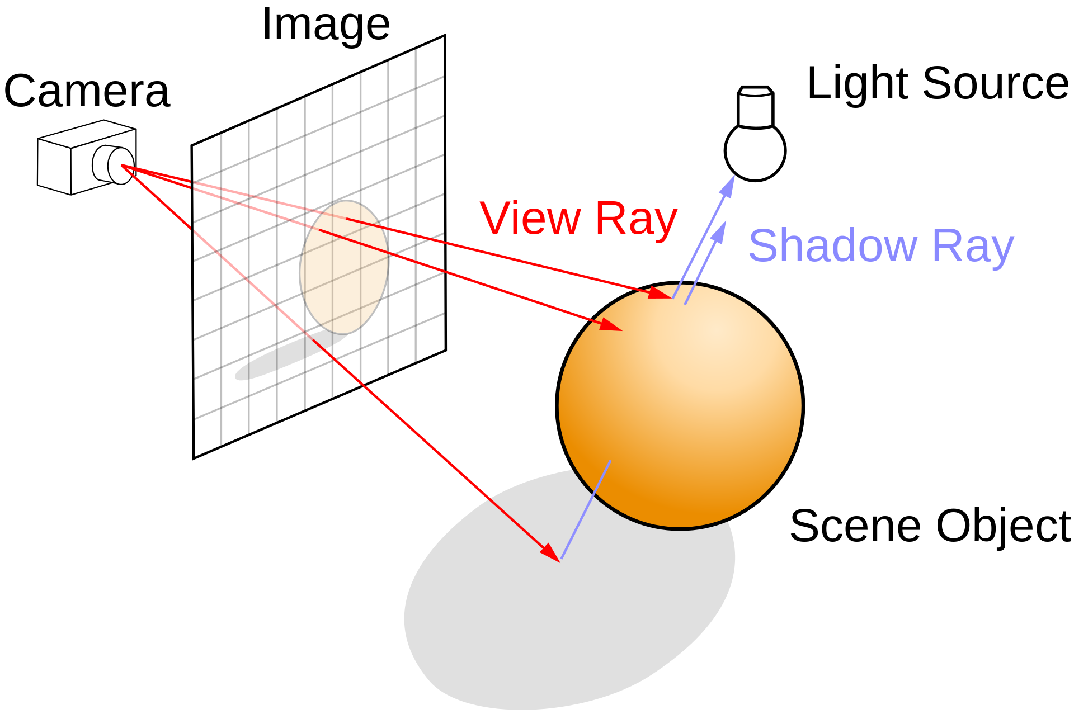
Ray tracing
Rendering technique for generating an image by tracing a ray from a virtual eye through each pixel of the screen and if it intersects an object

Slide 3
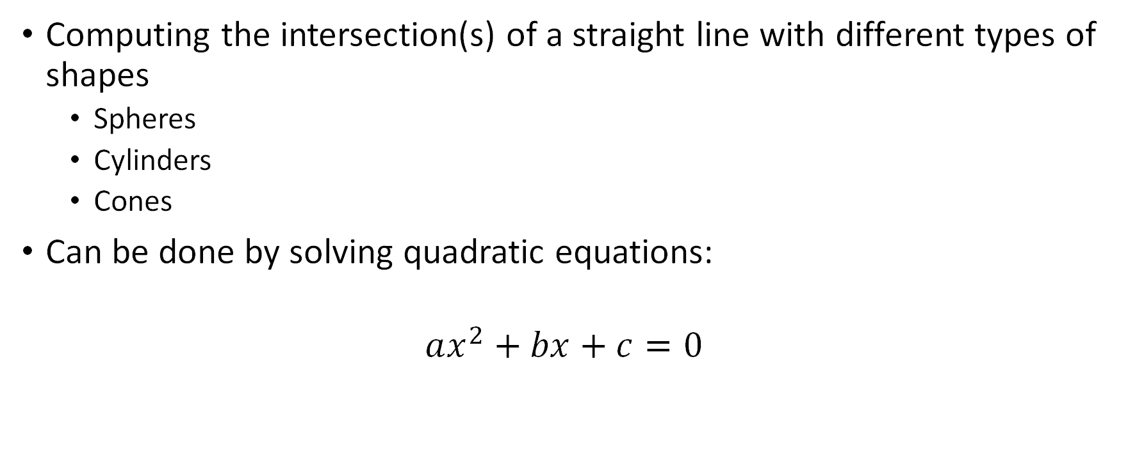
Goal
Computing the intersection(s) of a straight line with different types of shapes
Spheres
Cylinders
Cones
Can be done by solving quadratic equations:
$$ax^{2}+bx+c=0$$

Slide 4

Line
A line $L$ is defined by a point $P(x_{p}, y_{p}, z_{p})$ and a vector $V(x_{v}, y_{v}, z_{v})$
$$L\left(t\right):\left\{\begin{aligned}x(t)=x_{p}+tx_{v} \\ y(t)=y_{p}+ty_{v} \\ z(t)=z_{p}+tz_{v}\end{aligned}\right.$$
$$P=L(0)$$
P
V
L(t)

Slide 5

Sphere
Equation of a sphere centered in $O$ with a radius $R$:
$$x^{2}+y^{2}+z^{2}=R^{2}$$
Z
R
O
Y
X

Slide 6

Cylinder
Equation of a cylinder around the $Z$-axis with a radius $R$:
$$x^{2}+y^{2}=R^{2}$$
Z
R
O
Y
X

Slide 7

Cone
Equation of a cone around the $Z$-axis with apex in $O$ and angle $θ$:
$$x^{2}+y^{2}=\tan^{2}\left(θ\right)z^{2}$$
Z
θ
O
Y
X

Slide 8

Intersection of a line with a sphere
$$L\left(t\right):\left\{\begin{aligned}x(t)=x_{p}+tx_{v} \\ y(t)=y_{p}+ty_{v} \\ z(t)=z_{p}+tz_{v}\end{aligned}\right.$$
$$x^{2}+y^{2}+z^{2}=R^{2} \\ {\left(x_{p}+tx_{v}\right)}^{2}+{\left(y_{p}+ty_{v}\right)}^{2}+{\left(z_{p}+tz_{v}\right)}^{2}=R^{2}$$
$${\left(u+v\right)}^{2}=u^{2}+2uv+v^{2}$$
$$\left(x_{v}^{2}+y_{v}^{2}+z_{v}^{2}\right)t^{2}+2\left(x_{p}x_{v}+y_{p}y_{v}+z_{p}z_{v}\right)t+\left(x_{p}^{2}+y_{p}^{2}+z_{p}^{2}\right)=R^{2}$$
$$at^{2}+bt+c=0$$

Slide 9

Solving a quadratic equation
$$at^{2}+bt+c=0$$
$$∆=b^{2}−4ac$$
$$t=\frac{−b±\sqrt{∆}}{2a}$$
2 solutions if $∆>0$
1 solution if $∆=0$
No solutions if $∆<0$
If $a=0$, this needs to be handled specifically

Slide 10
104intersection
Computing intersection(s) of a line with a surface
Inputs
Surface type (sphere, cylinder, cone)
Coordinates of a point on the line
Coordinates of a vector parallel to the line
Surface parameter (radius or angle)
Outputs
Type of surface
Line
Number of intersections
Coordinates of the intersections

Slide 11

Points of attention
Beware of edge cases
No solutions
Infinite number of solutions
Linear equation instead of quadratic
Incorrect parameters ($\tan\left(π/2\right)$ is undefined)
Division by 0
…

Slide 12
Suggested bonuses
Additional surfaces
Multiple surfaces

