Slide 1

Website
Project Presentation
By: Steven Atilho, Andrew Mahr, Colin Dunn, Andrew Manfredi, Brandon Trundy

Slide 2
Website Design overview
Home Page -
About Page -
Contact Page -
Login/Logout Portal -
Profile Page -
Design and Code Implementation

Slide 3
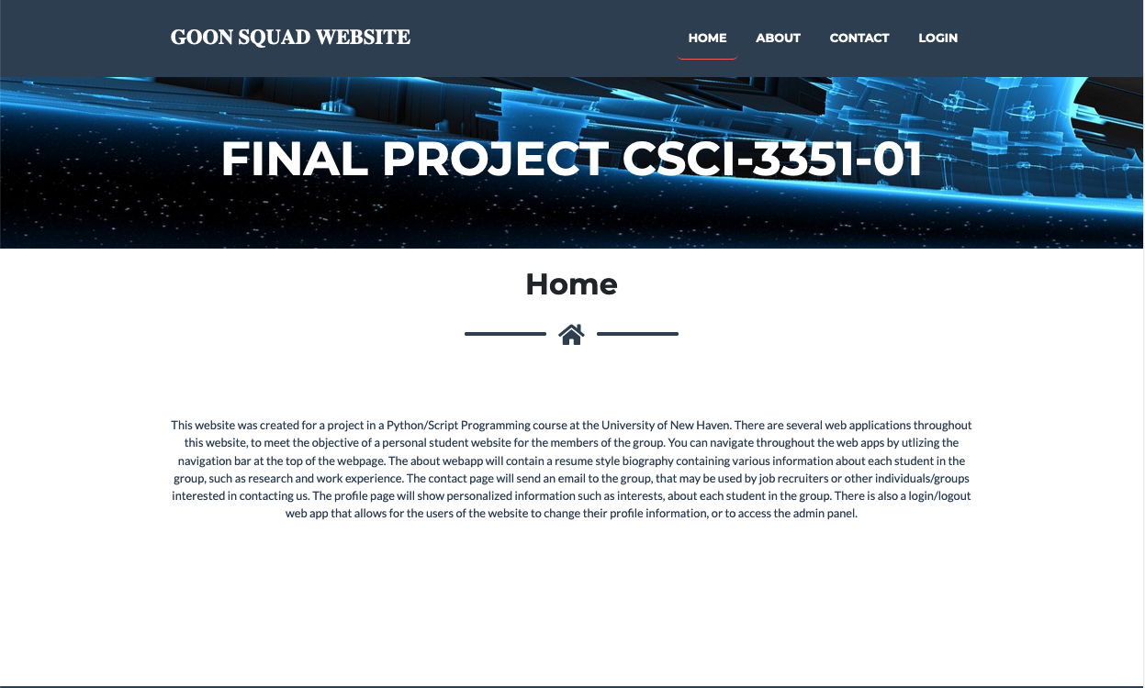

Slide 4
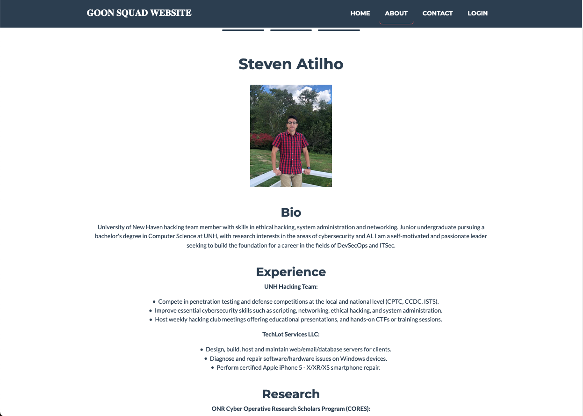
About Page

Slide 5
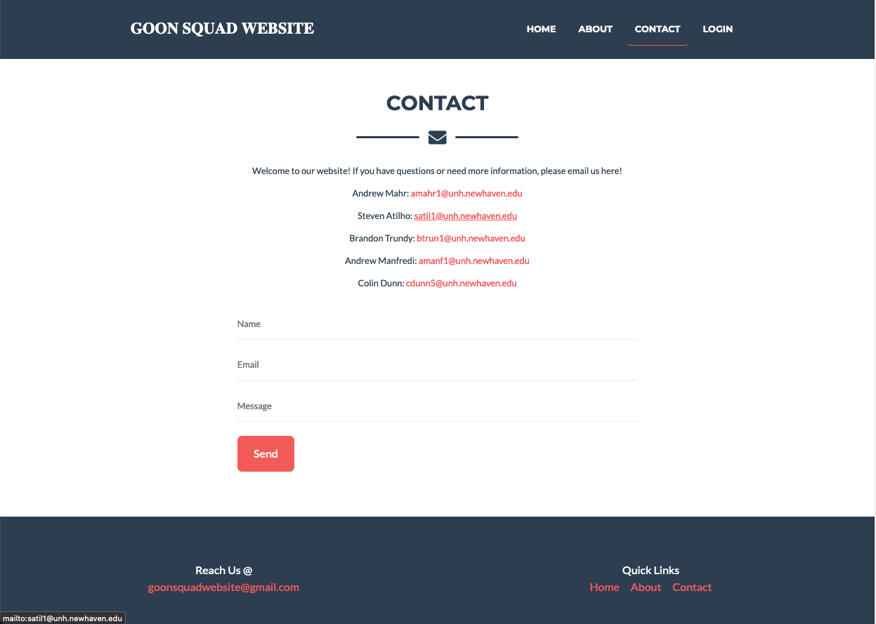
Contact Page

Slide 6
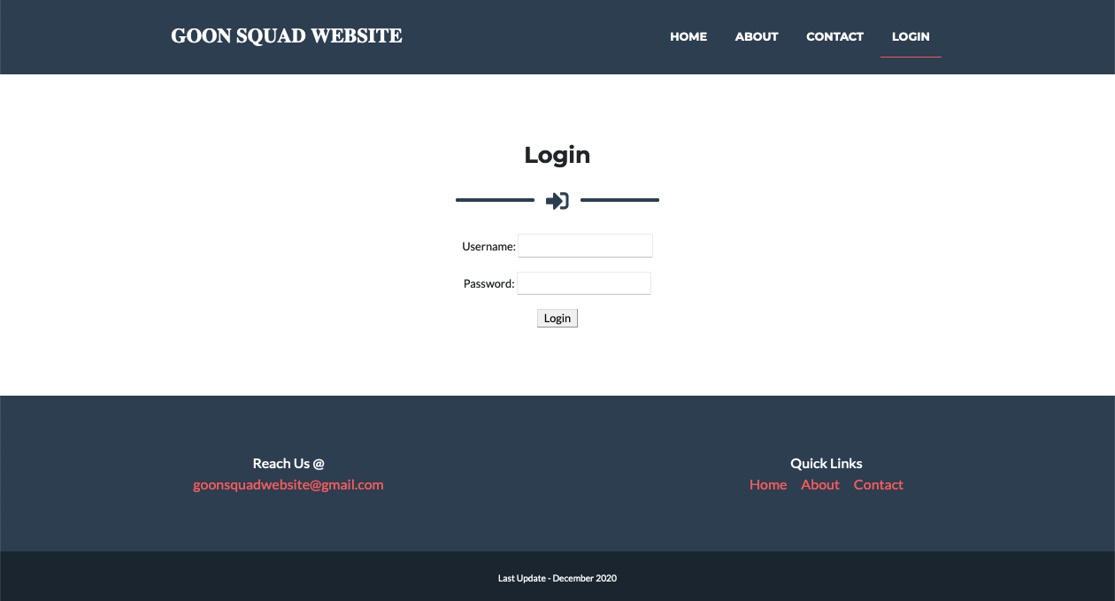
Login/Logout Portal

Slide 7
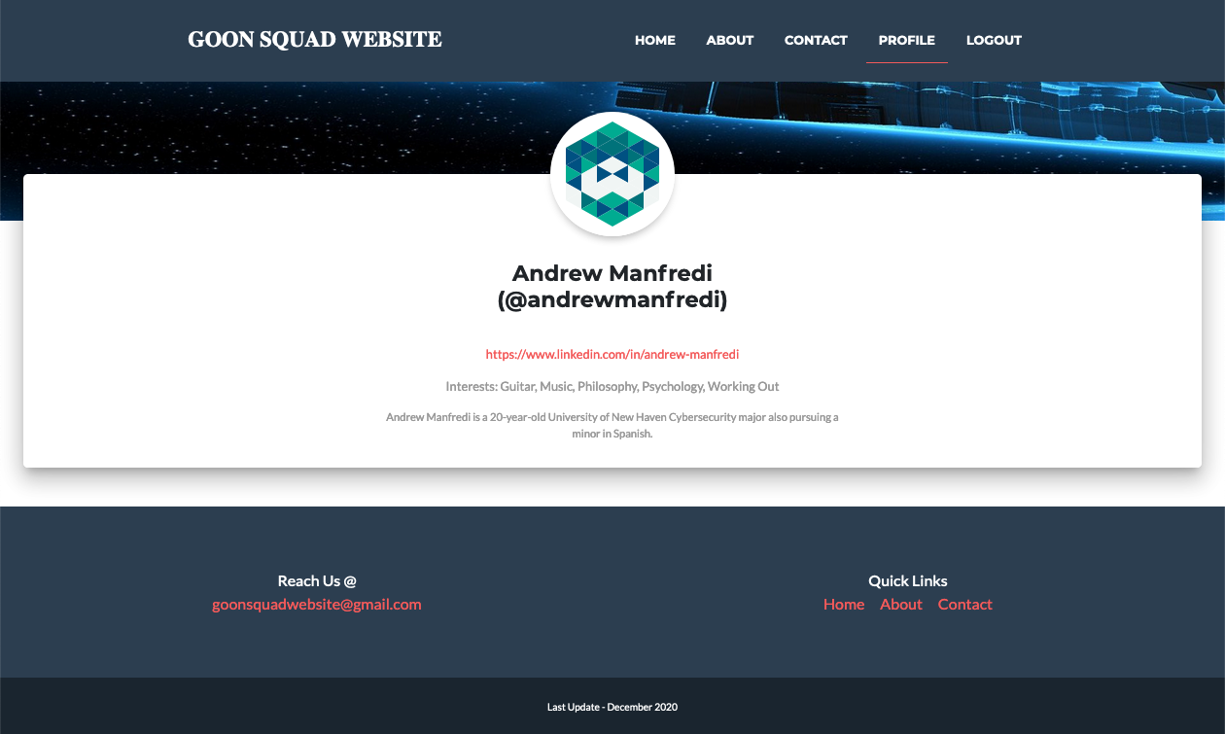
Profile Page

Slide 8
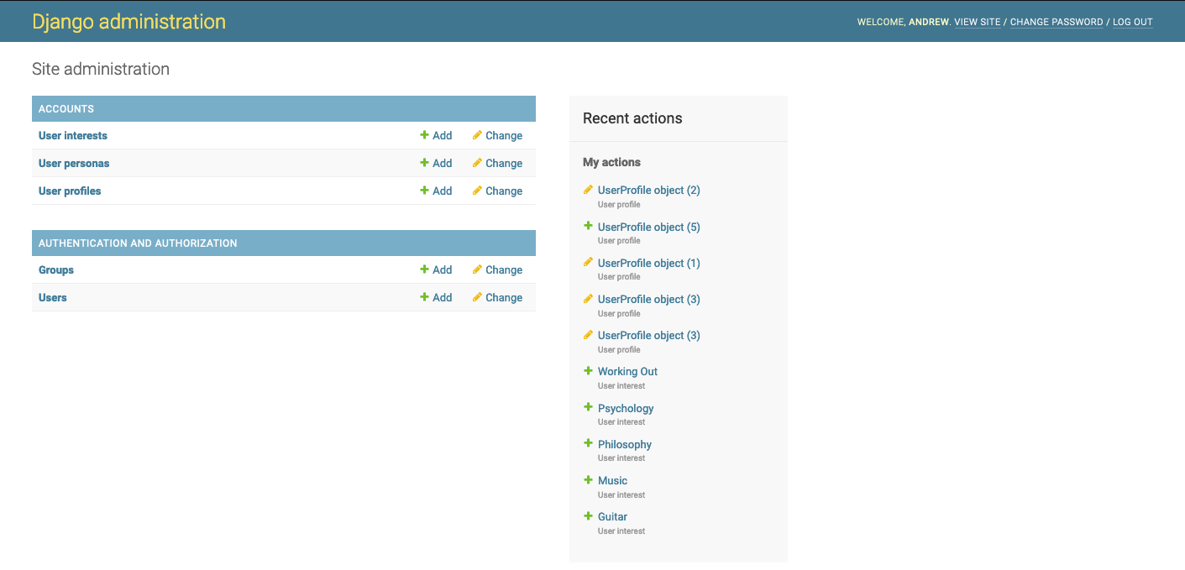
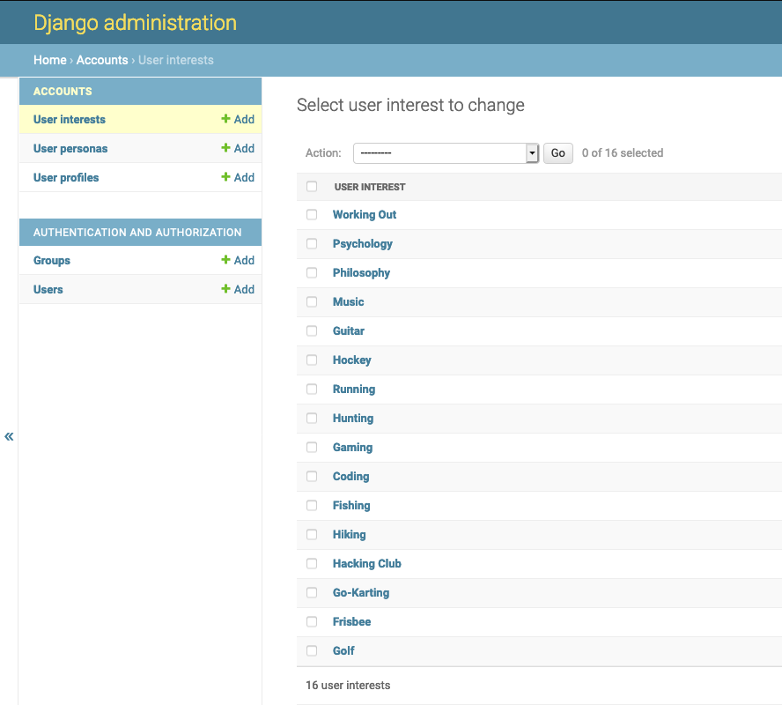
Django Admin portal

Slide 9
Design and code implementation
Postgres Database – used to store account data such as logins, permissions, user interests and personas, etc...
Docker – used to run website in a container from anywhere
Docker commands helped automate the setting up of commands and taking care of ensuring everything is started and removed when finished
Django – Used as the shell and the framework for the website.
Authentication features and login portals
Visual Studio Code – used to collaborate and create the files necessary for the website

Slide 10
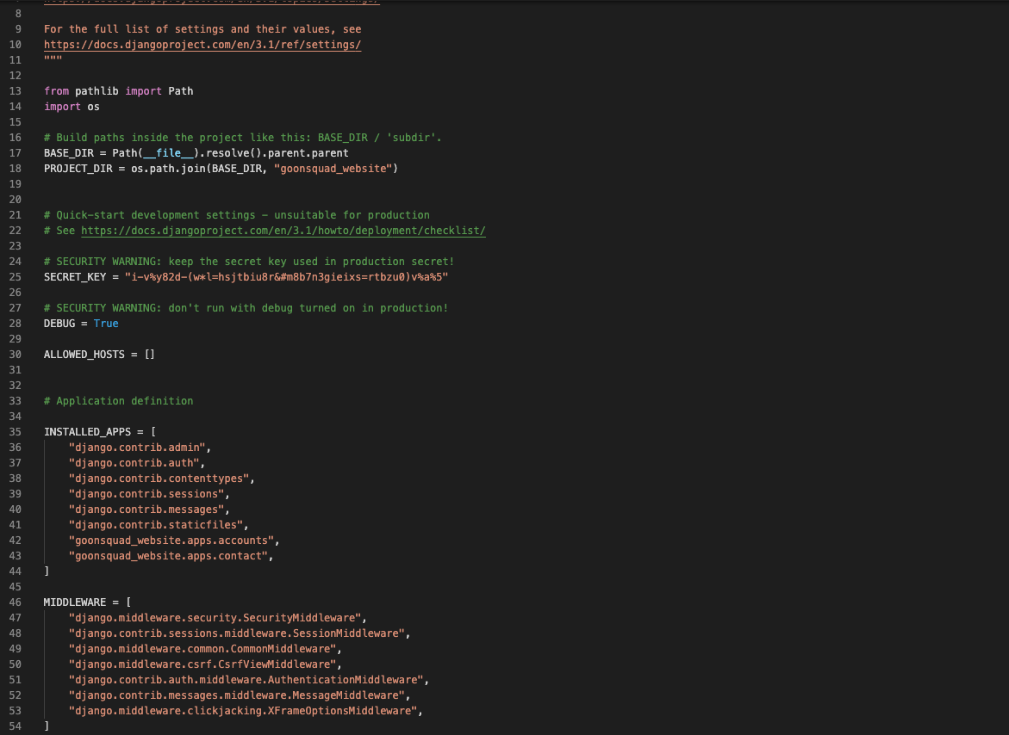
PYthon Code/Settings

Slide 11
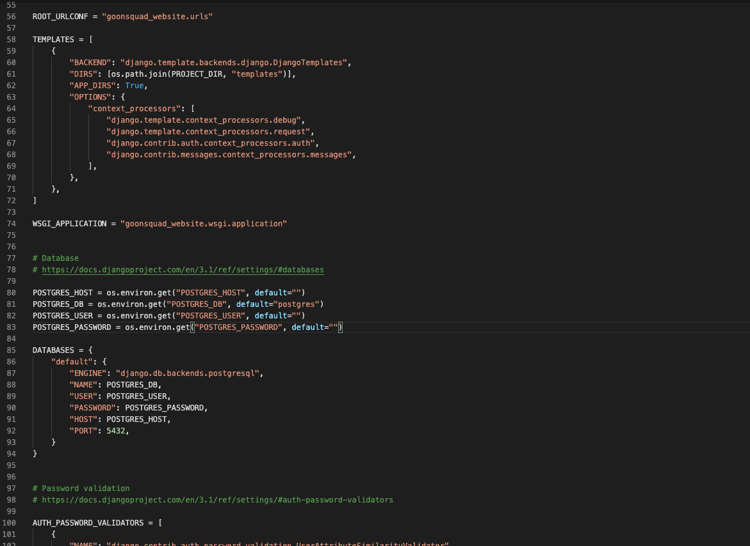
PYthon Code/Settings

Slide 12
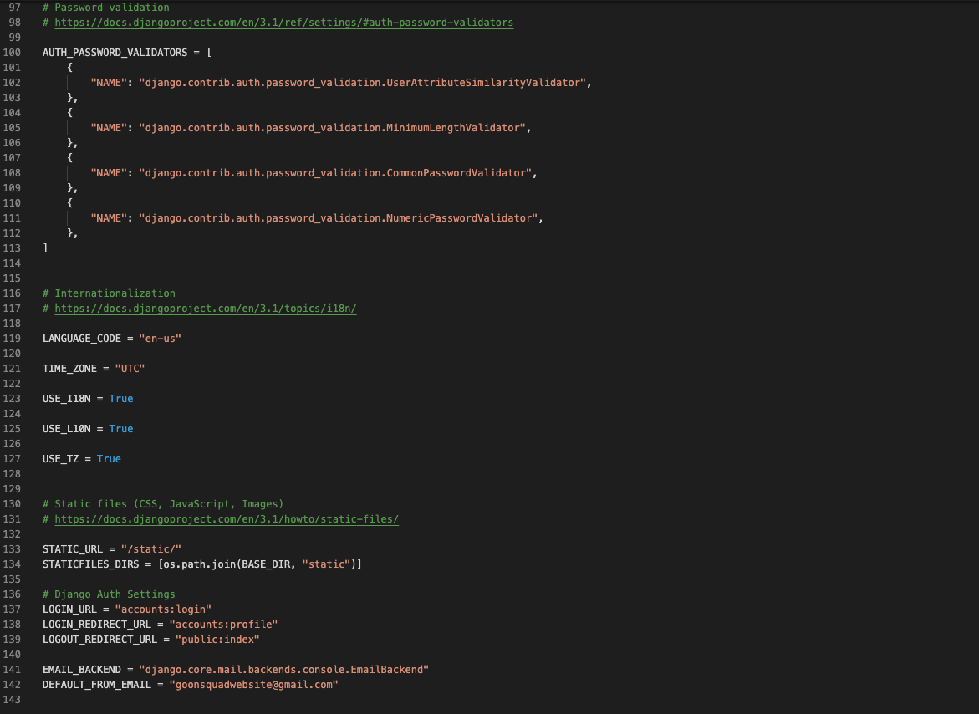
PYthon Code/Settings

Slide 13
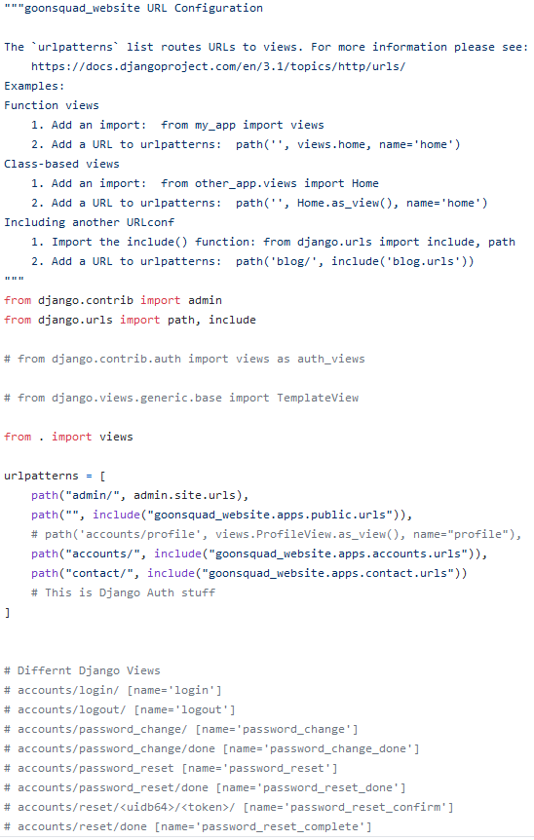
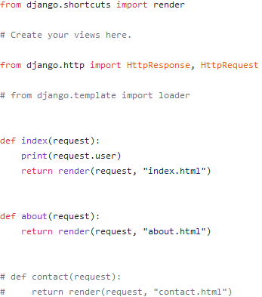
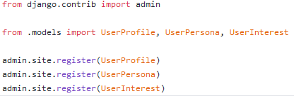
PYthon Code/Views
PYthon Code/URLS
PYthon Code/Admin

Slide 14
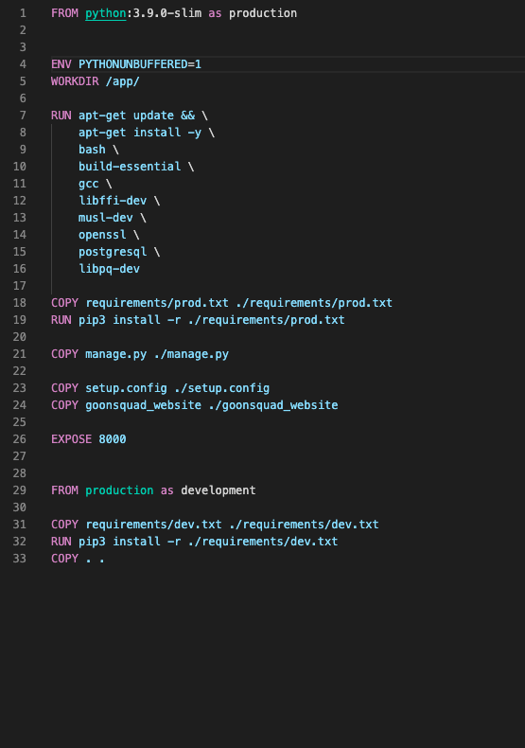
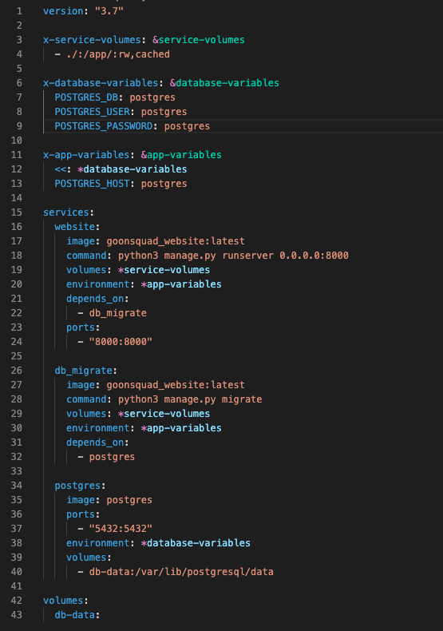
Docker
Docker-Compose

Slide 15

DEMO

Slide 16
Any Questions?

