Slide 1
Python Course Elementary
Lecturer: Reza Lotfi

Slide 2
Contents
00-Introduction
01-Python Object and Data Structure Basics
02-Python Comparison Operators
03-Python Statements
04-Methods and Functions
05-Numpy
06-Pandas
07-Matplotlib

Slide 3
00-Introduction
Curriculum Overview
Python 2 vs Python 3
How to Approach this Course
Jupyter Notebook
Learning Recourses
Git and GitHub

Slide 4
01-Python Object and Data Structure Basics
Numbers
Strings
Lists
Dictionaries
Tuples
Files
Sets
Booleans
Quizzes after each individual lecture
After all the lectures, There is going to be a test

Slide 5
02-Python Comparison Operators
Basic Operators
Chained Comparison Operators
Quiz

Slide 6
03-Python Statements
If, elif, and else
For loops
While loops
Range()
List Comprehensions
Assessment Test

Slide 7
04-Methods and Functions
Methods
Functions
Lambda Expressions
Nested Statements
Scope
Homework Assignment

Slide 8
First Project

Slide 9
05-Numpy
NumPy Datatypes and Attributes
Arrays and Metrics
Random Seed
Manipulating Arrays
Standard Deviation and Variance
Reshape and Transpose
Dot Product vs Element Wise
Comparison Operators
Sorting Arrays
Turn Images Into NumPy Arrays

Slide 10
06-Pandas
Selecting and Viewing
Manipulating Data

Slide 11
07-Matplotlib and Seaborn
Scatter Plot And Bar Plot
Histograms And Subplots
Data Visualizations
Customizing Your Plots

Slide 12
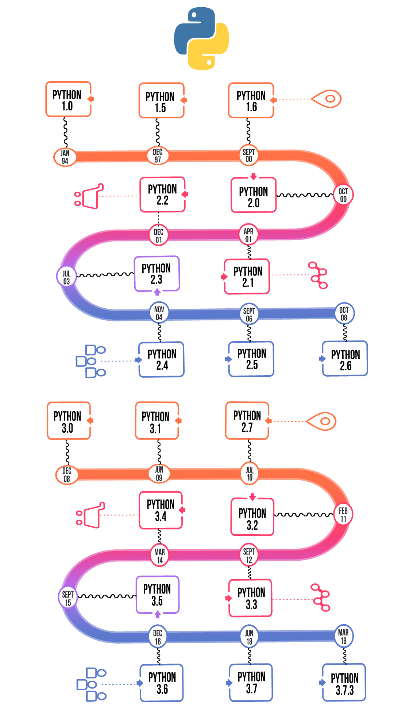
Brief History
Created in 1990 by Guido van Rossum
Python 3 released in 2008
Latest Version: 3.10.8

Slide 13
Why python
Easy to read and easy to learn
Less code
Scopes based on white space
Lots of existing libraries (math-random-…)
Optimizing developer time not the computation time
Great Documentation Online (docs.python.org/3)
Automate simple tasks (searching for files-reading and editing excel files- work with PDFs-…)
Data Science and Machine Learning (Pandas-Numpy-Matplotlib- Seaborn)
Create a website

Slide 14
Installations
To install python we will use Anaconda Distributer
Includes python
Includes many other useful libraries
Easily installed on Windows-MacOS or Linux

Slide 15
How to Get Help
Check the Recorded file and Notebooks
Google it
Stack overflow
Python Documentation
Ask in the Chat we have

Slide 16



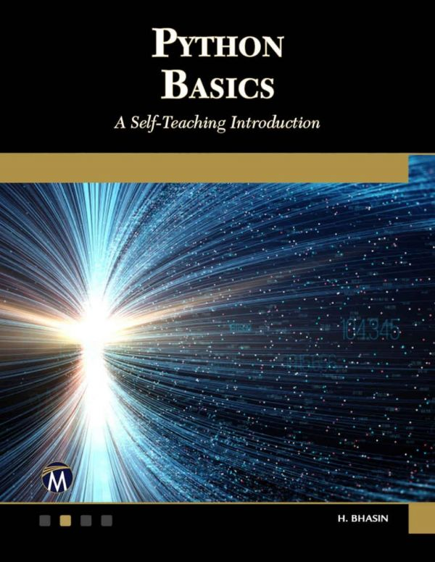
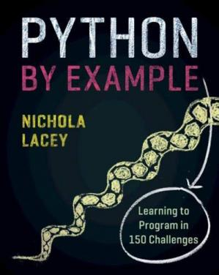
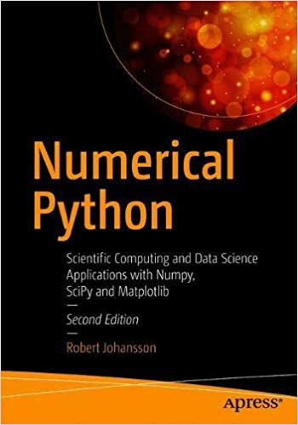
Recourses
Books | Online Platforms
Python Basics: A Self-Teaching Introduction | Udemy.com
Numerical Python: Scientific Computing and Data Science Applications with Numpy, SciPy and Matplotlib | Coursera.org
Python by Example - Learning to Program in 150 Challenges | Downloadly.ir

Slide 17

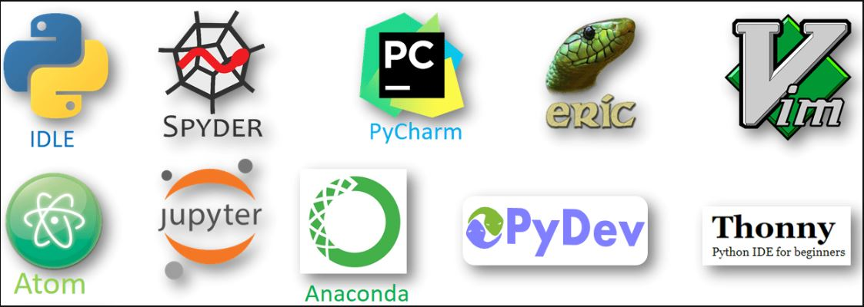

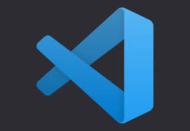
Environment
Code Editors | Coding Environments | IDEs
Sublime Text | Python IDLE | Visual Studio Code | Spyder
ATOM | Jupyter Notebook | Eclipse+ PyDev | Thonny
Vi / Vim | Google Collaboratory | PyCharm | eric

Slide 18
Code Editors
Code Editor is basically a text editor that is used to write and edit code. They are lightweight, fast, easy to install and great for learning. However, once your program gets larger, you need to test and debug your code, in that case, you can use an IDE.
Integrated Development Environment (IDE)
An IDE (Integrated Development Environment) understands your code much better than a text editor. IDE is basically a development environment that consists of multiple features that are used for developing and testing the software. You will find all of them in one place making life easier for developers. However, IDEs can be complicated to use. So, it depends – if you really need an IDE for your program.

Slide 19
List and Background of Students
Name | Coding Background | Education | Comment
Hasan Shaghaghi | No Coding background | MSc of Geology | In Person- Online
Ayda Attari navab | No Coding Background | PhD in Chemistry | In Person
Fateme Rezaei | Only Advanced Pascal | PhD in Exercise Physiology | In Person
Fateme Bardestani | A bit Familiar | MSc of Mechanical Engineering | In Person
Mohammad Hosein Qaed Sharaf | Matlab | PhD in Mechanical Engineering | Online
Mohammad Kahe | C#, Java | MSc of Computer Science (Data Mining) | Online
Mohammadreza Faraji | C++ , VB, Matlab | MSc of Mechanical Engineering | In Person
Masoumeh Moradi | No Coding Background | MSc Of Tech Management | In Person
Mostafa Rajabzadeh | Advance C++ and qml in Qt platFrom | PhD Student in software Engineering | Online
Peyman Arefi | A bit Familiar | MSc of Civil Engineering | In Person

Slide 20
Lets Dive into Coding

