Slide 1

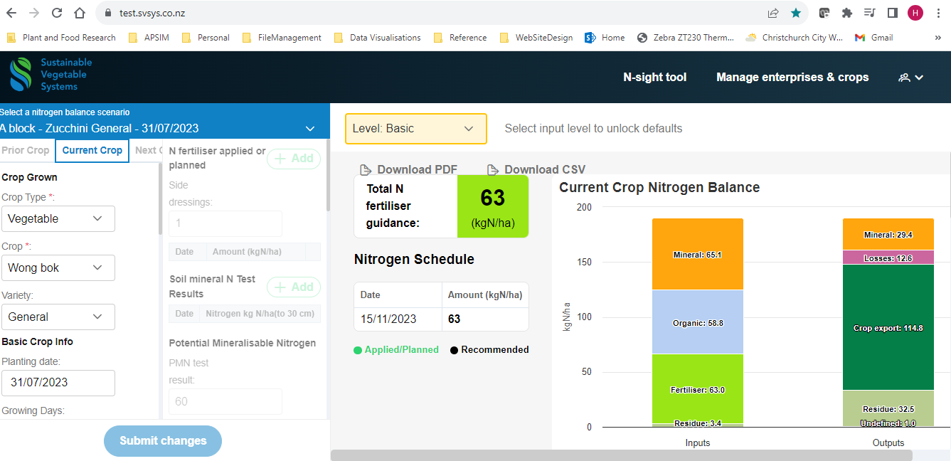
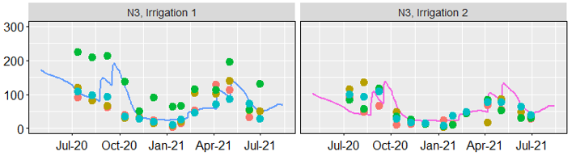
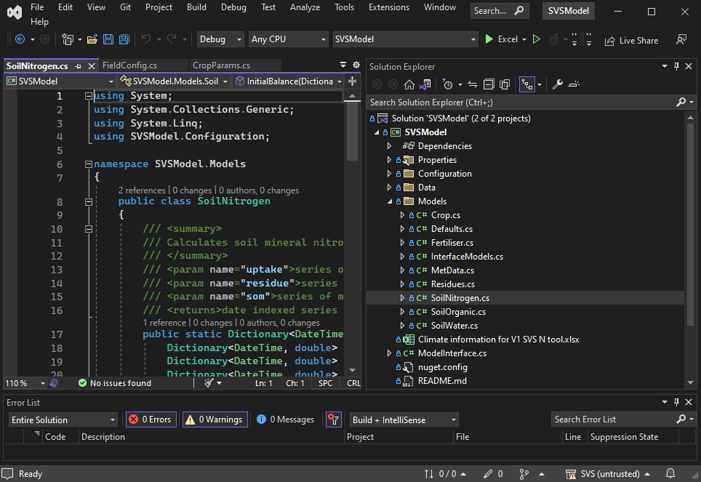
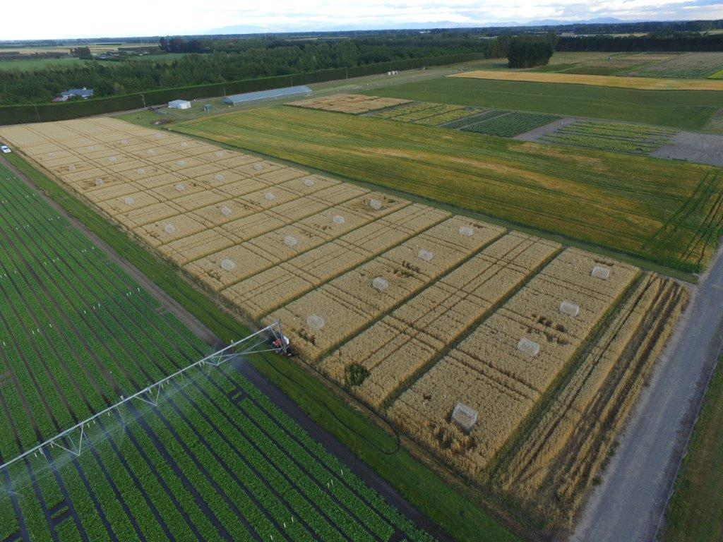
Soil test
results
Fertiliser
Requirements
Estimated
Right amount of N
at the right time
Lit review
Crop
Information
https://test.svsys.co.nz/
Model Validation
SVS nutrient
management tool
Process
abstraction
Process
model
testing
Testing System
N balance improvement
Leaching, Gaseous losses,
Residues, scheduling, coeffs
Evaluate
Nitrogen
balance
Coefficients
Pull request
Configuration
Data analysis
Model Code
WS1 & 2 field
Observations, site
and management data
API
Test
data
NuGet
https://github.com/
PlantandFoodResearch/SVS

Slide 2
To do list
Crop coefficients
Potato cultivars
Veges
APSIM testing
Data cleaning
Leaching calculations
Model evaluation
newSCRUM
API model testing
WS1 and 2 configurations
Model runner
Result evaluation
Web App role out
Testing
Bug fixes
Review defaults
N Balance model improvements
Residue mineralisation
Leaching
De/Nitrification
Scheduling rules

