Slide 1
Design and Development of Doctor’s Appointment System Based on Patient Location
Presented By:
Session : 2013-14
Session : 2013-14
Class Roll : 1453
Class Roll : 1455
Reg. No : 13502000498
Reg. No : 13502000464

Slide 2
Introduction
By this system we can book doctors appointment in anywhere
in Bangladesh.
By this system user can able to book doctor’s appointment from
nearest doctor’s chamber.
By this system user can able to find doctor based on users
location.
Doctor can follow patient’s condition by this system.
This system can store patient information for farther use.

Slide 3
Motivation
People don’t know where & when they book appropriate
doctor’s appointment .
People don’t know about doctor’s Qualification or Degree.
Patients have to wait long time for doctors appointment
Sometime a patient can not get appointment in the nearest
hospital or the nearest doctor’s chamber at the necessary time.
Existing appointment system are more complex.
Increase of Broker in public hospital
Increasing patient

Slide 4
Existing System Overview
Appointment system use in single hospital
Hospital management system use for single hospital
Hospital website
Doctor’s website or Facebook page

Slide 5
Fact Findings
Problem
Problem with finding nearest doctors or Hospital
Problem with book appointment on emergency
Appointment delay
Proposed solution
“Doctor’s Appointment Booking System Based on patient Location”

Slide 6
Features of The Proposed System
People can book appointment anywhere in Bangladesh.
By using this system we find nearest Doctor’s or Hospital for
appointment.
This system can store patients diagnosis report also.
User can search for doctor’s help at any point of time.
User can talk about their illness and get instant diagnosis.
User can update there condition in this system.
Doctor’s can follow the patient condition

Slide 7
Proposed System Design
Block diagram of system module
Flow Chart
Data flow diagram (DFD)
Entity relationship diagram(E-R)
Use case diagram

Slide 8
Block Diagram of System Modules
Administrative Modules
Patient Login
Patient Registration
Patient Details
Edit Patient details
Search Doctor
Search by location
Get appointment
Patient Modules
Add doctor’s
View doctor’s
Add patient
View Patient
Add Department
View Department
Make Appointment
Doctor Modules
Doctor Login
Doctor registration
Edit patient record
View patient
Update patient diagnosis
Follow-up patient

Slide 9
Flow Chart
Start
Patient Registration and login
Select Doctor In your location and select Appointment Slot
Authentication
DB
Check Availability of appointment slot
No
Yes
Input patient details &
Previous report
Store Information
Contract With doctor’s
Book Doctor’s Appointment
END

Slide 10
Data Flow Diagram(DFD) DFD Level 0
Doctor’s Appointment System Based on Patient Location
Input
Output

Slide 11
DFD Level 1
User Details
Select Doctor’s
Doctor’s Appointment System Based on Patient Location
Appointment Details
Appointment book
Database

Slide 12
DFD Level 2
Search by
Doctor
Department
Location
id
Doctor’s Appointment Booking System Based On Patient location
Doctor’s Name
Select Doctor
Appointment Booking
Date & Time
Patient Details
Location
Date
Department
Doctor
Date

Slide 13
E-R Diagram
Name
User_name
update
delete
Id
password
Gender
Administration
Admin
user
Date_of_birth
Location
id
Date
name
Doctors
id
time
Schedule
Appointment
Department
Database

Slide 14
Use Case Diagram
Login
Authentication
Patient
0
Visit
Get Permission
System Control
View Profile
Get Contact of related doctors
Doctor
0
Update & upload data
System Database
Search Doctor
Get
appointment
Follow up patient

Slide 15
Tools
Frontend
HTML5
CSS3
JavasScript
Backend
PHP
MySQL server
Apache server
JQuery
SQL

Slide 16
System Comparison
Old System | New System
Search doctor in hospital . Book appointment in single hospital . System have patient’s and admin activities. | Search doctor by name, department, location and hospital. Book appointment in anywhere in Bangladesh. Send appointment information to patient by mail. System have admin, doctor and patient’s activities. Patient information follow by any doctor or hospital.

Slide 17
Features Comparison Table
Features | Existing System | Proposed System
System login & registration
View Doctor’s
Book appointment
Patient’s activities
Admin activities
Doctor’s activities | X
Book appointment in any hospital | X
Book appointment in nearest Doctors | X
Patient diagnostic report stored for farther user | X
Patient follow up | X

Slide 18
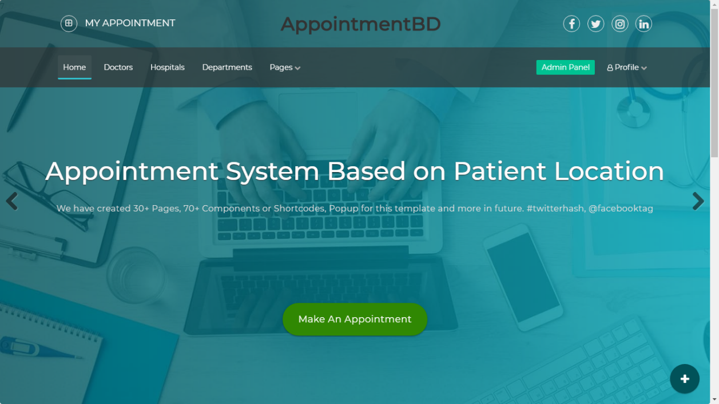
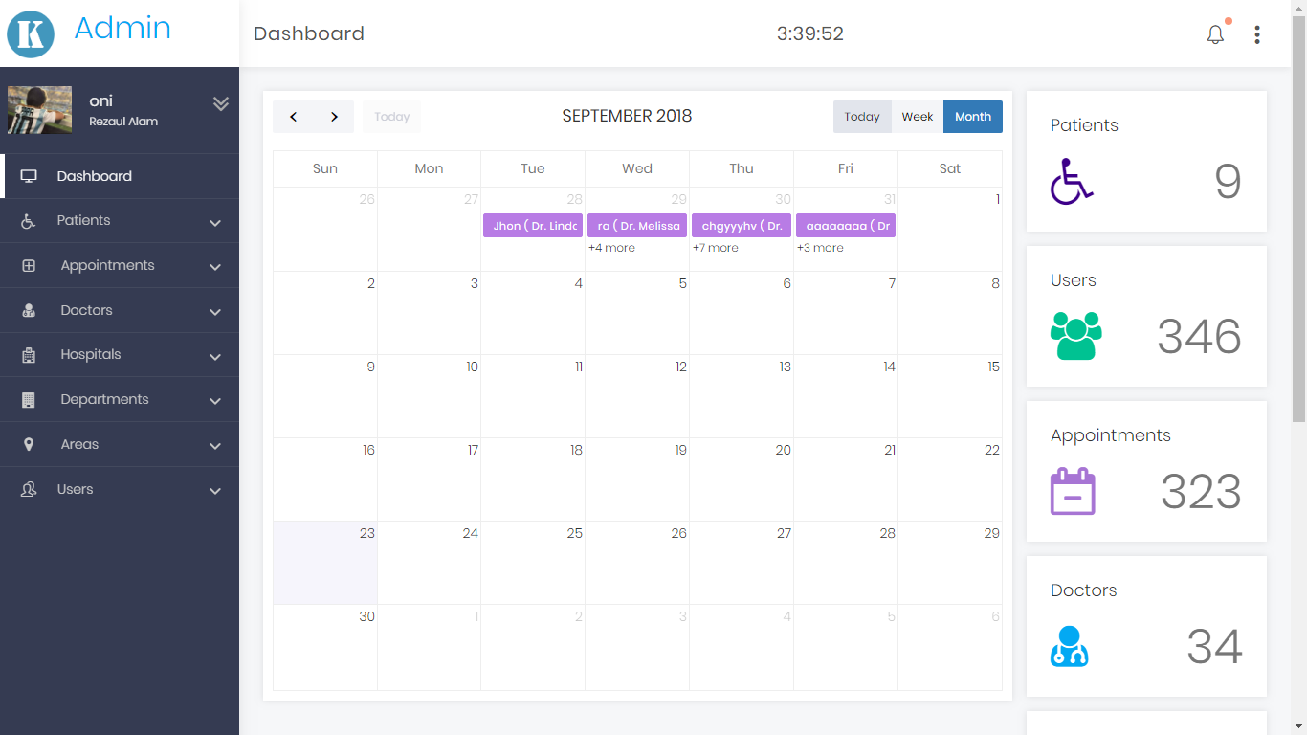
Implementation

Slide 19
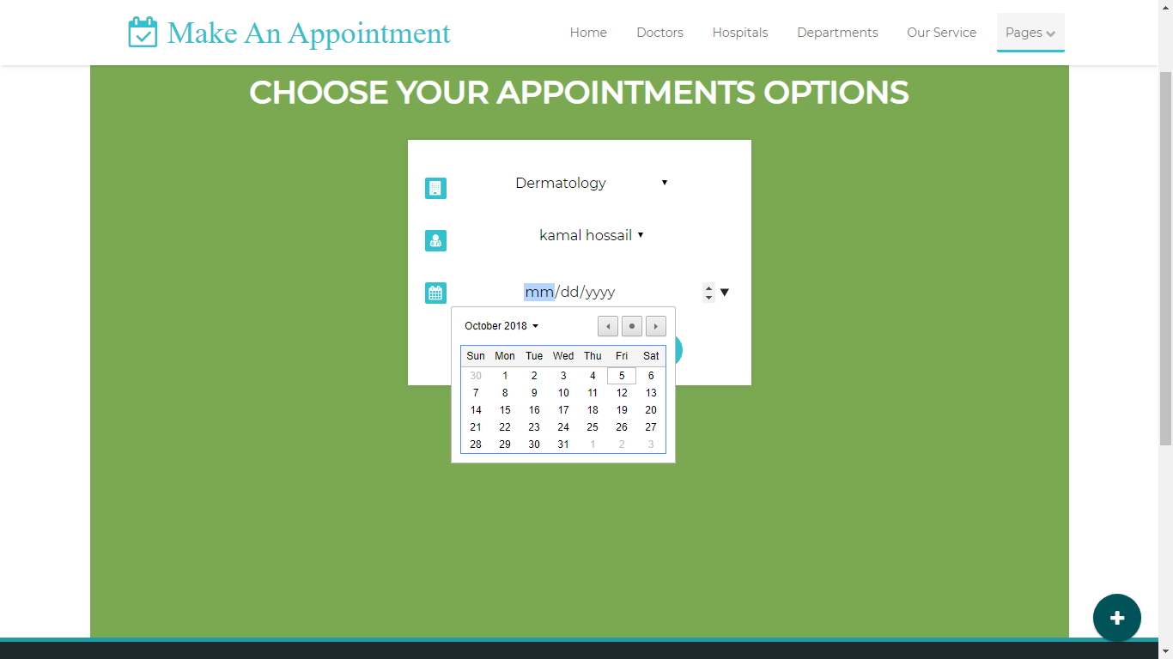
Appointment Booking Page

Slide 20
Testing (Test Case)
Se. No. | Test Objectives | Test Process
1 | Check Database Connection | http://localhost/phpmyadmin Create a database in this server Enter database username Enter database password Enter database name
2 | Check Patient & Doctor Registration Form | http://appointment.bd/register.php Enter full name, Enter a unique Gmail address, Enter phone, Select address location, Choose gender, Enter password , Click for submit
3 | Check Patient & Doctor Login Credentials | http://appointment.bd/login.php Enter Email address Enter password, Click for submit
4 | Check Admin Login Credentials | http://localhost/qb Enter username Enter password

Slide 21
Check Database Connection
TEST CASES | TEST DATA | EXPECTED RESULT | ACTUAL RESULT
Valid server name, username, password, database name | Localhost, root, NULL, doctors | Successful database connection | Successful
Valid server name, invalid username, password, valid database name | Localhost, boot, NULL, doctors | Unsuccessful database connection | Failed
Invalid server name, valid username, password, database name | Publichost, root, NULL, doctors | Unsuccessful database connection | Failed
Valid server name, username, password, invalid database name | Localhost, root, NULL, bank | Unsuccessful database connection | Failed

Slide 22
Check Patient Registration Form
TEST CASES | TEST DATA | EXPECTED RESULT | ACTUAL RESULT
First Name, last name, Valid Gmail, phone, location, blood group, password, gender, role First Name, last name, invalid Gmail, phone, location, blood group, password, department, gender, role First Name, last name, Valid Gmail, phone, location, blood group, password, department, gender, role | Rezaul Alam ,oni@gmail.com, +8801687855988, Dhanmondi, A+, 123456, Male, patient Rezaul Alam ,oni.com, +8801687855988, Dhanmondi, A+, 123456, Male, patient Kamrul Alam ,oni@gmail.com, +8801687855988, Dhanmondi, A+, 123456, Male, patient | Registration Successful Registration Unsuccessful Gmail already taken, please registred | Successful Failed Failed

Slide 23
Check Doctor Registration Form
TEST CASES | TEST DATA | EXPECTED RESULT | ACTUAL RESULT
First Name, last name, Valid Gmail, phone, location, password, department, gender, First Name, last name, invalid Gmail, phone, location, password, department, gender, First Name, last name, Valid Gmail, phone, location, password, department, gender, | Dr. Abu Ahsan ,ahsan@gmail.com, +88099999999, Dhanmondi, 123456, Oncology, male Dr. Abu Ahsan ,gmail.com, +88099999999, Dhanmondi, 123456, Oncology, male Dr. Abu ,ahsan@gmail.com, +88099999999, Dhanmondi, 123456, Oncology, male | Registration Successful Registration Unsuccessful Gmail already taken, please choose another one | Successful Failed Failed

Slide 24
Check Patient & Doctor Login Credentials
TEST CASES | TEST DATA | EXPECTED RESULT | ACTUAL RESULT
Correct Gmail & password Correct Gmail & incorrect password Incorrect Gmail & correct password Incorrect Gmail & password | oni@gmail.com, 123456 oni@gmail.com, tttttt$$#% oni32@gmail.com, 123456 ongmail.com, 123456 | Login Successful Wrong password Email is not registered Invalid email | Successful Failed Failed Failed

Slide 25
Check Admin Login Credentials
TEST CASES | TEST DATA | EXPECTED RESULT | ACTUAL RESULT
Correct Username & password Correct Username & incorrect password Incorrect Username & correct password username & Incorrect password | oni123 ,123456 oni123 , tttttt$$#% oni1 , 123456 oni123 , 123 | Login Successful Wrong password Username is not registered Invalid password length | Successful Failed Failed Failed

Slide 26
Conclusion
This web base system help the people to book
appointment near there location .
This system help the people to know about doctors and
Hospital and select for appointment
This system will make easy the appointment system.
This system is develop across in our country.
Future Work

