Slide 1
Networking Task
Raymond Ezekiel

Slide 2
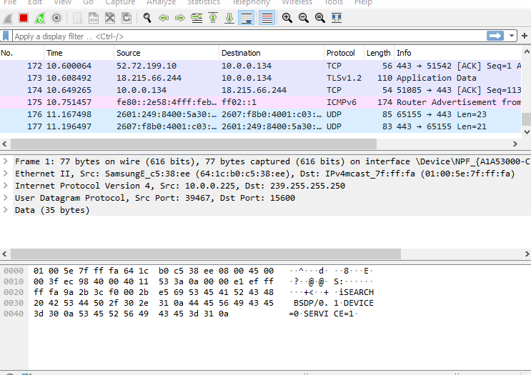
Wireshark

Slide 3
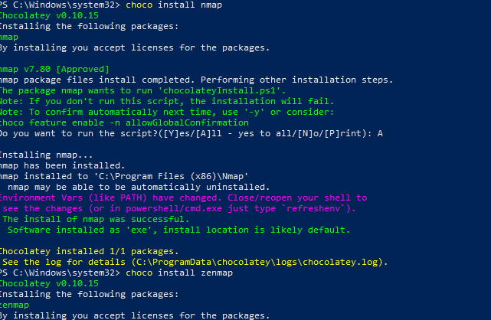
NMAP & ZENMAP

Slide 4
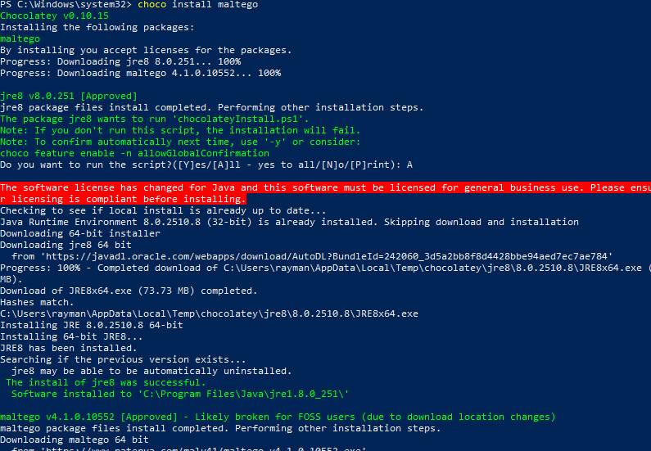
mALTEGO

Slide 5
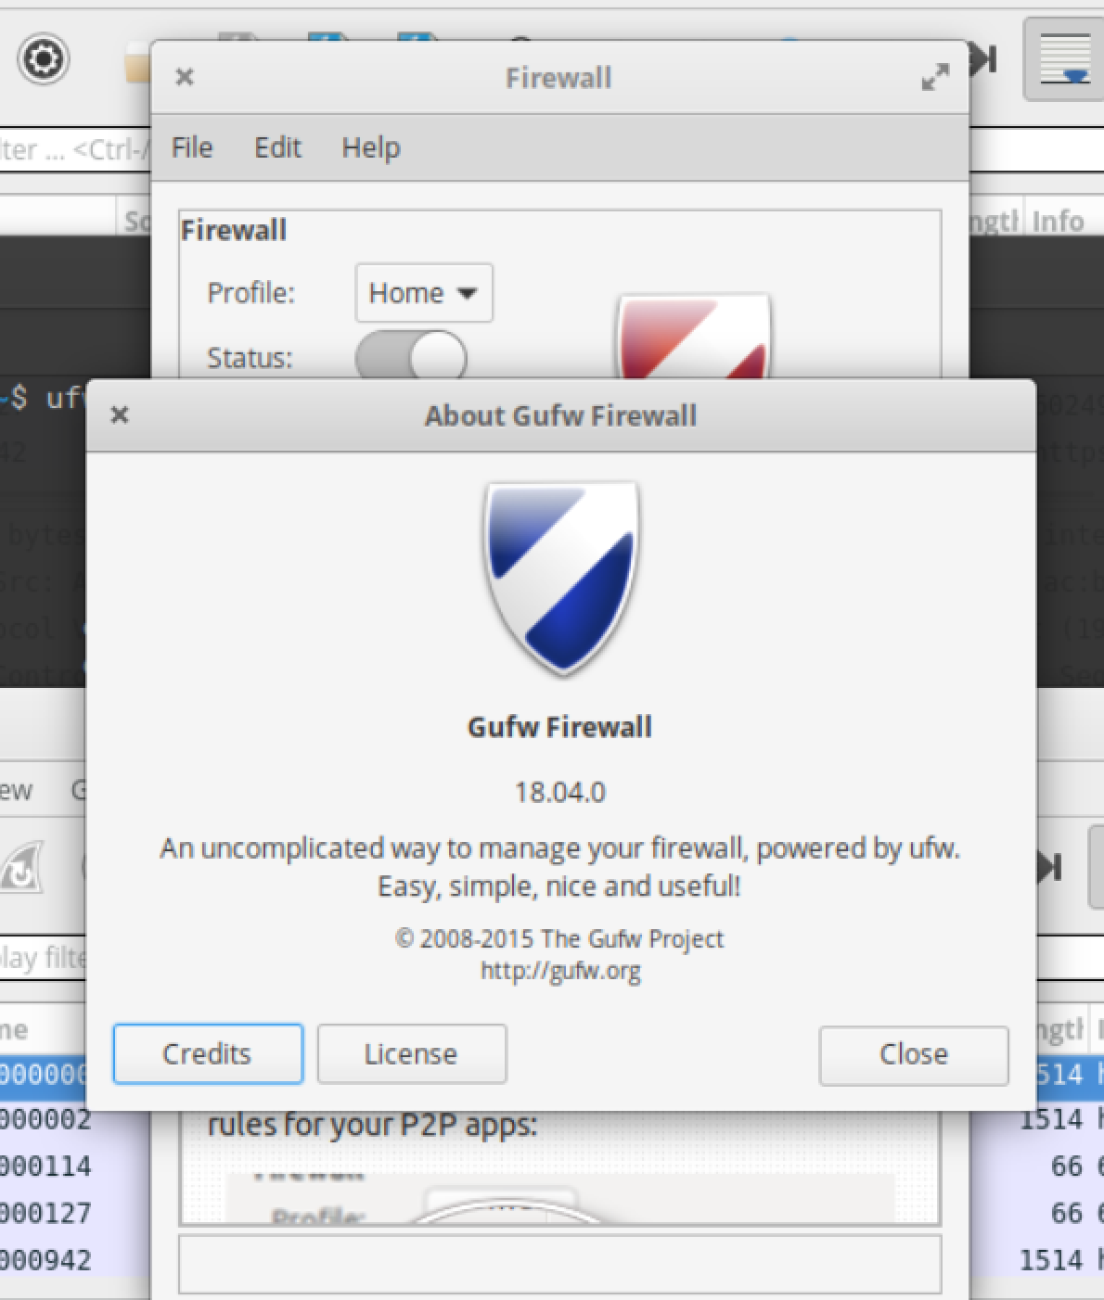
Gufw

