Slide 1
Hawk Pro Your College AI Assistant
Raymond Ezekiel

Slide 2
Mission Statement and Scope
This team will focus on a college AI assistant for students and professors.
College is known to be a struggle and a lot to handle for people who do not have the necessary management skills. Students are mostly frustrated with the platforms provided by schools, Blackboard for example. So, our mission is to provide a service that will give everyone an ease of mind. We are confident that college life will run smoother for students and professors once we deliver our app to them.
Google Home, Amazon Echo, and or Opensource Mycroft based assistant.
Coordinate department syllabi to be injected into application.
Create voice syntax for querying via voice and receiving spoken responses.
Focus on VI/VX (voice interface, voice experience) to make the service as friendly as possible.

Slide 3
Development Methodolgy
This project will utilize the Agitle testing model.
Scrum and Kanban-Trello/Slack
This method of testing has been chosen for its allowance of coding and testing to be done incrementally throughout the development phase to ensurea quality product that atisfies all customer requierments,
Methods of testing
User Acceptance Testing
Behavior-Driven Development (BDD)

Slide 4
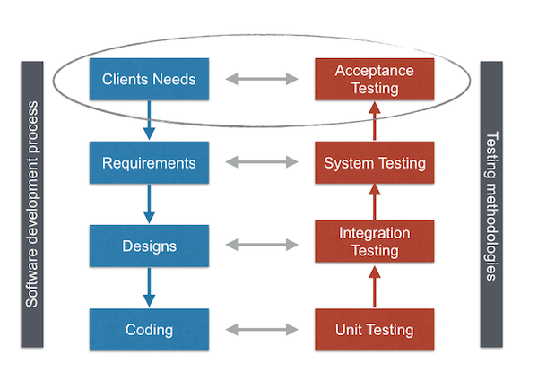

Testing
User Acceptant Testing(UAT)
Behavior-Driven Development (BDD)

Slide 5






Build
PHP JavaScript – NodeJS MongoDB Adobe XD Flutter Dart

Slide 6
Value
Cost
The value of this project is primarily for self –enjoyment, practice with technologies, implementation into student life and possible generation of income.

Slide 7
Monitor/Control
Quality Metrics

Slide 8
Cos

Slide 9
Summary
Status
This project is currently in it’s final stage of development. Finishing features need to be added and tested to meet objectives.
Retrospective (also called lessons learned or post mortem): If this project were done again, what would you recommend the team do differently?
In another instance of working on tis project the following would be done differently
Better foundational UX/UI design
Utilize Firebase for easy and better data implementation and management.
Utilize a different software to work on back-end code- Android Studio vs Visual Sudio
Possible deployment on a different platform such as web or
Allocate more time on backend code

