Slide 1
Pernod Ricard SA (RI FP)
Initiating Coverage · Spirits & Wine
BUY · Target €108 · Upside +68% · Current €64.14
Axone Equity Research | Prepared by Sabashvili Rezi | Juin 2026

Slide 2
Investment thesis: a quality franchise at a discount
Pernod trades at 8.1x EV/EBITDA versus a 12.4x peer median. This implies a ~24% discount despite holding the #2 global position and an ultra-premium portfolio (Jameson, Absolut, Martell).
Deep valuation discount
Q3 organic net sales returned to stability (+0.1%) after a soft H1. Management guidance of +3% to +6% organic growth per annum over FY27-29 offers clear visibility.
FY26 transition year
We project net debt/EBITDA falling from ~3.4x to ~2.0x by FY30. This is perfectly in line with the <3.0x target by FY29, supported by an ~80% cash conversion rate.
Clear deleveraging
Precedent transactions in the spirits sector have priced at a median 16.9x EV/EBITDA. A control-premium scenario yields an implied value well above our €108 target.
M&A floors valuation
Source: Company filings, Axone Equity Research estimates | Strictly Private & Confidential
2

Slide 3
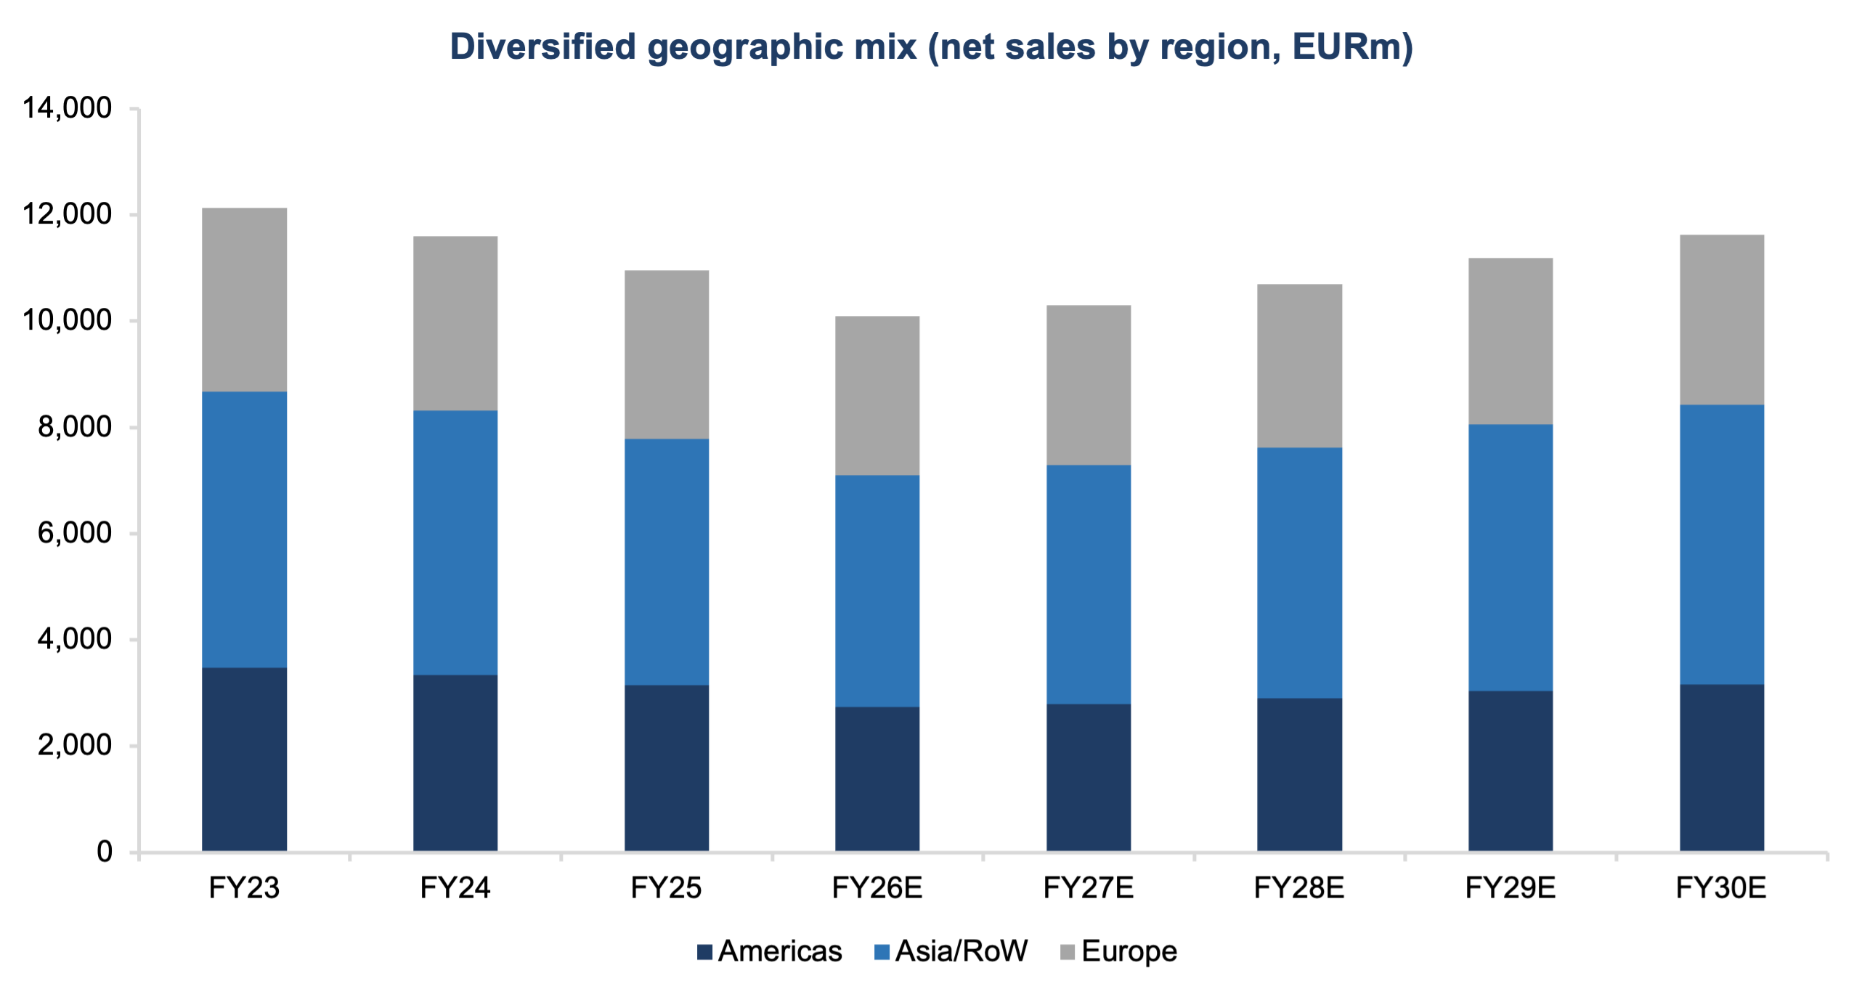
A diversified, premium global spirits leader
Key Takeaways
Global Footprint : Revenues are highly diversified across the Americas, Europe, and Asia/RoW, minimizing reliance on a single geographic market.
Premiumization Strategy : High exposure to premium and super-premium segments protects gross margins during inflationary cycles.
Strategic Focus : Continued rationalization of the portfolio (e.g., disposal of local wine brands) to focus exclusively on high-margin core spirits.
Source: Company filings, Axone Equity Research estimates | Strictly Private & Confidential
3

Slide 4
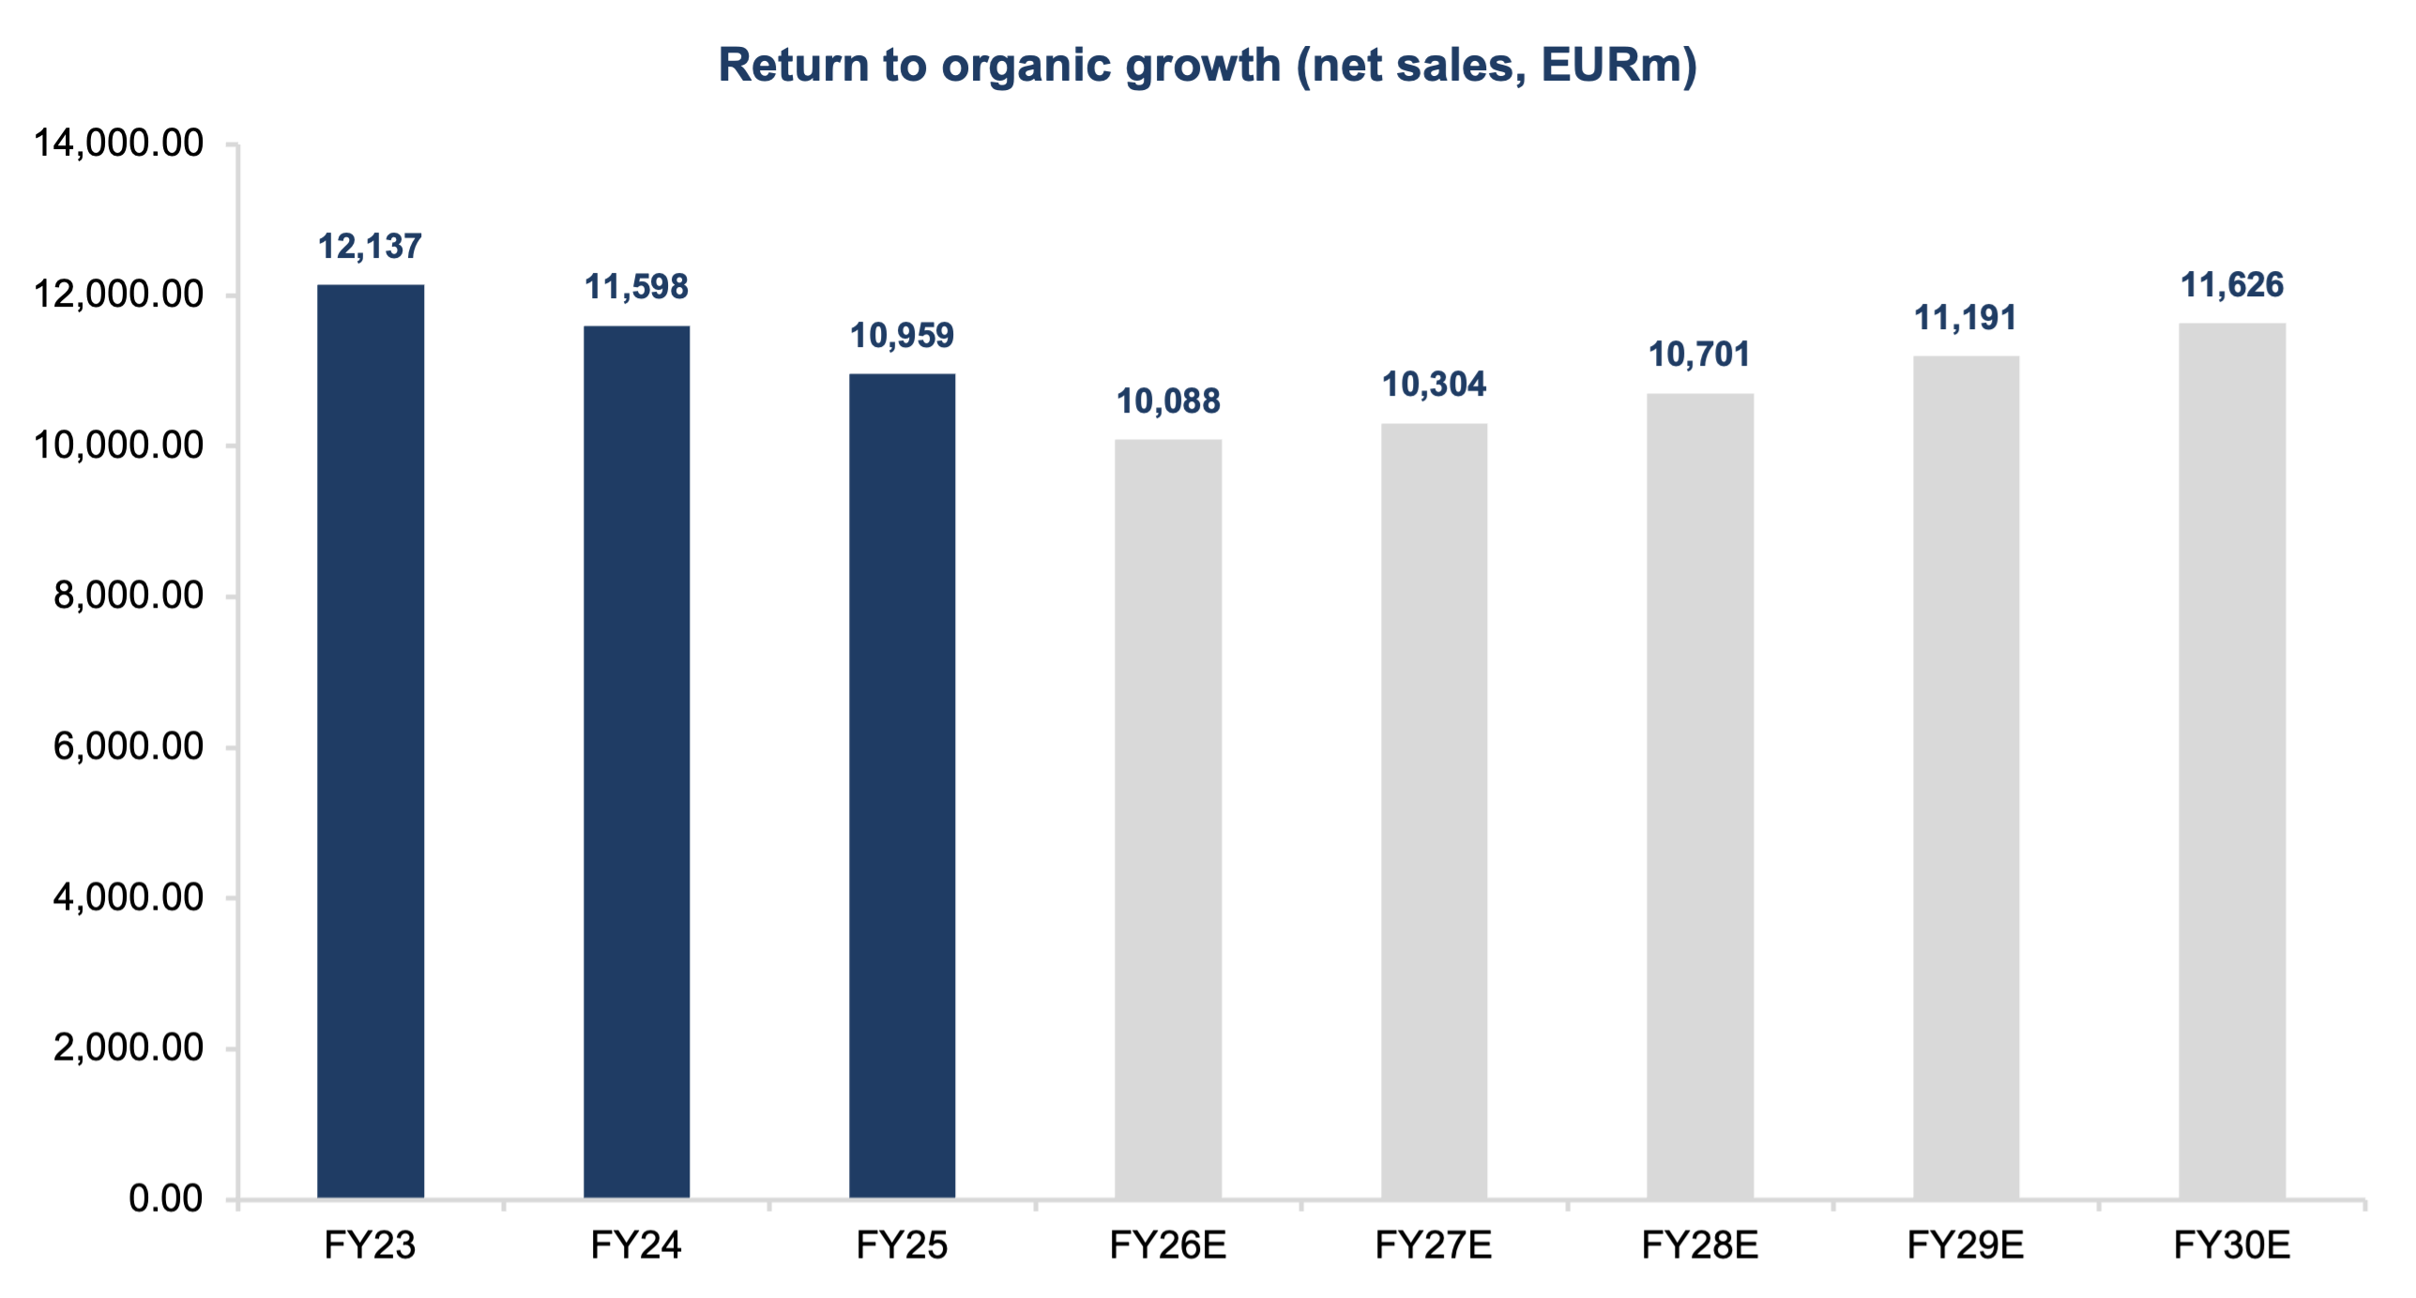
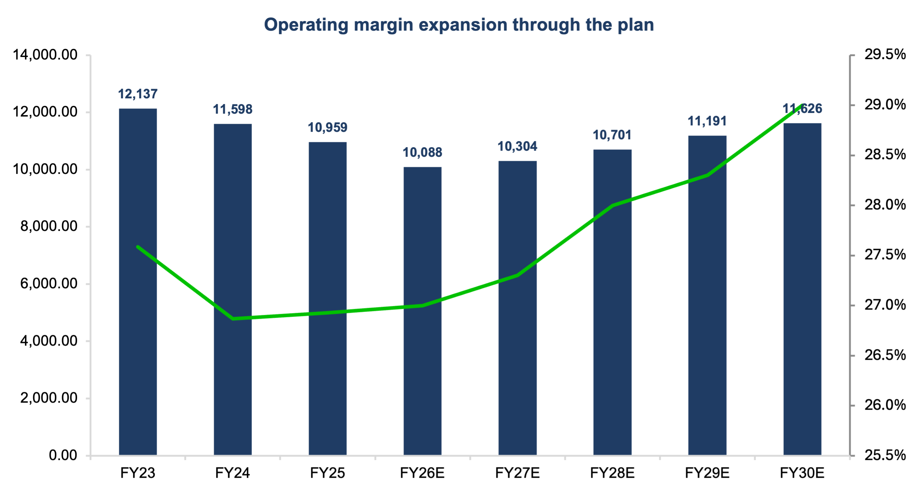
Returning to top-line growth with steady margin expansion
Takeaway: We model organic revenue growth stabilizing at ~4-5% from FY28, with gross margins expanding slightly to 60.0% by FY30 driven by positive price-mix and easing COGS.
Source: Company filings, Axone Equity Research estimates | Strictly Private & Confidential
4

Slide 5
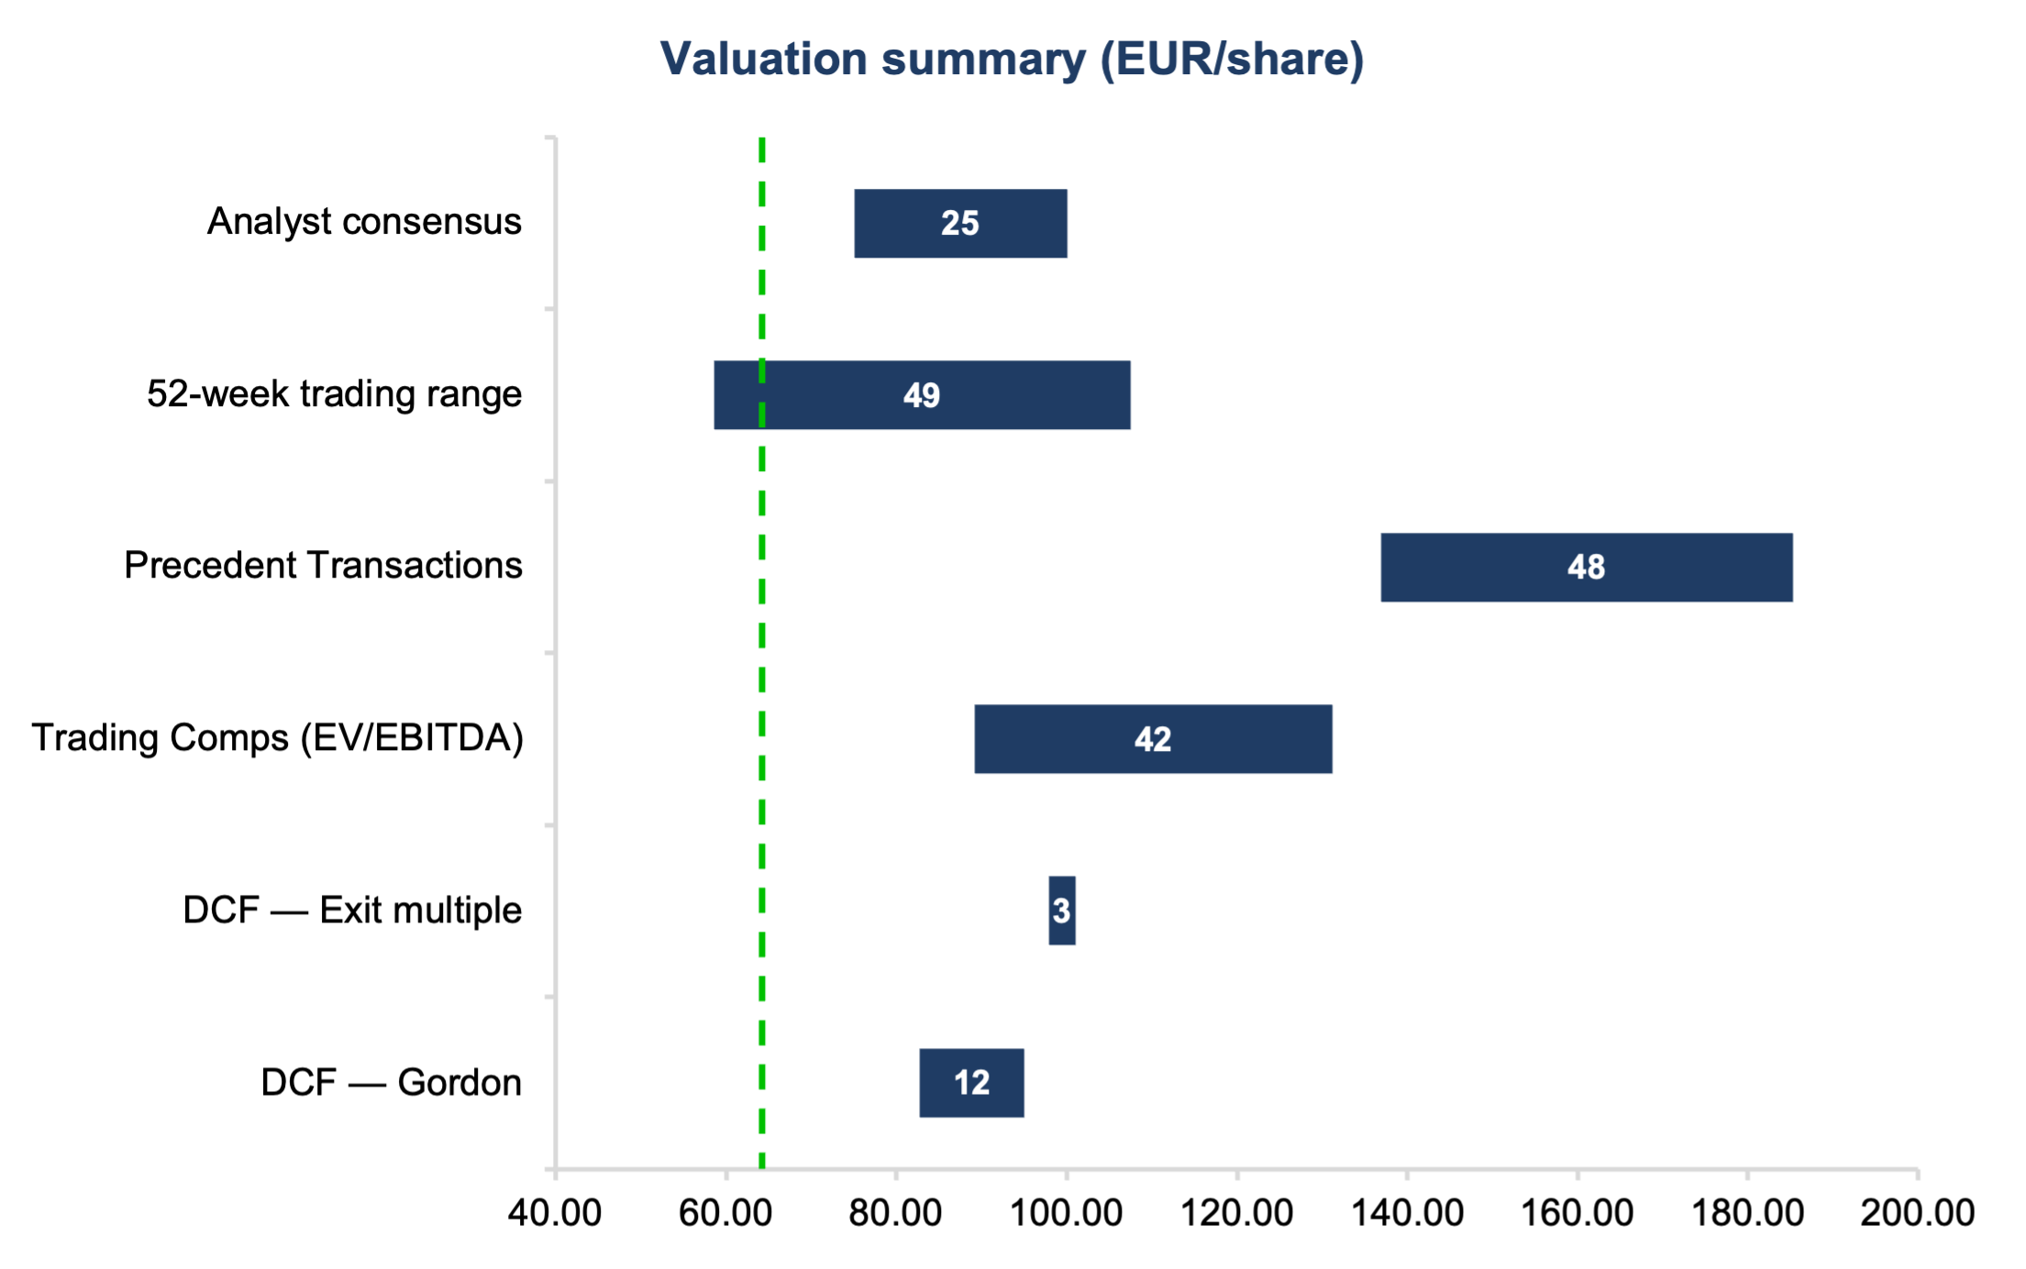
Valuation points to material upside across all methodologies
Key Takeaways
DCF Valuation : Points to a fundamental range of €88 - €99 per share, based on conservative terminal growth (1.5%) and exit multiples (11.0x).
Trading Comparables : Suggests a fair value of ~€105. Pernod's current multiple is heavily penalized compared to direct peers like Diageo and Campari.
Precedent Transactions : Implies a control value of ~€161, highlighting the immense strategic scarcity value of Pernod's portfolio.
Conclusion : Our €108 blended target price represents an asymmetric risk/reward profile with +68% upside from current spot levels.
Source: Company filings, Axone Equity Research estimates | Strictly Private & Confidential
5

Slide 6
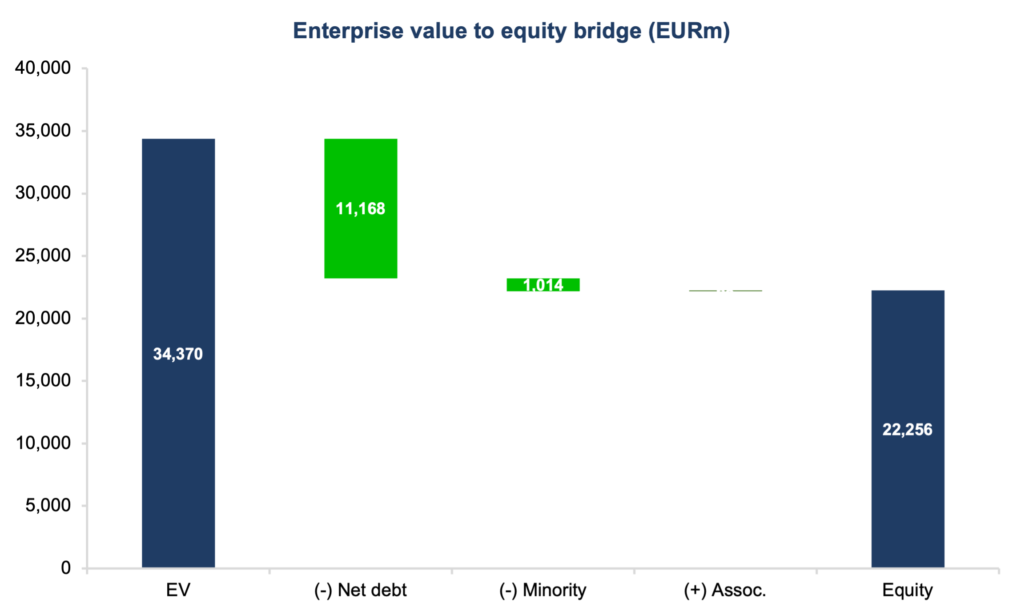
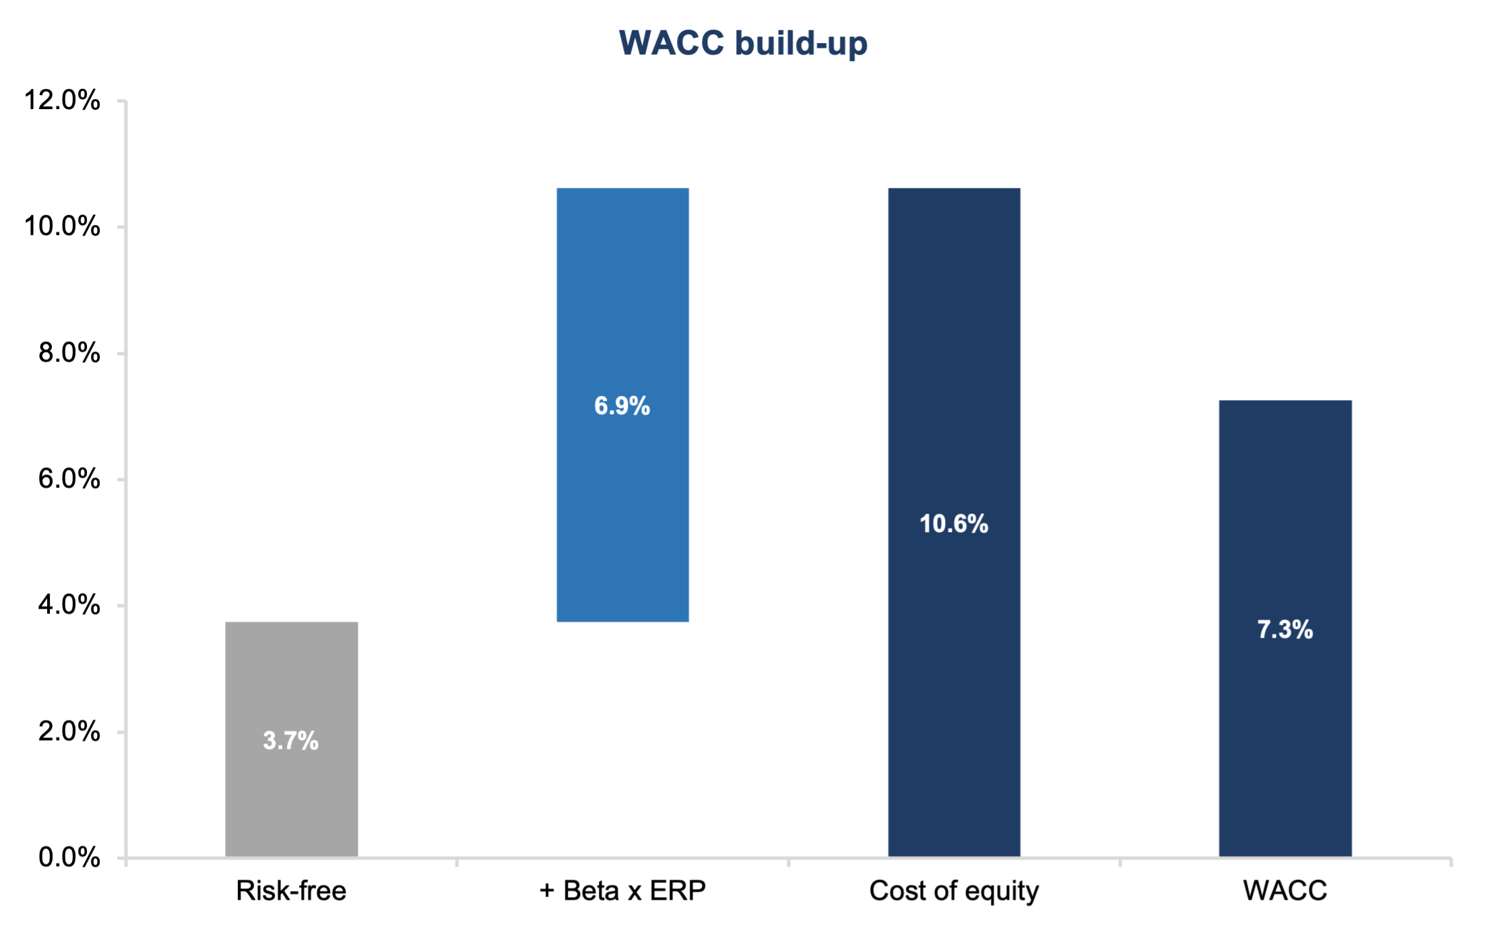
DCF supports a €88-99 intrinsic value
Key Modeling Assumptions
▪ Discount Rate & TV: WACC of 7.3% (Beta 1.25, ERP 5.5%, RFR 3.7%). Terminal growth of 1.5% and implied exit multiple of 11.0x.
▪ Cash Flow Mechanics: Unlevered FCF = NOPAT + D&A - Capex - Change in NWC. Effective tax rate normalized at 25%.
▪ Valuation Triangulation: Enterprise Value derived from an equal blend of Gordon Growth (€34.4bn) and Exit Multiple (€37.1bn) methods.
Source: Company filings, Axone Equity Research estimates | Strictly Private & Confidential
6

Slide 7
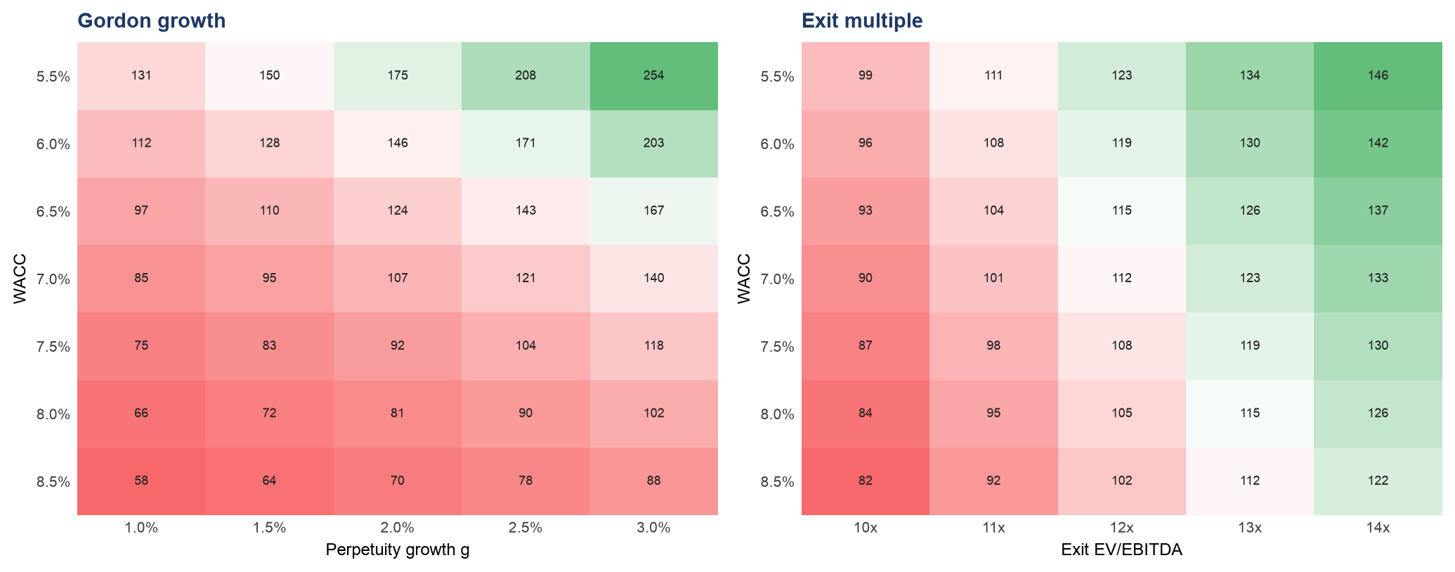
Valuation is robust across WACC and growth scenarios
Key Takeaways
Base Case : At a 7.3% WACC and 1.5% perpetuity growth, the Gordon Growth method yields €88/share.
Downside Protection : Even in a stressed scenario (WACC at 8.0%, growth at 1.0%), the implied equity value remains above the current market price of €64.14.
Upside Potential : A reversion to historical WACC levels (~6.5%) combined with standard 2.0% terminal growth would imply a share price above €120.
Source: Company filings, Axone Equity Research estimates | Strictly Private & Confidential
7

Slide 8
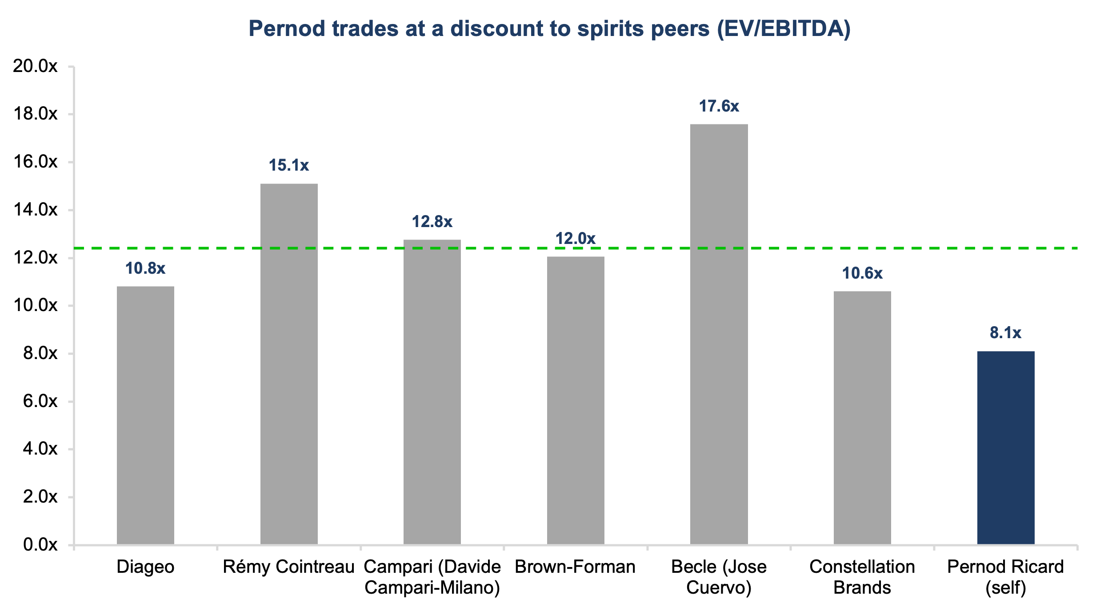
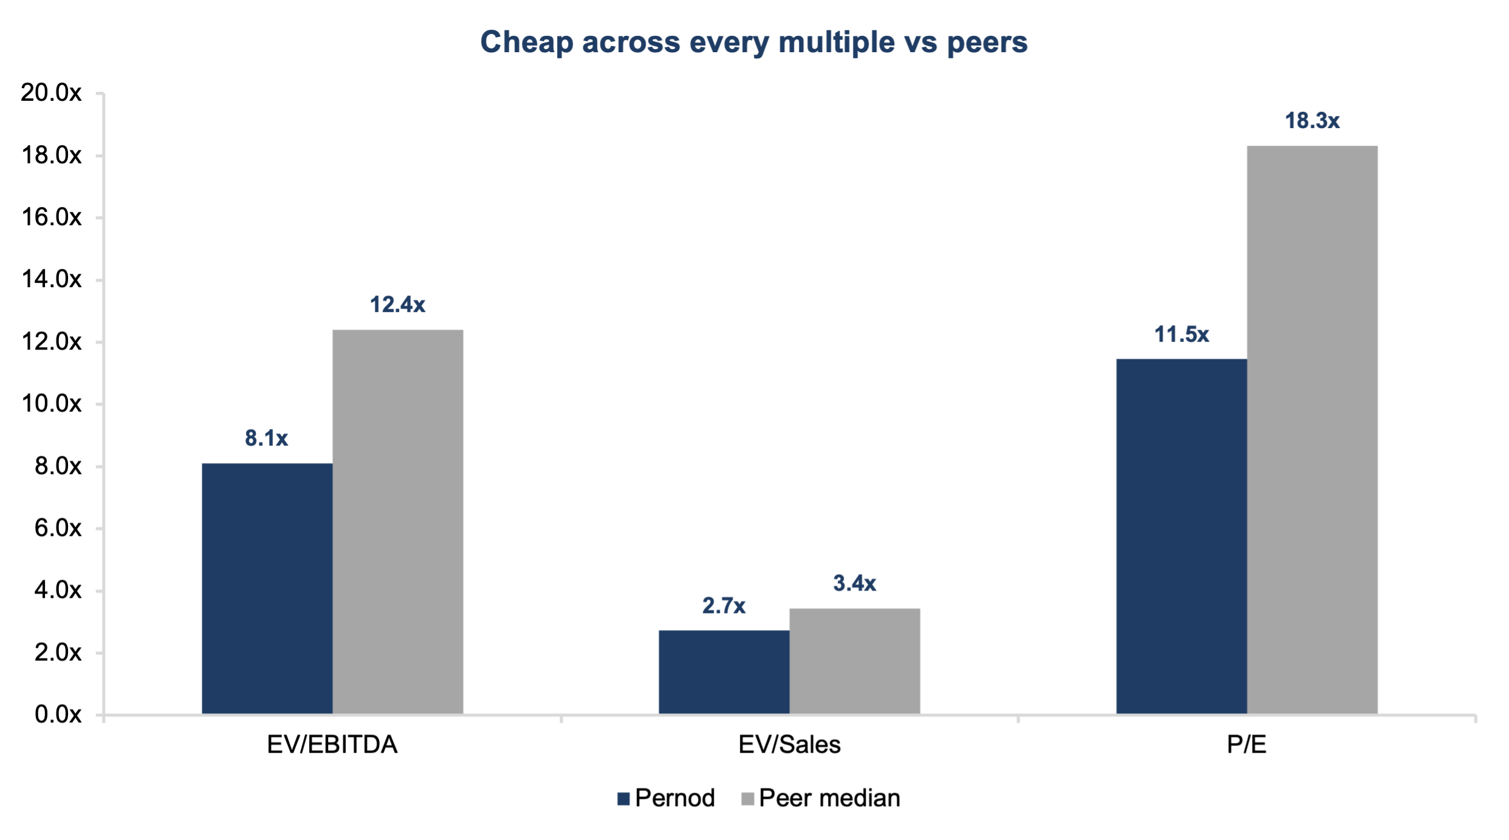
Pernod is mispriced versus global spirits peers
Takeaway: At 8.1x EV/EBITDA, PR trades at a ~35% discount to Diageo (10.8x) and Campari (12.8x). Reverting to the peer median (12.4x) yields our €105 implied price.
Source: Bloomberg, Company filings, Axone Equity Research estimates | Strictly Private & Confidential
8

Slide 9
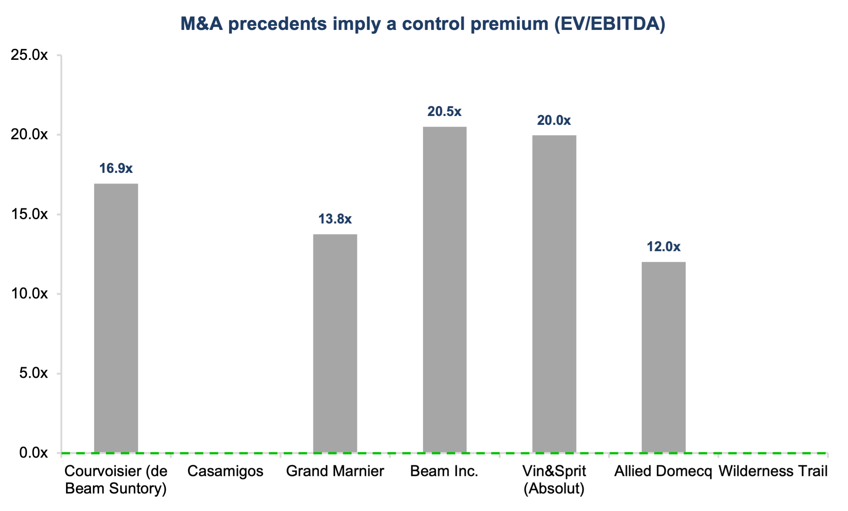
M&A precedents imply a substantial control premium
Key Takeaways
Historical Multiples : Over the last 15 years, major spirits platforms (Beam, Allied Domecq, Grand Marnier) have been acquired at a median EV/EBITDA of 16.9x.
Strategic Scarcity : Assets of Pernod Ricard's scale are essentially impossible to replicate. Any theoretical buyout would require a massive premium.
Implied Value : Applying the 16.9x median to our FY26E EBITDA (€3.1bn) yields an implied share price of ~€161, acting as a definitive valuation floor.
Source: Mergermarket, Company filings, Axone Equity Research estimates | Strictly Private & Confidential
9

Slide 10
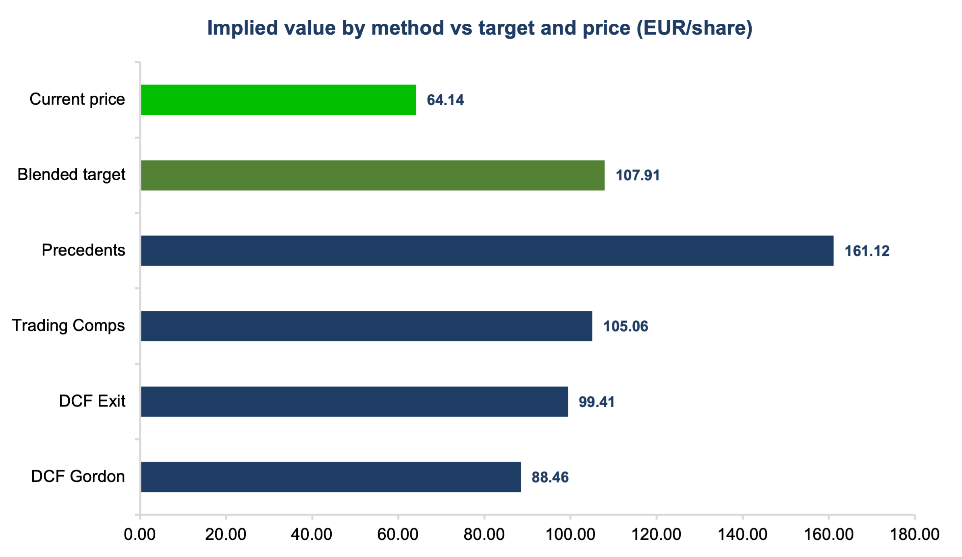
Triangulating to a €108 blended target price
Key Takeaways
Methodology Weighting : We apply a 50% weight to DCF (average of Gordon and Exit methods), 35% to Trading Comps, and 15% to Precedent Transactions.
Why this mix? : Acknowledges the fundamental cash-generative nature of the business (DCF) while factoring in the reality of public market multiples (Comps) and latent strategic value (M&A).
Final Target : The blended output is €107.91, which we round to €108, representing a 68% upside.
Source: Company filings, Axone Equity Research estimates | Strictly Private & Confidential
10

Slide 11
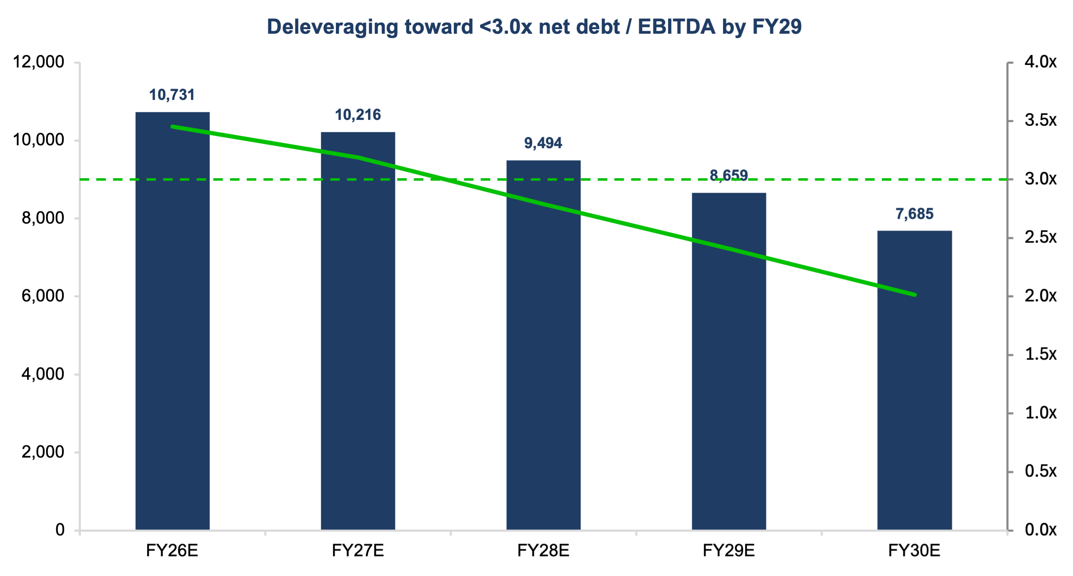
Strong cash generation drives rapid deleveraging by FY29
Key Takeaways
Current Position : Net debt stands at €11.1bn (FY25), representing an elevated ~3.4x Net Debt/EBITDA ratio.
Cash Conversion : Robust Unlevered FCF generation allows for rapid debt paydown without compromising the dividend policy (DPS €4.70).
Target Reached : We forecast leverage falling comfortably below management's 3.0x target by FY29, and reaching 2.0x by FY30, offering future balance sheet optionality.
Source: Company filings, Axone Equity Research estimates | Strictly Private & Confidential
11

Slide 12
Key risks to our thesis
▪ China weakness : Organic net sales -24% YTD; prolonged Martell/cognac softness would severely pressure margin mix.
▪ US normalization : Organic net sales -14% YTD. The pace of trade inventory adjustments taking longer than expected could push the return to growth into late FY27.
▪ Adverse FX : Management guides to a significantly negative FX impact (USD, INR, TRY) presenting a material translation drag on EUR earnings.
▪ Global Travel Retail : Growth could stall due to geopolitical tensions and Middle East travel disruptions, despite a strong Q3 (+39%).
▪ Execution risk : The €1bn FY26-29 efficiency program is central to margin defense. Any under-delivery directly hits our DCF value.
▪ Tariff escalations : Potential trade disputes (e.g., EU vs China cognac probes) could result in punitive tariffs that compress margins.
Educational purposes only; not investment advice, an offer, or a solicitation. Prepared for the Axone platform based on public filings and proprietary estimates. Figures as of June 2026.
Source: Company filings, Axone Equity Research estimates | Strictly Private & Confidential
12

